Slide 1

Michelle Naclerio, Ariel Fitzgerald, Hannah Cranford

Slide 2
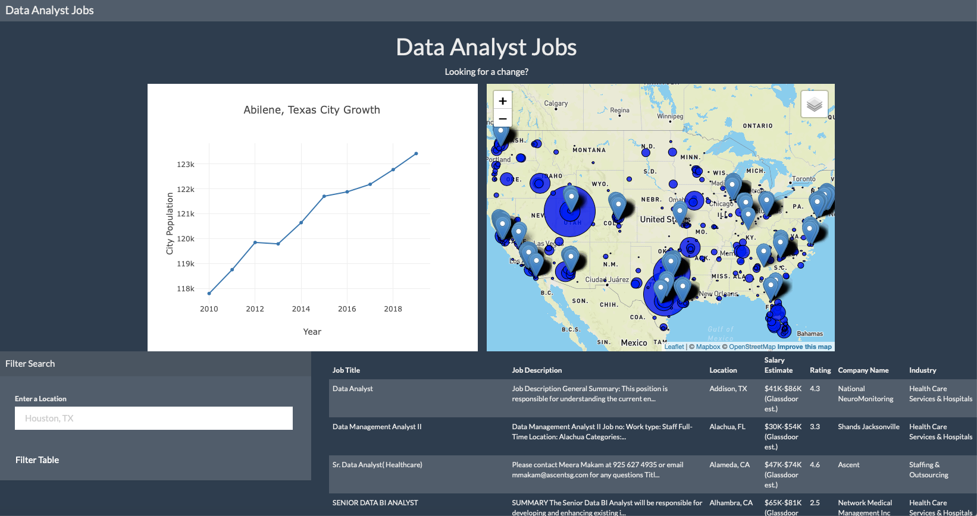
Our Website
https://hncranford.github.io/Project-2/

Slide 3
Data Analyst Positions vs Population Growth
Census Data
Data Analyst Jobs listing
US City data CSV file with Lat & Lng coordinates
Utilized Python, PostgreSQL, JavaScript
In JavaScript: Plotly, Leaflet, and Bootstrap
Lodash JavaScript library as additional library

Slide 4
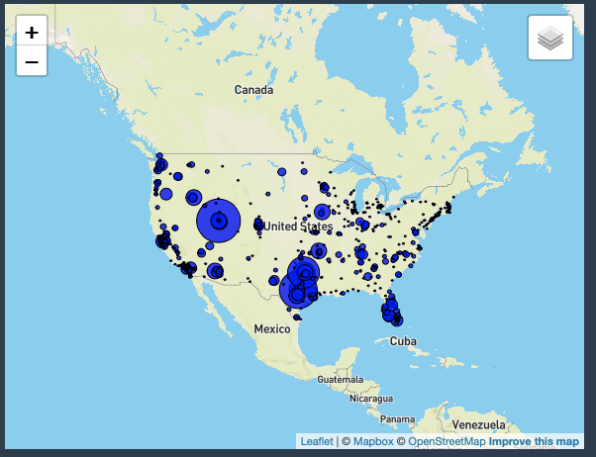
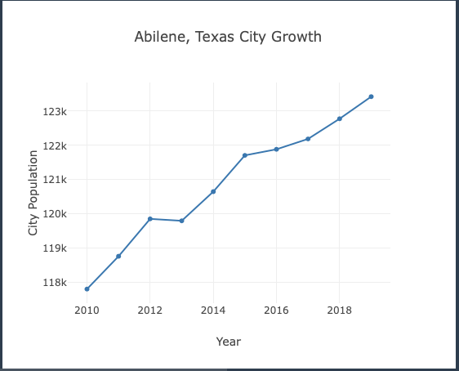
Census Data
CSV file
Census data included Populations by City
2010 to 2019
Combined the City Lat/Lng and Census
Created circles on the Map
The larger the circle, the larger the Population % Increase from 2010 to 2019
Created the Line graph

Slide 5
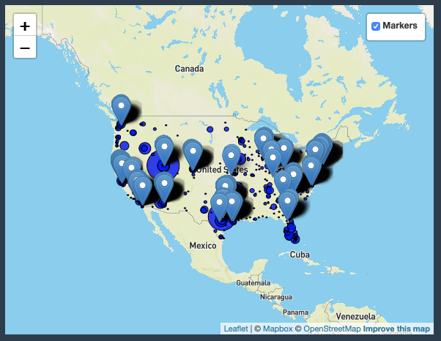
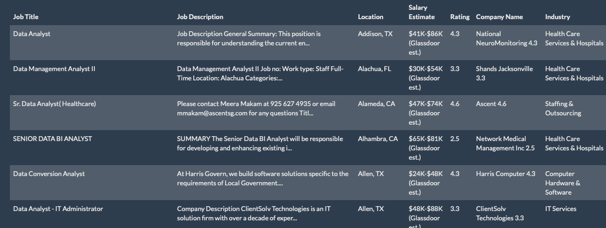
Data Analyst Job Data
CSV file
Current list of open Data Analyst Jobs by City
Combined the Data Analyst, City Lat/Lng
Created Tool Pins on the Map
These can be removed by clicking the button on the map
Created Job list table
Can be filtered by entering a location

Slide 6
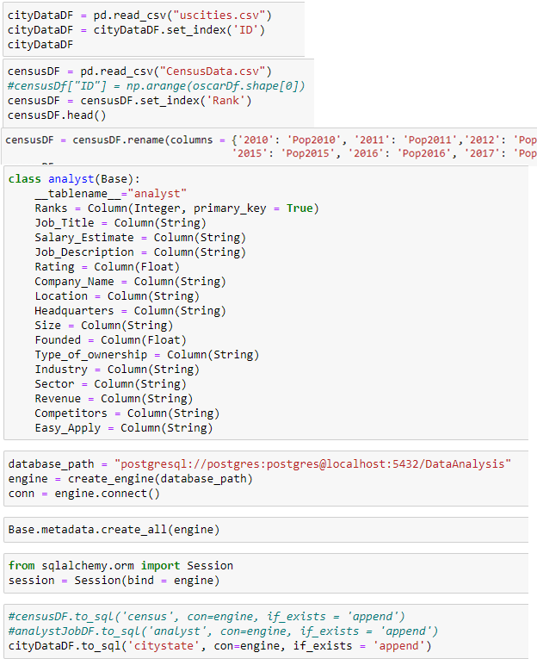
Import/Clean/Export
Import CSV files to PostgreSQL using Jupyter Notebook
Clean-up/combine data from the 3 tables into 2 tables
Export data from PostgreSQL using Jupyter Notebook
Convert CSV files to JSON using Jupyter Notebook
Convert the JSON files to JavaScript files
Notes:
For cleaning up our data we mainly had to make sure all the data had coordinates, and some form of city and state location identifier coming from the us city data csv. To do this we decided to use jupyter notebook and Postgres. We used jupyter notebook to upload the tables to postgres (example on the right), we did have to rename some columns to make it work (a lot of our data columns had spaces in the names, or the name of the column was actually a number (like 2010) which was giving us some trouble so we just decided to rename them.

Slide 7
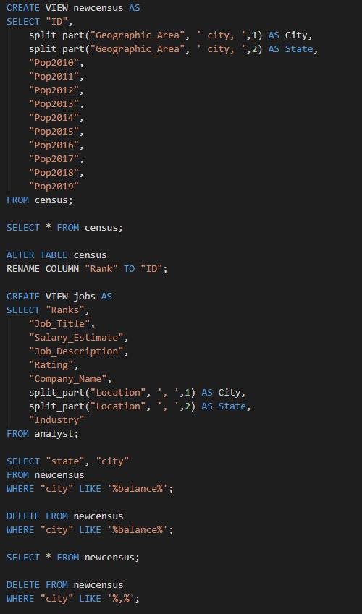
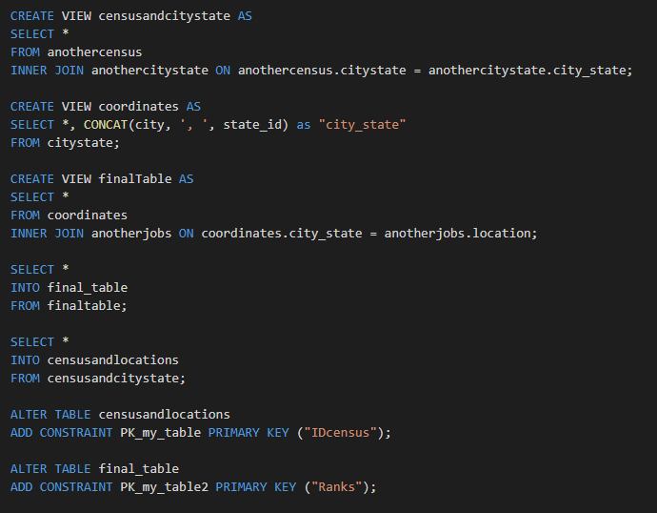
Postgres Table Clean-up
Notes:
Once we were in postgres, we deleted columns we didn’t feel we needed, deleted rows with null values or values that didn’t match the information in that column. FInally, we were able to join tables and created two final tables. One contained all the census data and the other had all the jobs information

Slide 8
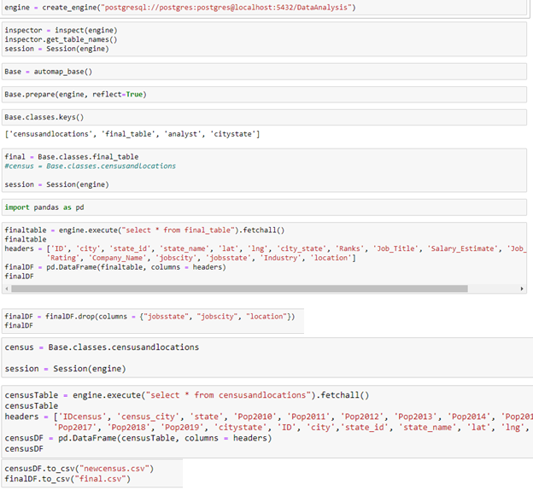
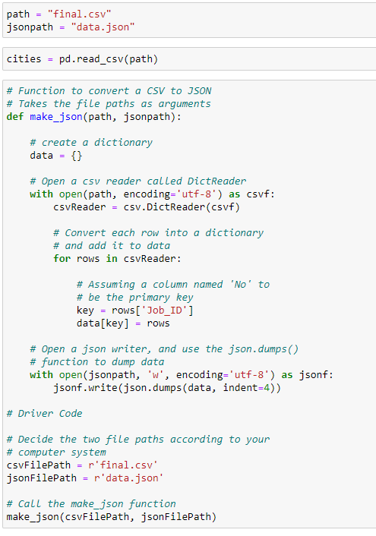
Exporting to CSV
Files
CSV files were also
converted to json
files
Notes:
We then used jupyter notebook again to export the tables in postgres to a csv. Those csv files were converted to JSON files and then JS files as it was easier for us to work with js data.

Slide 9
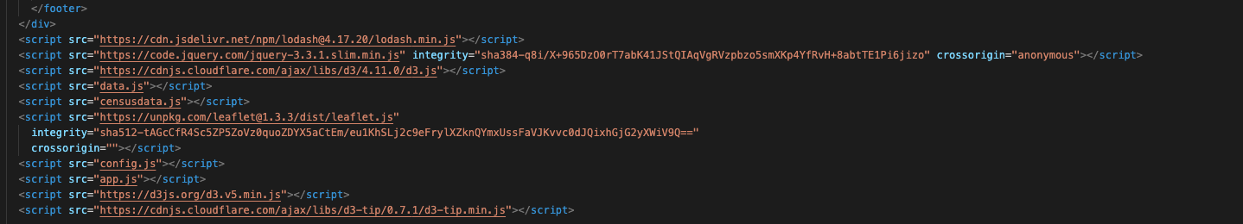

Lodash Library
In the Index.html file: add script
In app.js: use _.values
Notes:
For our extra javascript library, we used lodash. As you can see above, it was only used in line 2 of our main js code and allowed us to easily clean up our data.

Slide 10
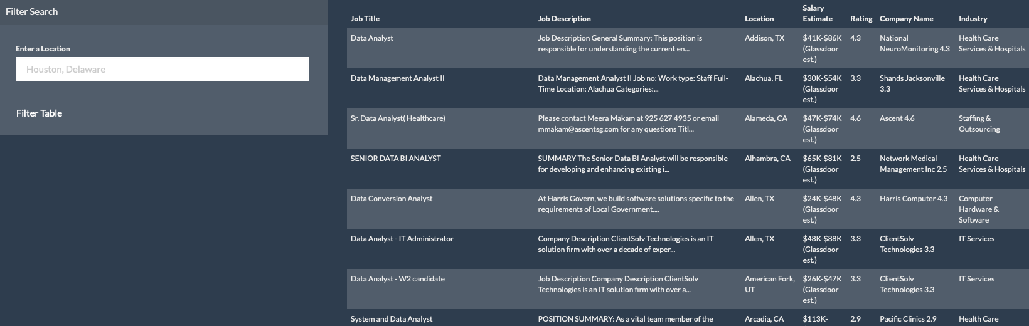
Table
Using a template from Bootstrap, created a table to display all available jobs
Enabled a filter button to filter the table according to location (City, State Abbr.)

Slide 11
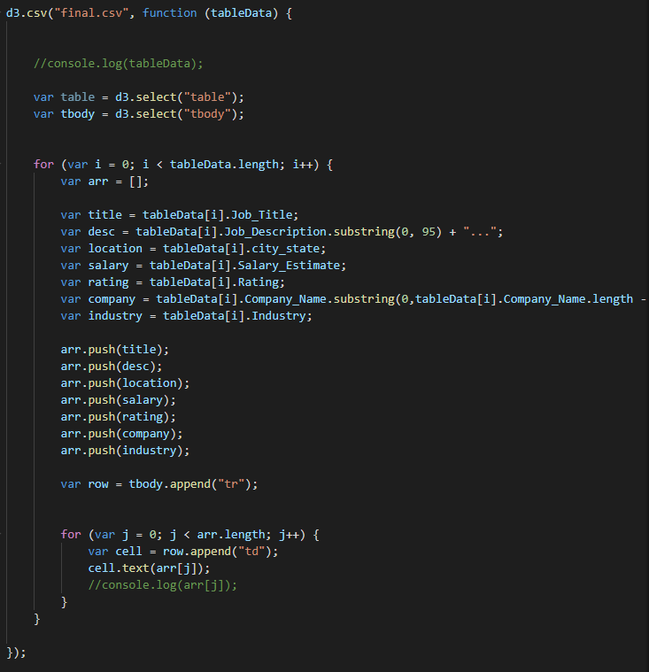
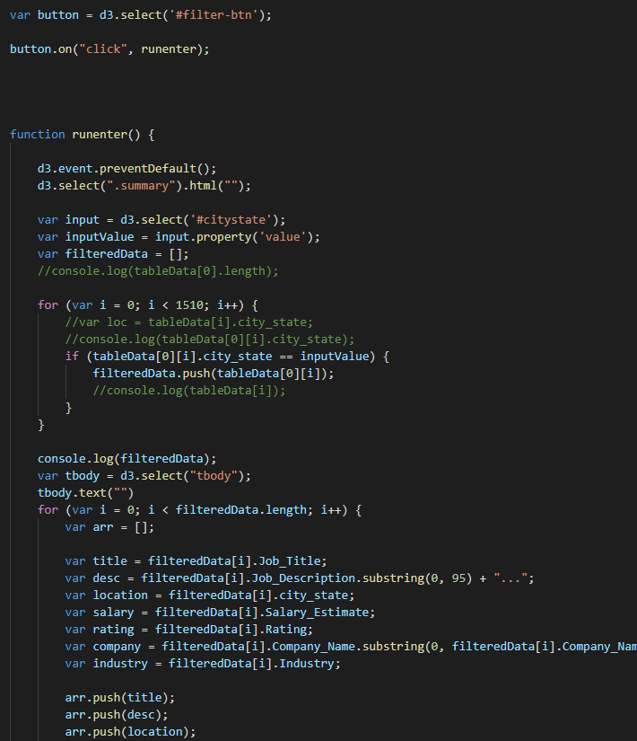
Table Code
Notes:
We decided not to import every column for the table so we used a for loop to grab the variables we needed and pushed them to an array. Each value in that array was then appended to the table. We used similar code for the filter button, but instead of grabbing every variable, the location column is compared to the input value to only append rows with the matching location.

Slide 12
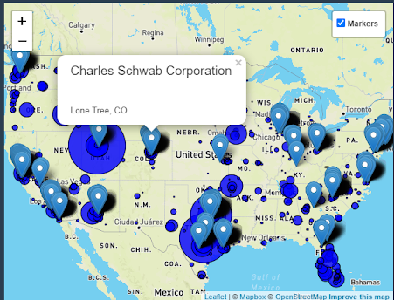
Leaflet Map
Popup for each marker shows company name and location of the job
Markers can be turned on and off using this checkbox
Blue circles corresponded to calculated annual city growth ( %)
Markers show location of each job

Slide 13
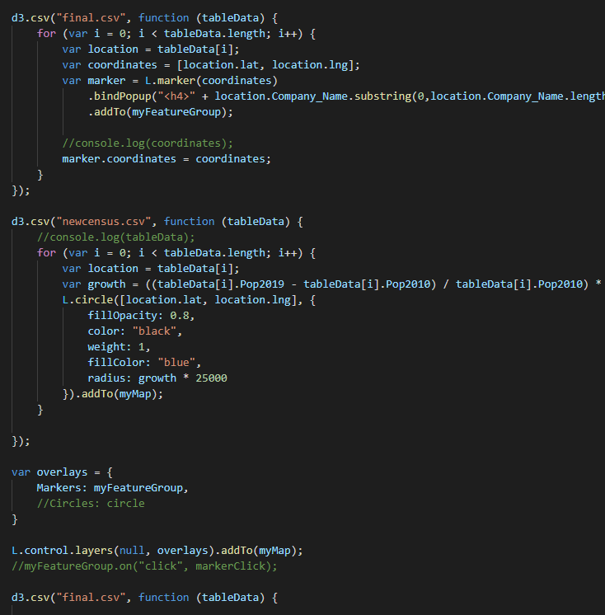
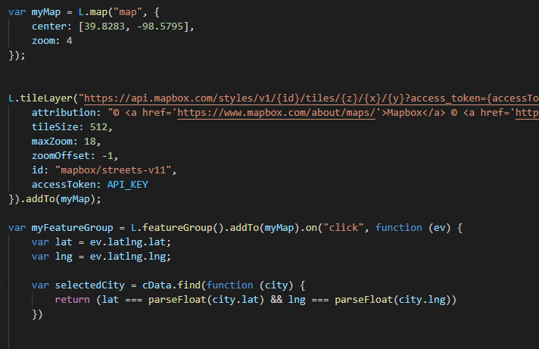
Leaflet Code
Notes:
The leaflet map, we used data coordinates from the census data to locate both the circles and the markers. The circle radius was determined by an equation that calculated the annual average city growth and multiplied by 5000. FInally, we used an overlay layer for the markers on the map to be able to turn them on and off

Slide 14
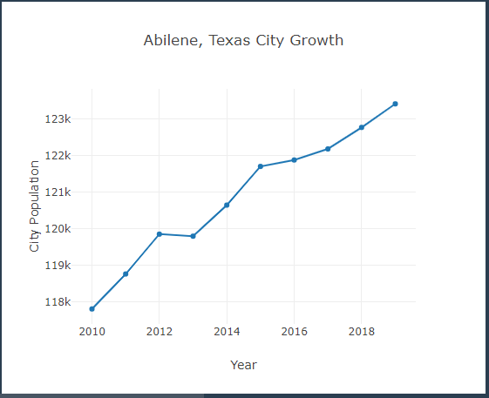
Line Graph
Displays population growth for selected City via marker
Census years 2010 - 2019
Graph will change based on which marker in the map is clicked

Slide 15
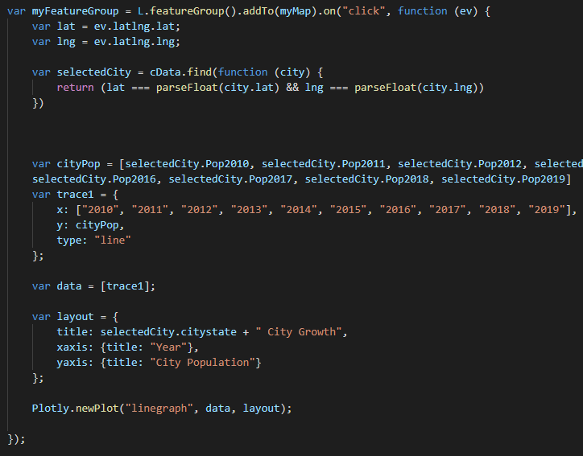
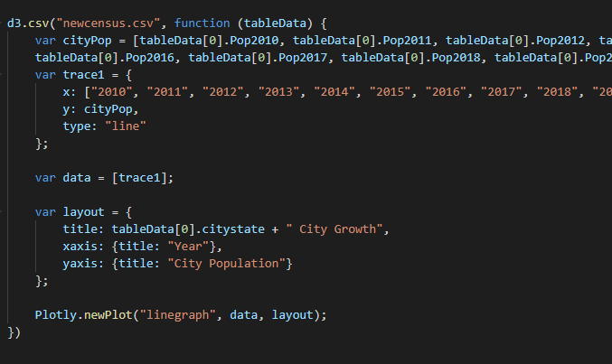
Line Graph Code
Notes:
As you can see, the linegraph is your standard plotly graph. To get the map to change, the coordinates for the selected marker were compared against the census data using a “.find” function to find the matching city in the census data based on the lat/lng. Once that data point is found, a new Plotly graph is created displaying data from the selected location

Slide 16
Considerations
The line graph will not change if there is no data for that selected city included in the census data.
City growth was calculated using the percent change in population from 2010 to 2019 and dividing by 10 to get the average annual percent change.
The data used for the jobs portion in this project is not live. The jobs listed may not be available anymore.
Some of the cities with the largest growth don’t have active job listings. The opposite is also true. Many cities with little to no growth have a large number of positions available.

Slide 17
Thanks for your Time
Are there any questions?

