Slide 1
Agile Project Tracking
Raspberry Pi

Slide 2
Agile Team Update – Completed Stories
Takes Pictures
Records Temperature
Motion Detection
Temperature uploads to the Cloud

Slide 3
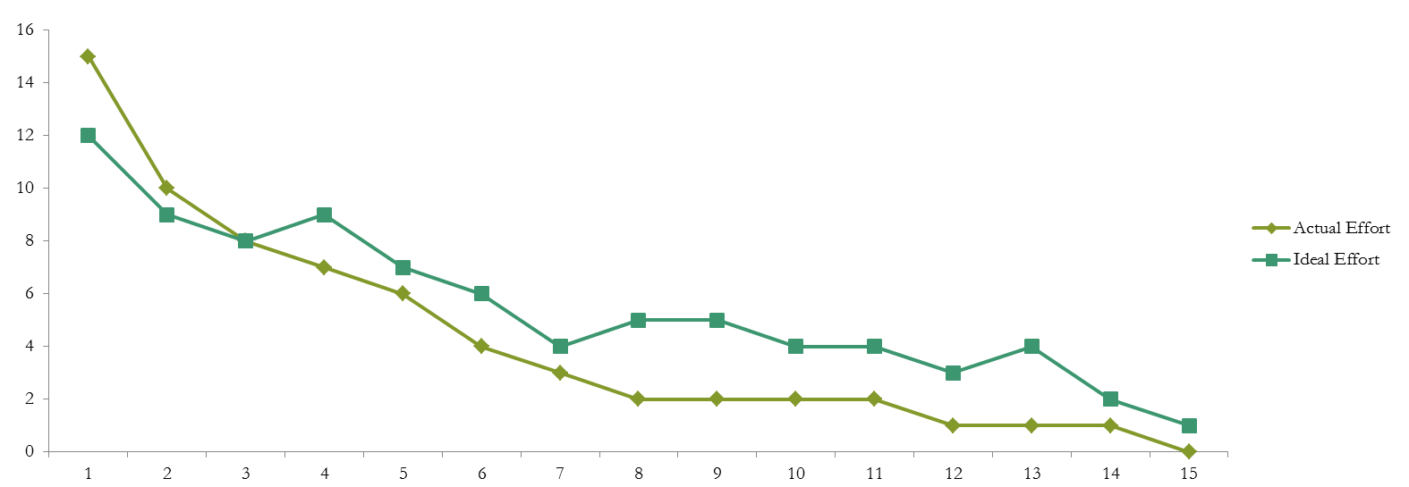
Sprint 1 Burn Down Chart

Slide 4
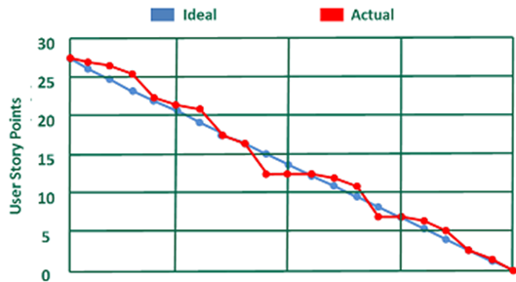
Sprint 6 Burn Down Chart

Slide 5
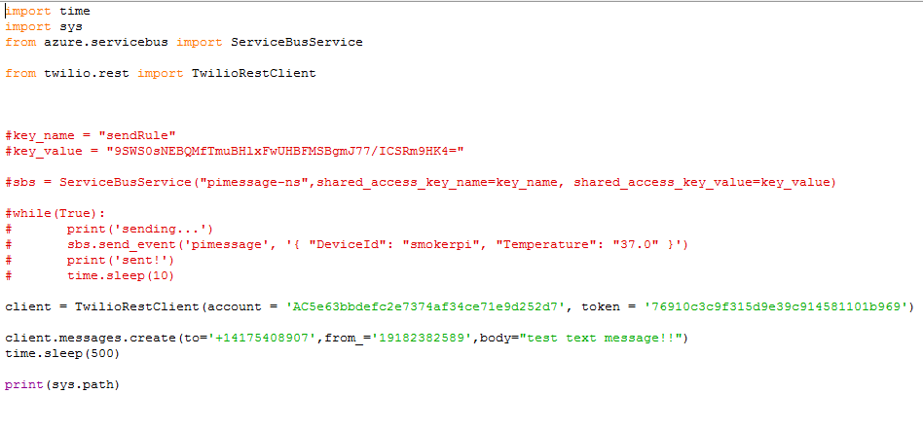
Sending Temperature

Slide 6
Motion Detection (Support by pyimagesearch)
Basic Algorithm: Background Subtraction
Four parts:
Json file (store command line arguments)
Import and drop box API connection
If the camera does not detected motion
If the camera detected motion

Slide 7
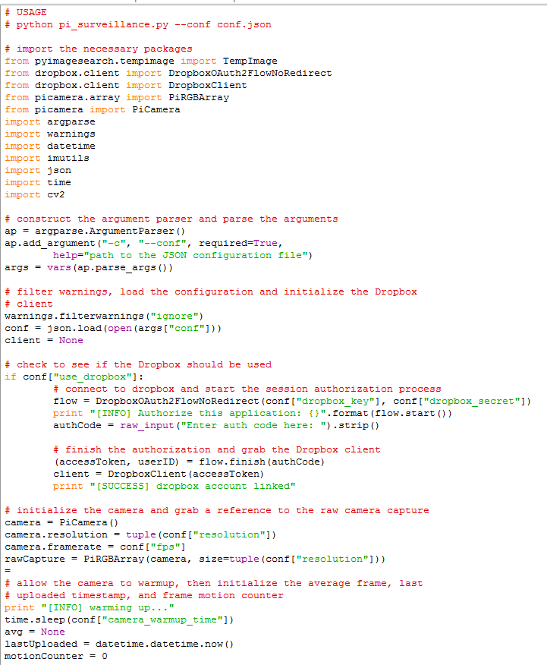
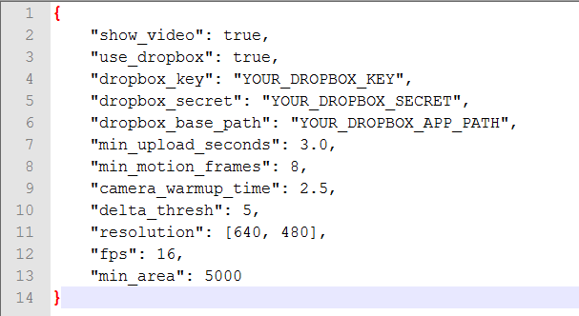

Slide 8
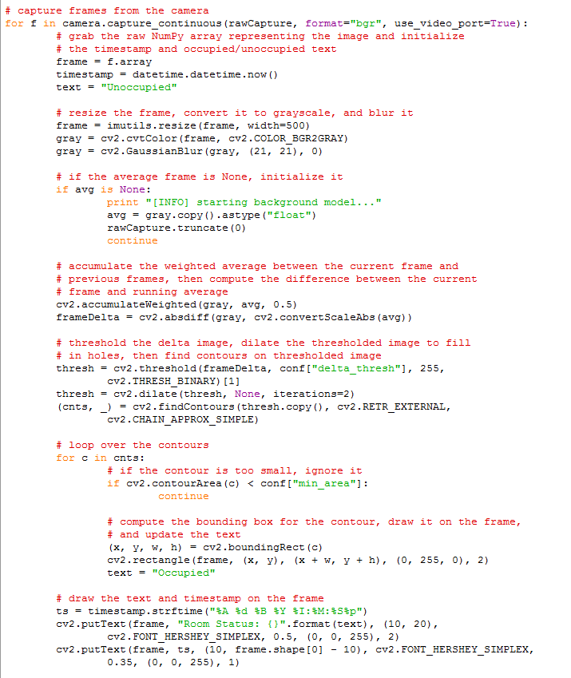
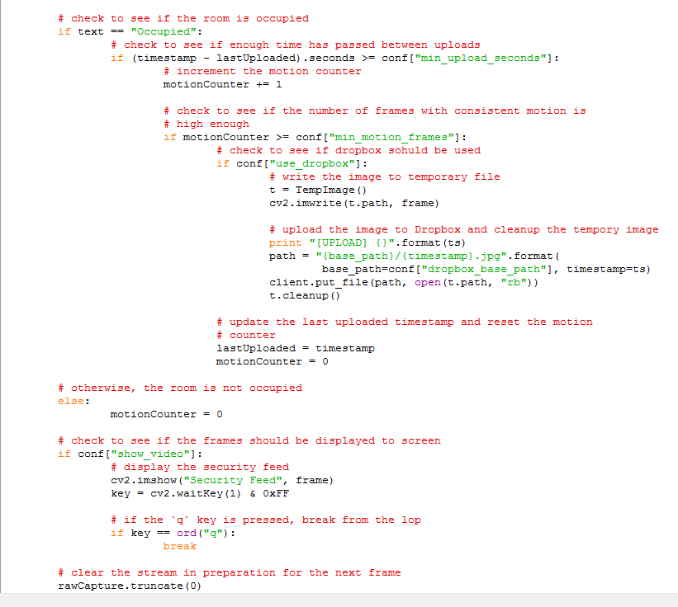

Slide 9
Temperature Detection (Support by Sunfounder Comp.)
Two Parts:
Detect temperature
Create temperature log

Slide 10
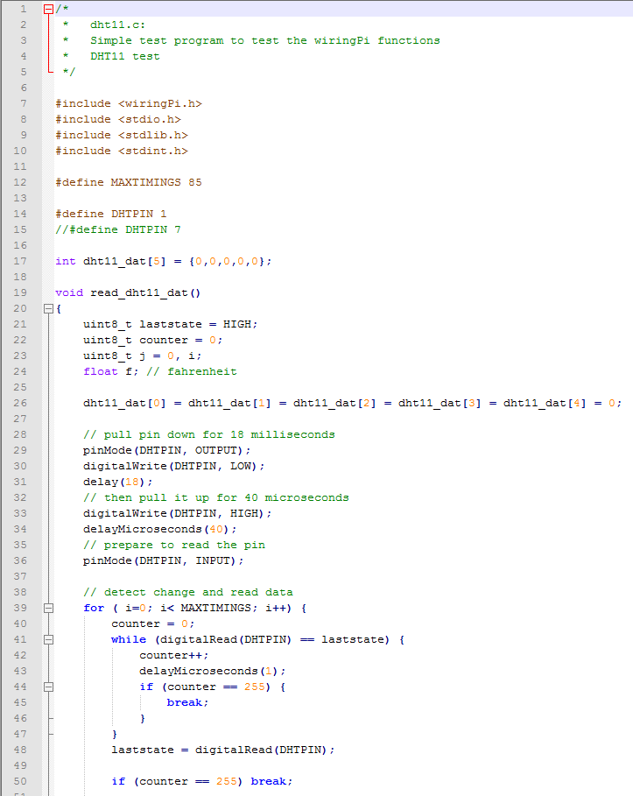
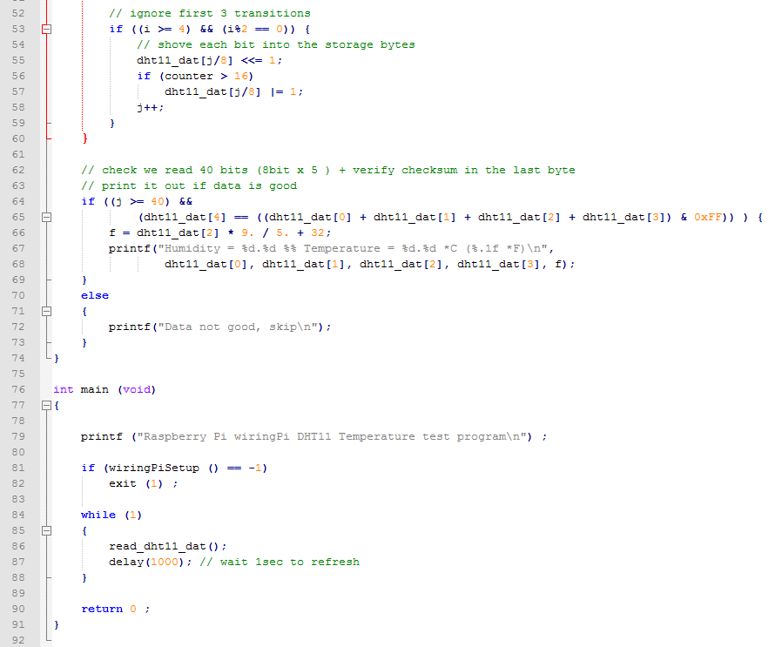

Slide 11
Demo

Slide 12
Test Plan

Slide 13
Question

