Slide 1

Competitor Analyzer
AI-powered Python tool for tracking keyword trends and competitor visibility
Soumya Porwal 23BMV1067
Rachit Pratap Singh 23BME1037

Slide 2



The Challenge
Tracking at Scale
Digital marketers struggle to track competitor movements across search — the volume of data is simply too large to monitor manually.
Manual Monitoring Fails
Manual keyword monitoring is time-consuming and error-prone, leaving teams reactive rather than proactive.
Real-Time Insights Gap
Real-time market insights are critical for competitive strategy, yet they remain hard to access without dedicated automation.

Slide 3
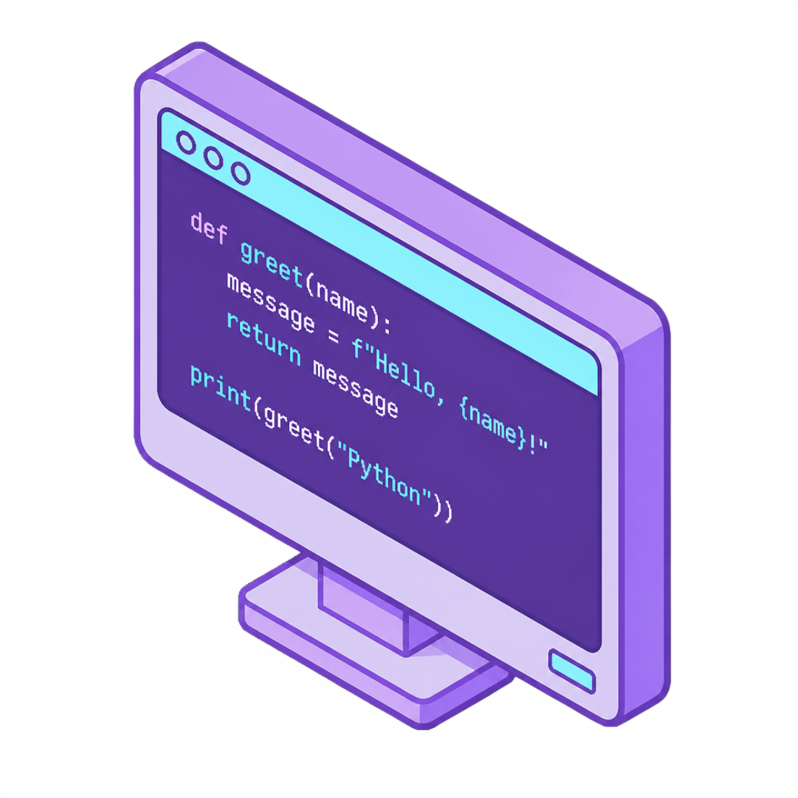
What is Competitor Analyzer?
Competitor Analyzer is an automated Python application that brings competitive intelligence into one unified workflow.
Google Trends Integration: Continuously tracks keyword trends using live pytrends data — no manual lookups required.
Competitor Visibility Analysis: Scrapes and ranks search results to show how visible competitors are per keyword.
AI-Powered Chat Interface: Ask natural language questions about trends and competitors and receive instant, context-aware answers.

Slide 4




Core Features
Google Trends Integration
Web Scraping
Real-time keyword trend data via pytrends — live market signals at your fingertips.
Extract competitor presence and search rankings using Selenium + BeautifulSoup.
Data Visualization
AI Chat Interface
Interactive, publication-ready graphs built with Matplotlib & Plotly.
Ask natural language questions about trends and competitors — powered by an embedded AI model.

Slide 5
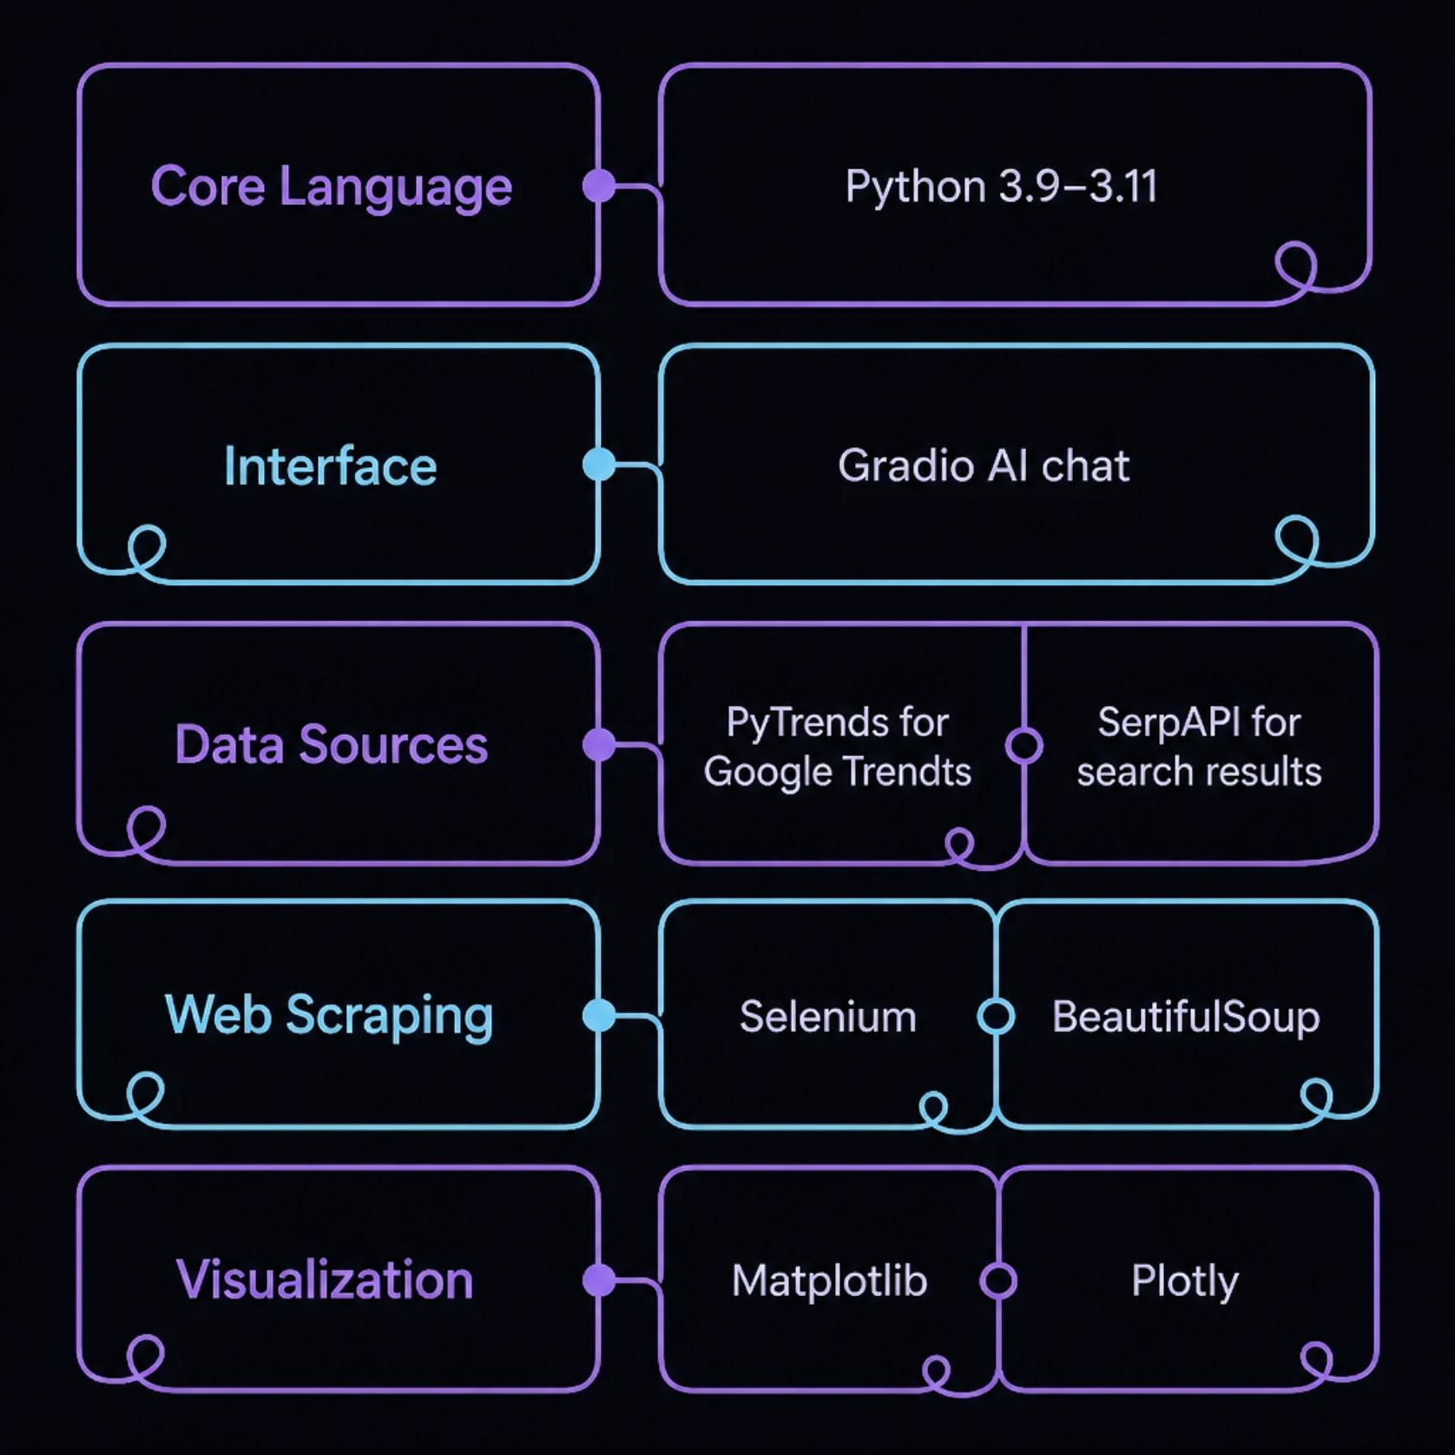
Tech Stack
Built for Developers
Every library in the stack was chosen for reliability, community support, and ease of integration — making the tool straightforward to extend or customize.
Python 3.9–3.11 — broad compatibility and modern language features
Gradio — rapid deployment of the AI chat UI with minimal boilerplate
PyTrends & SerpAPI — authoritative, structured data sources for search intelligence
Selenium & BeautifulSoup — robust scraping pipeline for live competitor data
Matplotlib & Plotly — static and interactive chart generation in one workflow

Slide 6
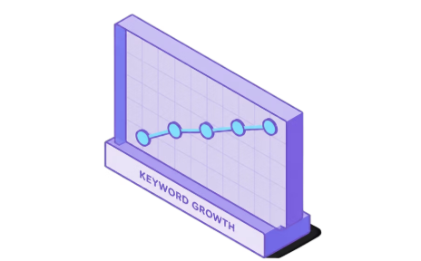
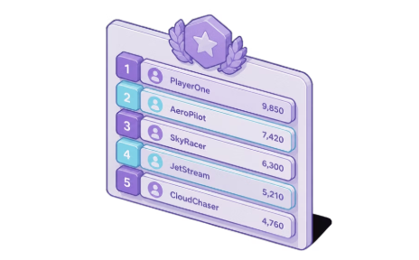
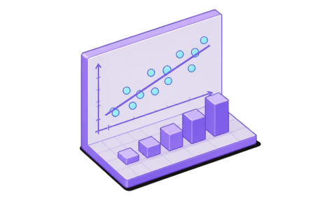

Key Outputs
Trend Line Graphs
Competitor Rankings
Growth Predictions
AI Summaries
Keyword trend line graphs showing growth patterns over time — visualize momentum at a glance.
Growth rate predictions using Linear Regression — turn historical data into forward-looking strategy.
AI-generated summaries that answer strategic questions directly, reducing time to insight.
Top 10 competitors ranked per keyword, so you always know who occupies the most valuable search real estate.

Slide 7

Quick Setup
Up and Running in Minutes
01
Install Prerequisites
Install Python 3.9–3.11 and ChromeDriver matching your browser version.
02
Create Virtual Environment
Isolate dependencies: python -m venv venv then activate it.
03
Install Dependencies
Run pip install -r requirements.txt to pull in the full stack automatically.
04
Launch the App
Run the application and access the Gradio interface in your browser — ready to query.

Slide 8

Perfect For
Digital Marketers
Track SEO performance and spot competitor shifts before they impact your rankings.
Content Strategists
Identify trending topics early and build content plans backed by real search data.
Businesses
Monitor the competitive landscape continuously — not just when you remember to check.
SEO Analysts
Optimize keyword strategies with growth predictions and competitor visibility scores.

Slide 9

Get Started Today
Clone Repo
AI Insights
Copy the Competitor Analyzer code
Chat to surface competitor signals
Explore Trends
Decide Faster
Analyze industry keyword patterns
Act on data-driven recommendations

