Slide 1
gosu-figure

Slide 2
Drum UI
Note, Judgment, Play Scene, Dancer

Slide 3





Drum: Note Type
Red
Shake
Blue
Dot
Roll
Regular
Big

Slide 4





Drum: Judgment
100%
25%
0%
Early
Regular
Late
100%
25%
0%
Early
Late
Big
50%
12.5%
0%
Early
Partial
Late

Slide 5
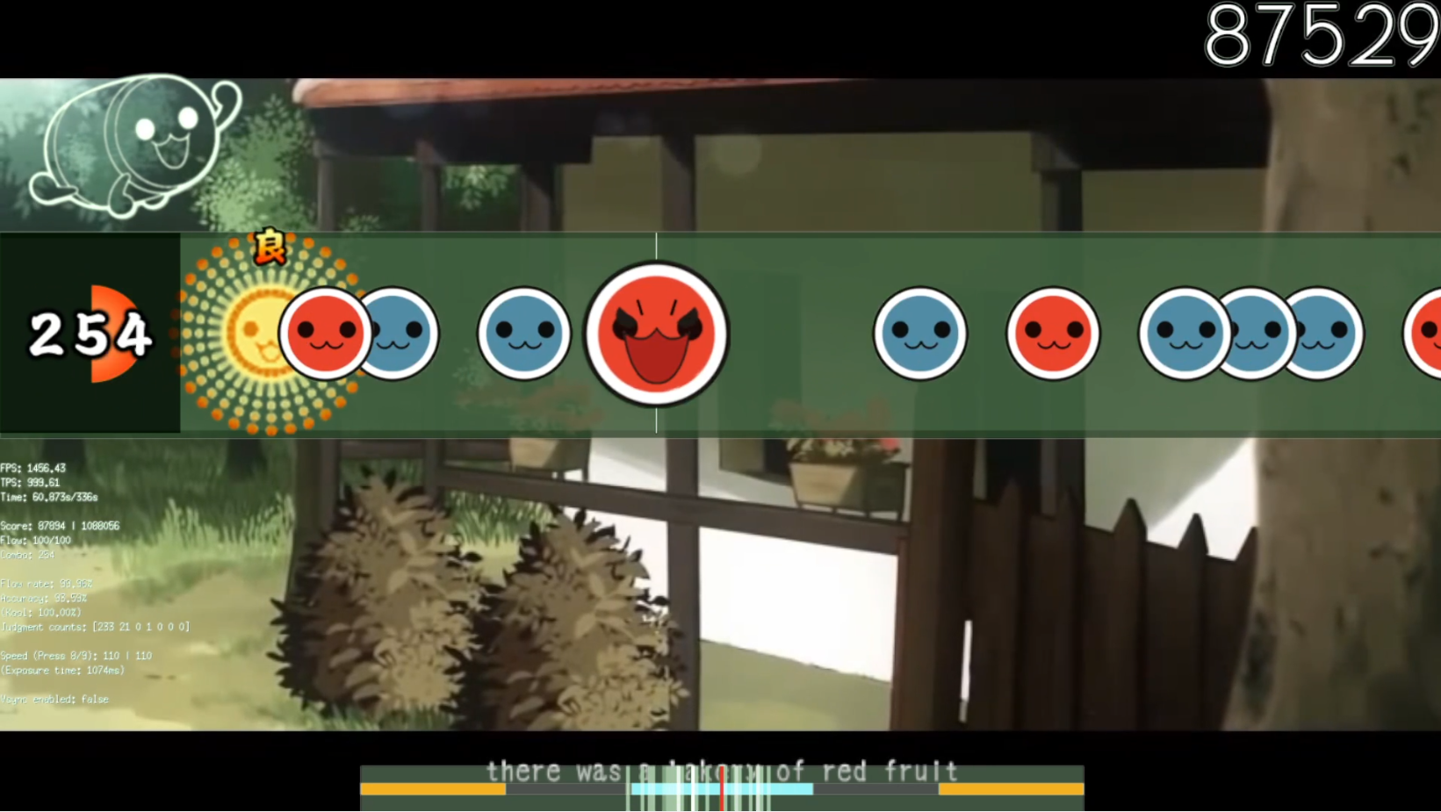
Drum: Play Scene (1)
Bar
(beat separator)
Score
Combo
Notes
Judgment

Slide 6
Drum: Play Scene (2)
Background
Dancer
Stage
Keys
(lights on if pressed)
DebugPrint
Meter
(shows timing error)

Slide 7

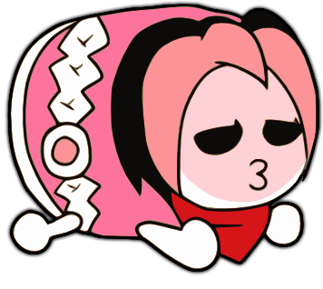


Dancer
Idle
High (when music is highlight)
Yes (when combo reaches 50, 100, 150, …)
No (when combo breaks)

Slide 8
Drawing Notes on Drum mode
func (n Note) Position(time int64) float64 {
return float64(n.Time-time) * f.Speed
}
func (d NoteDarwer) Draw(screen *ebiten.Image) {
if note.Marked {
op.ColorM.Scale(1, 1, 1, 0) // Invisible
}
note.Move(position, 0)
note.Draw(screen, op)
}

Slide 9
Visual Effects
Scroll Effect

Slide 10
Scroll Effect on Score
type Delayed struct {
Delayed float64
Source float64
Feedback float64
}
func (d *Delayed) Update(v float64) {
d.Delayed += (d.Source - d.Delayed) * d.Feedback
}
// The formula is to make speed of transition constant regardless of TPS.
func (d *Delayed) setSource(v float64) {
const tick = 800
d.Source = v
d.Feedback = 1 - math.Exp(-math.Log(d.Source - d.Delayed)/float64(tick))
}

Slide 11
Example: Scroll Effect on Score
Tick | Delayed
0 | 10000
1 | 11423
2 | 12644
3 | 13690
4 | 14588
5 | 15358
6 | 16019
7 | 16585
8 | 17071
9 | 17488
10 | 17846
11 | 18152
12 | 18415
13 | 18641
14 | 18834
15 | 19000
16 | 19142
17 | 19264
18 | 19369
19 | 19459
20 | 19536
21 | 19602
22 | 19659
23 | 19707
Delayed | 10000
Source | 20000
Tick | 60
Feedback | 0.142304

Slide 12
Logic Flow
Update() of Play Scene

Slide 13
Update() of Play Scene
Check Event
Play music if Tick is 0
Return to SelectScene if Tick is MaxTick
Fetch Input
Judge and Score
Play Effect Sound
Update Drawers
Update Speed
Increment Tick

