Slide 1
Download charts

Slide 2




MuangMuangE
8812.3pp
2,923,005 hits
Search:
Soliely
Renatus
Normal
#239
地球ヤバイ
Gamu
◎ 820
LN: 6%
03:28
182 BPM (91-182)
Ranked
Mods-specific: O
Local
Global
Rival
AwesomePlayer1
1,099,912
1.50
MR
AwesomePlayer2
1,095,019
1.50
14
AwesomePlayer3
1,090,077
1.50
16
Renatus [Normal]
Soliely / Gamu
1098
-52
MuangMuangE
1,098,912
1.25
background
AwesomePlayer4
1,092,912
1.25
AwesomePlayer5
1,099,077
AwesomePlayer6
1,095,812
AwesomePlayer7
993,113
Tags
Mods
1.25x
Piano7
Options
Editor
7 Key

Slide 3



MuangMuangE
8812.3pp
2,923,005 hits
Search:
Soliely
Renatus
Normal
Gamu
#239
地球ヤバイ
◎ 820
LN: 6%
SearchBox
03:28
182 BPM (91-182)
Ranked
Mods-specific: O
Local
Global
Rival
ChartBoardBox
(stands for signboard)
AwesomePlayer1
1,099,912
ScoreTextBox
AwesomePlayer2
1,095,019
1.50
ScoreLabelBox
14
UserTextBox
AwesomePlayer3
1,090,077
1.50
UserAvatarBox
16
Renatus [Normal]
Soliely / Gamu
1098
-52
MuangMuangE
1,098,912
1.25
background
16
Renatus [Normal]
Soliely / Gamu
1098
-52
AwesomePlayer4
1,092,912
1.25
Renatus [Normal]
Soliely / Gamu
ChartItemBox
16
AwesomePlayer5
1,099,077
ChartLevelBox
ChartTextBox
ShortScoreBox
AwesomePlayer6
1,095,812
4
Renatus [Normal]
Soliely / Gamu
1098
-52
16
AwesomePlayer7
993,113
ModsBox
ModeBox
OptionsBox
Tags
Mods
1.25x
Piano7
Options
Editor
7 Key

Slide 4
Free to play other charts in same song
MuangMuangE
8812.3pp
2,923,005 hits
Search:
Soliely
Renatus
Normal
4
Renatus [Normal]
Soliely / Gamu
1098
-52
#239
地球ヤバイ
Gamu
◎ 820
LN: 6%
16
03:28
182 BPM (91-182)
4
Renatus [Normal]
Soliely / Gamu
1098
-52
AwesomePlayer1
1,099,912
16
Ranked
4
Renatus [Normal]
Soliely / Gamu
1098
-52
4
Renatus [Normal]
Soliely / Gamu
1098
-52
16
16
AwesomePlayer2
1,095,019
1.50
4
Renatus [Normal]
Soliely / Gamu
1098
-52
4
Renatus [Normal]
Soliely / Gamu
1098
-52
Reservation system
16
16
AwesomePlayer3
1,090,077
1.50
Renatus [Normal]
Soliely / Gamu
Renatus [Normal]
Soliely / Gamu
4
1098
-52
4
1098
-52
16
16
MuangMuangE
1,098,912
1.25
4
Renatus [Normal]
Soliely / Gamu
Renatus [Normal]
Soliely / Gamu
16
1098
-52
4
1098
-52
16
All scrollable
AwesomePlayer4
1,092,912
1.25
Renatus [Normal]
Soliely / Gamu
Renatus [Normal]
Soliely / Gamu
4
1098
-52
4
1098
-52
16
16
AwesomePlayer5
1,099,077
4
Renatus [Normal]
Soliely / Gamu
Renatus [Normal]
Soliely / Gamu
16
1098
-52
4
1098
-52
16
4
Renatus [Normal]
Soliely / Gamu
1098
-52
16
Chatting box
4
Renatus [Normal]
Soliely / Gamu
1098
-52
16
4
Renatus [Normal]
Soliely / Gamu
1098
-52
16
Mods
1.25x
Piano7
Options
7 Key

Slide 5
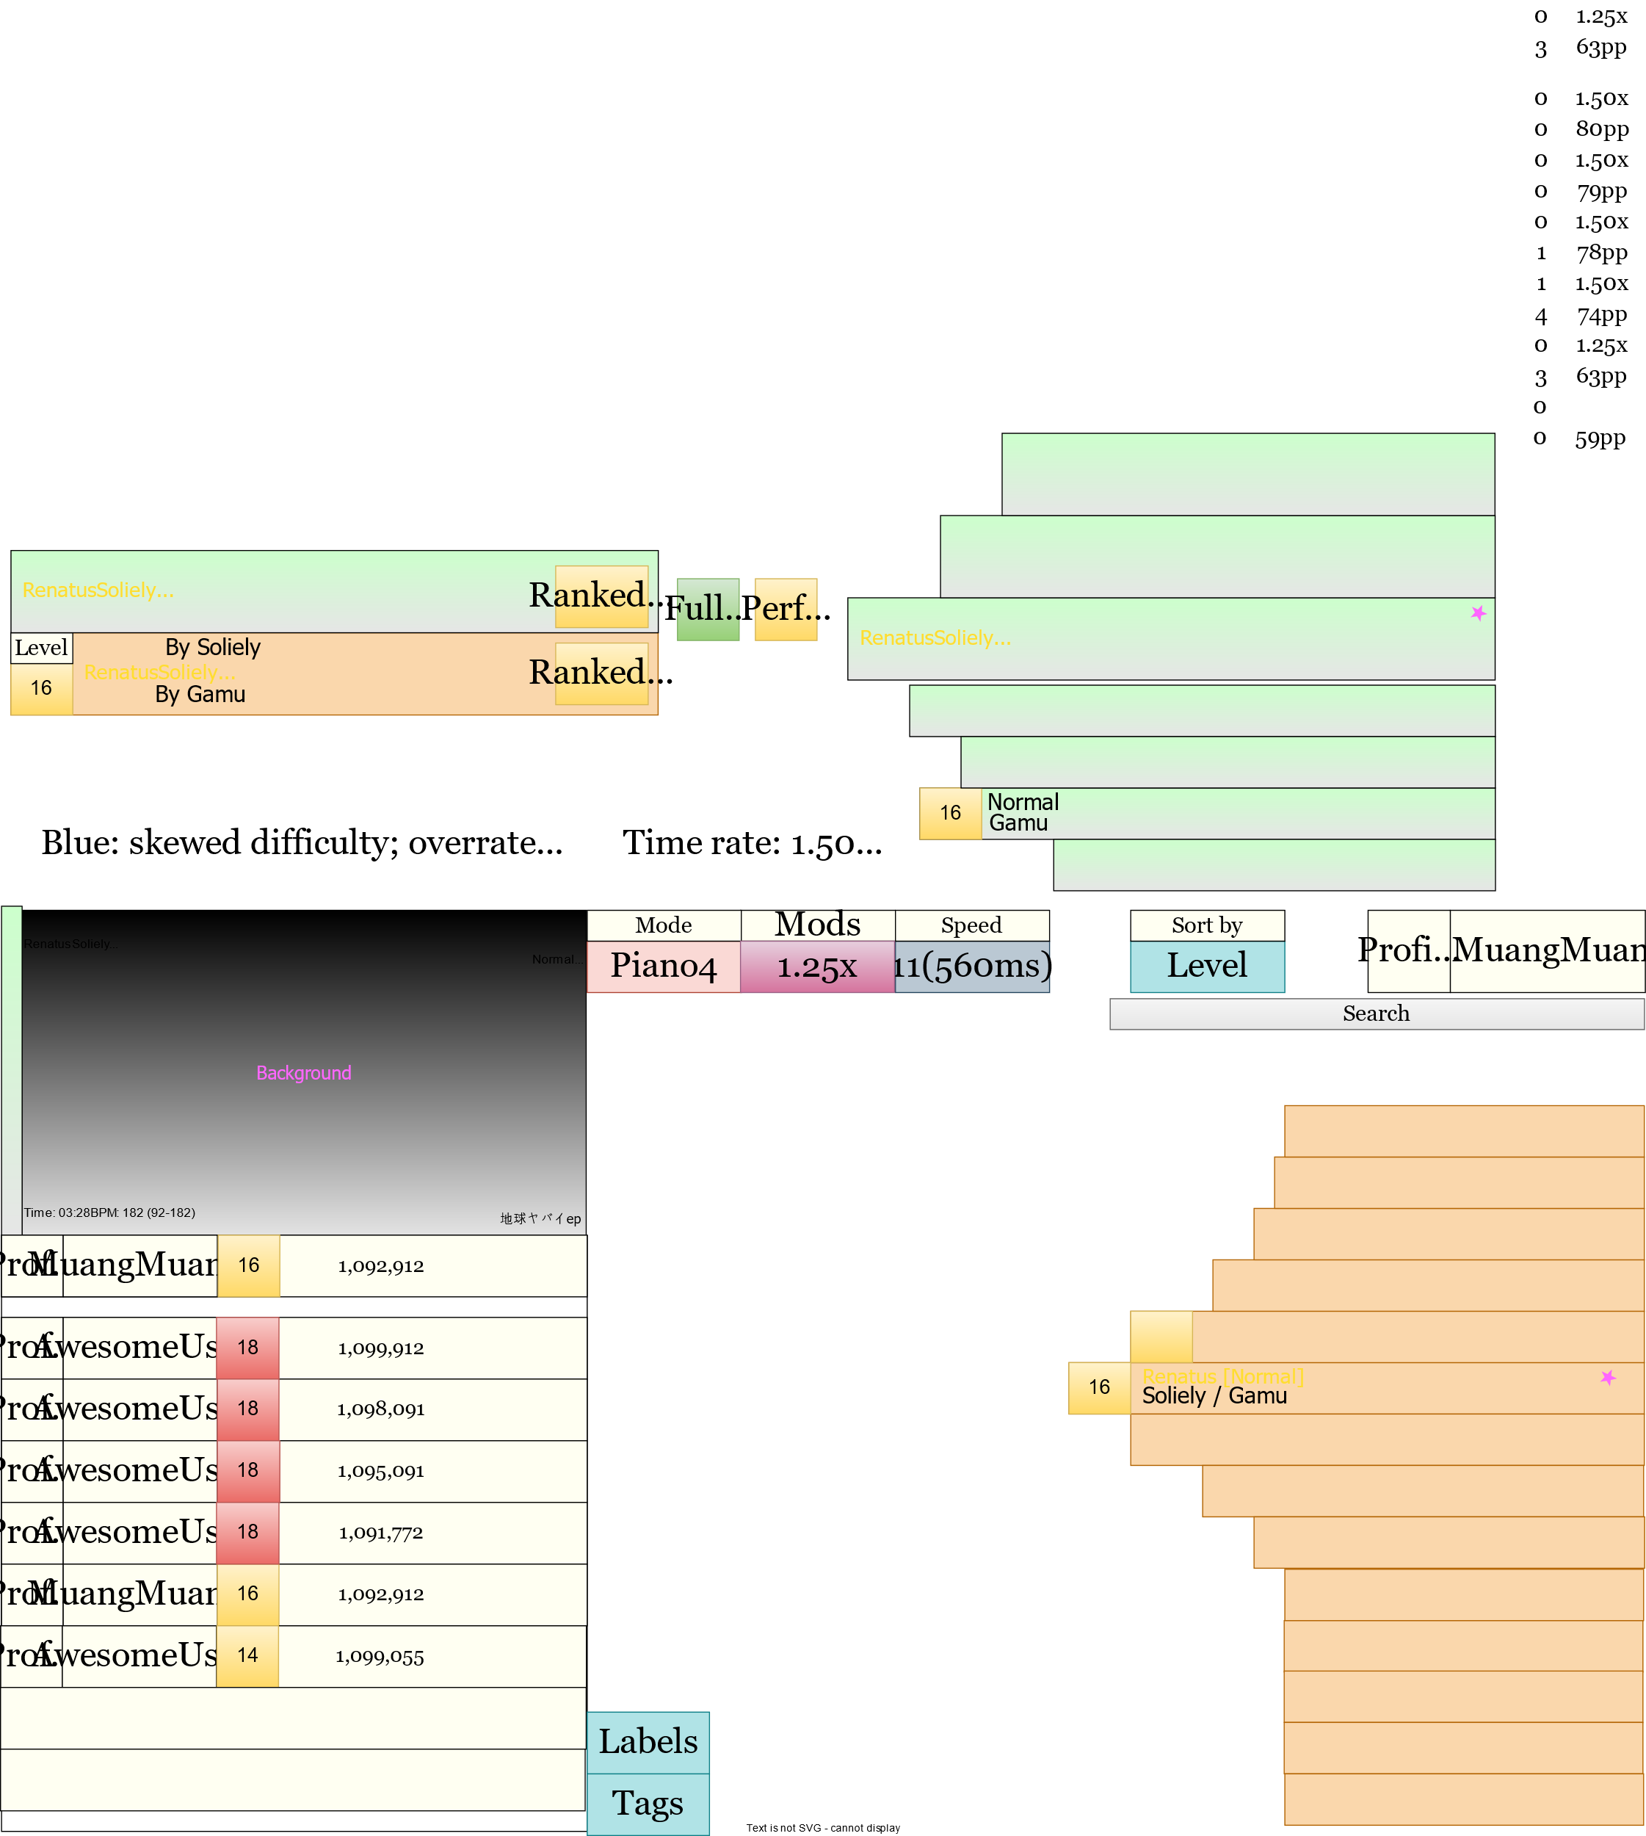
Hello

Slide 6
MuangMuangE
MuangMuangE

Slide 7

MuangMuangE
MuangMuangE

Slide 8
03:28
182 BPM (91-182)
MuangMuangE
1,098,912
1.25
1.25
Renatus [Normal]
Soliely / Gamu
16
1098
-52
Normal
Gamu
Notes: 820 (LN: 6%)

Slide 9
128, 128, 128, 10%
224, 224, 224, 10%

Slide 11
Chart info
Mode
Mods
Sort
Img
User
Statistics
Search
Ranking
Player list when at lobby
Play
Back
Tags Collect.
Editor
Options

