Slide 1
music player
Main page
Single
Multi
Editor
Download song
options
Exit
powered 2022
mua.ng/gosu

Slide 2
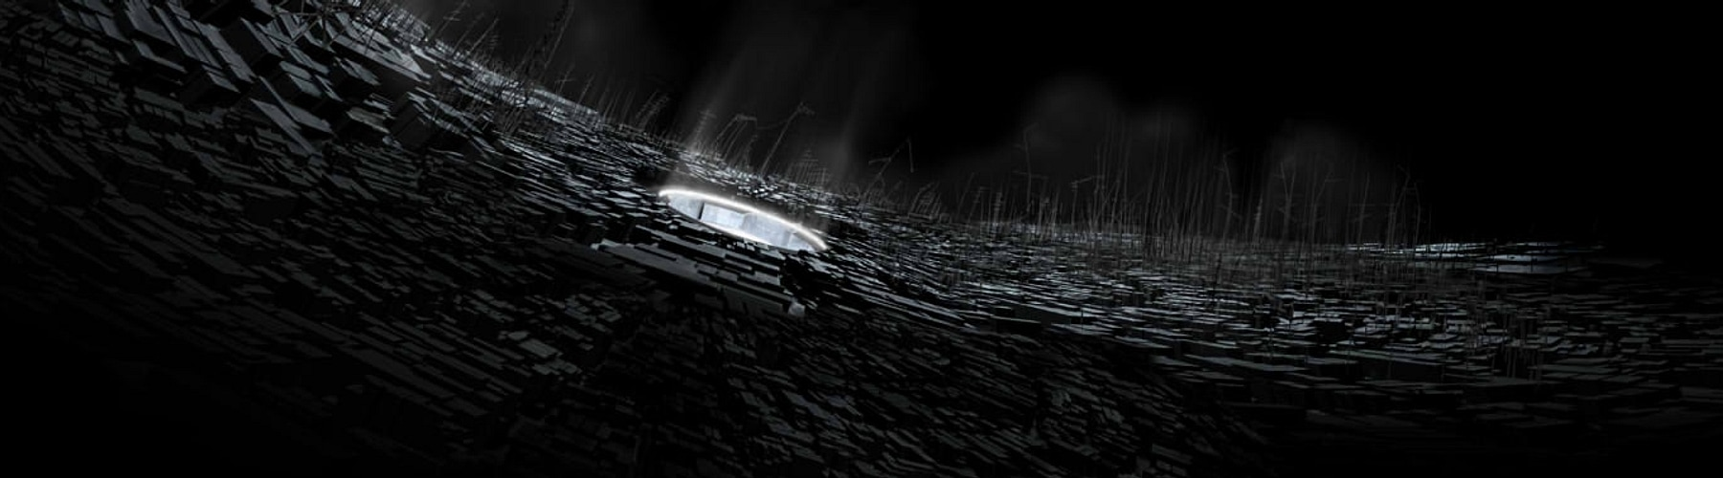


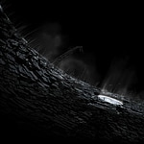

Renatus
Soleily
03:28
182 BPM
(91-182)
Group 1
Group 2
Sort
Filter
Artist
Title
Level
Ranked Level▼ Length▲
cover@2x with scale
Search:
Normal
Gamu
ranked at 2015.02.26
Level: 16
◎ 820 (LN: 6%)
Local / Global / Rival
Mods
AwesomePlayer1
1,099,912
1.50
MR
1,098k
C52
Renatus
(Lv.14) Normal
list@1x
download list images
when items are in range
so as preview music
cover@2x
MuangMuangE
8812.3pp
#239
settings
mods
target
Mode: Piano
skin name
rankable
Stop
7 Key
Notes:
https://assets.ppy.sh/beatmaps/241526/covers/cover.jpg?1622080332
https://assets.ppy.sh/beatmaps/241526/covers/cover@2x.jpg?1622080332
https://assets.ppy.sh/beatmaps/241526/covers/list.jpg?1622080332
https://assets.ppy.sh/beatmaps/241526/covers/list@2x.jpg?1622080332

Slide 3


Renatus
Soleily
03:28
182 BPM
(91-182)
Group 1
Group 2
Sort
Filter
Artist
Title
Level
Ranked Level▼ Length▲
cover@2x with scale
Search:
Normal
Gamu
ranked at 2015.02.26
Level: 16
◎ 820 (LN: 6%)
Local / Global / Rival
Mods
AwesomePlayer1
1,099,912
1.50
MR
1,098k
C52
Renatus
(Lv.14) Normal
AwesomePlayer2
1,095,019
1.50
list@1x
AwesomePlayer3
1,090,077
1.50
download list images
when items are in range
so as preview music
MuangMuangE
1,098,912
1.25
AwesomePlayer4
1,092,912
1.25
AwesomePlayer5
1,099,077
AwesomePlayer6
1,095,812
cover@2x
MuangMuangE
8812.3pp
#239
settings
mods
target
Mode: Piano
skin name
rankable
Stop
7 Key
Notes:
https://assets.ppy.sh/beatmaps/241526/covers/cover.jpg?1622080332
https://assets.ppy.sh/beatmaps/241526/covers/cover@2x.jpg?1622080332
https://assets.ppy.sh/beatmaps/241526/covers/list.jpg?1622080332
https://assets.ppy.sh/beatmaps/241526/covers/list@2x.jpg?1622080332

Slide 4
16
Renatus [Normal]
1,098k
16
Renatus [Normal]
1,098k
16
Renatus [Normal]
1,098k
16
Renatus [Normal]
1,098k
16
Renatus [Normal]
1,098k
16
Renatus [Normal]
1,098k
16
Renatus [Normal]
1,098k
16
Renatus [Normal]
1,098k
16
Renatus [Normal]
1,098k
16
Renatus [Normal]
1,098k
16
Renatus [Normal]
1,098k
16
Renatus [Normal]
1,098k
16
Renatus [Normal]
1,098k
16
Renatus [Normal]
1,098k
921
/960fps

Slide 5
Local / Global / Rival
Mods
Mode: Piano
7 Key
AwesomePlayer1
1,099,912
1.50
MR
MuangMuangE
8812.3pp
#239
AwesomePlayer1
1,099,912
1.50
MR
Renatus
by Soleily
Normal
by Gamu
AwesomePlayer1
1,099,912
1.50
MR
03:28
182 BPM (91-182)
AwesomePlayer1
1,099,912
1.50
MR
✔️
◎ 820
LN: 6%
AwesomePlayer1
1,099,912
1.50
MR
300x300
Renatus
by Soleily
Normal
by Gamu
AwesomePlayer1
1,099,912
1.50
MR
AwesomePlayer1
1,099,912
1.50
MR
✔️
AwesomePlayer1
1,099,912
1.50
MR
AwesomePlayer1
1,099,912
1.50
MR
AwesomePlayer1
1,099,912
1.50
MR
AwesomePlayer1
1,099,912
1.50
MR
settings
mods
target
sort
skin name
rankable
Stop
Filter: on
Notes:
list.jpg (150×150) (ppy.sh) list@2x.jpg (300×300) (ppy.sh) cover.jpg (900×250) (ppy.sh)
Renatus
list.jpg (150×150) (ppy.sh)

Slide 6

Mode: Piano
Soliely
Renatus
Normal
Gamu
Group 1 Artist
Group 2 Title
Sort
Level
7 Key
地球ヤバイ (also tags here) (special tags for pitch here)
03:28
182 BPM (91-182)
MuangMuangE
8812.3pp
2,923,005 hits
#239
Filter: Length△, Score▽, Ranked
✔️
◎ 820
LN: 6%
16
Renatus [Normal]
1,098k
Search:
16
Renatus [Normal]
Local / Global / Rival
Mods
1,098k
AwesomePlayer1
1,099,912
1.50
MR
Score ~1.1M
Max Combo 0~
Miss ~0
Bad ~0 (Miss 0 is prerequisite)
Good ~0
Cool ~0
background
16
Renatus [Normal]
1,098k
16
Renatus [Normal]
AwesomePlayer2
1,095,019
1.50
Score ~1.1M
Local Best
Global Best
Rival (including me)
1,098k
16
Renatus [Normal]
1,098k
AwesomePlayer3
1,090,077
1.50
Kool 20 → 18ms (-2) [+] [--]
Cool 45 → 30ms (-15) [+] [--]
Good 75 → 75
Bad 110 → 110
Miss 150 → 150
16
Renatus [Normal]
1,098k
MuangMuangE
1,098,912
1.25
16
Renatus [Normal]
1,098k
AwesomePlayer4
1,092,912
1.25
16
Renatus [Normal]
1,098k
16
Renatus [Normal]
AwesomePlayer5
1,099,077
1,098k
Mirror
Random
Shuffle
Hidden
(Fade Out)
Sudden
(Fade In)
Full LN
Inverse No LN
Stakato
Mono (Drum)
16
Renatus [Normal]
1,098k
AwesomePlayer6
1,095,812
16
Renatus [Normal]
rank X
Alert
0.5~2.0x
Lv. XX
1,098k
AwesomePlayer7
993,113
16
Renatus [Normal]
1,098k
16
Renatus [Normal]
Speed: 150 (520ms)
Volume: 25 | 25
Offset: -65ms
rank O
mods
On
1.25x
Mirror
Hidden
O2Jam (name)
1x (default)
Stakato
Stop
Target
1.09M
0 Miss
1,098k
16
921
Renatus [Normal]
/960fps
(glows when hover)
settings
1,098k
1.1
Auto
Playback
Arrange
Vision
Judge
Dynamic
Notes
Ghost
Attack
ms

Slide 7
Mode: Piano
Group 1 Artist
Group 2 Title
Sort
Level
7 Key
Soliely
Renatus
Normal
地球ヤバイ
Gamu
◎ 820
LN: 6%
MuangMuangE
8812.3pp
2,923,005 hits
#239
03:28
182 BPM (91-182)
Filter: Length△, Score▽, Ranked
Ranked
16
Renatus [Normal]
1,098k
Mods-specific: O
Search:
16
Renatus [Normal]
Local / Global / Rival
1,098k
AwesomePlayer1
1,099,912
1.50
MR
16
Renatus [Normal]
1,098k
16
Renatus [Normal]
AwesomePlayer2
1,095,019
1.50
1,098k
16
Renatus [Normal]
1,098k
AwesomePlayer3
1,090,077
1.50
16
Renatus [Normal]
1,098k
MuangMuangE
1,098,912
1.25
background
16
Renatus [Normal]
1,098k
AwesomePlayer4
1,092,912
1.25
16
Renatus [Normal]
1,098k
16
Renatus [Normal]
AwesomePlayer5
1,099,077
1,098k
16
Renatus [Normal]
1,098k
AwesomePlayer6
1,095,812
16
Renatus [Normal]
1,098k
AwesomePlayer7
993,113
16
Renatus [Normal]
1,098k
16
Renatus [Normal]
Speed: 150 (520ms)
Volume: 25 | 25
Offset: -65ms
1,098k
Mods
1.25x
Settings [skin name]
Tags [1st tag]
Edit chart
16
Renatus [Normal]
1,098k

Slide 8
16
[.35]
Renatus Normal
1,098,112
-52

Slide 9
MuangMuangE
8812.3pp
2,923,005 hits
Search:
Soliely
Renatus
Normal
#239
地球ヤバイ
Gamu
◎ 820
LN: 6%
03:28
182 BPM (91-182)
Ranked
Mods-specific: O
Local
Global
Rival
AwesomePlayer1
1,099,912
1.50
MR
AwesomePlayer2
1,095,019
1.50
14
AwesomePlayer3
1,090,077
1.50
16
Renatus [Normal]
Soliely / Gamu
1098
-52
MuangMuangE
1,098,912
1.25
background
AwesomePlayer4
1,092,912
1.25
AwesomePlayer5
1,099,077
AwesomePlayer6
1,095,812
AwesomePlayer7
993,113
Tags
Mods
1.25x
Piano7
Options
Editor
7 Key

Slide 10



MuangMuangE
8812.3pp
2,923,005 hits
Search:
Soliely
Renatus
Normal
Gamu
#239
地球ヤバイ
◎ 820
LN: 6%
SearchBox
03:28
182 BPM (91-182)
Ranked
Mods-specific: O
Local
Global
Rival
ChartBoardBox
(stands for signboard)
AwesomePlayer1
1,099,912
ScoreTextBox
AwesomePlayer2
1,095,019
1.50
ScoreLabelBox
14
UserTextBox
AwesomePlayer3
1,090,077
1.50
UserAvatarBox
16
Renatus [Normal]
Soliely / Gamu
1098
-52
MuangMuangE
1,098,912
1.25
background
16
Renatus [Normal]
Soliely / Gamu
1098
-52
AwesomePlayer4
1,092,912
1.25
Renatus [Normal]
Soliely / Gamu
ChartItemBox
16
AwesomePlayer5
1,099,077
ChartLevelBox
ChartTextBox
ShortScoreBox
AwesomePlayer6
1,095,812
4
Renatus [Normal]
Soliely / Gamu
1098
-52
16
AwesomePlayer7
993,113
ModsBox
ModeBox
OptionsBox
Tags
Mods
1.25x
Piano7
Options
Editor
7 Key

Slide 11
Free to play other charts in same song
MuangMuangE
8812.3pp
2,923,005 hits
Search:
Soliely
Renatus
Normal
4
Renatus [Normal]
Soliely / Gamu
1098
-52
#239
地球ヤバイ
Gamu
◎ 820
LN: 6%
16
03:28
182 BPM (91-182)
4
Renatus [Normal]
Soliely / Gamu
1098
-52
AwesomePlayer1
1,099,912
16
Ranked
4
Renatus [Normal]
Soliely / Gamu
1098
-52
4
Renatus [Normal]
Soliely / Gamu
1098
-52
16
16
AwesomePlayer2
1,095,019
1.50
4
Renatus [Normal]
Soliely / Gamu
1098
-52
4
Renatus [Normal]
Soliely / Gamu
1098
-52
Reservation system
16
16
AwesomePlayer3
1,090,077
1.50
Renatus [Normal]
Soliely / Gamu
Renatus [Normal]
Soliely / Gamu
4
1098
-52
4
1098
-52
16
16
MuangMuangE
1,098,912
1.25
4
Renatus [Normal]
Soliely / Gamu
Renatus [Normal]
Soliely / Gamu
16
1098
-52
4
1098
-52
16
All scrollable
AwesomePlayer4
1,092,912
1.25
Renatus [Normal]
Soliely / Gamu
Renatus [Normal]
Soliely / Gamu
4
1098
-52
4
1098
-52
16
16
AwesomePlayer5
1,099,077
4
Renatus [Normal]
Soliely / Gamu
Renatus [Normal]
Soliely / Gamu
16
1098
-52
4
1098
-52
16
4
Renatus [Normal]
Soliely / Gamu
1098
-52
16
Chatting box
4
Renatus [Normal]
Soliely / Gamu
1098
-52
16
4
Renatus [Normal]
Soliely / Gamu
1098
-52
16
Mods
1.25x
Piano7
Options
7 Key

Slide 12
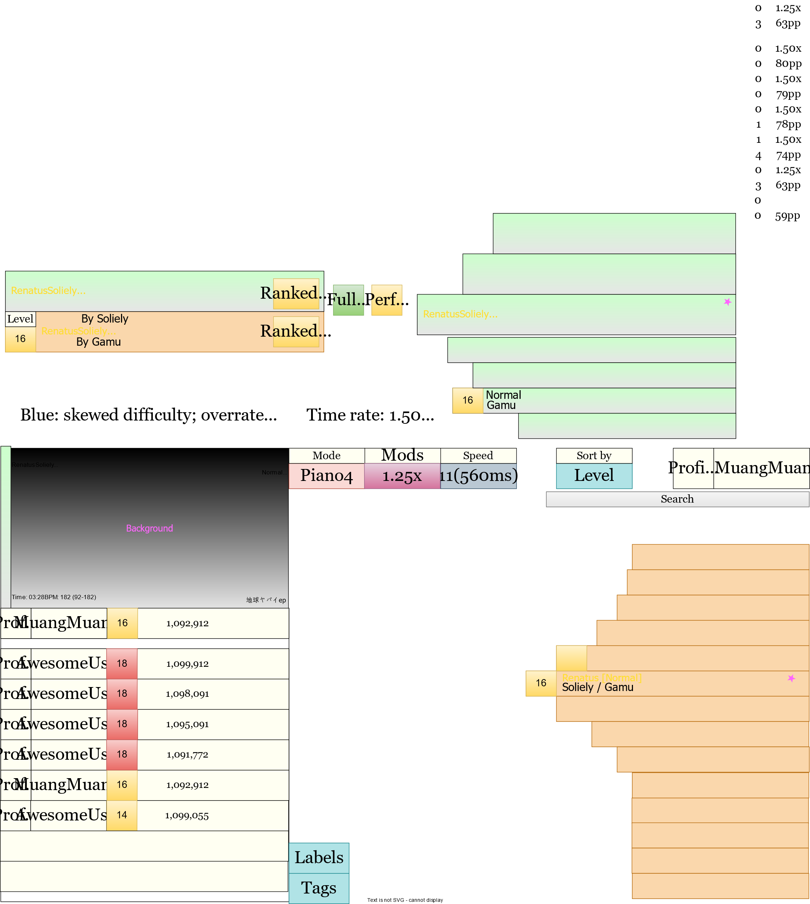
Hello

Slide 13
MuangMuangE
MuangMuangE

Slide 14

MuangMuangE
MuangMuangE

Slide 15
03:28
182 BPM (91-182)
MuangMuangE
1,098,912
1.25
1.25
Renatus [Normal]
Soliely / Gamu
16
1098
-52
Normal
Gamu
Notes: 820 (LN: 6%)

Slide 16
128, 128, 128, 10%
224, 224, 224, 10%

Slide 18
Chart info
Mode
Mods
Sort
Img
User
Statistics
Search
Ranking
Player list when at lobby
Play
Back
Tags Collect.
Editor
Options

