Slide 1

HO CHI MINH CITY UNILVERSITY OF TECHNOLOGY AND EDUCATION
OBJECT-ORIENTED SOFTWARE DESIGN
VISITOR
INSTRUCTOR: Nguyễn Trần Thi Văn
MEMBERS:
17110008 Hồ Ngọc Đình Châu
17110195 Nguyễn Thị Bích Nhàn

Slide 2
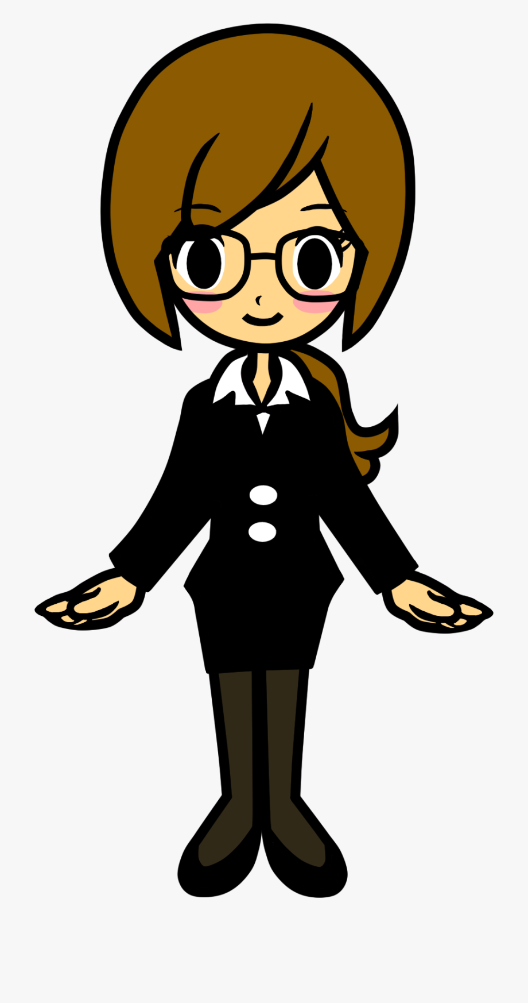
DEFINITION AND GOAL
STRUCTURE
FIELD OF APPLICATION
ADVANTAGES AND DISADVANTAGES
RELATED TEMPLATES
DEMO

Slide 3



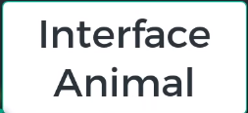
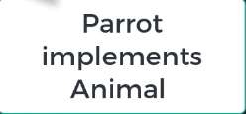
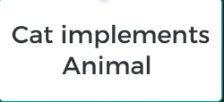
+op2()
+op3()
+op4()
+op5()
+op6()
+New_op()
VISITOR
+New_op()
+New_op()
+New_op()
+op2()
+op3()
+op4()
+op5()
+op6()
+op2()
+op3()
+op4()
+op5()
+op6()
+op2()
+op3()
+op4()
+op5()
+op6()

Slide 4


What is the Visitor Design Pattern

Slide 5
Visitor Design Pattern is :
Allows you to add methods to classes of different types without much altering to those classes .
You can make completely different methods depending on the class used.
Allows you to defined external classes that can extend other classes without majorly editing them.
Notes:
Là mẫu thiết kế thuộc Behavior Pattern

Slide 6
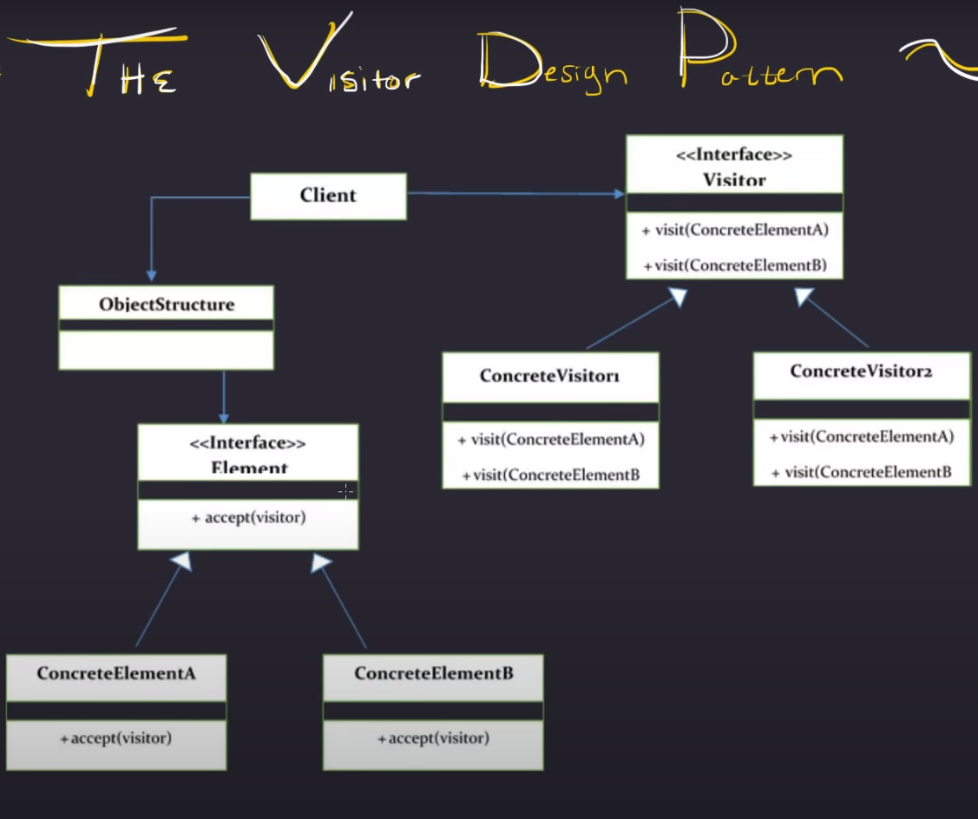

Slide 7
FIELD OF APPLICATION
When there is a complex object structure with multiple classes and interfaces. Users need to perform some specific behaviors of their own objects, depending on their concrete class.
When the data structure of the object rarely changes but their behavior is changed frequently.
Notes:
Là mẫu thiết kế thuộc Behavior Pattern

Slide 8
ADVANTAGES
Makes adding new operations easy.
Keep Open / Close principle: the original object is not changed, easily adds new behavior to the object through the visitor.
Visitor brings related methods together.
Notes:
Là mẫu thiết kế thuộc Behavior Pattern

Slide 9
DISADVANTAGES
Adding new ConcreteElement class is very difficult.
Break Encapsulation.
Notes:
Là mẫu thiết kế thuộc Behavior Pattern

Slide 10
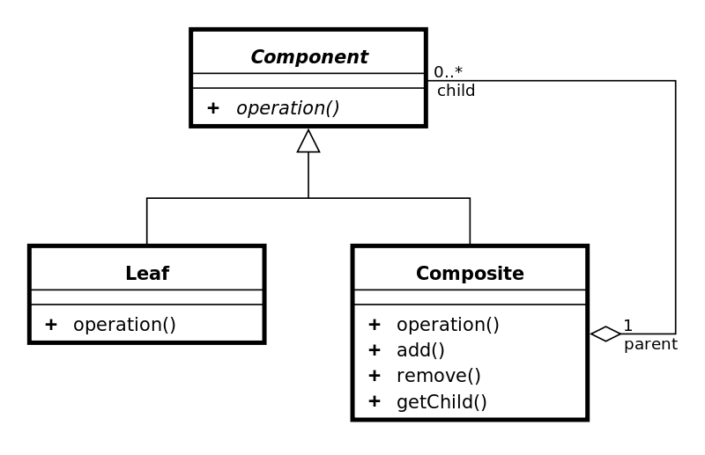
RELATED TEMPLATES
Notes:
Là mẫu thiết kế thuộc Behavior Pattern

Slide 11
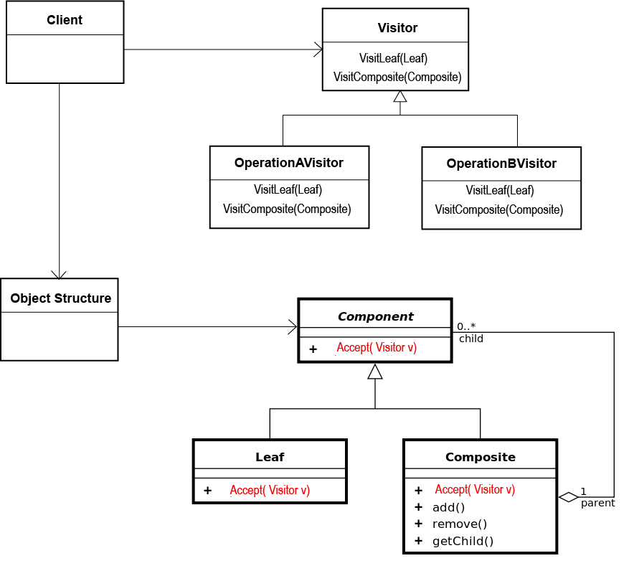
RELATED TEMPLATES
Notes:
Là mẫu thiết kế thuộc Behavior Pattern

Slide 12



Notes:
Là mẫu thiết kế thuộc Behavior Pattern

Slide 13



