Slide 1
YottaDBTM Foundation Comsan Chanma (Neo) T.N. Incorporation Ltd.

Slide 2
Agenda
2nd Day.
Database Extract and Load
Database Backup and Restore
Database Integrity Check
Database Fragmentation
Database Monitoring

Slide 3
Database Extract and Load

Slide 4
MUPIP EXTRACT
The EXTRACT command copies specified globals from the current database to a sequential output file
The format of the EXTRACT command is:
MUPIP> EXTRACT -qualifier file-name
The optional qualifiers are:
-FO[RMAT]=GO | B[INARY] | Z[WR]
-FR[EEZE]
-LA[BEL]=text
-[NO]LO[G]
-S[ELECT]=global-name-list
-R[EGION]=region-list

Slide 5
MUPIP EXTRACT Example
Extract the ^ACN global and place it into a binary file named acn.bin:
MUPIP> EXTRACT -FORMAT=BINARY -SELECT=”^ACN” acn.bin
ACN Key Cnt: 1659 max rec size: 188
EXTRACT TOTAL Key Cnt: 1659 max rec size: 188
The data remains in the database file after the extract has taken place
Extract the ^ACN global and placed it into a global file acn.go:
MUPIP> EXTRACT -FORMAT=GO -SELECT="^ACN" acn.go
ACN Key Cnt: 1659 max subsc len: 18 max data len: 181 max rec len: 188
EXTRACT TOTAL Key Cnt: 1659 max subsc len: 18 max data len: 181 max rec len: 188
Here is an example of what the data in the file looks like:
GT.M MUPIP EXTRACT
15-APR-1998 23:34:56
^ACN(50068,1)
FIRST LAST|||
^ACN(50068,49)
|2|0||11|1||0||0|1|1|2|7D|||||1|||||1||1|1|15|0|0||0
^ACN(50068,50)
502|L|LN||1|FIRST LAST,FIRST |0|0||||RM|||||||||500A

Slide 6
MUPIP LOAD
The LOAD command enters global variable names and their corresponding data values into a YDB database from a sequential file in one of three formats:
GO (global output)
BINARY (binary format)
ZWR (ZWrite)
By default, LOAD uses FORMAT=ZWR
This command uses the Global Directory to determine which database file to use. The LOAD command may operate concurrently with normal YDB database access

Slide 7
MUPIP LOAD (Cont.)
The format of the LOAD command is:
MUPIP> LOAD -qualifier file-name
The optional qualifiers are:
-FO[RMAT]=GO | B[INARY] | ZWR
-BE[GIN]=integer
-E[ND]=integer
-FI[LLFACTOR]=integer

Slide 8
MUPIP LOAD Example
Load in a binary file named acn.bin. (Only fill 85% of each data block within the database file.)
MUPIP> LOAD -FORMAT=BINARY -FILL=90 acn.bin
Label = GDS BINARY EXTRACT LEVEL
219980415234130020480051000510GT.M MUPIP EXTRACT
LOAD TOTAL Key Cnt: 1659 Max Subsc Len: 18 Max
Data Len: 181
Last LOAD record number: 64

Slide 9
Database Backup and Restore

Slide 10
Backup Scenario
What?
DB files. (with GLD file and other related files)
Working path.
Source code.
Binary.
When?
Daily, Monthly
How?
Copy files
Snapshot

Slide 11
MUPIP BACKUP
The BACKUP command copies from one or more Greystone Technology Database Structure (GDS) files to a new file or files. This command suspends updates to all regions specified by the BACKUP command from the time it starts the first region until it finishes the last region
This ensures that BACKUP captures a consistent application state. The command does not suspend processes that only perform retrievals

Slide 12
MUPIP BACKUP (Cont.)
The format of the backup command is:
MUPIP> BACKUP [-qualifier] region-list file-name
Qualifiers to the backup command include:
-DATABASE -- Creates a disk-to-disk backup copy of the files of all selected regions.
-Bytestream -- Transfers MUPIP BACKUP output to a TCP connection, file, or a pipe.
-INCREMENTAL – specifies that backup copy only changed blocks
-[NO]ONLINE -- allows updates to the database while backing it up
-[NO]NEW – creates a new set of journal files for the backup
Important notes on backing up database files includes:
To BACKUP only one region, the file name must resolve to a Unix file or directory name
To backup several regions, the file-name must be a directory
If the file-name is a directory, MUPIP assigns the backup files the same name as the file associated with the dynamic segment of each region. The target directory, therefore, must not contain any of the regions included in the BACKUP
Incremental backups have to be restored to the database with the mupip restore command. Comprehensive backups can be done using the Unix cp command
Use of “*” to reference all db files

Slide 13
MUPIP BACKUP Example
To backup the file associated with the region UBG to the file mumps.bak:
MUPIP> BACKUP UBG mumps.bak
DB file /ydbinst/mumps.ubg backed up in file mumps.bak
DB file /ydbinst/mumps.ubg backed up in file mumps.bak. By default, the backup was comprehensive and no new journal files were created. This command requires stand-alone access and restricted updates to the db file.
To restore the backup file, use the Unix copy command to copy the file back to it’s original destination.
$ cp mumps.bak mumps.ubg

Slide 14
MUPIP BACKUP Example (Cont.)
To backup all files with new journal files in a directory named /BACKUPS_DIR without interrupting users access
MUPIP> BACKUP “*” -online -new /ydbinst/BACKUPS_DIR
A comprehensive backup of all db files was created in the /ydbinst/BACKUPS_DIR with a corresponding set of journal files while allowing updates to the db files
To backup all updates to all files in a directory named /BACKUPS_DIR.
MUPIP> BACKUP -incremental “*” /ydbinst/BACKUPS_DIR
A backup of the updates to all the database files since the last backup was created in /ydbinst/BACKUPS_DIR
To restore the backup file, the mupip restore command must be used

Slide 15
MUPIP BACKUP Example (Cont.)
The MUPIP BACKUP command can also use system utilities:
MUPIP BACKUP can be of the form “| <string> where <string> is executed and the backup output is passed in as standard input. The backup qualifiers can be freely mixed with any/all of the following commands.
mupip backup “*” “|gzip -c”
creates a compressed backup of all databases
mupip backup “*” tcp://pharaoh:5000
sends the backup to the machine pharaoh at port 5000, assuming a listener is awaiting the output

Slide 16
MUPIP RESTORE
Integrates one or more BACKUP -INCREMENTAL files into a corresponding database.
The transaction number in the first incremental backup must be one more than the current transaction number of the database.
The format of the RESTORE command is:
MUPIP> RE[STORE] file-name bytestrm-bkup-list
Example
$ mupip restore backup.dat backup.bk1,backup.bk2

Slide 17
Database Integrity Check

Slide 18
MUPIP INTEG
The INTEG command performs an integrity check on a GDS database file. The command operates on one or more regions in the current global directory by suspending current updates to those regions
The INTEG command should be done at the following times:
Periodically -- to ensure ongoing integrity of the database(s)
Frequent INTEGs help catch integrity problems before they spread throughout the database file.
After a Crash -- to ensure that the database was not corrupted
When Database Errors are Reported -- to troubleshoot the problem

Slide 19
MUPIP INTEG (Cont.)
The format of the INTEG command is:
MUPIP> INTEG [-qualifier] -FILE file-name
MUPIP> INTEG [-qualifier] -REGION region-list
The file-name or region-list identifies the target of the INTEG.
The INTEG command must include -FILE or -REGION qualifiers that determine whether the argument of the INTEG is a file-name or region-list.
The optional qualifiers which determine the action(s) for the SET are:
-FAST only looks at index blocks (dramatically faster than full)
-FULL looks at index and data blocks (default qualifier)
-SUBSCRIPT specifies which global to verify

Slide 20
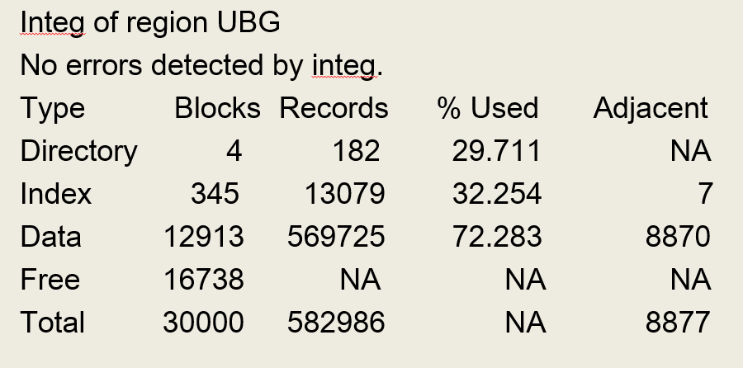
MUPIP INTEG Example 1
A full integrity check for region UBG:
$ mupip integ –region UBG

Slide 21
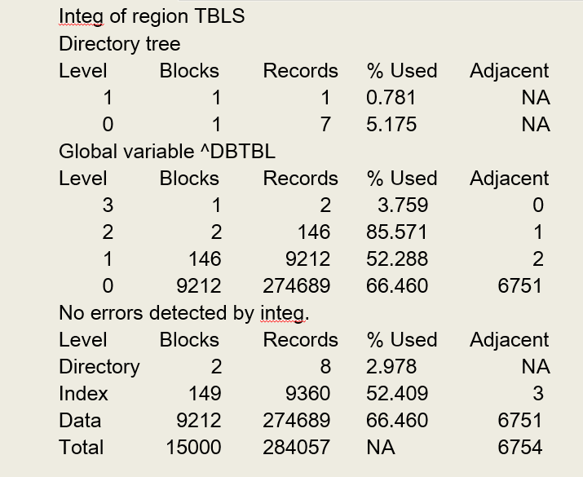
MUPIP INTEG Example 2
A full integrity check on the global ^DBTBL with the -FULL qualifier to show how much space this particular global is taking up:
$ mupip integ -full -subscript=“^DBTBL” -region TBLS

Slide 22
Database Fragmentation

Slide 23
MUPIP REORG
The REORG command is used to defragment and compact database files. The REORG runs concurrently with other database activity, including updates. REORG optimizes the structure of database files but does not handle native file system fragmentation.
The format of the REORG command is:
MUPIP>REORG [–qualifier]

Slide 24
REORG Command Qualifiers
EXCLUDE- Restricts swapping blocks used by the specified globals. EXCLUDE will bypass the blocks containing the global/globals specified. Arguments for the EXCLUDE qualifier are:
A Global name, such as ACN
A range of global names, such as A7:B7
A list, such as A,B,C
Global names with the same prefix, such as TMP*
FILL_FACTOR- Specifies the percent to fill each database block. Updates to the block fill the remaining available space.
RESUME-If the REORG is stopped, the resume qualifier allows you to restart the REORG operation from the point where the operation stopped
SELECT- By default, REORG operates on all globals in all database files identified by the current global directory. SELECT specifies specific globals to run the REORG operation on. Arguments for the SELECT qualifier are:
A Global name, such as ACN
A range of global names, such as A7:B7
A list, such as A,B,C
Global names with the same prefix, such as TMP*
REGION - Specifies that REORG operate in the regions in the associated list and restricts REORG to the globals in those regions that are mapped by the current global directory;

Slide 25
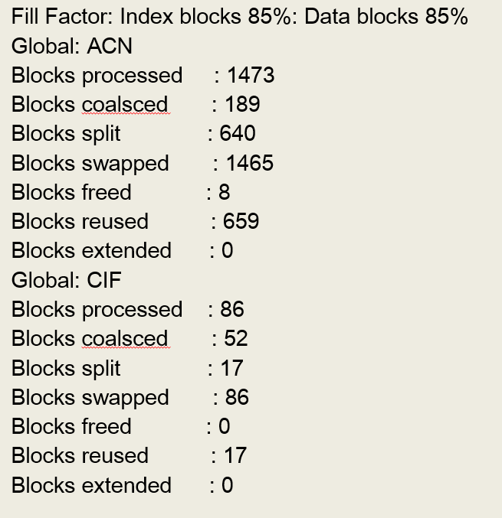
MUPIP REORG Example
To reorg globals ACN and CIF with a fill factor of 85%:
$ mupip reorg -fill_factor=85 -select=ACN,CIF

Slide 26
Database Monitoring

Slide 27
YottaDB Log
YottaDB runtime message
YottaDB process’s log

Slide 28
YottaDB Messages
The YottaDB run-time system sends messages to the system log. These are not trapped by the application error trap.
Compilation errors generated by YottaDB are directed to STDERR. These are not trapped by the application error trap. You can avoid them by compiling application code before deploying it in production or log them by running mumps processes with STDERR directed to a file.
Application error are handled by application.
YottaDB sends messages to the system log at the LOG_INFO level of the LOG_USER facility
rsyslogd configuration
user.info /var/log/user.log

Slide 29
YottaDB Message Severity
-I- for informational messages
-W- for warnings
-E- for errors
-F- for events that cause a YottaDB process to terminate abnormally.
Messages and Recovery Procedures Reference : https://docs.yottadb.com/MessageRecovery/index.html

Slide 30
YottaDB Process Log File
.mje and .mjo files : STDERR and STDOUT of YottaDB JOB command
YDB_FATAL_ERROR.ZSHOW_DMP_*.txt : YottaDB process terminates abnormally

Slide 31
YottaDB Database Size
Database file size
Data size
Global size

Slide 32
Database File Size
OS file size
ls -l [database file]
How different of “ls” VS “du” command?

Slide 33
Data Size
YDB>D ^%FREECNT
YDB> d ^%FREECNT
Region Free Total Database file
------ ---- ----- -------------
DATA 94 100 ( 94.0%) /ydbdir/gbls/mumps.data
OCTO 56 100 ( 56.0%) /ydbdir/gbls/mumps.octo
YDB>

Slide 34
Global Size
“Mupip size” command
Mupip size : Estimates and reports the size of global variables using a format that is similar to the one that appears at the end of the MUPIP INTEG -FULL report.
The format of the MUPIP SIZE command is:
MUPIP> SI[ZE] [-h[euristic]=estimation_technique] [-s[elect]=global-name-list] [-r[egion]=region-list] [-a[djacency]=integer]
Example
$ mupip size -heuristic="impsample,samples=2000" -select="y*" -region=”DATA"

Slide 35
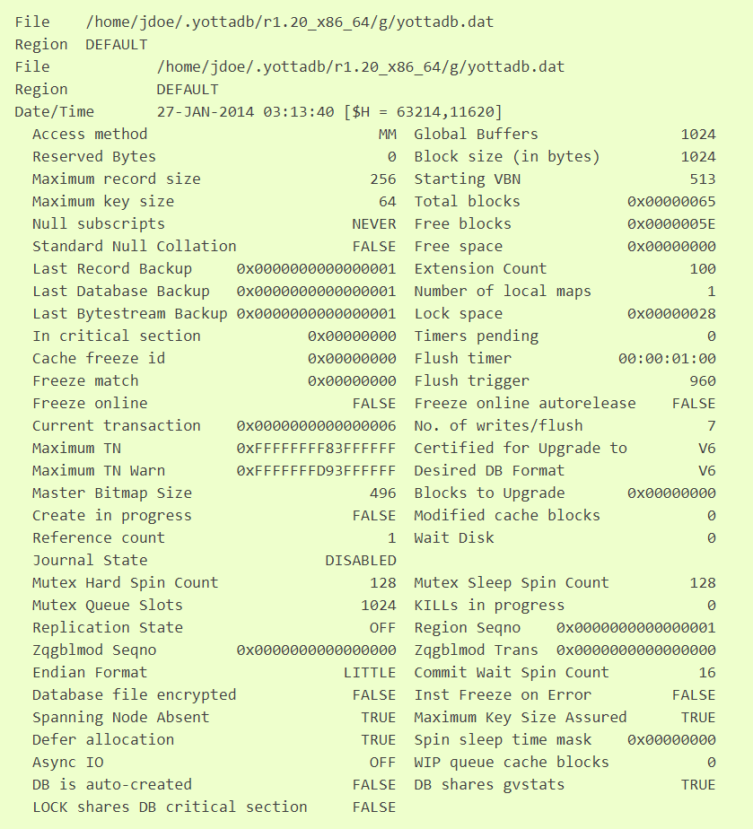
Database File Header
DSE> dump -fileheader
DSE> dump -fileheader -all

Slide 36
Database File Header Element
Block size (in bytes) : The size (in bytes) of a GDS block.
Extension Count: The number of GDS blocks by which the database file extends when it becomes full.
Global Buffers: The number of BG buffers for the region.
Maximum key size: The minimum key size is 3 bytes and the maximum key size is 1019 bytes.
Maximum record size: The minimum record size is zero. The maximum is 1,048,576 bytes (1MiB).
Freeze match: 0x00000000 mean DB is not suspend, others mean DB is suspended

Slide 37
Question and Answer

