Slide 1
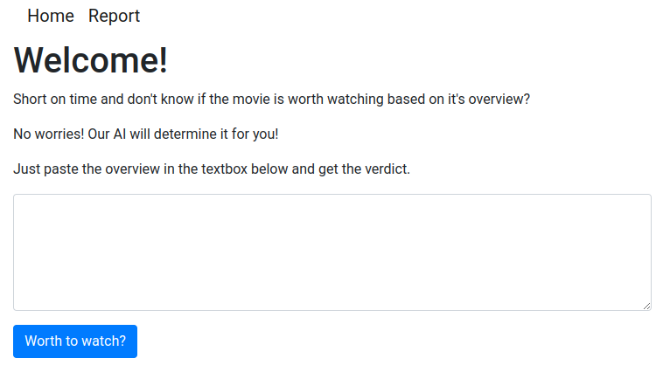
Worth2Watch
https://worth2watch.herokuapp.com/
Milja Ketoja, Arttu Koskinen, Heikki Nenonen

Slide 2
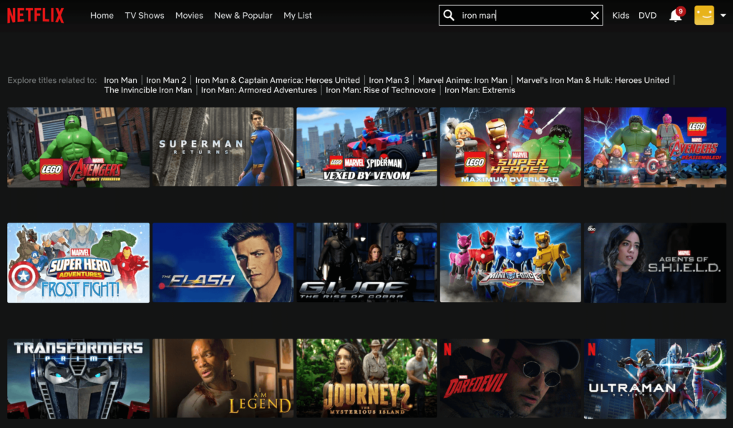
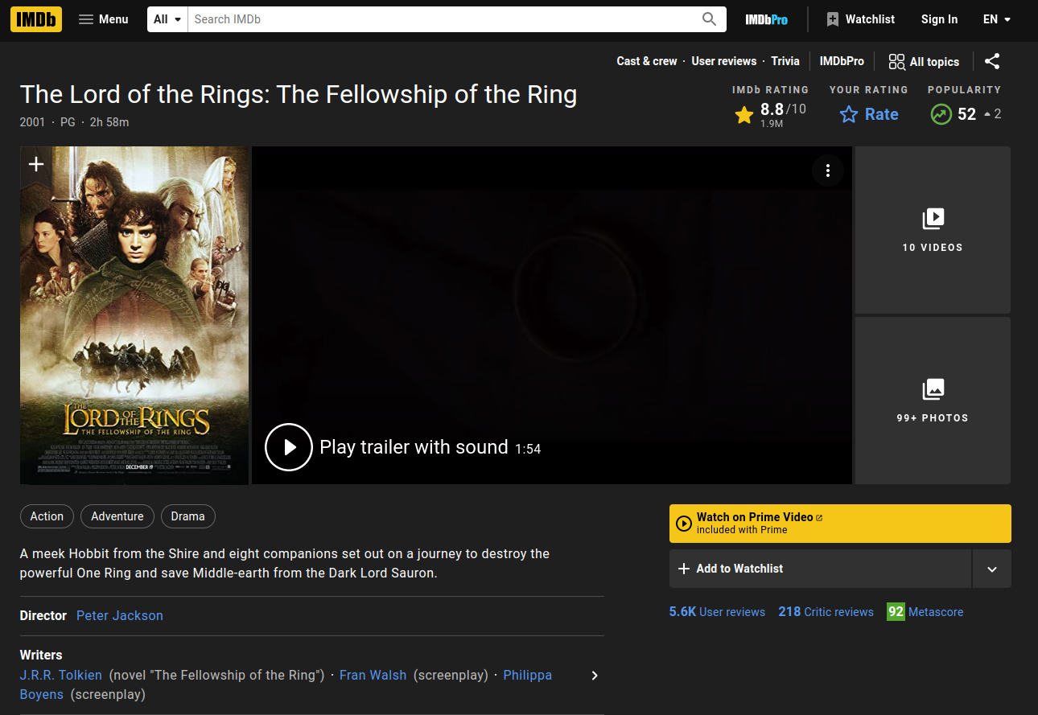
What to watch?

Slide 3
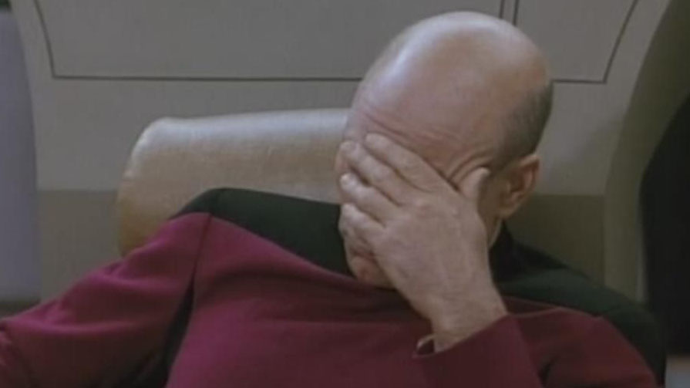

Slide 4
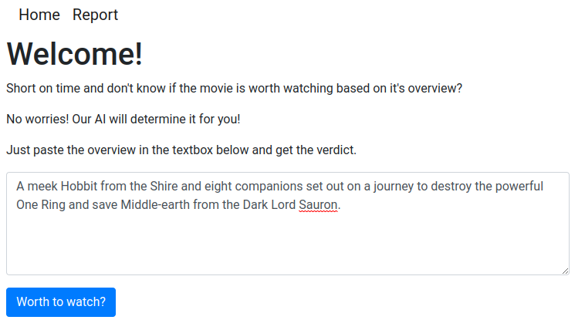
Solution!

Slide 5
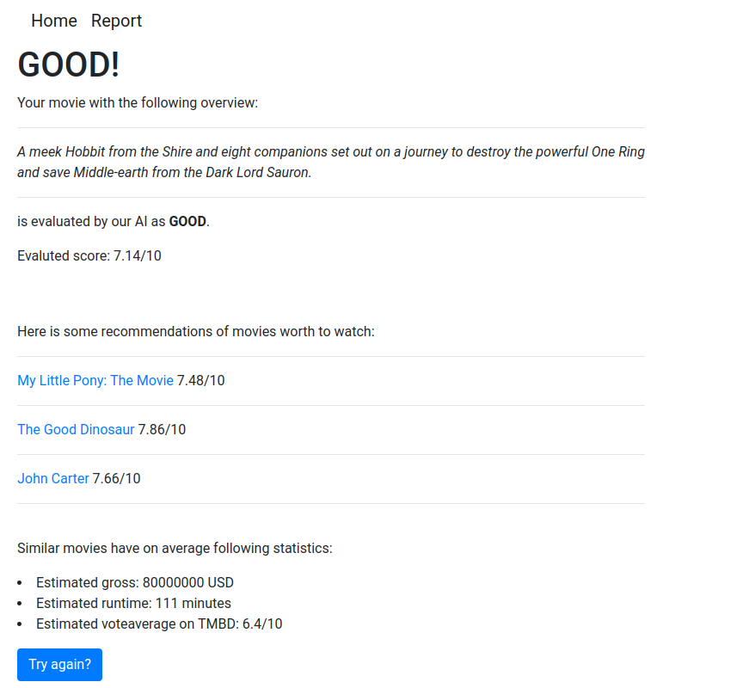

Slide 6


