Slide 1



Timer

Slide 2
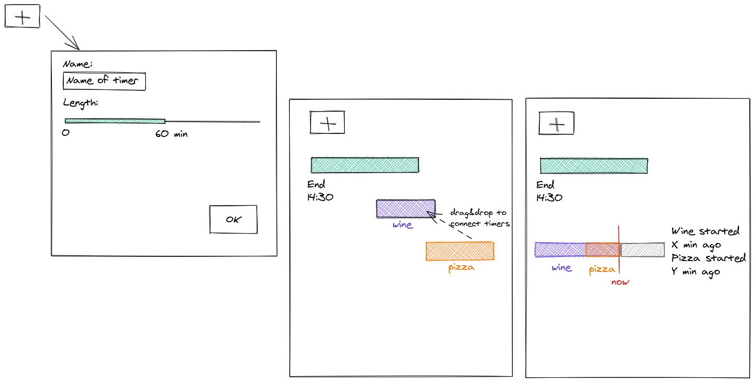
DEMO
Go to

Slide 3
Technology Stack

Slide 4
High Level Architecture

Slide 5


Collaborate: to work together especially in some literary, artistic or scientific undertaking. <Webster Dictionary>
Way Of Working: The Pillars

Slide 6

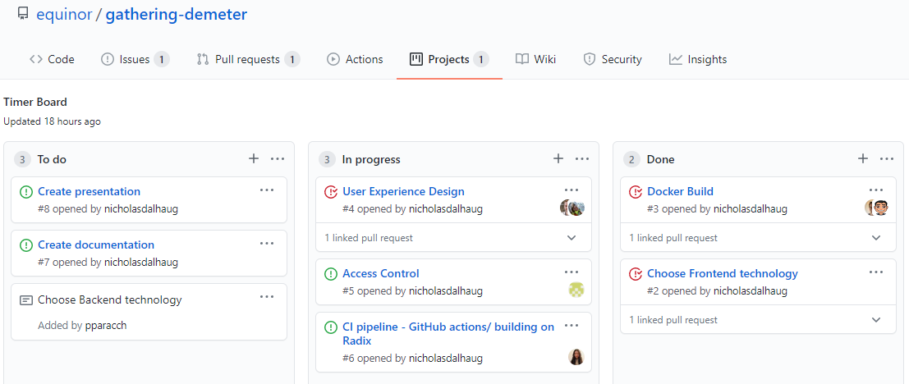



Way Of Working: The Process
PDCA
Plan
Do
Check
Act
2 or more people working together on the same task
Iterative and Incremental Approach

