Slide 1
Pitch

Slide 2
Technology Stack

Slide 3
High Level Architecture

Slide 4


Collaborate: to work together especially in some literary, artistic or scientific undertaking. <Webster Dictionary>
Way Of Working: The Pillars

Slide 5

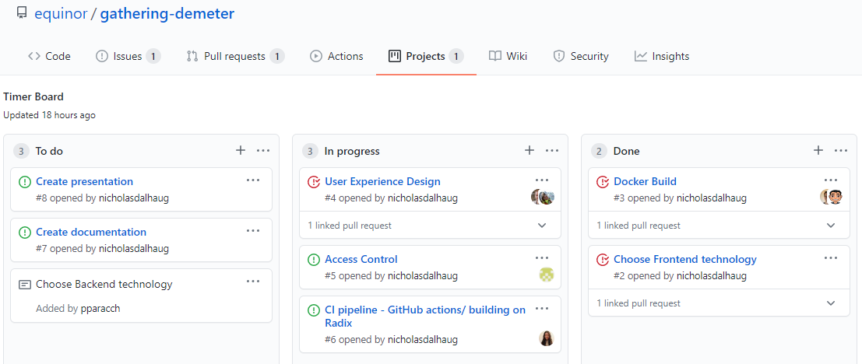



Way Of Working: The Process
PDCA
Plan
Do
Check
Act
2 or more people working together on the same task
Iterative and Incremental Approach

