Slide 1
REDDIT SENTIMENT PROJECT
Richard More | Quan Le | Hao Nguyen | Anirudh Chaudhary

Slide 2
Data Analytics Plan
We used https://www.reddit.com/ for the sentiment analysis of the recent Corona Virus outbreak. The idea behind it is to analyse Reddit community’s reaction to this outbreak by tracking the comments in Corona and World News subreddits.
Attributes used: Comments, Comments Score and Post Score

Slide 3
Peer Comments Summary
Inclusion of Deep learning models and machine learning techniques
To implement clustering in the analysis
Use PCA to reduce the number of features for faster computation
Use predefined sentiment lexicons like bing, nrc in tidytext package
To handle grammatical nuances, misspellings, and ambiguity during analysis

Slide 4
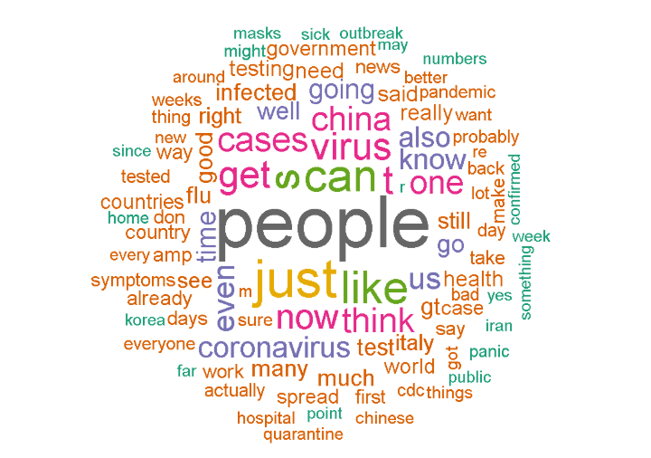
Word Cloud Visualization

Slide 5
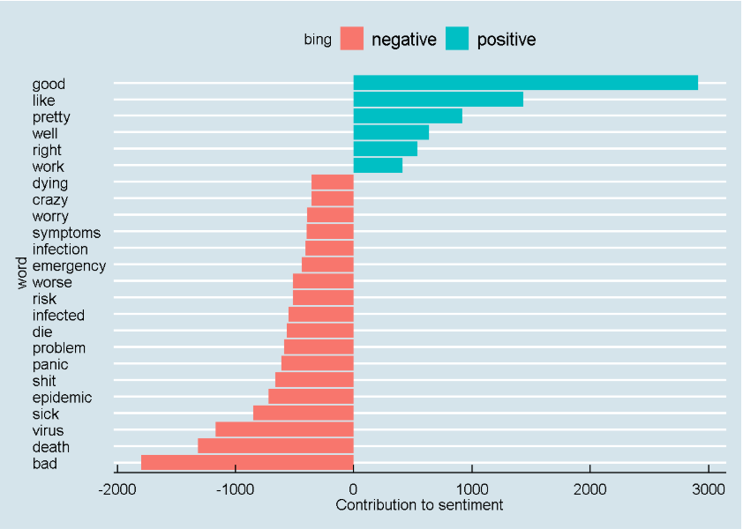
Sentiment Visualization using bing

Slide 6
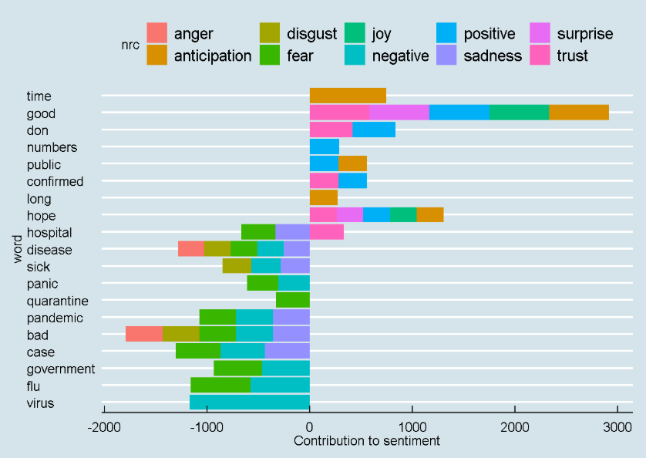
Sentiment Visualization using nrc

Slide 7
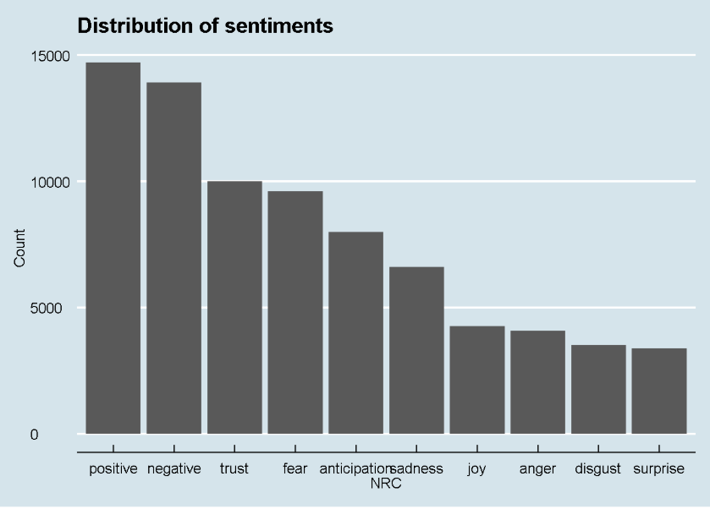
Sentiment Distribution

Slide 8
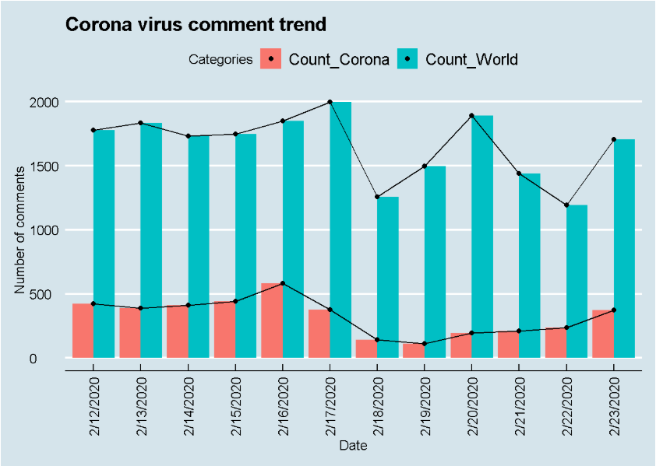
Corona Virus Comment Trend

Slide 9
ML Model Procedures
We used two models using H2o instances that can predict a comment’s score based on the score of the parent post and the NRC sentiments of the comments: - Gradient Boosting Model - Linear Regression Model
After processing data was divided: - Train (70%) - Test (15%) - Validate (15%)

Slide 10
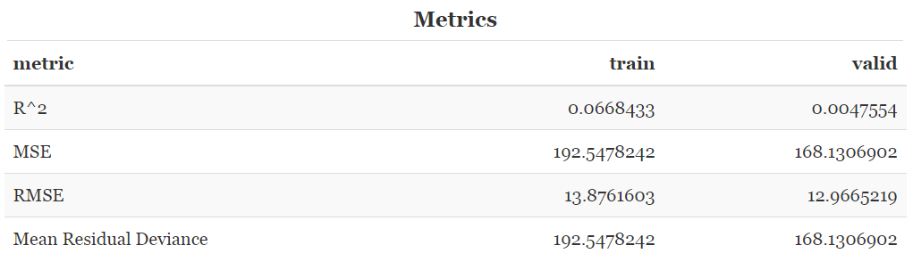
Gradient Boosting Model Results

Slide 11
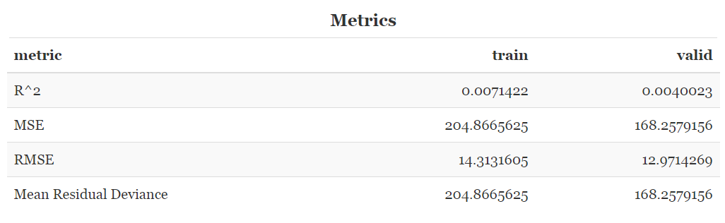
Linear Regression Model Results

Slide 12
Key Take-aways

