Slide 1

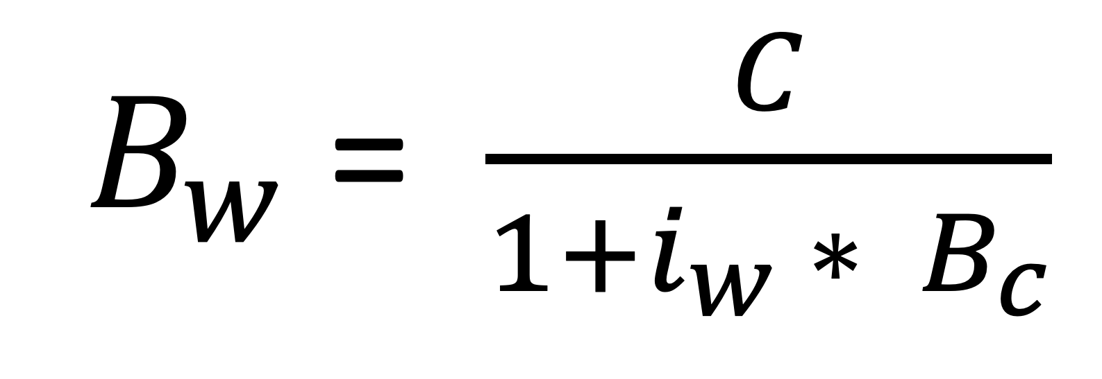
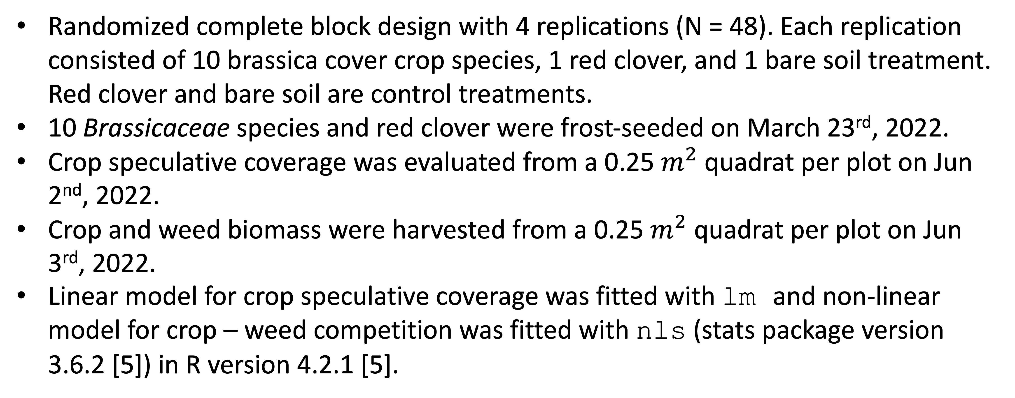
Weed suppression from frost-seeded Brassicaceae cover crops
Huong Nguyen, Olivia Fisher, Amy Fox, Kristen Loria, Kathryn Marini, Chris Pelzer, Adam Sharifi, Domenic Varma, Sandra Wayman, Matt Ryan
Result
Collard provided the strongest weed suppression among all the examined Brassicaceae species.
Motivation
Cover crops can build soil fertility and suppress weeds [1].
Red clover (Trifolium pratense L.) is a winter-hardy cover crop that provides multiple benefits [2] while requires little management [3].
Most brassicas are cool-season crops. Yellow mustard, spring canola, and winter rapeseed residues when incorporated with soil can reduce weed seedling emergence [4].
$B_{w}$ = $\frac{C}{1+i_{w} ∗ B_{c}}$
Can other brassicas provide reliable weed suppression?
Materials and Methods
References
Randomized complete block design with 4 replications (N = 48). Each replication consisted of 10 brassica cover crop species, 1 red clover, and 1 bare soil treatment. Red clover and bare soil are control treatments.
10 Brassicaceae species and red clover were frost-seeded on March 23rd, 2022.
Crop speculative coverage was evaluated from a 0.25 $m^{2}$ quadrat per plot on Jun 2nd, 2022.
Crop and weed biomass were harvested from a 0.25 $m^{2}$ quadrat per plot on Jun 3rd, 2022.
Linear model for crop speculative coverage was fitted with lm and non-linear model for crop – weed competition was fitted with nls (stats package version 3.6.2 [5]) in R version 4.2.1 [5].
Teasdale JR. Contribution of cover crops to weed management in sustainable agricultural systems. Journal of production agriculture. 1996 Oct;9(4):475-9.
Ohno T, Doolan K, Zibilske LM, Liebman M, Gallandt ER, Berube C. Phytotoxic effects of red clover amended soils on wild mustard seedling growth. Agriculture, ecosystems & environment. 2000 Apr 1;78(2):187-92.
Duiker SW, Curran SW. Management of red clover as a cover crop. PennState Extension. 2007 Oct.
Haramoto ER, Gallandt ER. Brassica cover cropping for weed management: A review. Renewable agriculture and food systems. 2004 Dec;19(4):187-98.
R Core Team (2022). R: A language and environment for statistical computing. R Foundation for Statistical Computing, Vienna, Austria. URL: https://www.R-project.org/.
Acknowledgements
Keith Berns, Green Cover Seed, Bladen, Nebraska

