Slide 1

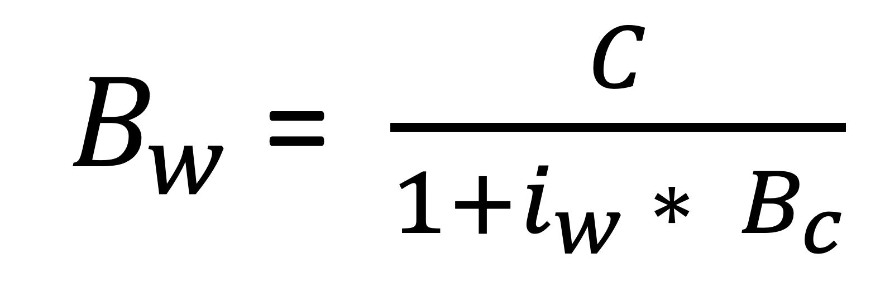
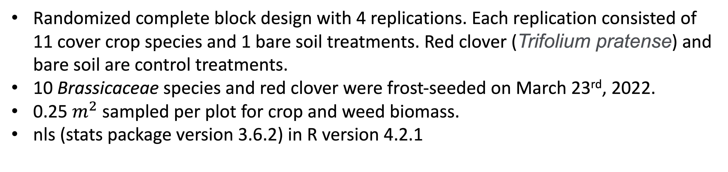
Weed suppression from frost-seeded Brassicaceae cover crops
Huong Nguyen, Olivia Fisher, Amy Fox, Kristen Loria, Kathryn Marini, Chris Pelzer, Adam Sharifi, Domenic Varma, Sandra Wayman, Matt Ryan
Motivation
Can frost-seeded Brassicaceae provide reliable weed suppression?
Result
Collard provided the strongest weed suppression among all the examined Brassicaceae species.
$B_{w}$ = $\frac{C}{1+i_{w} ∗ B_{c}}$
Materials and Methods
References
Randomized complete block design with 4 replications. Each replication consisted of 11 cover crop species and 1 bare soil treatments. Red clover (Trifolium pratense) and bare soil are control treatments.
10 Brassicaceae species and red clover were frost-seeded on March 23rd, 2022.
0.25 $m^{2}$ sampled per plot for crop and weed biomass.
nls (stats package version 3.6.2) in R version 4.2.1
Acknowledgements
Keith Berns, Green Cover Seed, Bladen, Nebraska

