Slide 1
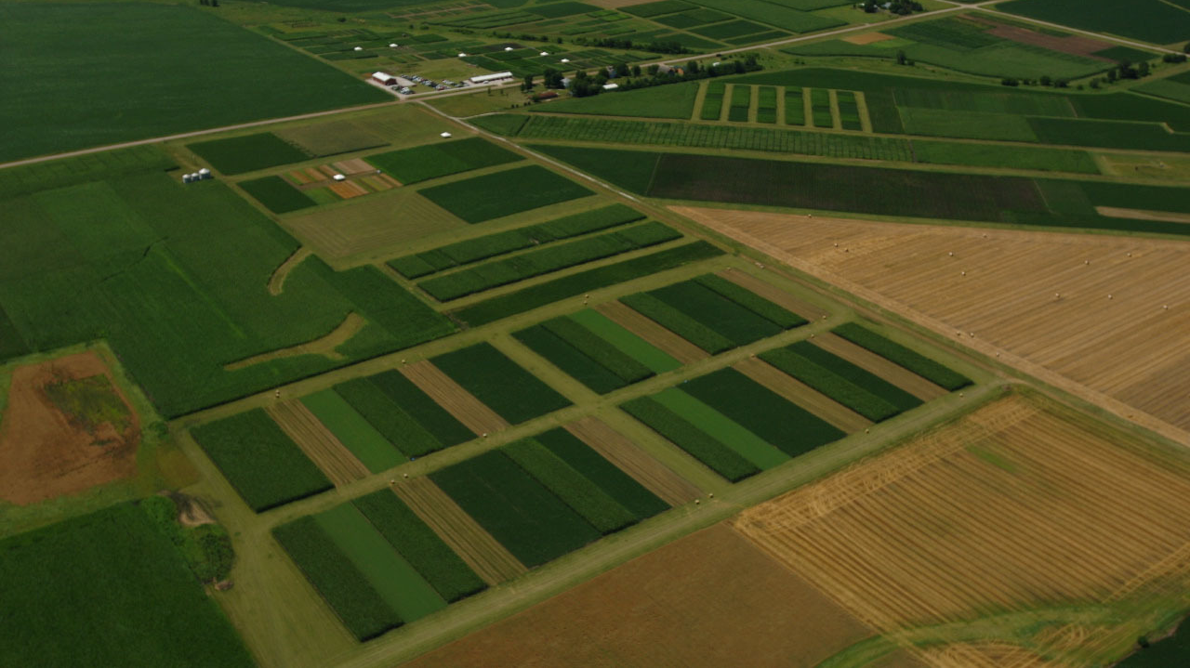
Weeds responses in simple versus diversified cropping systems
Huong Nguyen
March 25, 2022
Credit: Matt Liebman

Slide 2
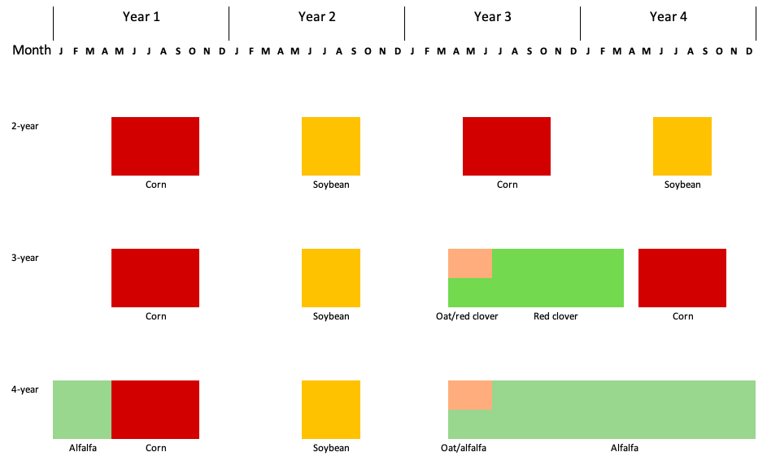


Rotation
Notes:
The design is RCBD,
No herbicide was applied in oat/red clover and alfalfa
Corn and soybean received 2 herbicide regimes up to 2016
From 2017, corn continued to receive 2 herbicide regimes, soybean 1
Arrows represent tillage timing and methods

Slide 3
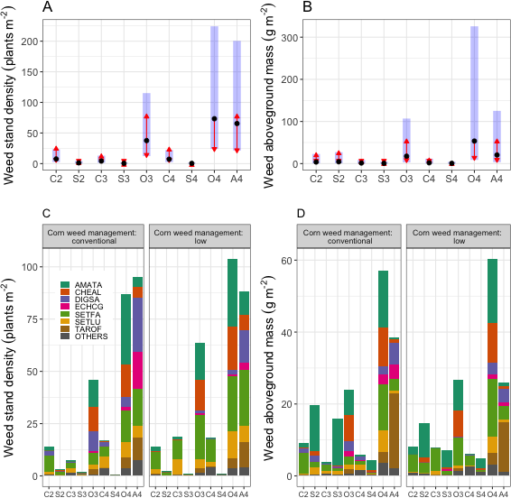
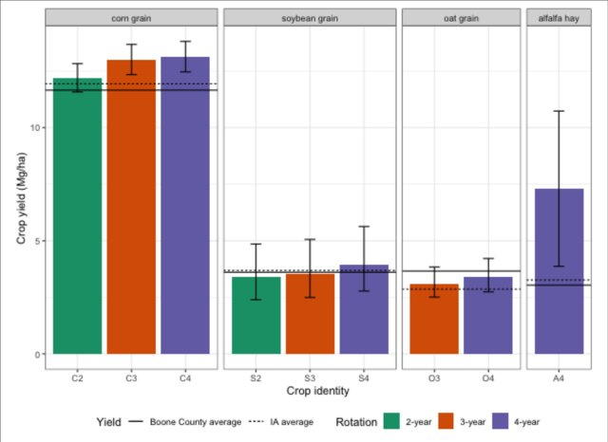
Weed aboveground community
Crop yields were comparable or higher than Iowa and Boone County averages.
Tolerating higher abundance of weeds can save a substantial amount of herbicide a.i.
Aggressive weed species’ abundance was lowered in the more diverse cropping systems.
Notes:
Question: How does cropping system diversification with cool-season crops change weed aboveground community?
Overall. 34 weed species were found, 20 dicots and 14 monocots
Higher weed abundance → higher diversity and richness indices and lower evenness index

Slide 4
Weed seedbank diversity as a potential sustainability indicator
Credit: Natalie Hunt
Performance indicator | 4-year rotation | 2-year rotation | F | p | Data source
Maize grain yield (dry), Mg ha⁻¹ yr⁻¹ | 10.6 (0.19) | 10.2 (0.19) | 6.14 | 0.04 | Hunt et al., (2019)
Soyabean seed yield (dry), Mg ha⁻¹ yr⁻¹ | 3.4 (0.08) | 2.8 (0.09) | 28.28 | 0.0007 | Hunt et al., (2019)
Energy content of all harvested products, GJ ha⁻¹ yr⁻¹ | 120 (4.5) | 120 (3.0) | 0.00 | 1.00 | Hunt et al., (2020)
Net returns to land and management, $ ha⁻¹ yr⁻¹ | 872 (60.3) | 833 (71.6) | 0.33 | 0.58 | Hunt et al., (2019)
Herbicide aquatic toxicity, CTUe ha⁻¹ yr⁻¹ | 2,363 (532) | 4,727 (1,064) | 18.49 | 0.003 | Hunt et al., (2017)
Soil sediment loss, Mg ha⁻¹ yr⁻¹ | 1.0 (0.16) | 2.6 (0.48) | 3.65 | 0.007 | Hunt et al., (2019)
Total N discharge in run-off, kg ha⁻¹ yr⁻¹ | 6.2 (0.89) | 10.0 (1.80) | 6.63 | 0.03 | Hunt et al., (2019)
Total P discharge in run-off, kg ha⁻¹ yr⁻¹ | 1.6 (0.23) | 2.3 (0.45) | 5.68 | 0.04 | Hunt et al., (2019)
Nitrate-N discharge in leachate, kg ha⁻¹ yr⁻¹ | 15.4 (4.51) | 19.8 (6.95) | 1.06 | 0.33 | Hunt et al., (2019)
Fossil energy use, GJ ha⁻¹ yr⁻¹ | 3.4 (0.14) | 9.5 (0.35) | 119.23 | <0.0001 | Hunt et al., (2020)
GHG emissions, kg CO₂e ha⁻¹ yr⁻¹ | 281 (15.2) | 783 (31.3) | 96.56 | <0.0001 | Hunt et al., (2020)
PM_{2.5}-related human health damage, $ ha⁻¹ yr⁻¹ | 298 (11.6) | 688 (22.4) | 62.65 | <0.0001 | Hunt et al., (2020)
Notes:
Question: How does seedbank diversity in different cropping systems align with established cropping system performance indicator?
This project went beyond weed management by looking at resource use efficiency
Comparison of weed seedbank diversity, crop yield, and environmental footprints in 2-year vs. 4-year rotation. The 2-year rotation consists of corn and soybean, and the 4-year rotation is an extension of the 2-year with three cool-season crops planted over 2 year:
Similar to the Weed aboveground community project, higher diversity and species richness but lower evenness were observed in the more diverse rotation; crop yield at the experiment site was higher than Iowa and Boone County’s averages.
Draw the audience’s attention to the red and green lines

Slide 5
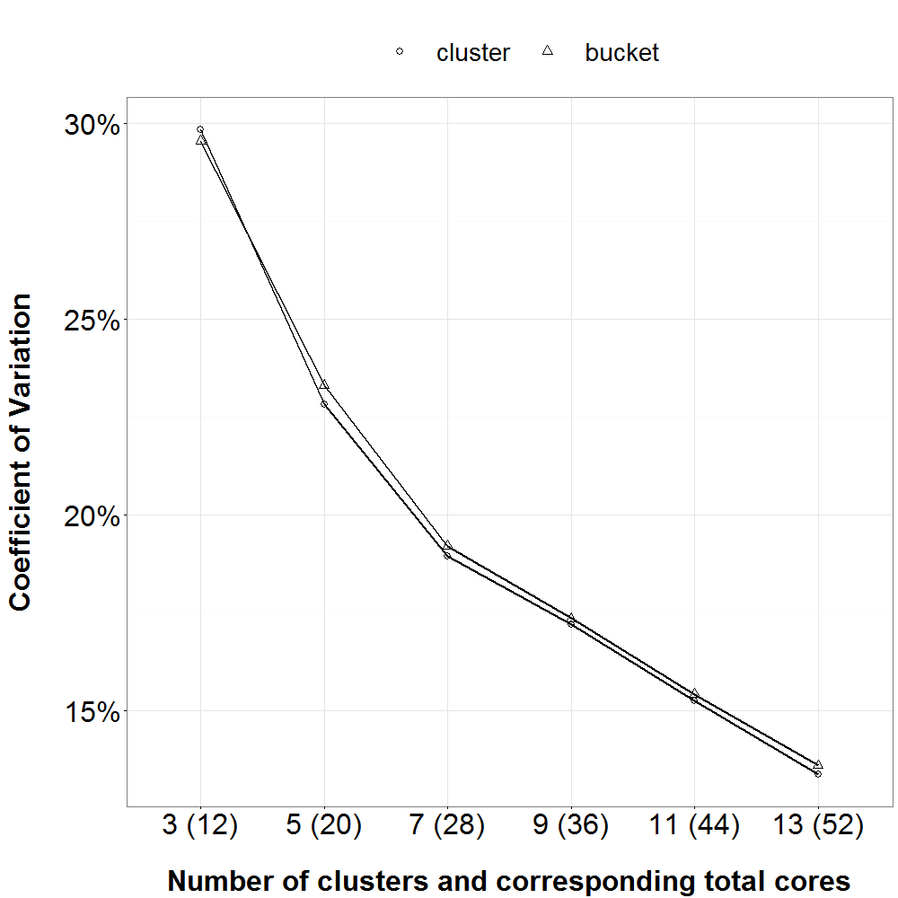
Soil sampling for seedbank density
X X X X | X X X X | X X X X
X X X X | X X X X | X X X X
X X X X | X X X X | X X X X
Notes:
Question: How much soil sample should be taken to parsimoniously estimate the soil seedbank?
Answer: 36 cores, 20 cm depth, distributed in a grid of 3x3 throughout each EU. Cores should be taken in cluters and can be combined into one data point.

Slide 6
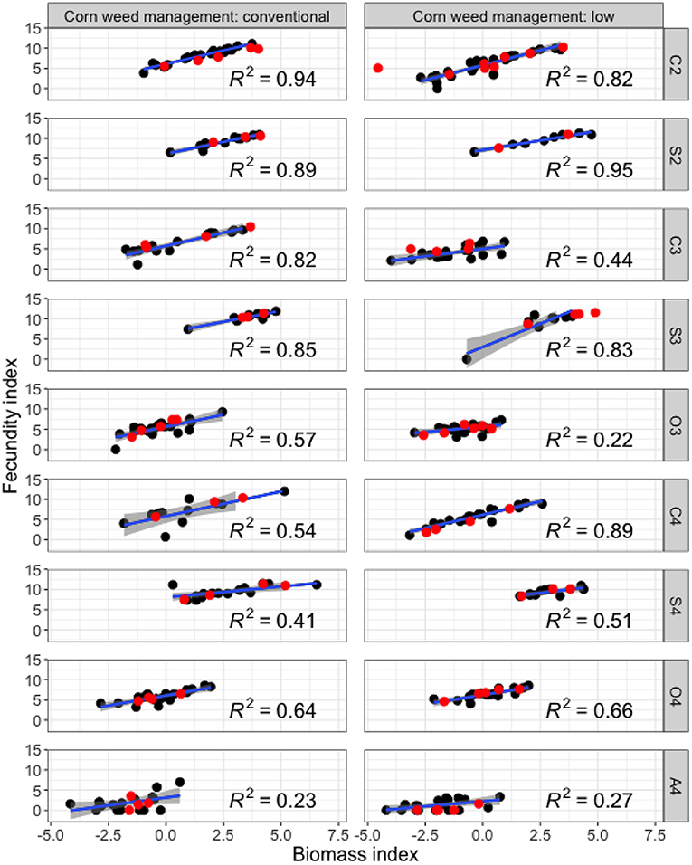
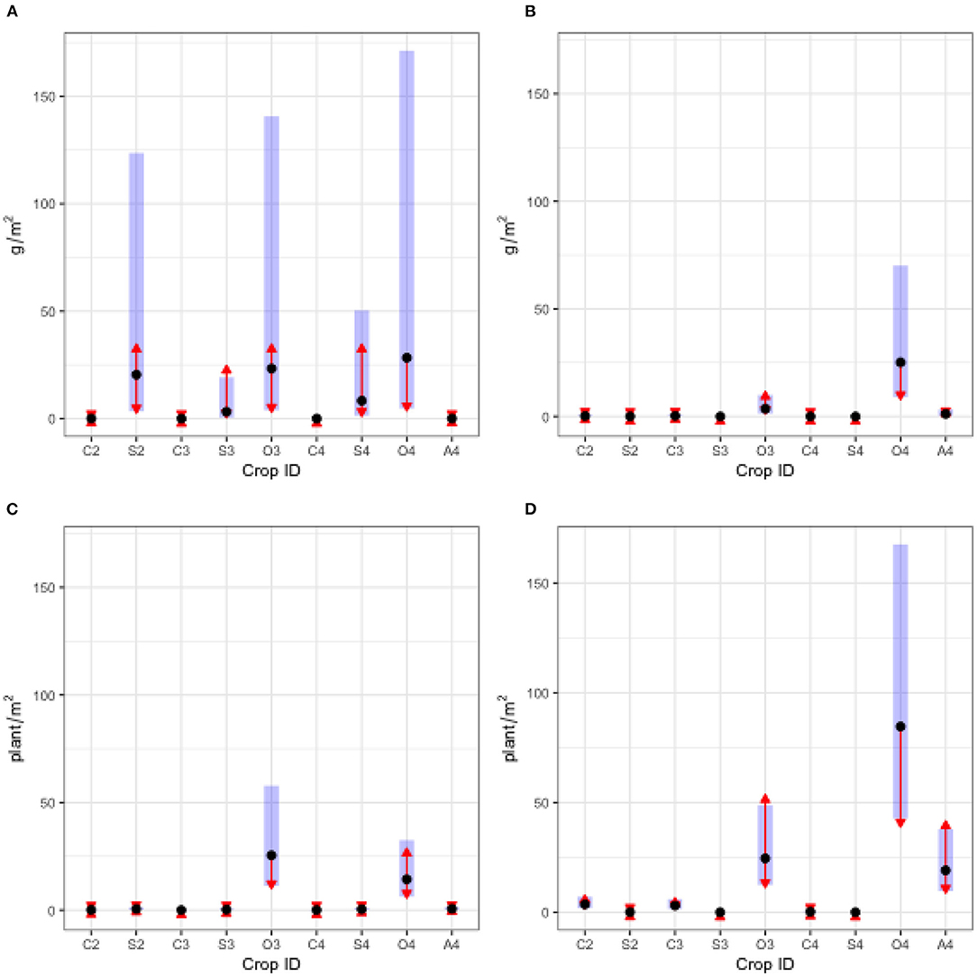
Waterhemp abundance and reproductive potential
Notes:
Questions:
1 – How does waterhemp abundance change in different cropping systems?
2 – How can aboveground mass be used to parsimoniously estimate fecundity?
Left: weed abundance, by density and aboveground mass, 2018 and 2019
Right: Reproductive potential: 2018 data
Fecundity index = ln(seed + 1)
Biomass index = ln(biomass + 0.005)

Slide 7
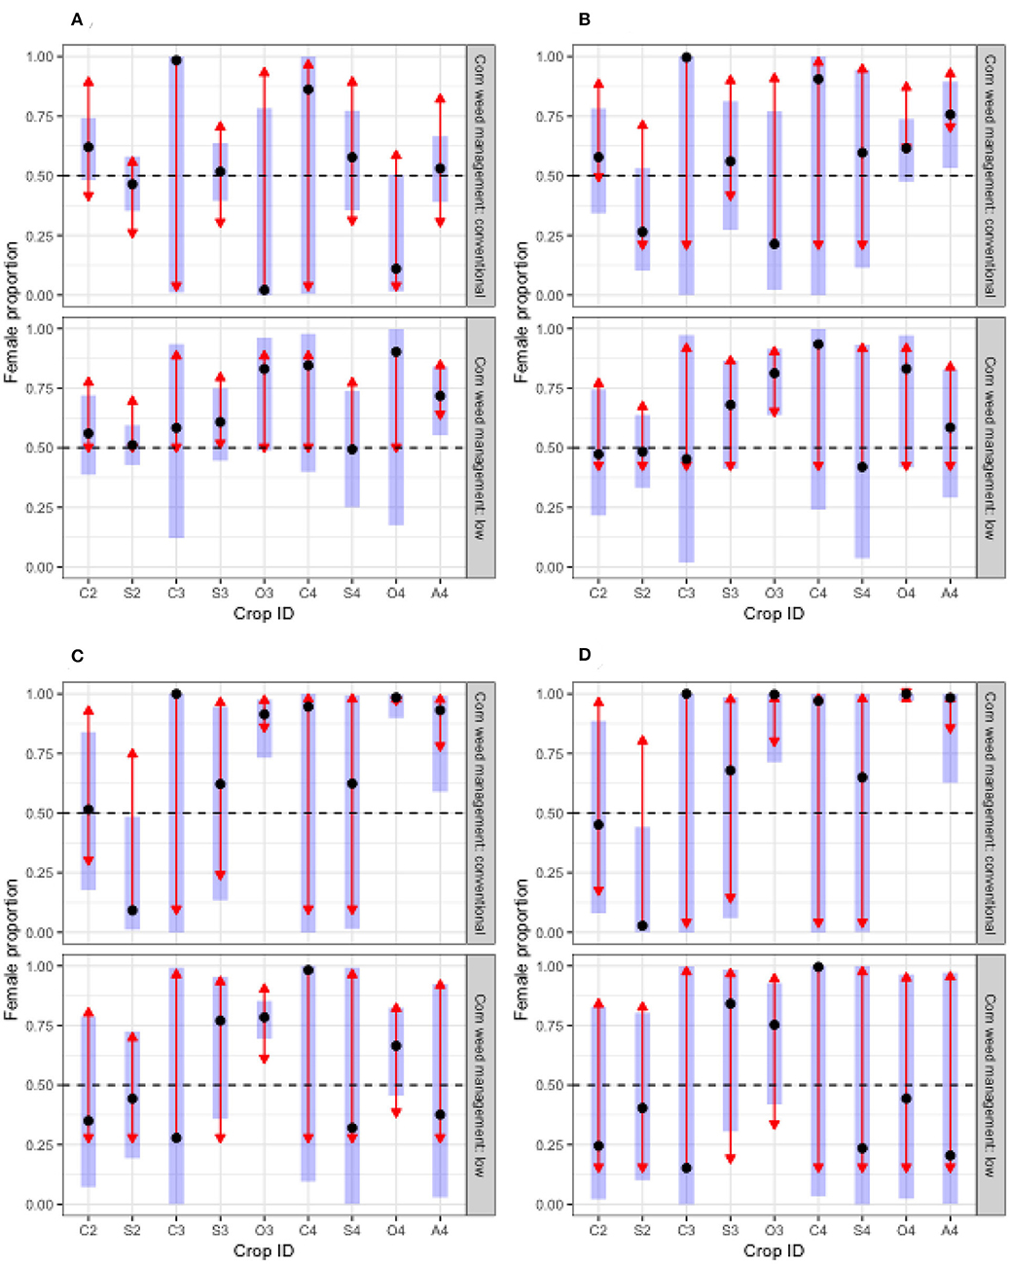
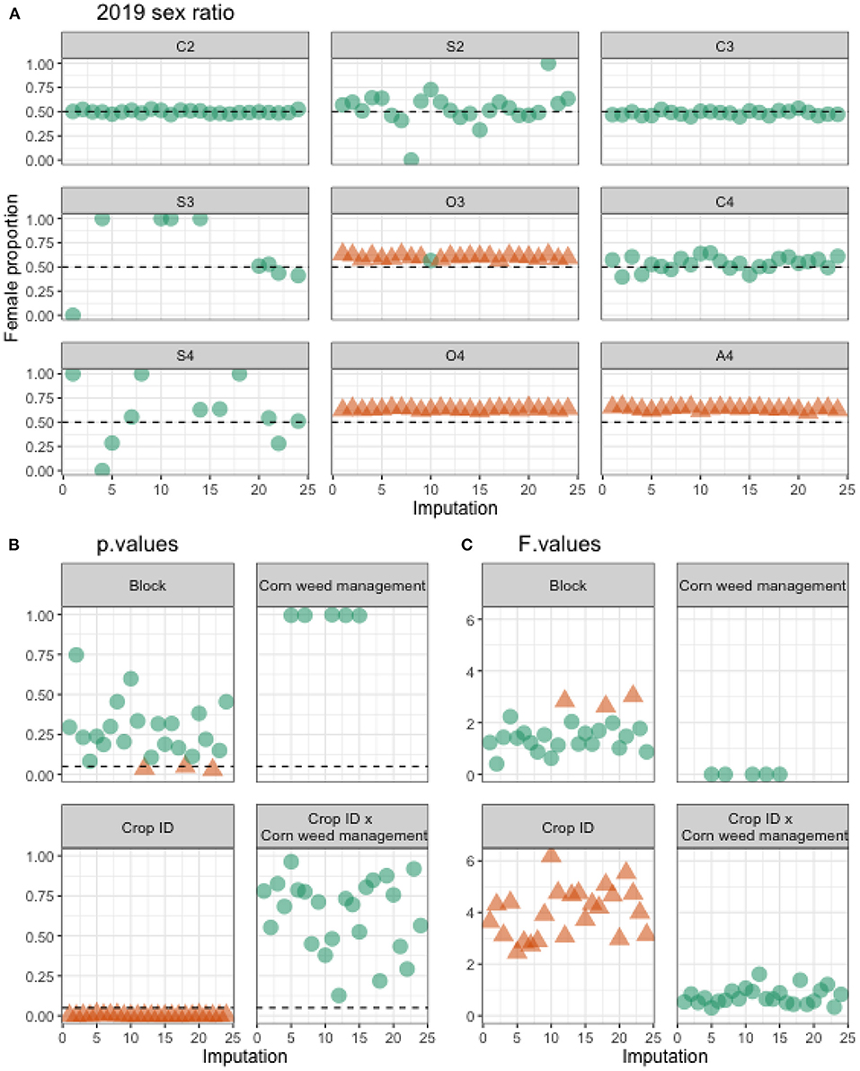
2018 sex ratio
Notes:
Question: Does population sex ratio changes between cropping systems?
Left: 2018 sex ratio with original data
Right: 2019 sex ratio with imputed data. 2019 herbicide efficacy was very high.

Slide 8
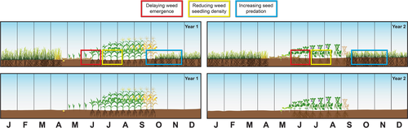
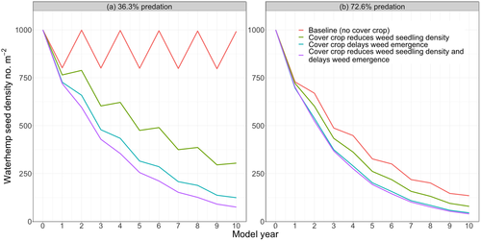
Contribution of rye cover crop in controlling waterhemp
Credit: Lana Koepke Johnson
Scenario | Required herbicide efficacy
 | 36.3% seed predation | 72.6% seed predation
No-cover crop | ≥99.955% | ≥99.896%
Cover crop reduces seedling density | ≥99.929% | ≥99.834%
Cover crop delays seedling emergence | ≥99.891% | ≥99.745%
Cover crop reduces seedling density and delays seedling emergence | ≥99.826% | ≥99.595%
Notes:
Question: How does rye cover crop contribute to waterhemp control?
A STELLA model examined 4 scenarios with a baseline cropping system of corn and soybean.
Parameters were taken from the literature
Conditions: no tillage, add-allow (waterhemp plants are allowed to deposit seeds to the soil surface at the end of amodel year)
Answer: above 99% herbicide efficacy is needed to keep waterhemp soil seedbank in check in all scenarios. At 72.6% seed predation, seedbank can decline rather quickly within the first 3 model years, and would be 86% lowered by the end of the 10th model year.

Slide 9
Waterhemp population dynamics in simple versus diverse cropping systems
Questions:
How do waterhemp populations grow in different cropping systems?
Where should attention be focused to deplete the soil seedbank?
Approach: periodic matrix model
Empirical data: soil seedbank density, emergence density and timing, and reproductive potential
Literature data: tillage-induced vertical redistribution (Seed Chaser), seed mortality, and seedling mortality
Notes:
An ongoing project that use structured population parameters: 2 soil depths and 6 plant cohorts.
Current observation: population growth is the most sensitive to the seedbank density and the success rate of cohort 1 establishment.

Slide 10
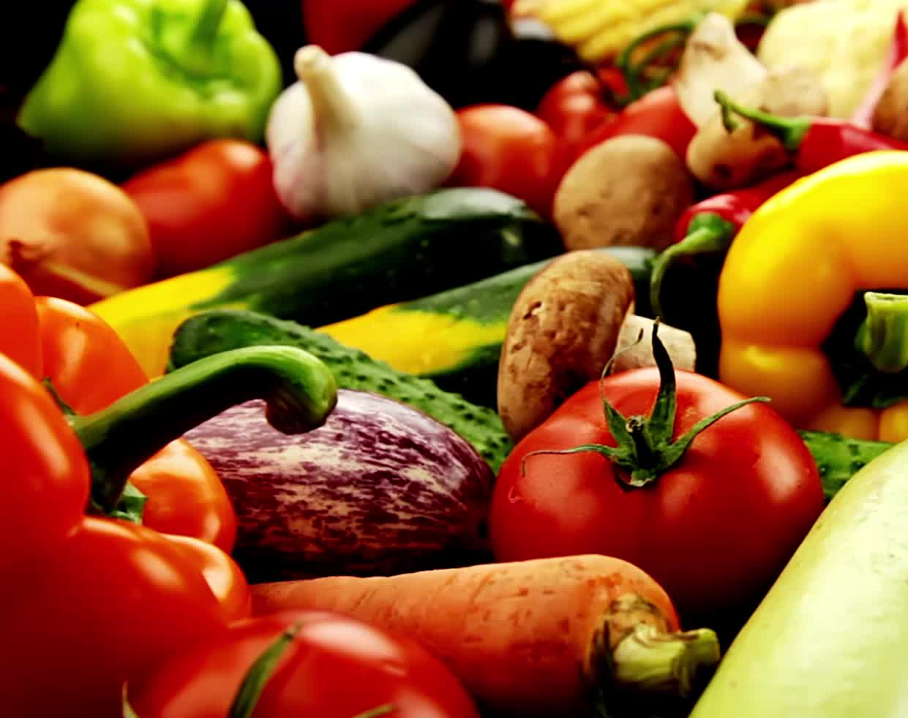
Career objectives
To redesign food production systems that are regenerative and resilient
To lessen the labor intensity of food production on agricultural workers
To make organic food more accessible and just
Notes:
A balanced approach between technical recommendation and understanding of socio-psychological drivers of sustainable agriculture adoption

