Slide 1
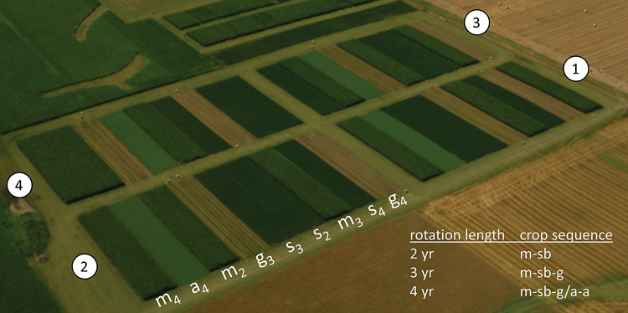
Weed community composition and waterhemp population dynamics in simple and more diverse cropping systems suitable for the Midwestern USA
Huong Nguyen
August 3rd, 2022
Photo: Matt Liebman

Slide 2
Acknowledgments
POS committee
The Liebman research group, ISU Agronomy Research Farm, and Seed Science Lab
The graduate program in Sustainable Agriculture, the Department of Agronomy, and the Department of Statistics Consulting
Henry A. Wallace Chair for Sustainable Agriculture, Robert A. Sloan, and Gary and Ann Holck scholarships for Sustainable Agriculture
Friends and family

Slide 3
Dissertation organization
Weed community composition in simple and more diverse cropping systems
Impact of cropping system diversification on vegetative and reproductive characteristics of waterhemp
Effects of crop rotation on common waterhemp population dynamics: prospective and retrospective analyses

Slide 4
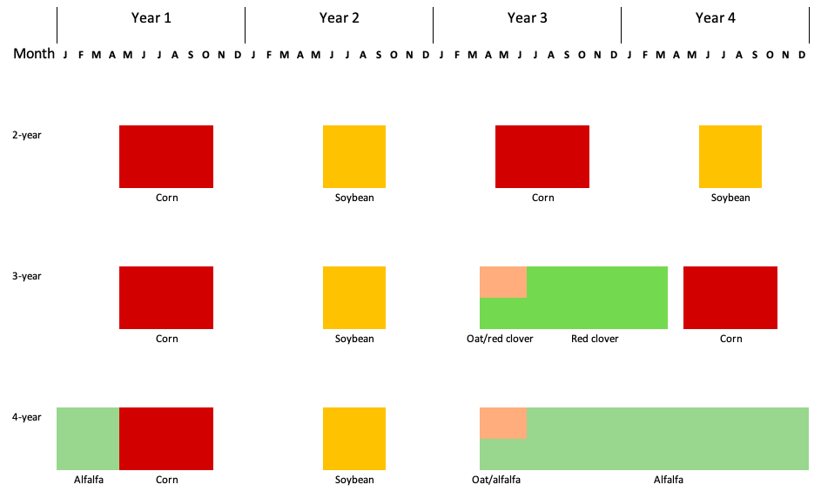


Rotation
Notes:
The design is RCBD,
No herbicide was applied in oat/red clover and alfalfa
Corn and soybean received 2 herbicide regimes up to 2016
From 2017, corn continued to receive 2 herbicide regimes, soybean 1
Arrows represent tillage timing and methods

Slide 5
Weed community composition in simple and more diverse cropping systems
How did rotation system and corn weed management affect crop yields?
How did rotation system, crop species, and corn weed management affect community ecological indices?
How did rotation, crop species, and corn weed management affect weed community density and growth?
How did rotation, crop species, and corn weed management affect individual weed species abundance?
@FrontAgro
https://doi.org/10.3389/fagro.2022.848548
Notes:
Crop yields were used to evaluate the effectiveness of contrasting weed management programs: no difference in yields suggests no difference in effectiveness

Slide 6
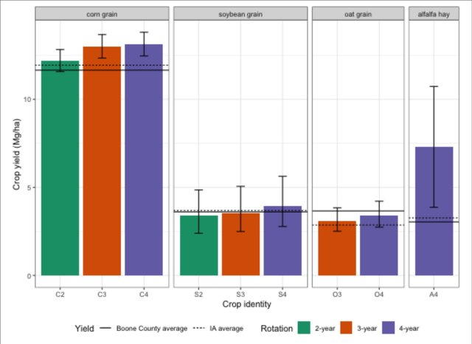
Tolerating a higher abundance of weeds can save a substantial amount of herbicide a.i.
Notes:
Question: How does cropping system diversification with cool-season crops change weed aboveground community?
Overall. 34 weed species were found, 20 dicots and 14 monocots
Higher weed abundance → higher diversity and richness indices and lower evenness index

Slide 7
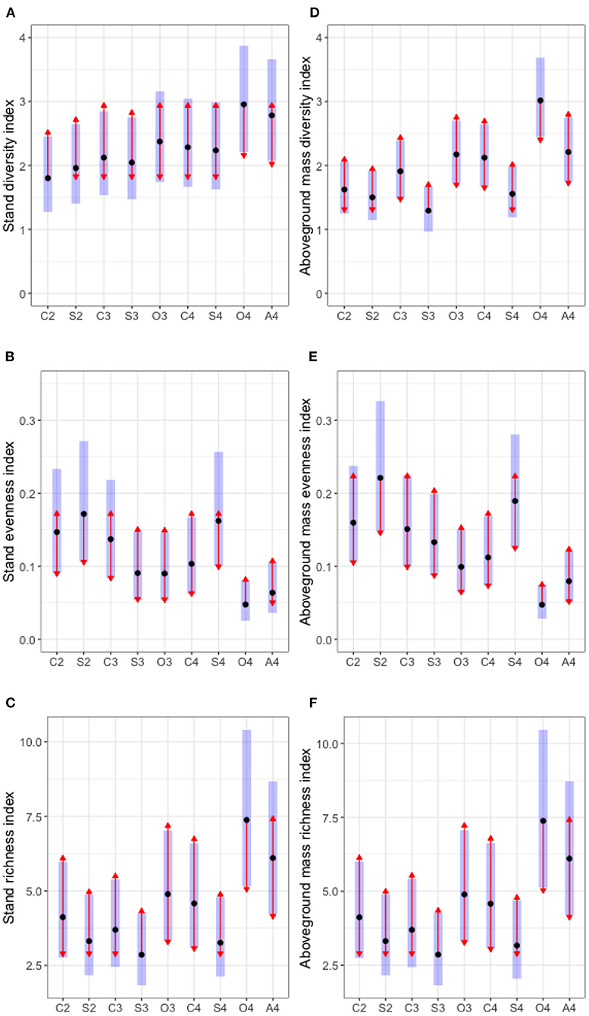
The diversity and richness indices are higher in the cool-season crops. The evenness index was lower in the cool-season crops.

Slide 8
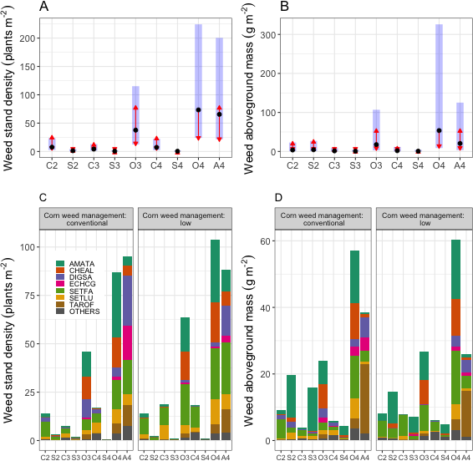
Aggressive weed species’ abundance was lower in the more diverse cropping systems.
Notes:
Question: How does cropping system diversification with cool-season crops change weed aboveground community?
Overall. 34 weed species were found, 20 dicots and 14 monocots
Higher weed abundance → higher diversity and richness indices and lower evenness index

Slide 9
Impact of cropping system diversification on vegetative and reproductive characteristics of waterhemp
The population aboveground mass, density, and sex ratio,
The relationship between waterhemp's female size and fecundity
@FrontAgro https://doi.org/10.3389/fagro.2022.811359
Notes:
Context: when the weed grew in association with five crop species (corn, soybean, oat, red clover, and alfalfa) arranged in three rain-fed cropping systems

Slide 10
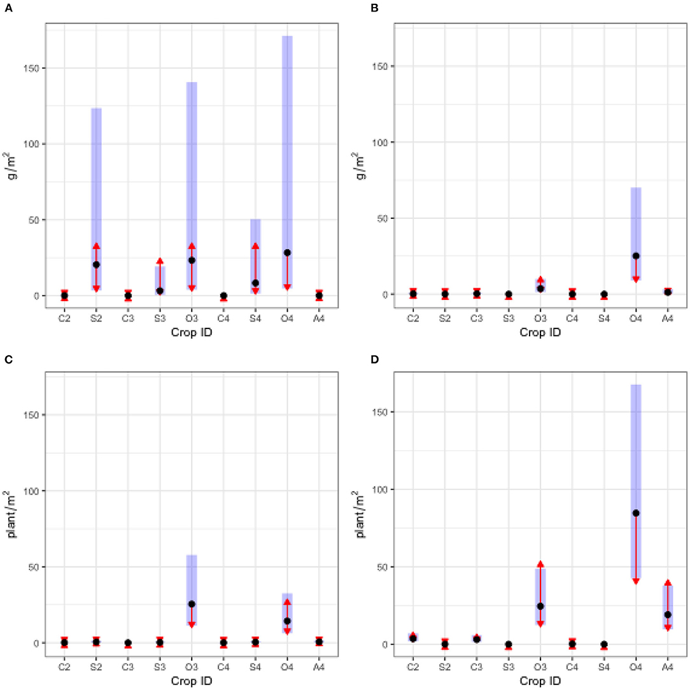
Waterhemp abundance and reproductive potential
2018
2019
2018
2019
Notes:
Questions:
1 – How does waterhemp abundance change in different cropping systems?
2 – How can aboveground mass be used to parsimoniously estimate fecundity?
Left: weed abundance, by density and aboveground mass, 2018 and 2019
Right: Reproductive potential: 2018 data
Fecundity index = ln(seed + 1)
Biomass index = ln(biomass + 0.005)

Slide 11
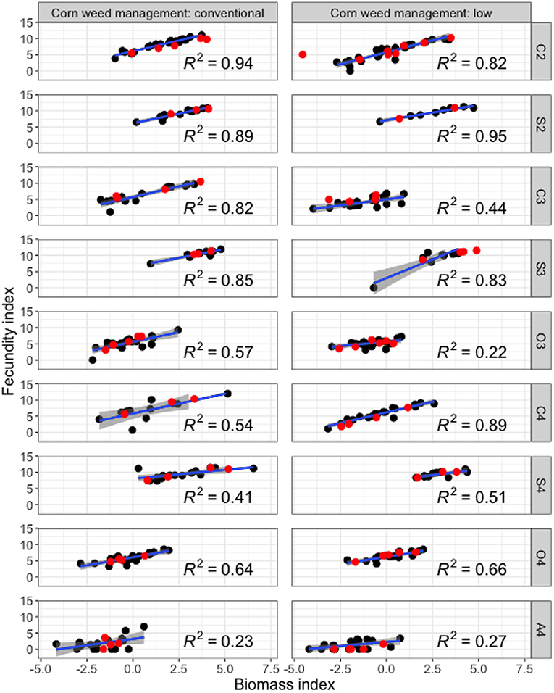
Estimations of plant fecundity from aboveground mass requires crop identity and corn weed management regime context
Notes:
Questions:
1 – How does waterhemp abundance change in different cropping systems?
2 – How can aboveground mass be used to parsimoniously estimate fecundity?
Left: weed abundance, by density and aboveground mass, 2018 and 2019
Right: Reproductive potential: 2018 data
Fecundity index = ln(seed + 1)
Biomass index = ln(biomass + 0.005)

Slide 12
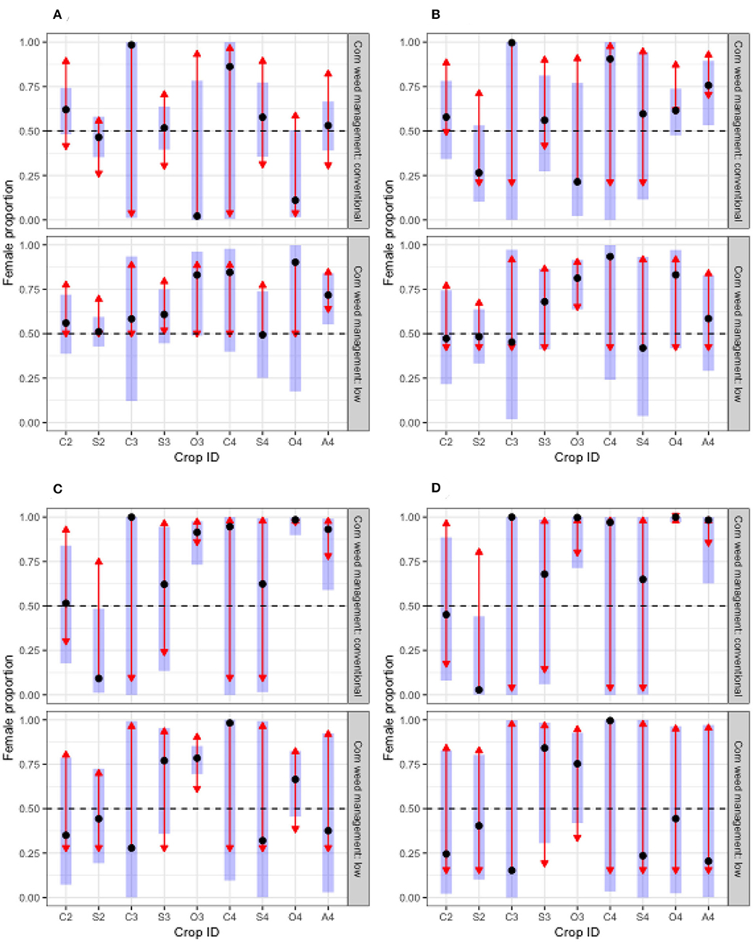
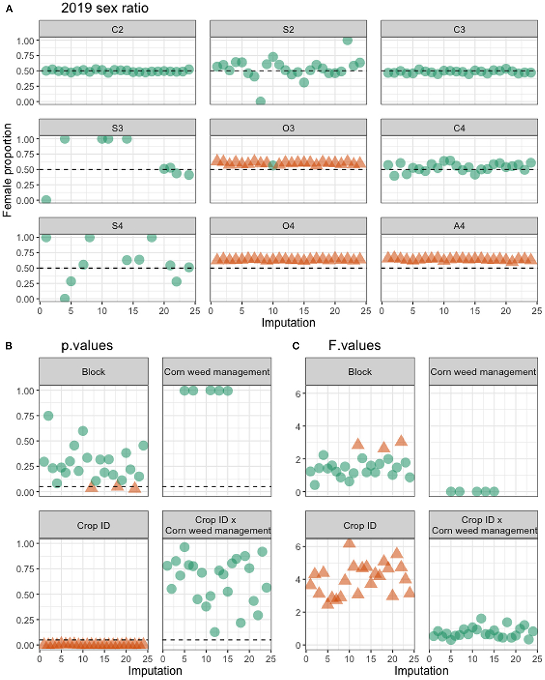
Female-biased populations might occur in oat, red clover, and alfalfa
2018 sex ratio
Notes:
Question: Does population sex ratio changes between cropping systems?
Answer: Maybe in O3
Left: 2018 sex ratio with original data
Right: 2019 sex ratio with imputed data. 2019 herbicide efficacy was very high.

Slide 13
Waterhemp population dynamics in simple versus diverse cropping systems
Questions:
How do waterhemp populations grow in different cropping systems?
What are the seed production thresholds in different cropping systems?
Approach: a periodic matrix model followed by simulations
Empirical data: soil seedbank density, emergence density and timing, and reproductive potential
Literature data: tillage-induced vertical redistribution (Seed Chaser), seed mortality, and seedling mortality
Notes:
An ongoing project that use structured population parameters: 2 soil depths and 6 plant cohorts.
Current observation: population growth is the most sensitive to the seedbank density and the success rate of cohort 1 establishment.

Slide 14
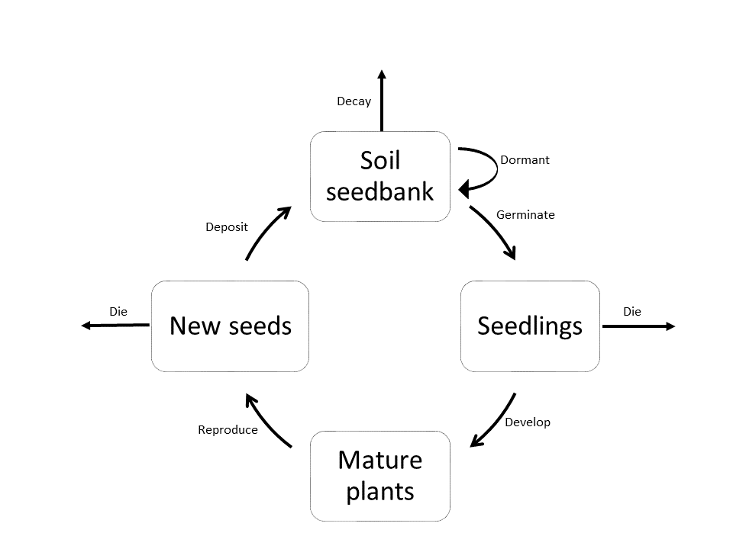
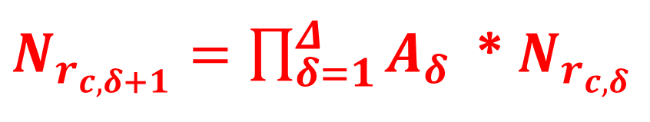

Population dynamics diagram
6 sub-annual matrices
Pre-planting tillage
Seedling recruitment/seedbank depletion
Seed and seedling survival during the crop season
Seed production
Post-harvest tillage
Overwinter seed survival
$$\left[\begin{matrix}M_{s} & M_{p,s } \\ M_{s,p} & M_{p}\end{matrix}\right]$$
$N_{r_{c,δ+1}}=\prod_{δ=1}^{Δ}{A_{δ}}$ * $N_{r_{c,δ}}$

Slide 15


Population growth rate ($λ$)
How the population change from one time step to the next
$λ$ > 1: population increasing
$λ$ < 1: population decreasing

Slide 16
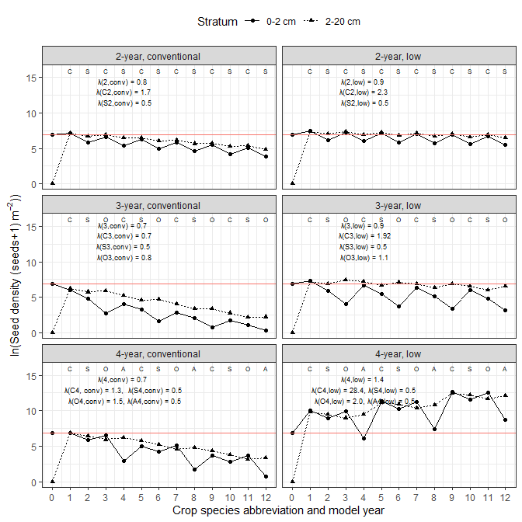
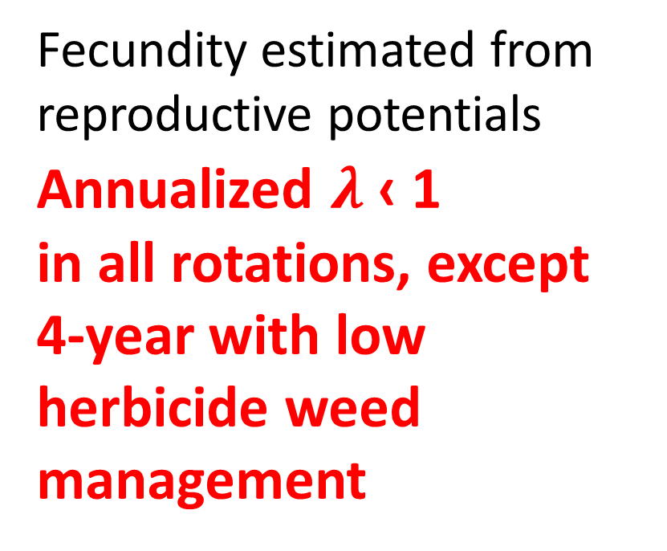
Scenario 1: high control efficacy → low fecundity
Fecundity estimated from reproductive potentials
Annualized $λ$ ‹ 1
in all rotations, except
4-year with low herbicide weed management
Notes:
12 model years

Slide 17
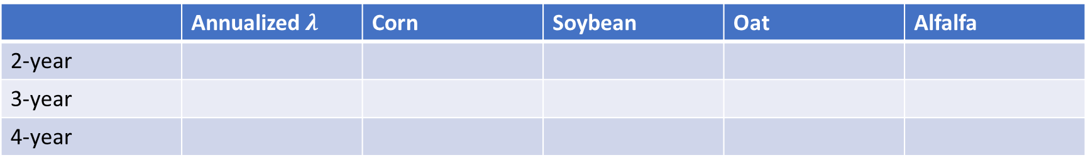
 | Annualized $λ$ | Corn | Soybean | Oat | Alfalfa
2-year
3-year
4-year

Slide 18
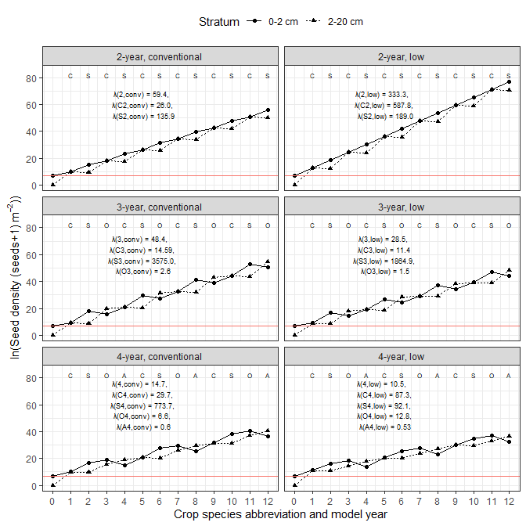
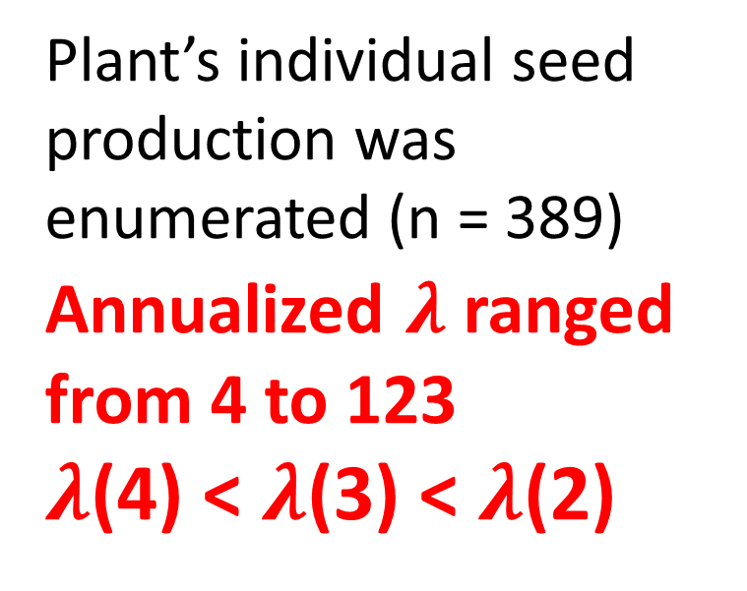
Scenario 2: low control efficacy → high fecundity
Plant’s individual seed production was enumerated (n = 389)
Annualized $λ$ ranged from 4 to 123
$λ$(4) < $λ$(3) < $λ$(2)
Notes:
12 model years

Slide 19
 | Annualized $λ$ | Corn | Soybean | Oat | Alfalfa
2-year
3-year
4-year

Slide 20
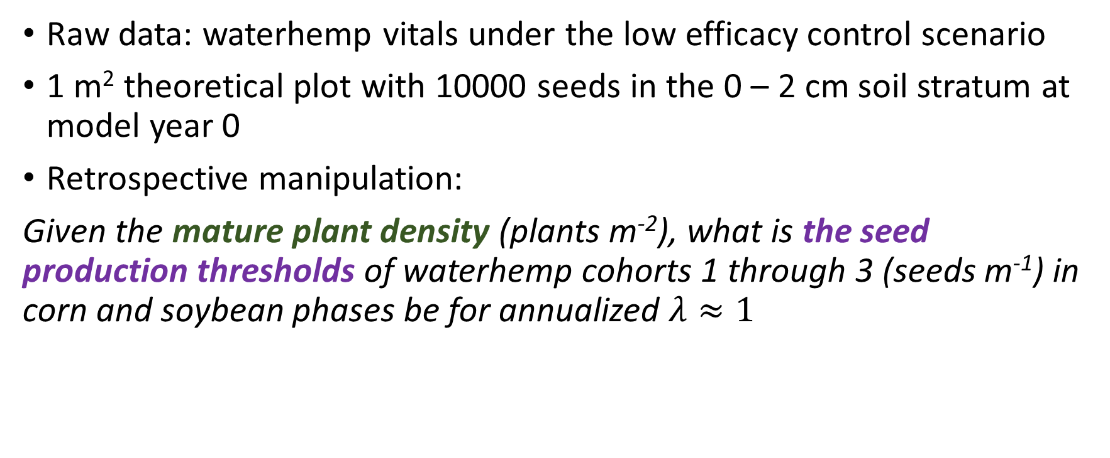
Seed production threshold simulation
Raw data: waterhemp vitals under the low efficacy control scenario
1 m² theoretical plot with 10000 seeds in the 0 – 2 cm soil stratum at model year 0
Retrospective manipulation:
Given the mature plant density (plants m⁻²), what is the seed production thresholds of waterhemp cohorts 1 through 3 (seeds m⁻¹) in corn and soybean phases be for annualized $λ≈1$

Slide 21
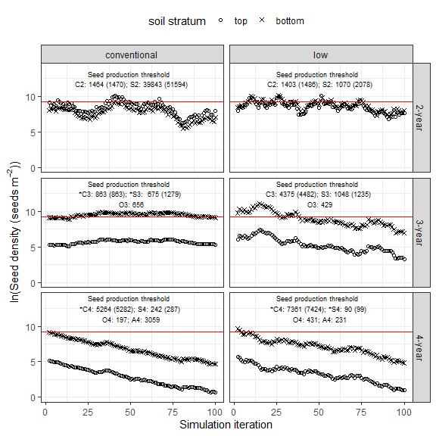
Seed production thresholds
Corn: 4-year > 3-year > 2-year
Soybean: 2-year > 3-year > 4-year
Oat: 3-year > 4-year
Notes:
Emergence success rates: PRE < cool-season crop < POST

Slide 22
 | Corn | Soybean | Oat | Alfalfa
Cohort 1
Cohort 2
Cohort 3
Cohort 4
Cohort 5
Cohort 6

Slide 23
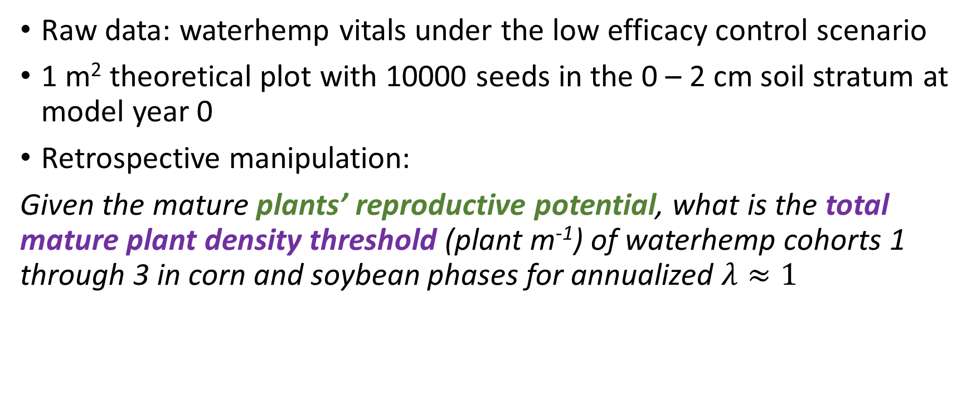
Mature plant density threshold simulation
Raw data: waterhemp vitals under the low efficacy control scenario
1 m² theoretical plot with 10000 seeds in the 0 – 2 cm soil stratum at model year 0
Retrospective manipulation:
Given the mature plants’ reproductive potential, what is the total mature plant density threshold (plant m⁻¹) of waterhemp cohorts 1 through 3 in corn and soybean phases for annualized $λ≈1$

Slide 24
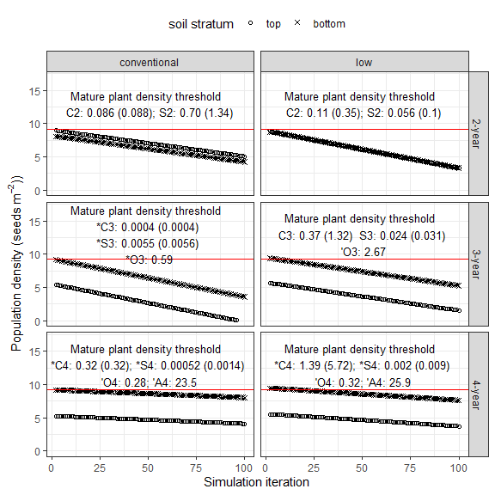
Mature plant density thresholds
Corn: 4-year > 2-year > 3-year
Soybean: 2-year > 4-year > 3-year
Oat: 3-year > 4-year

Slide 25
 | Corn | Soybean | Oat | Alfalfa
Cohort 1
Cohort 2
Cohort 3
Cohort 4
Cohort 5
Cohort 6

Slide 26
General conclusions
Crop identity was the most influential factor in the individual, population, and community dynamics
No yield decline was found in any crop in coincidence with higher weed community abundance
More diverse and species-rich weed communities were found in more diverse cropping systems
Lower evenness index of weed community was recorded in the more diverse cropping systems, but more of the rarer weed species were found and the relative abundance of competitive weed species was more even

Slide 27
General conclusions (continued)
Waterhemp's reproductive potential was reduced in the cool-season crops, and thus, its population growth rates were reduced.
Extending the 2-year rotation of warm-season crops with two years of cool-season crops could be effective in stabilizing waterhemp soil seedbank

Slide 28
Shortcomings and future research
Unclear relationship between individual plant size effects on weed community evenness
Unrealistic success rate from seedling to mature plant -> more focused field experiment for oat, red clover, and alfalfa crop environments
Establish waterhemp seedling control plans to eliminate highly productive mature plants from the seed production and plant density thresholds

