Slide 1
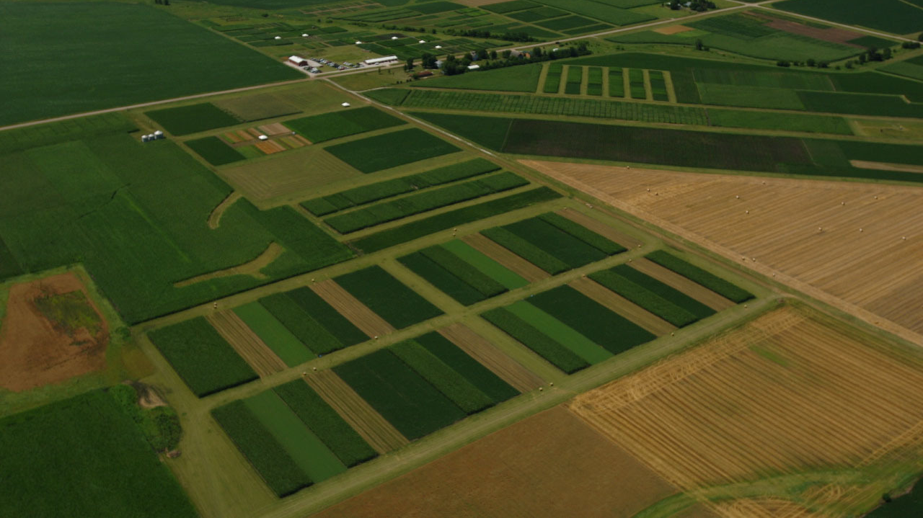
Credit: Matt Liebman
Notes:
The design is RCBD, with 4 replications

Slide 2
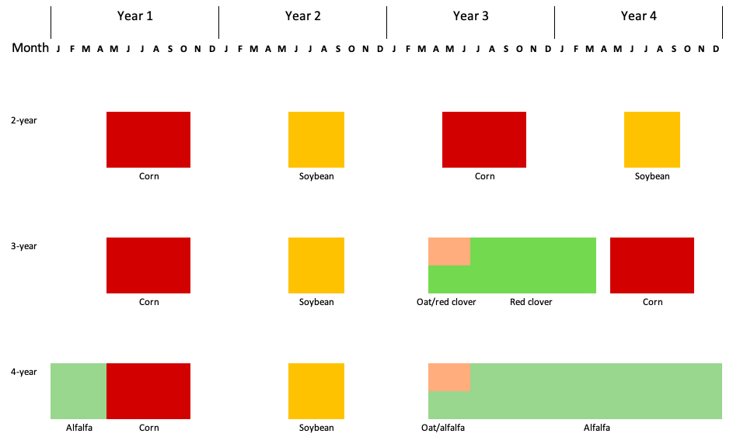


Rotation
Notes:
No herbicide was applied in oat/red clover and alfalfa
Corn and soybean received 2 herbicide regimes up to 2016
From 2017, corn continued to receive 2 herbicide regimes, soybean 1
Arrows represent tillage timing and methods

Slide 3
Waterhemp population dynamics in simple versus diverse cropping systems
Questions:
How do waterhemp populations grow in different cropping systems?
Where should attention be focused to deplete the soil seedbank?
Approach: periodic matrix model, matrices are listed by chronological order from slides 4 to 9.
Empirical data: soil seedbank density, emergence density and timing, and reproductive potential
Literature data: tillage-induced vertical redistribution (Seed Chaser), seed mortality, and seedling mortality

Slide 4
Spring tillage
 | Seed top | Seed bottom | Plant cohort 1 | Plant cohort 2 | Plant cohort 3 | Plant cohort 4 | Plant cohort 5 | Plant cohort 6
Seed top | st_11 | st_21 | 0 | 0 | 0 | 0 | 0 | 0
Seed bottom | st_12 | st_22 | 0 | 0 | 0 | 0 | 0 | 0
Plant cohort 1 | 0 | 0 | 0 | 0 | 0 | 0 | 0 | 0
Plant cohort 2 | 0 | 0 | 0 | 0 | 0 | 0 | 0 | 0
Plant cohort 3 | 0 | 0 | 0 | 0 | 0 | 0 | 0 | 0
Plant cohort 4 | 0 | 0 | 0 | 0 | 0 | 0 | 0 | 0
Plant cohort 5 | 0 | 0 | 0 | 0 | 0 | 0 | 0 | 0
Plant cohort 6 | 0 | 0 | 0 | 0 | 0 | 0 | 0 | 0
st_11: probability that a seed at the top stratum stay at the top stratum
st_22: probability that a seed at the bottom stratum stay at the bottom stratum
st_12: probability that a seed at the top stratum move to the bottom stratum
st_21: probability that a seed at the bottom stratum move to the top stratum

Slide 5
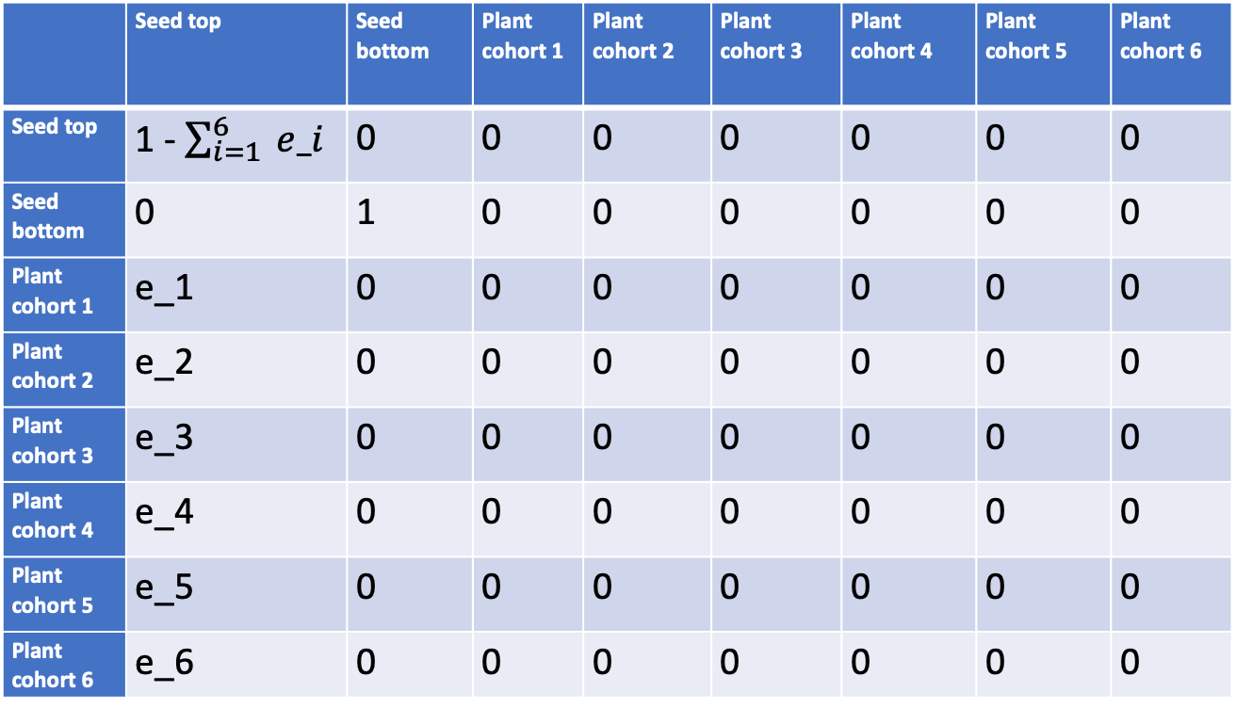
Recruitment
 | Seed top | Seed bottom | Plant cohort 1 | Plant cohort 2 | Plant cohort 3 | Plant cohort 4 | Plant cohort 5 | Plant cohort 6
Seed top | 1 - $\sum_{i=1}^{6}{ e_i}$ | 0 | 0 | 0 | 0 | 0 | 0 | 0
Seed bottom | 0 | 1 | 0 | 0 | 0 | 0 | 0 | 0
Plant cohort 1 | e_1 | 0 | 0 | 0 | 0 | 0 | 0 | 0
Plant cohort 2 | e_2 | 0 | 0 | 0 | 0 | 0 | 0 | 0
Plant cohort 3 | e_3 | 0 | 0 | 0 | 0 | 0 | 0 | 0
Plant cohort 4 | e_4 | 0 | 0 | 0 | 0 | 0 | 0 | 0
Plant cohort 5 | e_5 | 0 | 0 | 0 | 0 | 0 | 0 | 0
Plant cohort 6 | e_6 | 0 | 0 | 0 | 0 | 0 | 0 | 0
e_i: proportion of the top stratum seeds that emerge at cohort i, i = {1,…, 6}

Slide 6
In-season survival
 | Seed top | Seed bottom | Plant cohort 1 | Plant cohort 2 | Plant cohort 3 | Plant cohort 4 | Plant cohort 5 | Plant cohort 6
Seed top | ss_11 | 0 | 0 | 0 | 0 | 0 | 0 | 0
Seed bottom | 0 | ss_22 | 0 | 0 | 0 | 0 | 0 | 0
Plant cohort 1 | 0 | 0 | l_1 | 0 | 0 | 0 | 0 | 0
Plant cohort 2 | 0 | 0 | 0 | l_2 | 0 | 0 | 0 | 0
Plant cohort 3 | 0 | 0 | 0 | 0 | l_3 | 0 | 0 | 0
Plant cohort 4 | 0 | 0 | 0 | 0 | 0 | l_4 | 0 | 0
Plant cohort 5 | 0 | 0 | 0 | 0 | 0 | 0 | l_5 | 0
Plant cohort 6 | 0 | 0 | 0 | 0 | 0 | 0 | 0 | l_6
ss_11: probability that a seed at the top stratum survives during the crop season
ss_22: probability that a seed at the bottom stratum survives during the crop season
l_i: probability that the cohort i seedling survive to maturity during the crop season

Slide 7
Fecundity
 | Seed stratum 1 | Seed stratum 2 | Plant cohort 1 | Plant cohort 2 | Plant cohort 3 | Plant cohort 4 | Plant cohort 5 | Plant cohort 6
Seed stratum 1 | 1 | 0 | f_1 | f_2 | f_3 | f_4 | f_5 | f_6
Seed stratum 2 | 0 | 1 | 0 | 0 | 0 | 0 | 0 | 0
Plant cohort 1 | 0 | 0 | 0 | 0 | 0 | 0 | 0 | 0
Plant cohort 2 | 0 | 0 | 0 | 0 | 0 | 0 | 0 | 0
Plant cohort 3 | 0 | 0 | 0 | 0 | 0 | 0 | 0 | 0
Plant cohort 4 | 0 | 0 | 0 | 0 | 0 | 0 | 0 | 0
Plant cohort 5 | 0 | 0 | 0 | 0 | 0 | 0 | 0 | 0
Plant cohort 6 | 0 | 0 | 0 | 0 | 0 | 0 | 0 | 0
f_i: The number of seed that a plant of cohort i make

Slide 8
Post-harvest tillage
 | Seed stratum 1 | Seed stratum 2 | Plant cohort 1 | Plant cohort 2 | Plant cohort 3 | Plant cohort 4 | Plant cohort 5 | Plant cohort 6
Seed stratum 1 | pt_11 | pt_21 | 0 | 0 | 0 | 0 | 0 | 0
Seed stratum 2 | pt_12 | pt_22 | 0 | 0 | 0 | 0 | 0 | 0
Plant cohort 1 | 0 | 0 | 0 | 0 | 0 | 0 | 0 | 0
Plant cohort 2 | 0 | 0 | 0 | 0 | 0 | 0 | 0 | 0
Plant cohort 3 | 0 | 0 | 0 | 0 | 0 | 0 | 0 | 0
Plant cohort 4 | 0 | 0 | 0 | 0 | 0 | 0 | 0 | 0
Plant cohort 5 | 0 | 0 | 0 | 0 | 0 | 0 | 0 | 0
Plant cohort 6 | 0 | 0 | 0 | 0 | 0 | 0 | 0 | 0
pt_11: probability that a seed at the top stratum stay at the top stratum
pt_22: probability that a seed at the bottom stratum stay at the bottom stratum
pt_12: probability that a seed at the top stratum move to the bottom stratum
pt_21: probability that a seed at the bottom stratum move to the top stratum

Slide 9
Overwinter survival
 | Seed stratum 1 | Seed stratum 2 | Plant cohort 1 | Plant cohort 2 | Plant cohort 3 | Plant cohort 4 | Plant cohort 5 | Plant cohort 6
Seed stratum 1 | o_11 | 0 | 0 | 0 | 0 | 0 | 0 | 0
Seed stratum 2 | 0 | o_22 | 0 | 0 | 0 | 0 | 0 | 0
Plant cohort 1 | 0 | 0 | 0 | 0 | 0 | 0 | 0 | 0
Plant cohort 2 | 0 | 0 | 0 | 0 | 0 | 0 | 0 | 0
Plant cohort 3 | 0 | 0 | 0 | 0 | 0 | 0 | 0 | 0
Plant cohort 4 | 0 | 0 | 0 | 0 | 0 | 0 | 0 | 0
Plant cohort 5 | 0 | 0 | 0 | 0 | 0 | 0 | 0 | 0
Plant cohort 6 | 0 | 0 | 0 | 0 | 0 | 0 | 0 | 0
o_11: probability that a seed at the top stratum survive after winter
o_22: probability that a seed at the bottom stratum survive after winter

