Slide 1
lsmod
Hongyeob Kim, Yejin Lee, Kevin

Slide 2
01
Introduction to lsmod

Slide 3
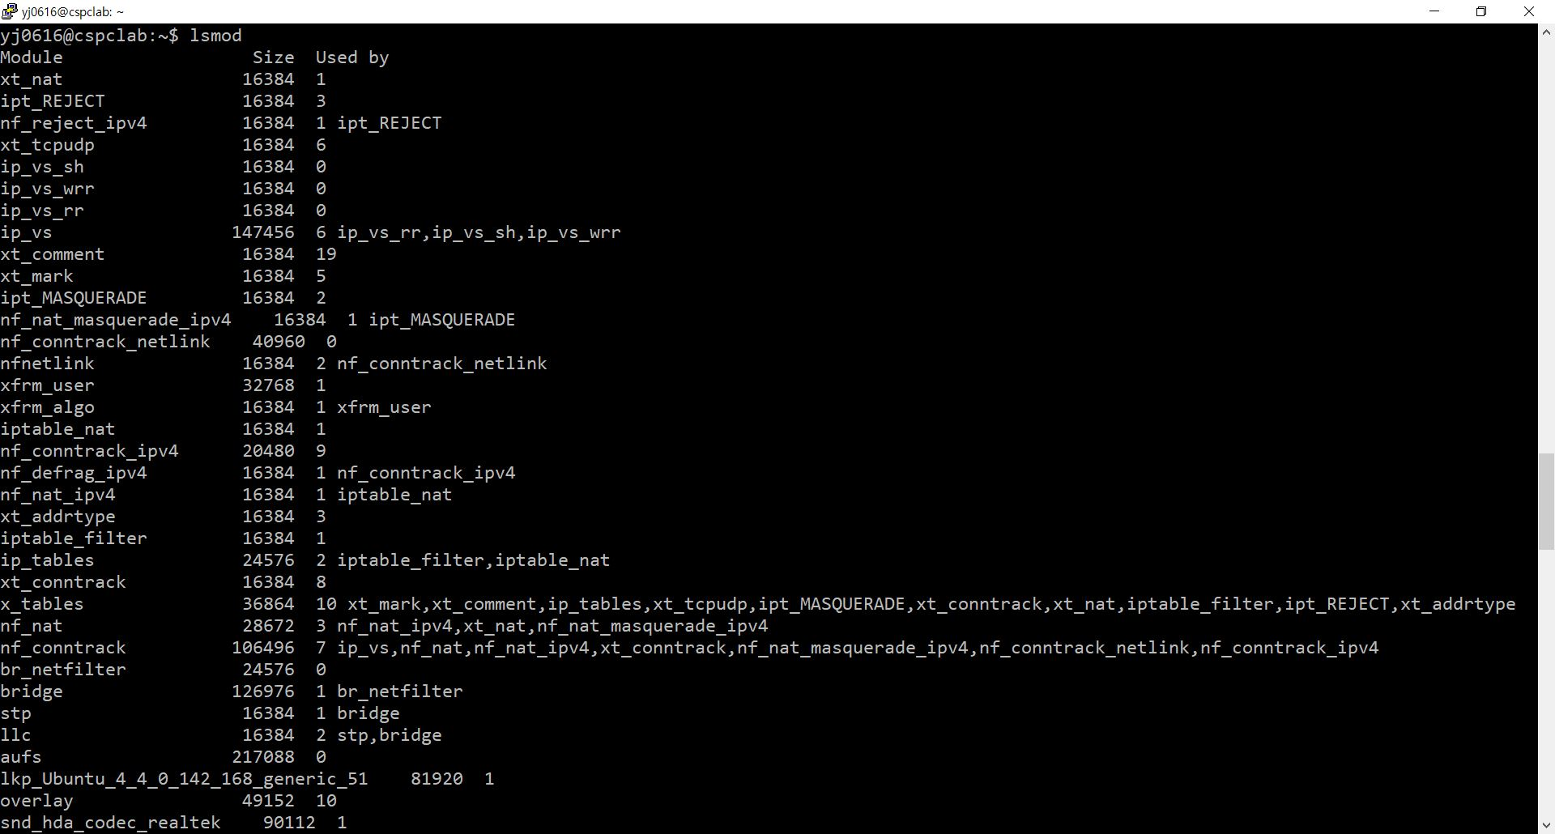
01. Introduction to lsmod

Slide 4
01. Introduction to lsmod

Slide 5
01. Introduction to lsmod

Slide 6
01. Introduction to lsmod

Slide 7
02
The purpose of this project

Slide 8
02. The purpose of the project

Slide 9
02. The purpose of the project
Size
Descending order
Ascending order

Slide 10
02. The purpose of the project
Space Utilization

Slide 11
03
Process

Slide 12
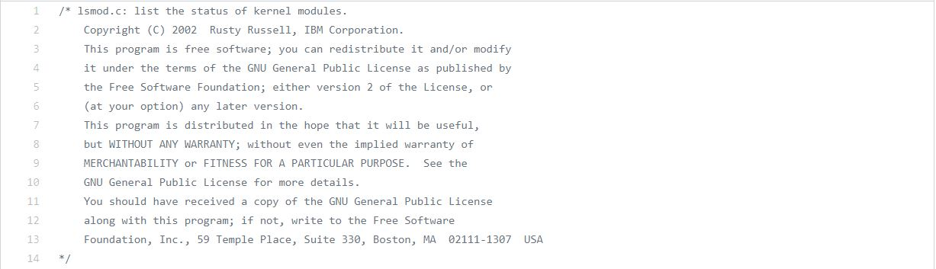
03. Process
Original
lsmod
code
https://fossies.org/dox/modutils-2.4.27/lsmod_8c_source.html#l00041

Slide 13
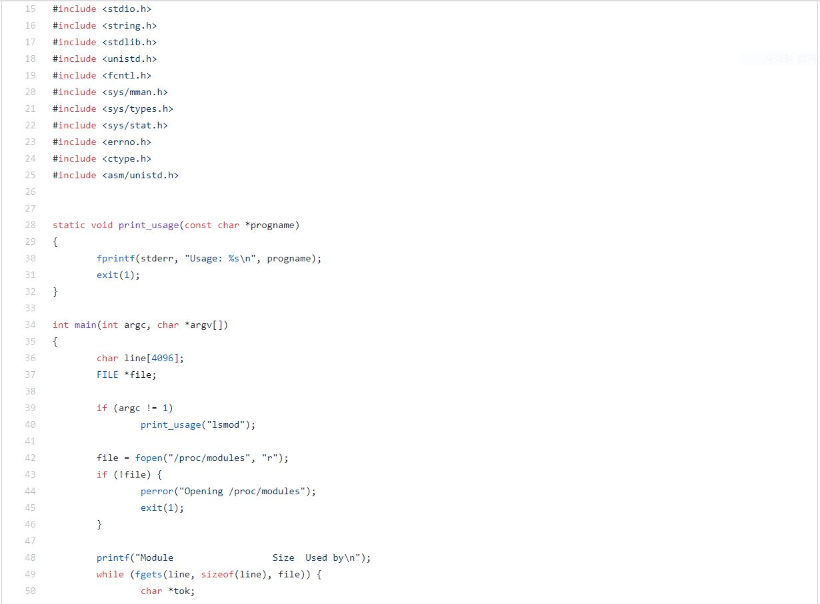
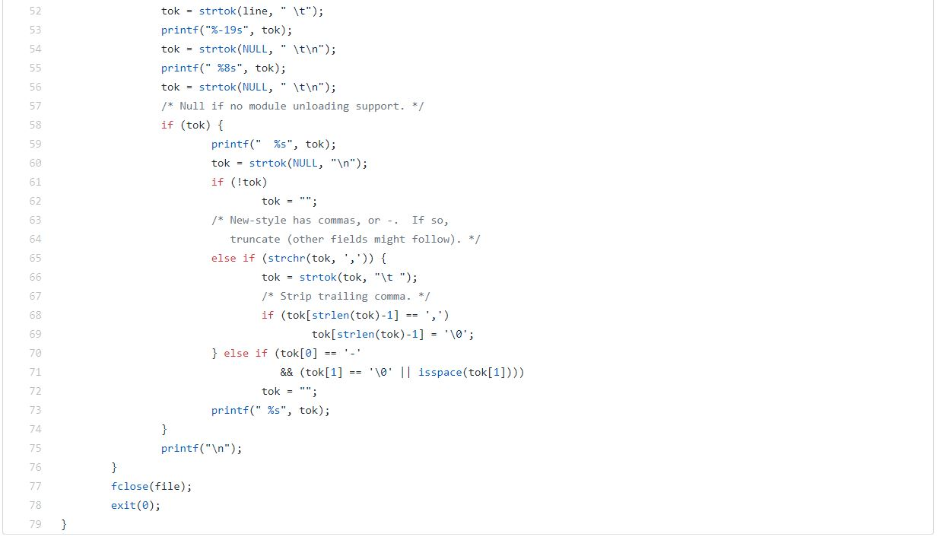
03. Process

Slide 14
03. Process
New
lsmod.c

Slide 15
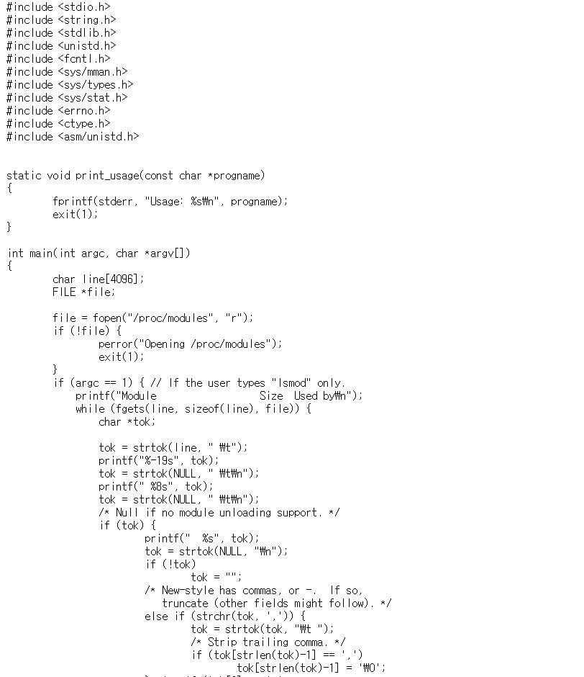
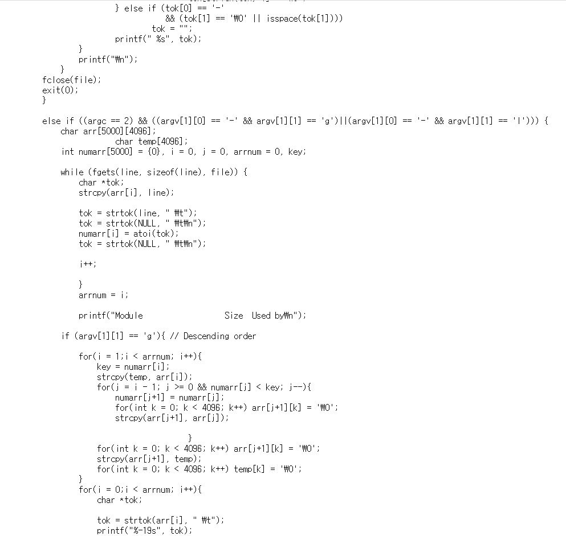
03. Process

Slide 16
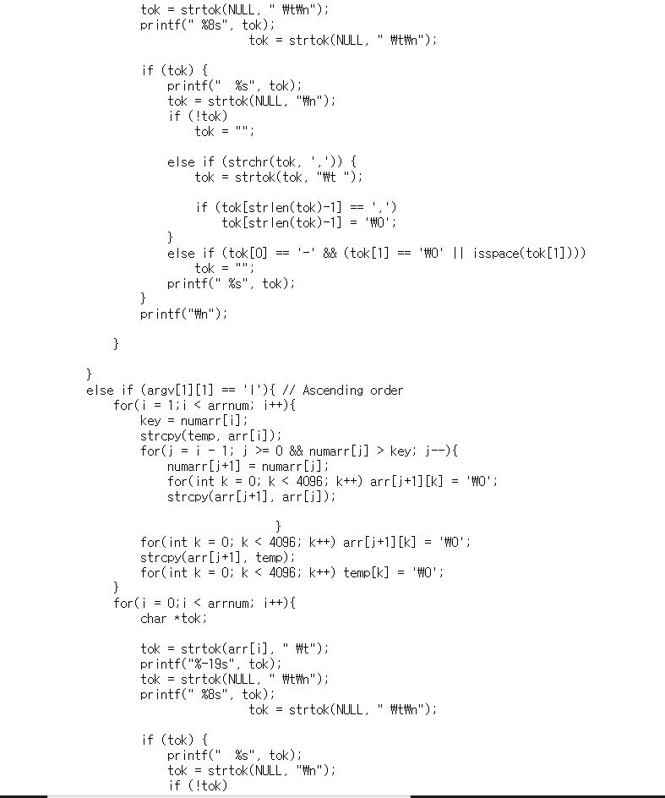
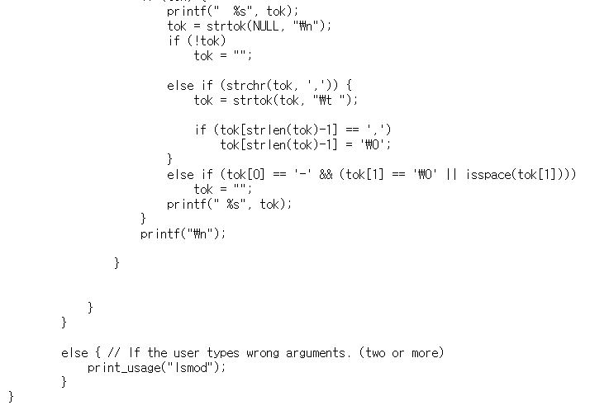
03. Process

Slide 17
03. Process
System call

Slide 18
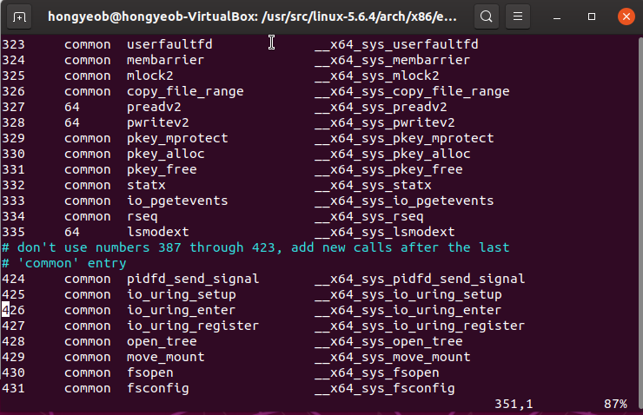
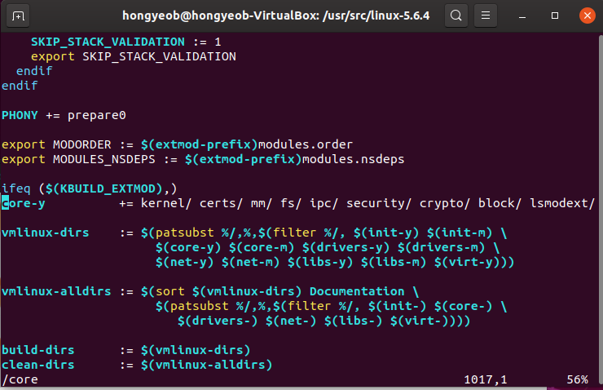
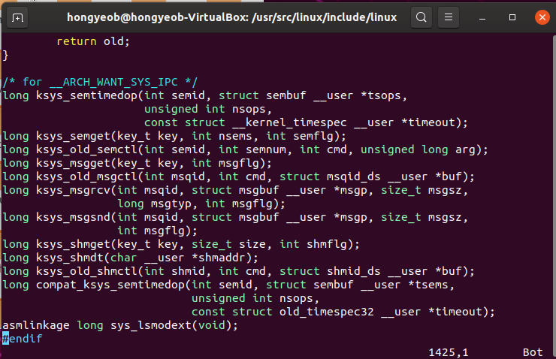
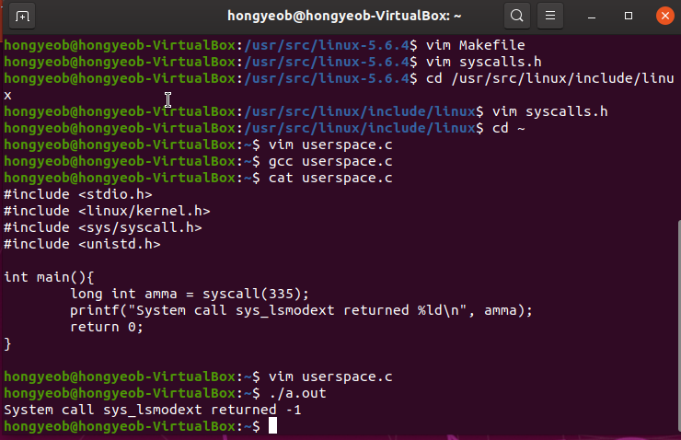
03. Process

Slide 19
03. Process
Module Programming

Slide 20
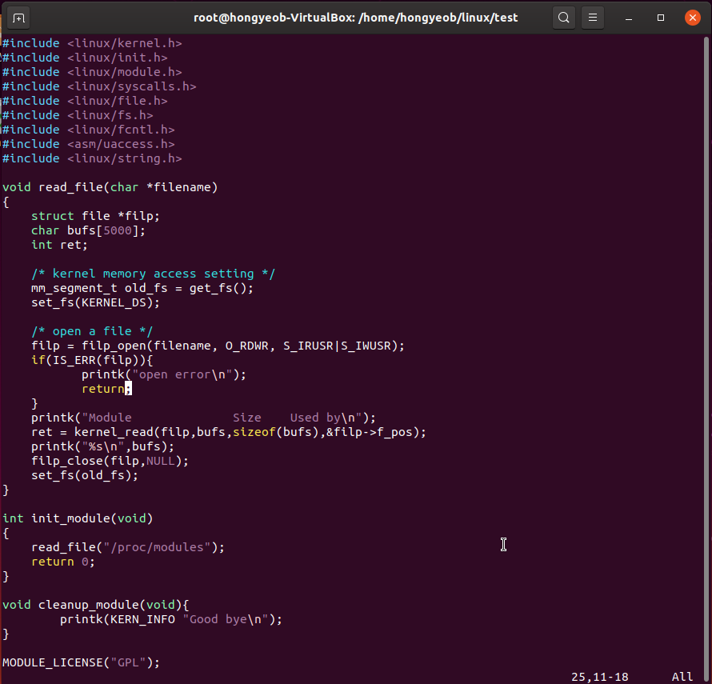
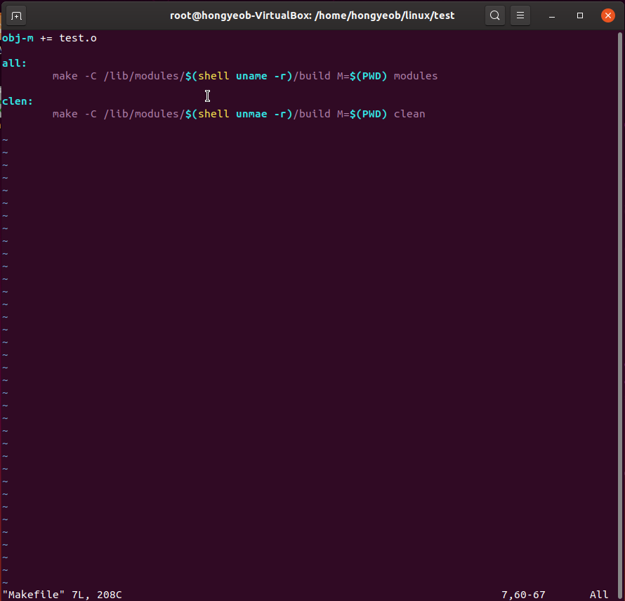
03. Process

Slide 21
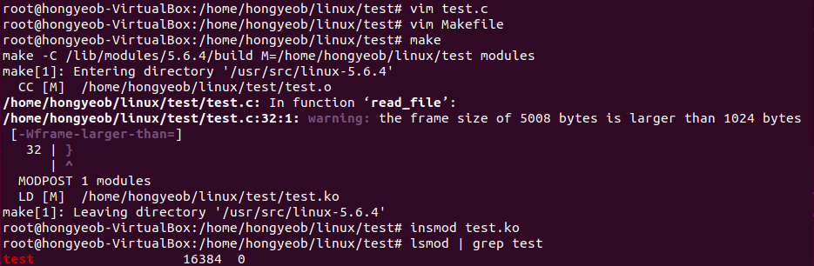
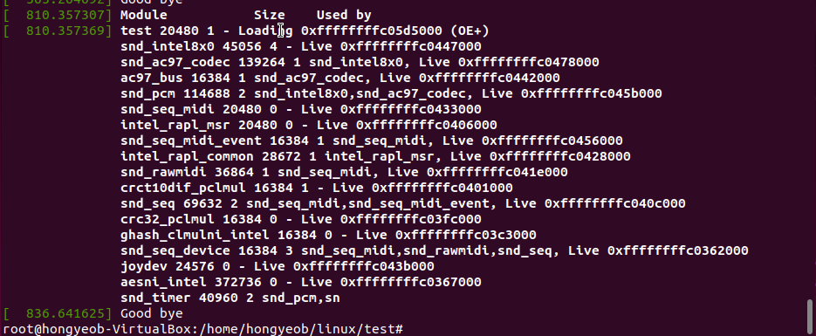
03. Process

Slide 22
03. Process
Combining two Commands

Slide 23
03. Process
lsmod –l: ‘lsmod | sort –k2 –g’
lsmod –g: ‘lsmod | sort –k2 –gr’

Slide 24
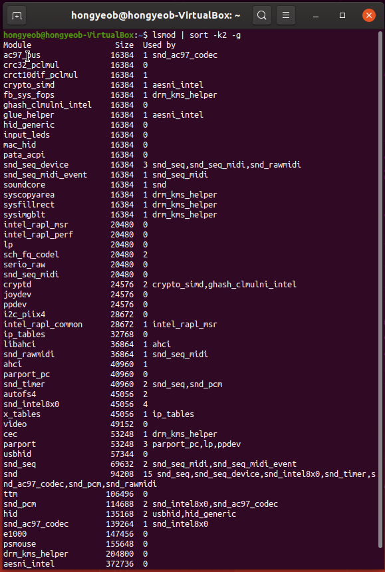
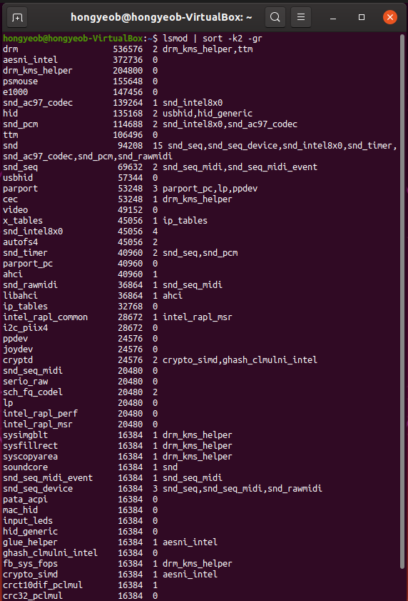
03. Process

Slide 25
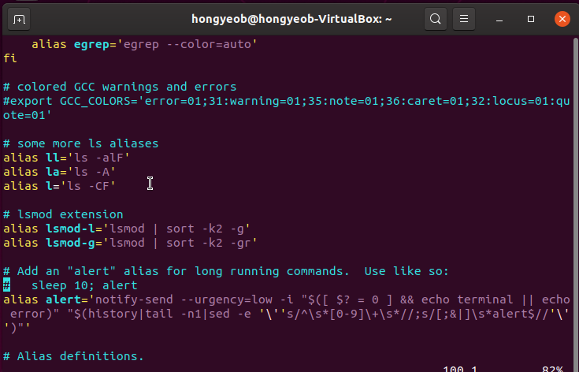
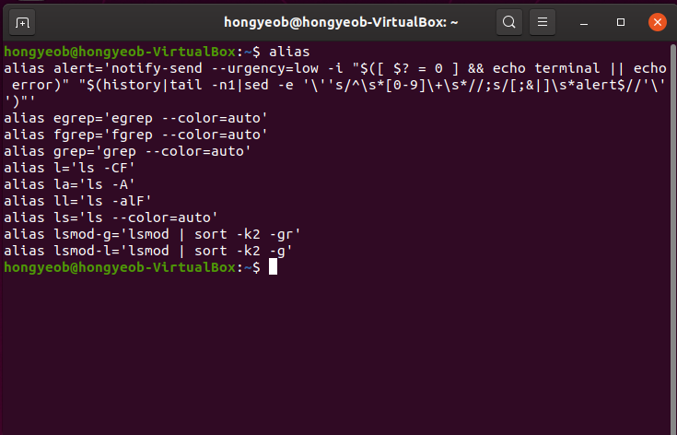
03. Process

Slide 26
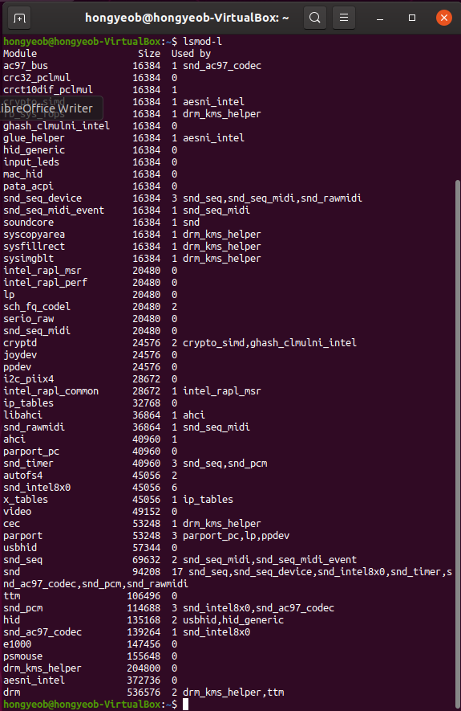
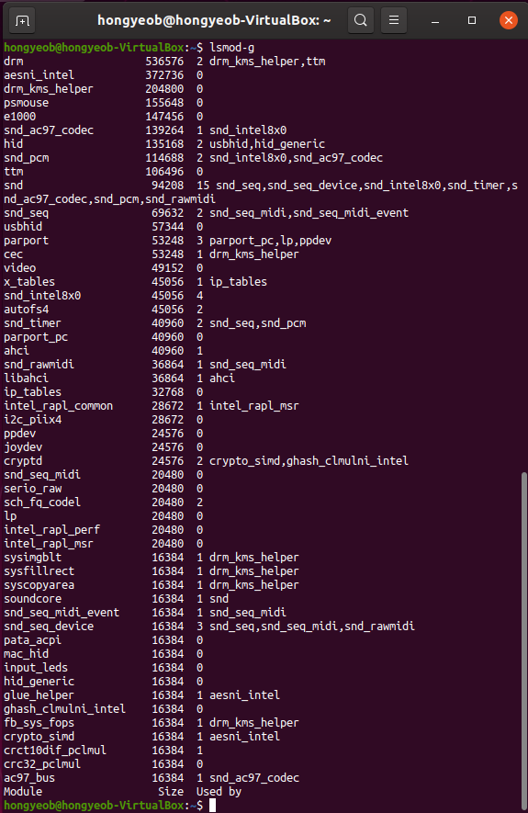
03. Process

Slide 27
04
Lesson

Slide 28
04. Lesson
Difference between ‘User space’ and ‘Kernel space’
What we should consider about when we do programming in kernel space
How to make system call
Module programming
Proc file system

