Slide 1

GitHub Copilot Hackathon
Team Name- HnH
Team Leader Name- Paritosh Dahiya
Team Leader Email Address- dahiyaparitosh@gmail.com

Slide 2

Brief Summary of Project:
The weather forecasting tool has two components CLI and GUI.
The CLI named ‘CLI-Mate’ has been made using openweathermap API to fetch the json weather data and argparse to take CLI arguments.
User can either enter ‘City name’ or ‘Coordinates’ to get the forecast.
The GUI titles ‘GUI-Mate’ was implemented using the CustomTkinter and TkinterMapView library.
User can pin any location on the mapView to get the name and weather forecast for that location.
I used Github Copilot for either autocompletion of code or to generate code for entire methods while creating the CLI and the GUI.
Future plan is to add the forecast of 5 upcoming days and Smart Chat features using GPT based models for complex queries like outdoor activity planning, agricultural tips, watering plants, etc.

Slide 3
Business Challenge /Use Cases
This tool can have many use cases such as:
Travel and Tourism: App can provide real-time updates which can be used to plan the optimal time for travelling.
Logistics: Logistic companies can use the weather data to estimate the arrival times.
Agriculture: Farmers can use the app to monitor specific areas and decide when to irrigate and harvest. At homes too, people can decide whether or not to water the plants.
Construction: Weather can be monitored at the construction/industrial sites for various purposes.
Freemium model can be used where additional features like more information about weather, extended forecasts can be given to the users for subscription.

Slide 4
Proposed Solution
OpenWeatherMap API is being used to get raw weather data and it is later parsed and processed to display data like Temperature, Humidity, Wind Speed, Pressure, etc.
User can either enter ‘City name’ or ‘Coordinates’ to get the forecast using CLI app.
The GUI can let the user pin any location on the map to get the name and weather forecast for that location.
I used Github Copilot for either autocompletion of code or to generate code for entire methods while creating the CLI and the GUI.
I am planning to use Github Copilot and Microsoft Online Services to make personalised solutions to people, like Outlook Calendar API to plan events, Bing Maps API for mapping, ChatGPT API for adding Chat features.

Slide 5
Innovation Novelty
First innovative feature is support for Co-ordinates to get weather data, this can help the users from smaller cities/villages.
Map view in the GUI makes the tool very simple and accessible, user can pin exact location to get weather updates in case they don’t know their co-ordinates.
End product will include Calendar and Chat functions which can help people schedule the tasks and ask questions like “Shall I water my plants today?” or “Shall I irrigate the wheat crops in this week?”.

Slide 6
Technology/Tool Stack Used:
Visual Studio Code – Text Editor / IDE
Python programming language.
OpenWeatherMap api for fetching weather data.
Argparse to create CLI app.
Requests module to send HTTP requests.
CustomTkinter to create modern looking GUI.
TKinterMapView to add mapView and related functionality.
Nominatim Package of GeoPy Module to get addresses for pinned coordinates.

Slide 7
Mention of usage of Github Copilot
For the development of prototype application the Github Copilot proved to be real time saver.
In CLI, copilot helped generating entire functions with simple prompts and minimal changes.
While during GUI, Copilot showed its true worth by giving excellent suggestions for uncommon libraries like CustomTkinter or TkinterMapView as it quickly understood the repetitive patterns.
Even during documentation, Copilot autocomplete suggestions were really helpful.

Slide 8
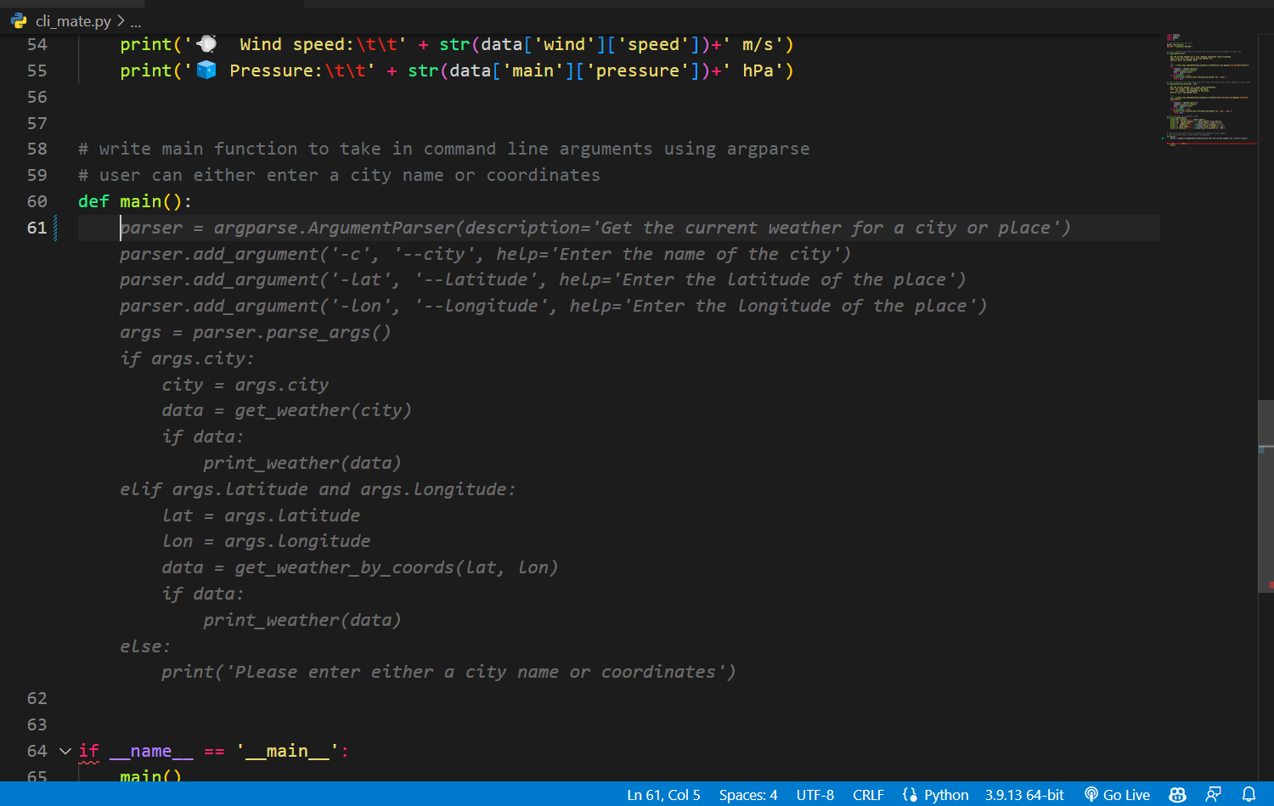
Copilot generating entire function

Slide 9
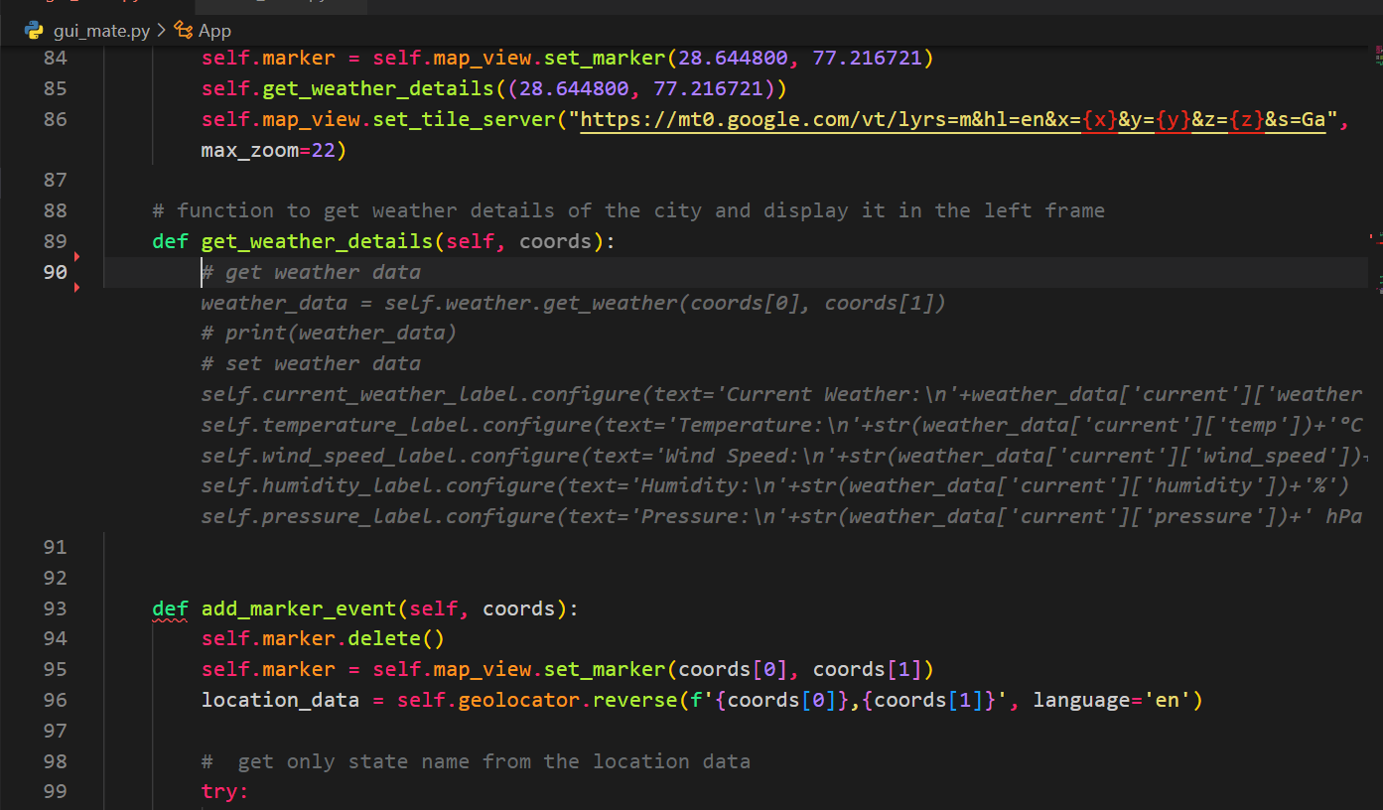
Copilot suggestions during GUI

Slide 10
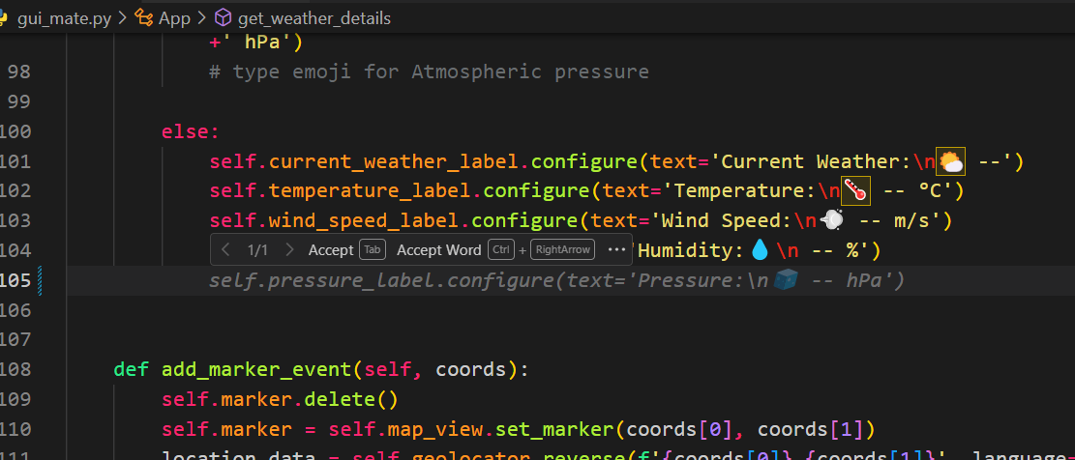
Copilot Recognizing patterns

Slide 11
https://github.com/hnhparitosh/cli_mate
Source code in zip file / Github link :

Slide 12
Execution Demo(Video/Screenshots) showing usage of the GitHub Copilot Platform :
Execution Demo Video Included in the Github Repository.
Screenshots from the next slide.

Slide 13
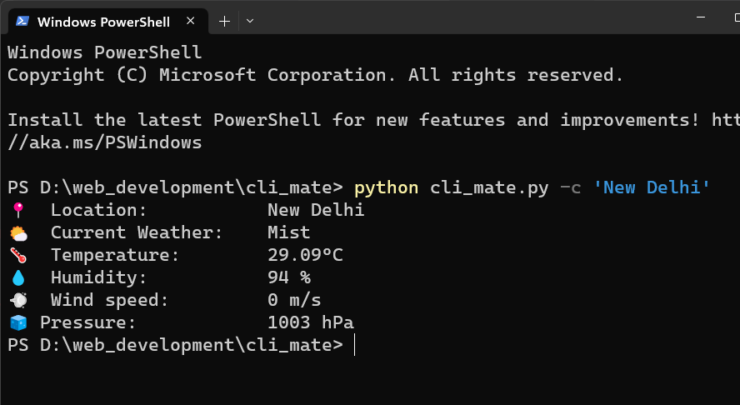
Output of CLI using City Name

Slide 14
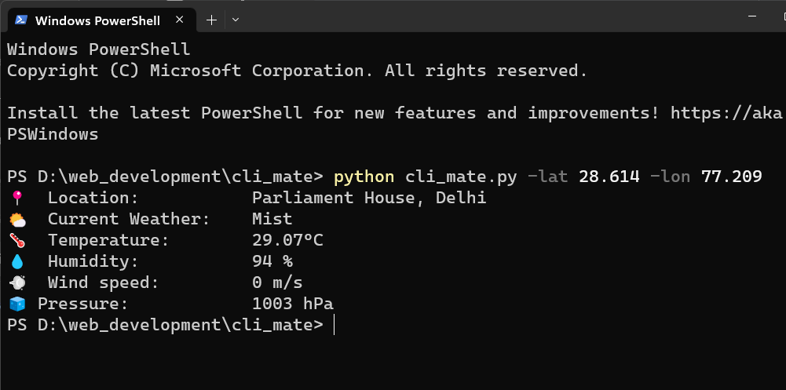
Output of CLI using Coordinates

Slide 15
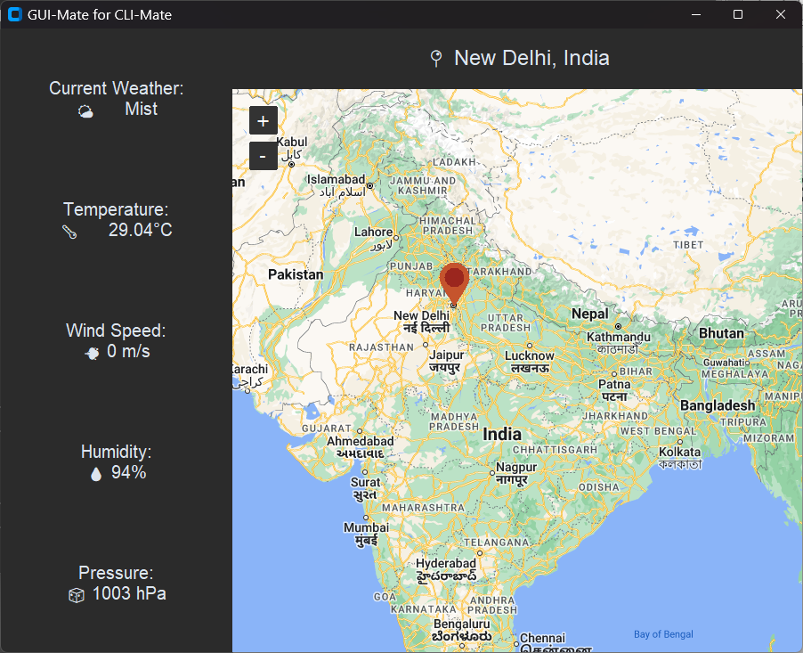
Demonstration of GUI

Slide 16
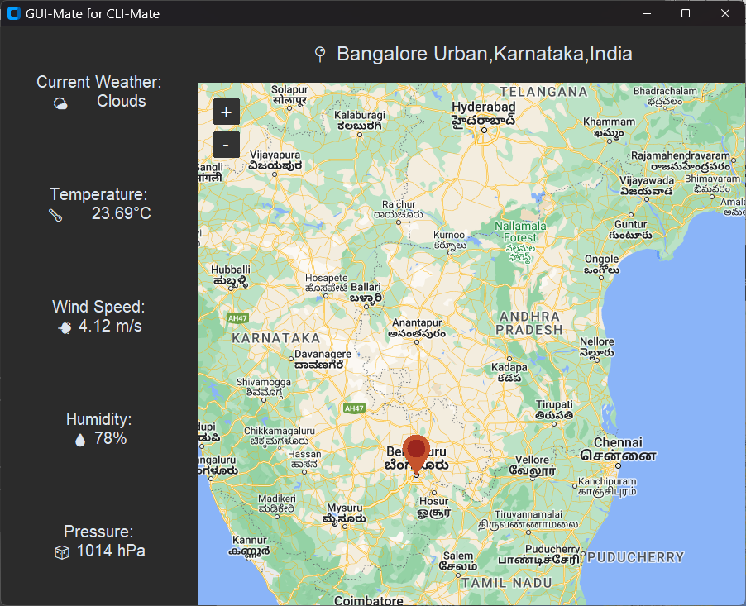
Demonstration of GUI

Slide 17
Additional comments (optional):
The CLI is intended to be simpler having ‘City Name’ and ‘Coordinates’ support.
GUI is more simple and accessible way to get weather forecast.
Calendar Scheduling, Chat features, Advance forecast can be really groundbreaking for tourism, agriculture and logistics industry.

Slide 18
THANK YOU

