Slide 1

HOTEL MANAGEMENT SYSTEM
M UMAR KHAN 10619
SHOAIB AHMED 10621
SKHAKH RAMEEZ AZHAR 10394

Slide 2
LOGIN FORM
LOGIN WITH USERNAME AND PASSWORD IF YOU’RE ALREADY REGISTERED
SIGN UP FOR A NEW VENDOR
FORGOT PASSWORD? CHANGE IT
Username and password validation
HOTEL NAME CANNOT BE USED AGAIN
USERNAME SHOULD BE UNIQUE
PASSWORDS CAN BE SAME

Slide 3
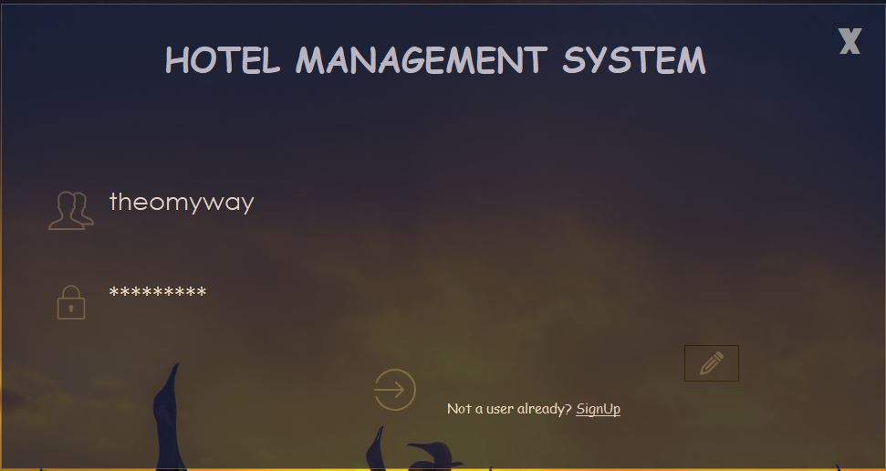

Slide 4
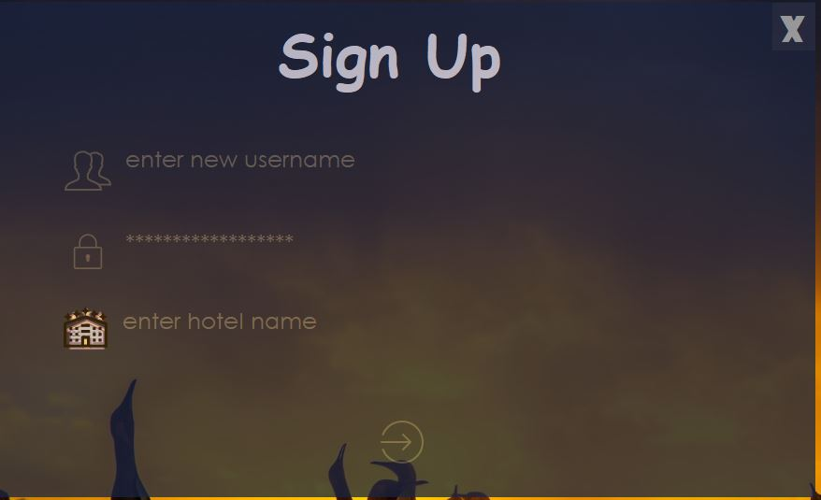
Sign Up

Slide 5
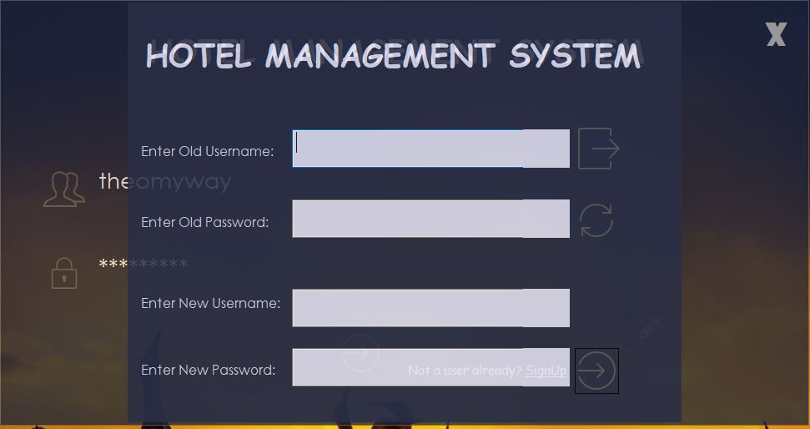
Change Password:

Slide 6
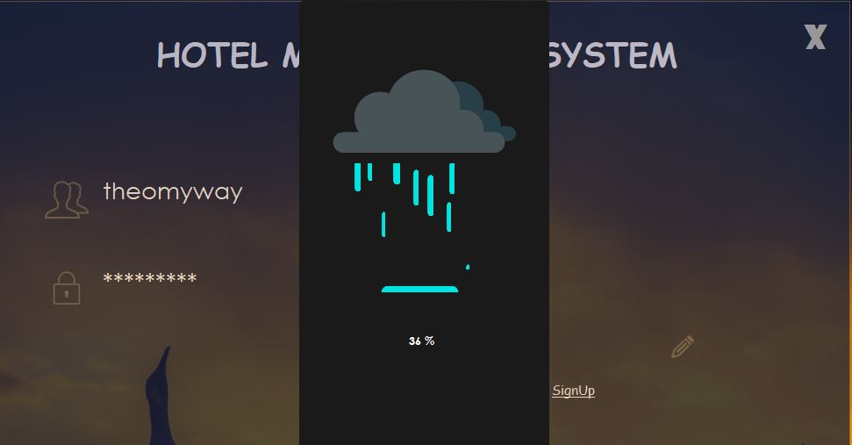
Loading Form:

Slide 7
Loading Form:
TIMERS ARE USED FOR EACH AND EVERY DROPLET OF RAIN
WHEN THE RAIN FILLS UP AND THE PERCENTAGE REACHER 100%
THE DASHBOARD OPENS
THE LOADING WILL NOT TAKE PLACE ONCE IF USERNAME OR PASSWORD ARE WRONG

Slide 8
Dashboard:
CIRCULAR PROGRESS BARS SHOWING COUNTED FIGURES
RECORDS CAN BE SEARCHER FROM THE SEARCHBAR BY RESERVATION NUMBER
THEY CAN ALSO BE SEARCHED THROUGH CUSTOMER ID
BUTTONS AND PANEL THAT MOVES ALONG WITH THEM AND BECOMES EQUAL TO THEIR SIZE ON HOVER
DATA GRID VIEW TO SHOW DATA FROM DATABASE
TIME PUT INTO LABEL WITH TICK FUNCTION WHICH EVERY SECOND IT UPDATES
USERNAME AND LOGGED IN USER NAME SHOWING UP
DELETE RESERVATION AND REFRESH RECORDS BUTTONS
MAKE A RESERVATION BUTTON

Slide 9
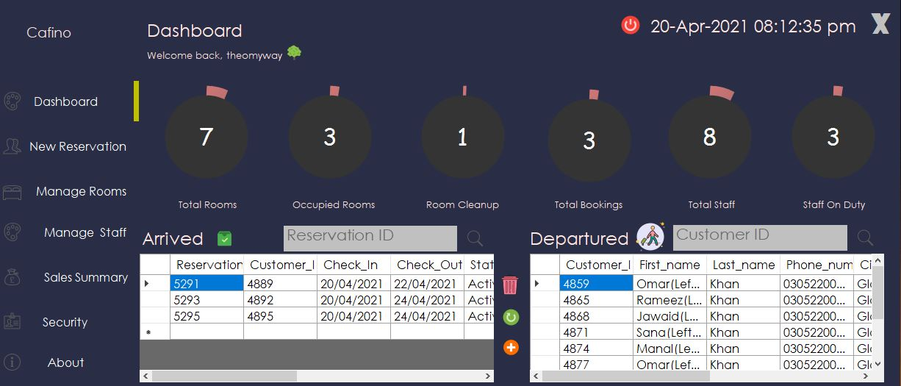
Dashboard:

Slide 10
Manage Room/Plans:
VENDOR CAN DO 2 THINGS FIRST WHEN HE GETS HIMSELF REGISTERED FOR THE FIRST TIME
ADD MEAL PLAN AND THEIR PRICES AND EDIT OR DELETE THEM
ADD ROOMS WITH THEIR INFORMATION AND MANAGE/EDIT OR DELETE THEM AND THEIR PRICES
A VENDOR CAN PUT ROOM CONDITION ACCORDING TO THE CONDITION OF THE ROOM SO AT THE TIME OF RESERVATION HE KNOWS IF THE CONDITION IS OKAY OR OUT OF ORDER

Slide 11
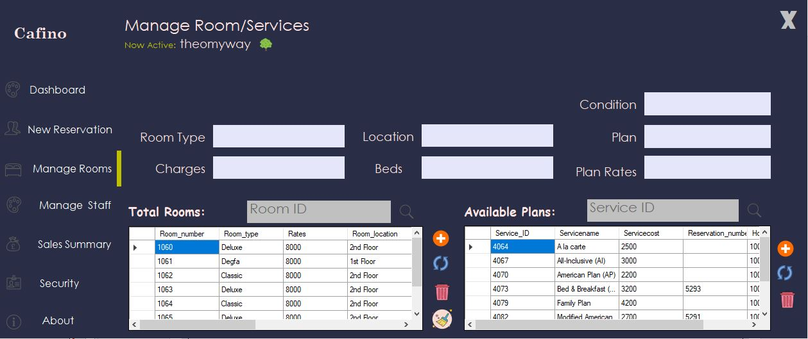
Add Rooms/plan:

Slide 12
Manage Employee:
VENDOR CAN ADD NEW EMPLOYEE WITH HIS DETAILS
A VENDOR CAN EDIT HIS/HER INFO OR DELETE (FIRE) HIM/HER
EMPLOYEE CAN BE SEARCHED THROUGH EMPLOYEE ID VIA QUICK TEXTBOX SEARCH
THESE EMPLOYEES WILL BE SHOWED AT THE TIME OF RESERVATION
THE EMPLOYEE WHO ARE ON DUTY SHOWN ON THE GRIDVIEW
ONE EMPLOYEE WILL MANAGE ONE ROOM ONLY AT A TIME

Slide 13
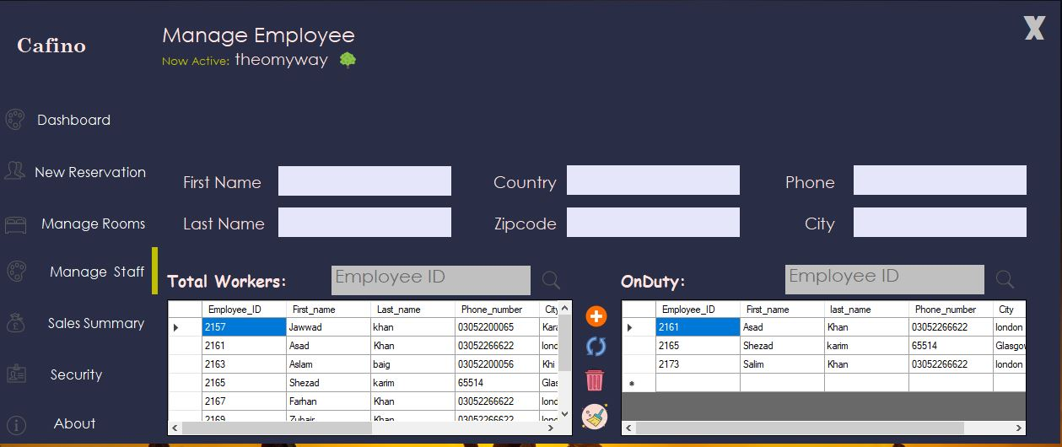
Manage Employee:

Slide 14
Billing Info:
WILL SHOW TODAY RESERVATION’S BILLING INFO
VENDOR CAN ALSO ACCESS A CERTAIN BILLING INFO BETWEEN A CERTAIN DATE
VENDOR CAN ACCESS OLD RECORDS WHICH ARE ONE DAY OLDER
ONLY TODAYS RECORD WILL BE ON THE GRID VIEW’S FRONT
TODAY CASH EARNED BY THE HOTEL WILL BE THE RESEULT OF SUM OF TODAY EARNED IN TODAYS DATE
CUSTOMER’S BILLING INFO CAN BE SEARCH THROUGH QUICK SEARCH BAR BY BILLING ID

Slide 15
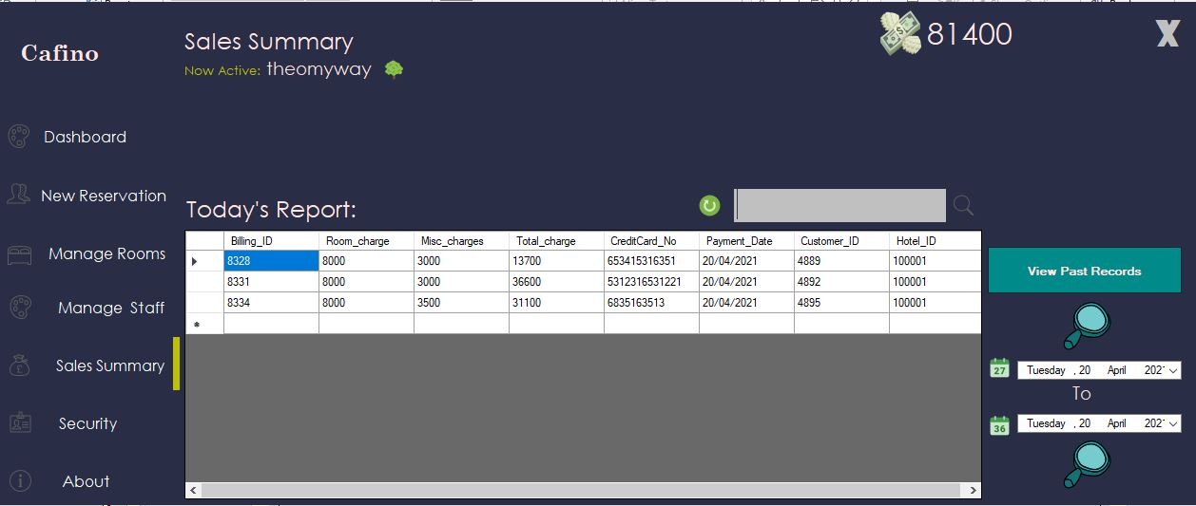
Billing Info:

Slide 16
About:
WHEN A NEW VENDOR GETS HIS HOTEL REGISTERED,HE CAN ADD A PIECE OF INFO ONCE
THE BUTTON OF INSERT DISSAPPEAR ONCE THE INFO ABOUT HOTEL IS INSERTED
THE VENDOR WILL BE DIRECTED TO THE DASHBOARD

Slide 17
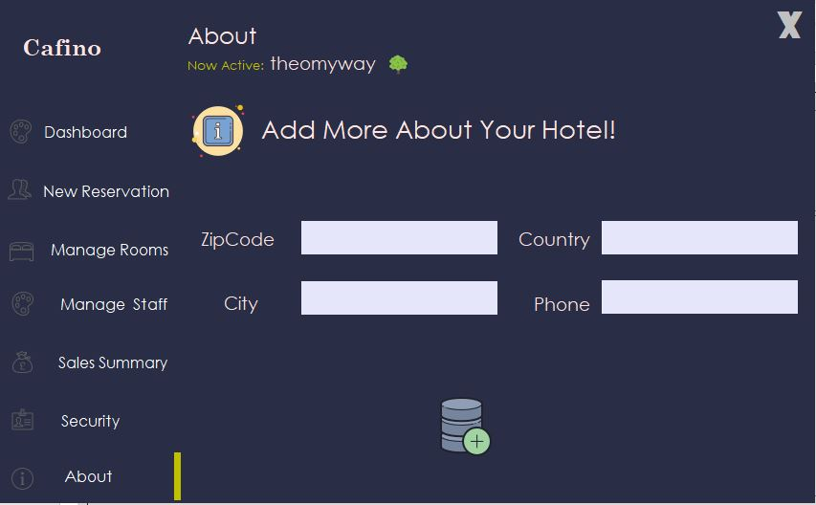
About:

Slide 18
Reservation:
THERE ARE 5 STEPS WHEN A CUSTOMER WILL WALK IN AND GET HIMSELF REGISTERED IN A HOTEL:
FILLING BASIC CUSTOMER DETAIL WHICH WILL BE INSERTED INTO CUSTOMER TABLE
ASSIGNING THE EMPLOYEE WILL JUST ASSIGN THE EMPLOYEE AND REMOVE HIM FROM THE GRID VIEW OF THE AVAILABLE EMPLOYEE
IN THE THIRD STEP, THE CUSTOMER AND EMPLOYEE ID COLUMNS WHICH ARE NULL IN ROOM TABLE GETS FILLED UP RESERVING THE ROOM
THE FOURTH STEP DO A COMPLETE RESERVATION SUPPLYING ALL THE FOREIGN KEYS TO THE TABLE CUSTOMER ID, EMPLOYEE ID, ROOM NUMBER
THE FIFTH AND THE FINAL STEP WILL ENTER THE BILLING INFO AND FINALLY RESERVE A CUSTOMER HAVING ALL THE FOREIGN KEYS SUPPLIED FROM THE PREVIOUS FORMS AND DATA WILL BE SAVED IN THE BILLING TABLE

Slide 19
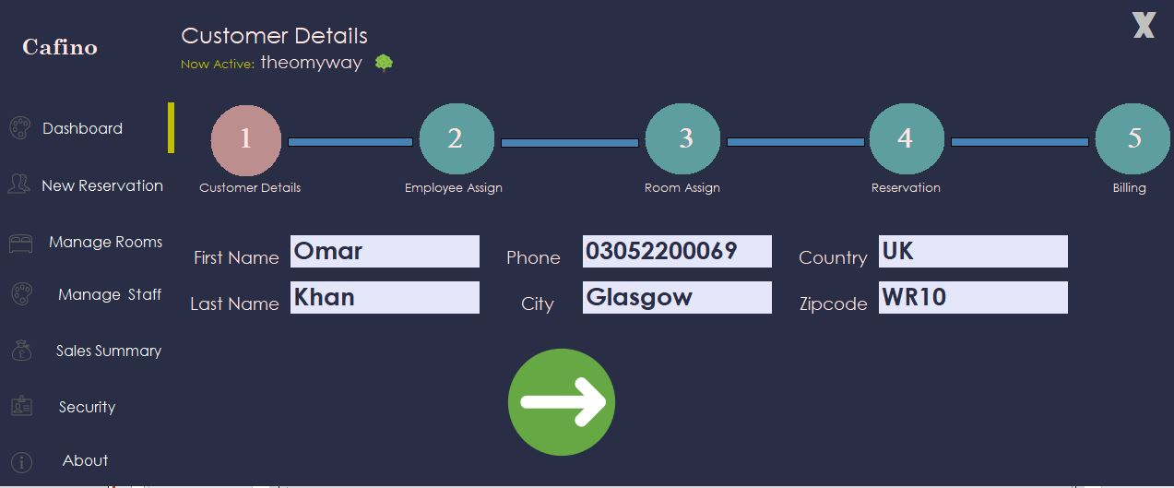
Reservation:

Slide 20
THANK YOU!

