Slide 1
AUTOMATIC WASTE SEGREGATION SYSTEM

Slide 2
INTRODUCTION
A hardware-based model that segregates waste into Wet, Dry, and Metal.
Uses sensors, servo motors, and microcontrollers.
Designed to support efficient household waste management.

Slide 3
PROBLEM STATEMENT
Manual waste segregation is time-consuming and inaccurate.
Mixed waste leads to pollution and recycling problems.
Need for an automated, low-cost segregation system.

Slide 4
OBJECTIVES
Identify waste type using sensors.
Automatically open the correct bin using servo motors.
Improve accuracy and reduce human effort.
Make a simple, low‑cost prototype.

Slide 5
HARDWARE COMPONENTS
Arduino Uno
IR sensor / Proximity Sensor
Metal detection sensor
Servo Motors (2 for lid)
Stepper Motor (rotation)
Dustbin Mechanism
Power Supply & Wires

Slide 6
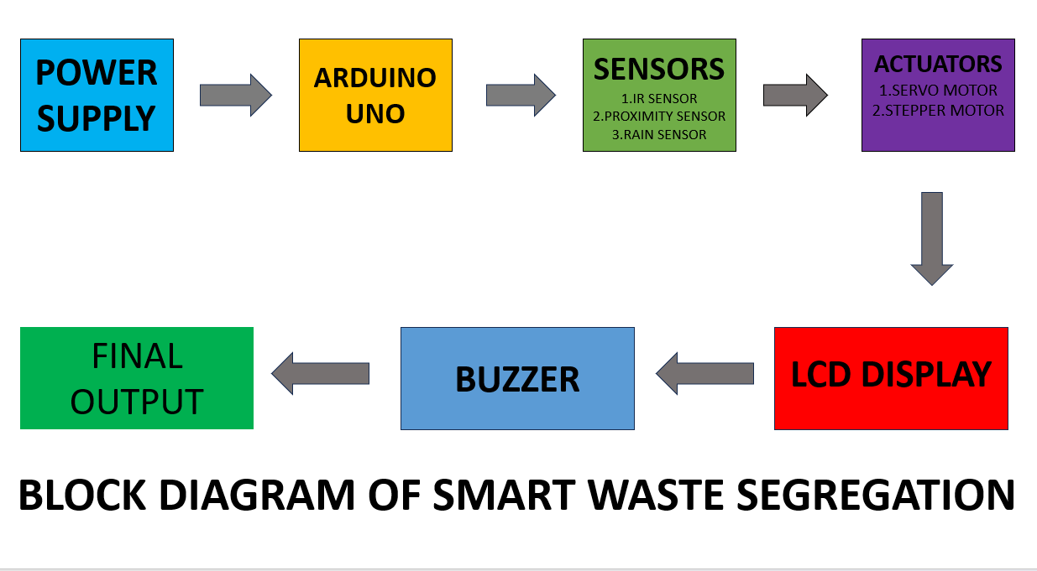
BLOCK DIAGRAM

Slide 7
WORKING PRINCIPLE
Sensor detects type of waste.
Arduino processes the signal.
Stepper rotates bin to correct position.
Servo motors open dustbin lid.
Waste falls into correct bin.

Slide 8
METHODOLOGY
1. Collect waste.
2. Sensor detection.
3. Arduino classification.
4. Stepper motor positioning.
5. Servo‑based lid opening.
6. Automatic segregation.

Slide 9
RESULTS
Successfully segregates Wet, Dry, and Metal waste.
Sensors respond quickly.
Mechanism works smoothly with servo and stepper motors.
Simple and cost‑effective.

Slide 10
CONCLUSION
Hardware-based system is efficient and practical.
Reduces human effort in waste segregation.
Can be improved for larger‑scale use.

