Slide 1
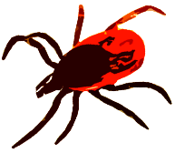


12
Life cycle stage:
(1) larva
(2) nymph
(3) adult
Behavioural states:
questing
inactive
engorged
late engorged
Forest
Ecotone
0
Meadow
0
12

