Slide 1
Hardcore fancy tinkery stuffs that you should know about

Slide 2
ELF
Executable and Linkable Format – ELF!
  Standard format for executables, object code, shared libraries and core dumps.
  Used my most sane OS:es nowadays.

Slide 3
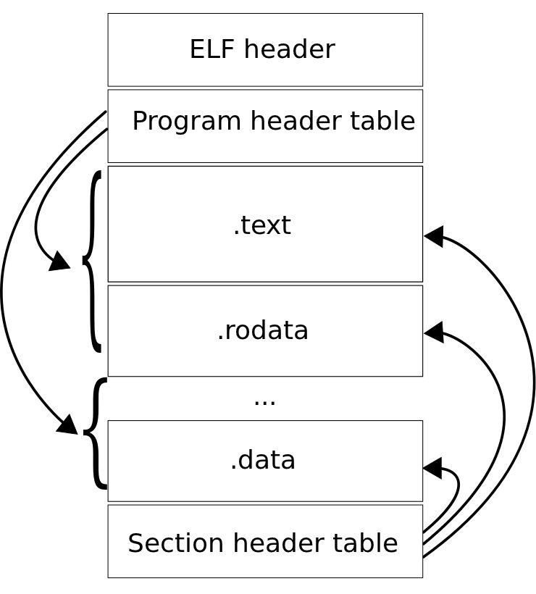
ELF

Slide 4
ELF
So..what does your typical ELF file contain?
  That stuff that you've compiled and will execute (the program!)
  Details on where that stuff should go
  Debug info, symbols, etc

Slide 5
ELF
Typical ELF sections
  .text – that stuff that you execute
  .data – those global variables that you've initialized..
  .rodata – strings, const variables, stuff that's not in ram.
  .bss – globals that aren't initialized. Should be zeroed out.
  COMMON – stuff that doesn't fit in .bss or .data.

Slide 6
ELF
Core dumps!
  The ELF format is also the format of core dumps for stuff that use ELF.
  It is totally possible to generate your own, and with some fancy patching to GDB you can roll your own coredump from your embedded system.
  You android folks should dump your cores more often..

Slide 7
GNU Toolchain
Most of you know these:
  GCC – the gnu compiler collection (previously gnu c compiler)
  GDB – gnu debugger
But what else?
  GNU ar, as, ld, nm, objcopy, objdump, etc, etc, todo

Slide 8
GNU LD
The GNU linker, part of binutils
What we use to link object files, etc to something we can execute
Can also produce interesting files that every embedded engineer should know about..

Slide 9
GNU LD
-Map <file> option to ld will produce a map file.
Learn to love it!
If you're sick of scanning addresses in map files, use addr2line -e=<elf> <addresses>*

Slide 10
Linker scripts
Varför skriver jag på engelska?
Linker scripts provide additional control over the linking process.
Entry points, where to place sections, relocation, memory mapping, alignment, etc.
That is: stuff you need if you don't execute your code under an OS that takes care of this for you...

Slide 11
Objdump
So, you have elf, raw binary or something. You don't read opcodes or elf headers like they were Winnie the Pooh, but you still want to know what the heck that compiler did...
  Then use objdump!

Slide 12
Objdump
Need the disassembly?
  objdump -d (or maybe -D)
What's in that ELF?
  objdump -h
..is there SOURCE<tm> included?
  objdump -S
..and lots of other stuff that can be erased by running strip.

Slide 13
Objdump
readelf can do lots of stuff too, but only reads elf files. Objdump can read everything BFD can.

Slide 14
addr2line
Your program crashed. You somehow know where (address wise..)
How to figure out where in your code it crashed? Use disassembly? Mapfile?
No, use addr2line!
  $ echo "0xabc" | arm-none-eabi-addr2line -e Projects/sam7-h256/sam7h256-flash/build/foo.elf
  /home/henrik/khelg/src/cdc_enumerate.c:291

Slide 15
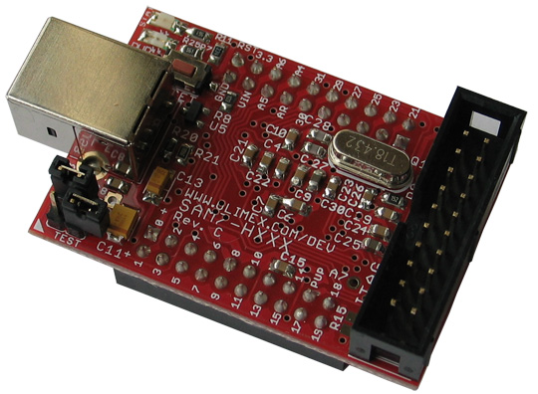
Laborationen
AT91SAM7S256
  Atmel ARM 7, 64k sram, 256k flash, USB 2.0, RTT, 10 bit ADC 384 ksps, 2x UARTs, TWI (I2C), SPI, 3x 32bit TIMERS, 4x PWM, SSC, WDT, PDC (DMA) for all peripherals, up to 60MHz operation
  Devplatta av Olimex, olimex sam7-h256

Slide 16
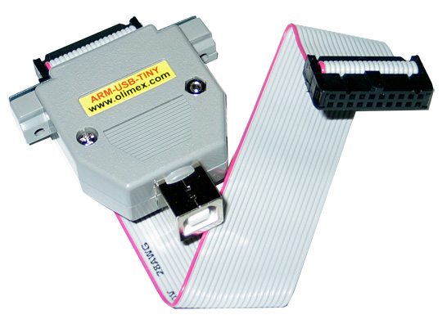
Laborationen
Olimex JTAG Tiny
Fungerar ypperligt med OpenOCD

Slide 17
Laborationen
Ni får ett eclipseprojekt med makefile och annat där manegen redan är relativt krattad.
Detta finns: initialisering av MCU, fungerande USB CDC ACM-drivare, Peters softsynth, script för flashning med jtag och openocd

