Slide 1
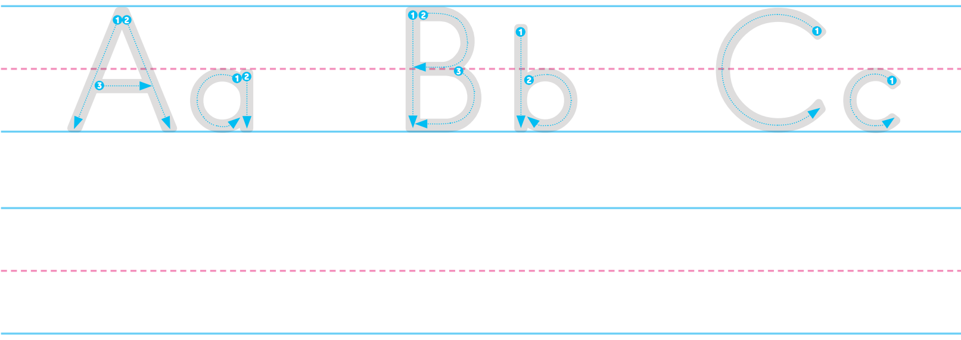
Back
Your turn!

