Slide 1
IIIT HYD OS-2019
Topic: Android
By:
Hemal N. Thakkar

Slide 2
Agenda
Basic Question – When/How/Why/What…
Android Architecture
Android File System…Security…in brief
Space Management ….SM
Power Management ….PM
Compiling the Source code…Customize Android
Demo Mobile Application
References

Slide 3
When…
Android Inc. founded 2003
Purchased by Google in 2005 for 50 Million dollars
Version 2.0 released in 2009 that’s when it had a tremendous Growth
From 2011 till date Android owns the highest market in mobile devices.
Especially tailored version’s of Android are implemented for Car (Auto Android), Android TV, Android Wear etc.
The latest version (mobile) is Android 10.0

Slide 4
How…
Based on Linux Kernel
Remember Micro-kernels, so the required part of the kernel was taken...probably modified too
Additional drivers and functionality such as enhanced power management or faster graphics support was included
GNU C library was discontinued

Slide 5
Interesting….q’s
Android runs on top of Linux kernel which is written in C/C++
Why was Android framework written in Java?
Can we write an OS in Java?
Is Android a Linux distro?

Slide 6
Why Java…
Java is portable.
Java code is compiled to Bytecode. Same Bytecode runs on any Architecture ARM, x86 or MIPS processor.
It’s the JVM which is platform dependent.
Inherently Java supports sandboxing/container ideology.
Java has excellent Memory Management.

Slide 7
DVM …and Why?
Dalvik Virtual Machine is a modified version of the JVM optimized for memory, battery and performance.
Android classes converted into DEX bytecode which is independent of device architecture. The DEX bytecode format in turn is translated to native machine code via either ART or the Dalvik runtimes.
The code is completely isolated.

Slide 8
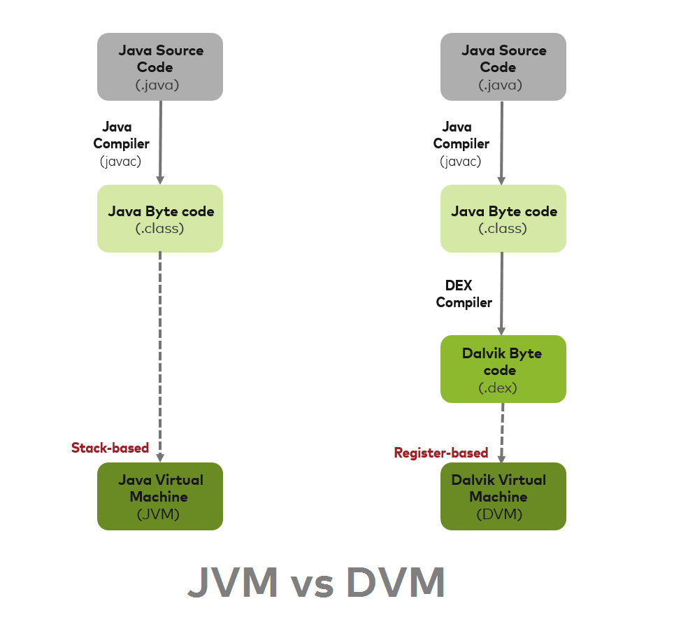
JVM vs DVM

Slide 9
DVM….ART…and more
Dalvik is a JIT compilation engine.
DVM has its drawbacks and from Android 5.0 it was completely replaced by ART.
ART is AOT compiler.
For profiling purpose JIT was again introduced from Android 7.0 along with ART

Slide 10
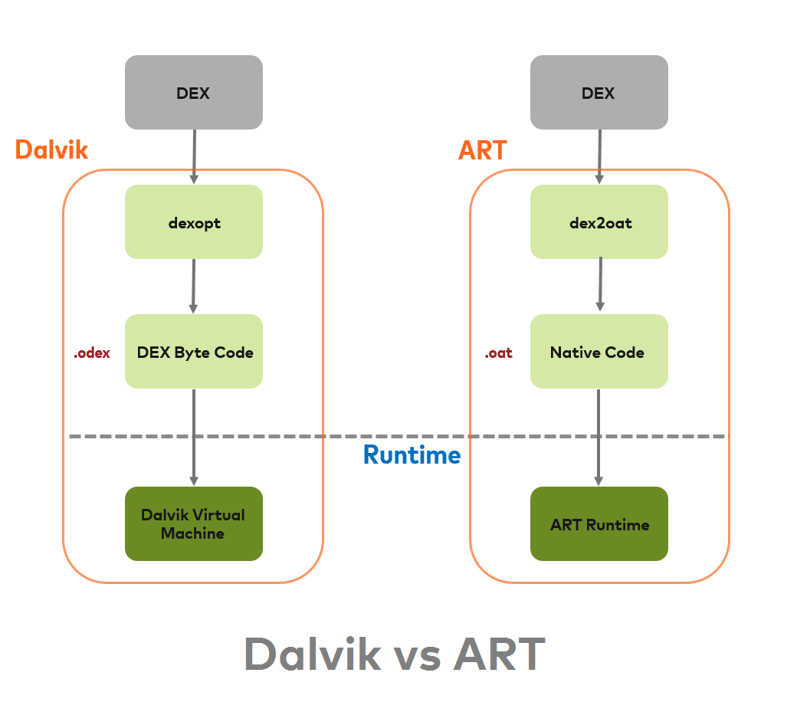
DVM vs ART

Slide 11
{ ‘’ | ‘Dis’} Advantage of ART over DVM
Apps run faster as DEX bytecode translation done during installation.
Reduces startup time of applications as native code is directly executed
Improves battery performance as power utilized to interpreted byte codes line by line is saved.
App Installation takes more time because of DEX bytecodes conversion into machine code during installation.
More internal storage is required.

Slide 12

Android Architecture

Slide 13
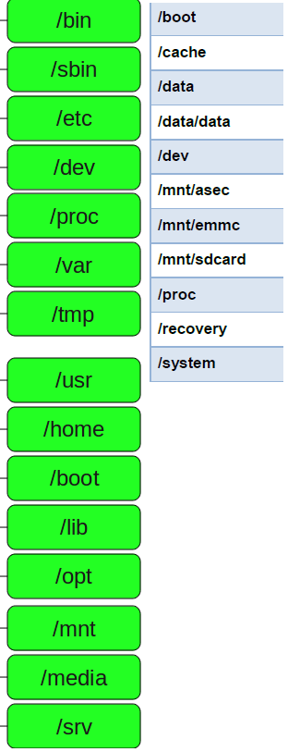
Linux vs Android File System

Slide 14
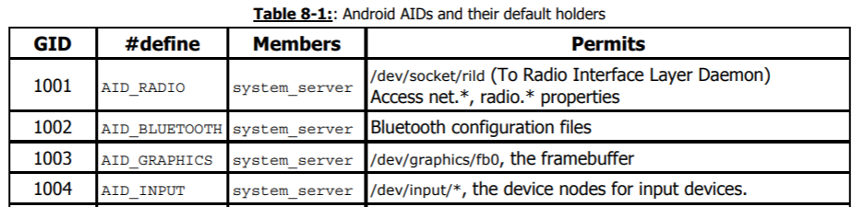
Security..
All Linux permissions are applicable.
Android maintains the lower range of user ids - 1000-9999 - exclusive for system use

Slide 15
Bionic C Library…SM
Google developed a custom library for the C compiler (libc) called Bionic.
This library has to be loaded in each process, so it needs to be small. Bionic is about 200K, half the size of glibc and optimized for embedded use.
Has its own implementation of very fast and small custom pthread.
This library is specifically designed for lower CPU speeds.

Slide 16
More….Bionic C Library
Additional support for Android specific services.
Bionic is not compatible with GNU libc, doesn’t support feature like exceptions.
All native code needs to be compiled using Bionic and not glibc.
{ Non technical } Licensing issue, so it had to be implemented.

Slide 17
ARM big.LITTLE…PM
big.LITTLE is one of the power management technologies employed by ARM
It’s a heterogeneous computing Architecture developed by ARM holdings.
Same architecture but different micro-architectures. Uses two types of processors.
”LITTLE” processors are designed for maximum power efficiency

Slide 18
More…ARM big.LITTLE…PM
”big” processors are designed to provide maximum compute performance
Also allows switching between different processor cores in accordance with the work load.
Task can be dynamically allocated to a big or LITTLE core depending on the instantaneous performance requirement

Slide 19
More…ARM big.LITTLE…PM
Snapdragon 845 – Qualcomm (2017) has four Kryo 385 Silver high-efficiency cores operating at 1.7 GHz along with four high-performance Kryo 385 Gold cores operating at 2.8 GHz.
Snapdragon 855 – Qualcomm (2019) four Kryo 485 Silver high-efficiency cores operating at 1.8 GHz along with three high-performance Kryo 485 Gold operating at 2.42 GHz and another higher-performance Kryo 485 Gold core operating at 2.84 GHz.

Slide 20
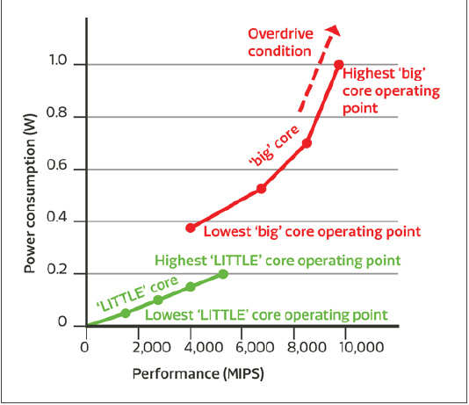
More…ARM big.LITTLE…PM
The latest big.LITTLE software and platforms can save 75% of CPU energy in low to moderate performance scenarios, and can increase performance by 40% in highly threaded workloads.

Slide 21
Scheduling…PM…Most IMP
Round Robin Scheduling
Completely Fair Scheduling
Heterogeneous Multi-processing
Energy Aware Scheduling (EAS), calculates energy impact…and assigns to the lowest one.
All latest mobile like OnePlus 3, Google Pixel uses the EAS technology + big.LITTLE

Slide 22
Customize Android
Android is a huge code base.
Requirements
https://www.youtube.com/watch?v=H_ReU-0w4IE
https://www.youtube.com/watch?v=99LUjX63LhU
Downloading the source code take up to 15 hours with reasonable internet speed.
Nothing much to do but highly resource and time consuming

Slide 23
DEMO...
Setting up development environment

Slide 24
References
https://source.android.com/
https://source.android.com/setup/build/requirements
https://en.wikipedia.org/wiki/ARM_big.LITTLE
https://www.arm.com/files/pdf/big_LITTLE_Technology_the_Futue_of_Mobile.pdf
https://www.androidauthority.com/qualcomm-snapdragon-855-vs-845-965871/
https://en.wikichip.org/wiki/qualcomm/snapdragon_800/855
https://en.wikichip.org/wiki/qualcomm/snapdragon_800/845
http://citeseerx.ist.psu.edu/viewdoc/download?doi=10.1.1.654.6317&rep=rep1&type=pdf
https://www.xda-developers.com/google-pixel-fastest-android-phone-eas/

Slide 25
References
ANDROID SECURITY INTERNALS - Nikolay Elenkov
ANDROID INTERNALS – Jonathan Levin
EMBEDDED ANDROID – Karim Yaghmour
https://www.quora.com/Why-are-Android-apps-written-in-Java-but-the-OS-is-written-in-C++
https://softwareengineering.stackexchange.com/questions/140848/why-was-java-chosen-for-android
https://www.slideshare.net/kitocheng/android-c-library-bionic
http://irati.eu/wp-content/uploads/2012/07/bionic_report.pdf

Slide 26
Thank you ☺

