Slide 1
This is a sample Digital PortfolioTemplate.
You are encouraged to create your own template to show your creativity.

Slide 2
MYP STUDENT DIGITAL PORTFOLIO
2025- 2026
Name: _______________________
Grade: MYP Year _____________
Homeroom: __________________

Slide 3
TABLE OF CONTENT
01
01
ALL-ABOUT-ME
07
VISUAL ARTS
02
ENGLISH LANGUAGE & LITERATURE
08
PERFORMING ARTS
03
LANGUAGE ACQUISITION- (FRENCH & SPANISH)
09
PHYSICAL & HEALTH EDUCATION
04
INDIVIDUALS & SOCIETIES
10
DESIGN
05
INTEGRATED SCIENCE
11
SERVICE AS ACTION/COMMUNITY PROJECT/ PERSONAL PROJECT
06
MATHEMATICS
12
REFLECTION

Slide 4
ALL –ABOUT- ME
A few things you should know about me:
My hobbies and a few of my favorite things:
Learner Profile attributes and how I have exhibited them:
………………………………………………………………………………………………………………………………………………………………
Place your photograph here

Slide 5
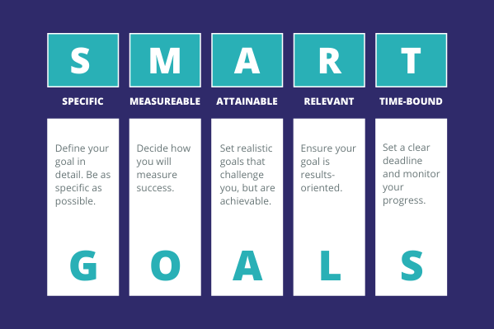
GOALS
Currently, I can _______________________
I want to improve _____________________
My goal is to __________________________
What are ways you can work toward your goal? ____________________________
I will work to achieve this goal by _____________________________

Slide 6
ENGLISH LANGUAGE & LITERATURE
UNIT TITLE:
SOI:
PRODUCT: Eg. Poster, presentation, article, etc.
REFLECTION: Use the following prompts to help you.
What did you use to think before the lesson, how has your thinking changed after the lesson?
What are two things you learnt from the lesson?
What strategies helped you understand the concept better? What challenges did you face?
CONNECTION: What connections can you make from the lesson to the real world? How will this lesson help you solve real life problems?

Slide 7
Place your work here

Slide 8
LANGUAGE ACQUISITION- FRENCH
UNIT TITLE:
SOI:
PRODUCT: Eg. Poster, presentation, article, etc.
REFLECTION: Use the following prompts to help you.
What did you use to think before the lesson, how has your thinking changed after the lesson?
What are two things you learnt from the lesson?
What strategies helped you understand the concept better? What challenges did you face?
CONNECTION: What connections can you make from the lesson to the real world? How will this lesson help you solve real life problems?

Slide 9
Place your work here

Slide 10
LANGUAGE ACQUISITION- SPANISH
UNIT TITLE:
SOI:
PRODUCT: Eg. Poster, presentation, article, etc.
REFLECTION: Use the following prompts to help you.
What did you use to think before the lesson, how has your thinking changed after the lesson?
What are two things you learnt from the lesson?
What strategies helped you understand the concept better? What challenges did you face?
CONNECTION: What connections can you make from the lesson to the real world? How will this lesson help you solve real life problems?

Slide 11
Place your work here

Slide 12
INDIVIDUALS & SOCIETIES
UNIT TITLE:
SOI:
PRODUCT: Eg. Poster, presentation, article, etc.
REFLECTION: Use the following prompts to help you.
What did you use to think before the lesson, how has your thinking changed after the lesson?
What are two things you learnt from the lesson?
What strategies helped you understand the concept better? What challenges did you face?
CONNECTION: What connections can you make from the lesson to the real world? How will this lesson help you solve real life problems?

Slide 13
Place your work here

Slide 14
INTEGRATED SCIENCE
UNIT TITLE:
SOI:
PRODUCT: Eg. Poster, presentation, article, etc.
REFLECTION: Use the following prompts to help you.
What did you use to think before the lesson, how has your thinking changed after the lesson?
What are two things you learnt from the lesson?
What strategies helped you understand the concept better? What challenges did you face?
CONNECTION: What connections can you make from the lesson to the real world? How will this lesson help you solve real life problems?

Slide 15
Place your work here

Slide 16
MATHEMATICS
UNIT TITLE:
SOI:
PRODUCT: Eg. Poster, presentation, article, etc.
REFLECTION: Use the following prompts to help you.
What did you use to think before the lesson, how has your thinking changed after the lesson?
What are two things you learnt from the lesson?
What strategies helped you understand the concept better? What challenges did you face?
CONNECTION: What connections can you make from the lesson to the real world? How will this lesson help you solve real life problems?

Slide 17
Place your work here

Slide 18
VISUAL ARTS
UNIT TITLE:
SOI:
PRODUCT: Eg. Poster, presentation, article, etc.
REFLECTION: Use the following prompts to help you.
What did you use to think before the lesson, how has your thinking changed after the lesson?
What are two things you learnt from the lesson?
What strategies helped you understand the concept better? What challenges did you face?
CONNECTION: What connections can you make from the lesson to the real world? How will this lesson help you solve real life problems?

Slide 19
Place your work here

Slide 20
PERFORMING ARTS
UNIT TITLE:
SOI:
PRODUCT: Eg. Poster, presentation, article, etc.
REFLECTION: Use the following prompts to help you.
What did you use to think before the lesson, how has your thinking changed after the lesson?
What are two things you learnt from the lesson?
What strategies helped you understand the concept better? What challenges did you face?
CONNECTION: What connections can you make from the lesson to the real world? How will this lesson help you solve real life problems?

Slide 21
Place your work here

Slide 22
PHYSICAL & HEALTH EDUCATION
UNIT TITLE:
SOI:
PRODUCT: Eg. Poster, presentation, article, etc.
REFLECTION: Use the following prompts to help you.
What did you use to think before the lesson, how has your thinking changed after the lesson?
What are two things you learnt from the lesson?
What strategies helped you understand the concept better? What challenges did you face?
CONNECTION: What connections can you make from the lesson to the real world? How will this lesson help you solve real life problems?

Slide 23
Place your work here

Slide 24
DESIGN
UNIT TITLE:
SOI:
PRODUCT: Eg. Poster, presentation, article, etc.
REFLECTION: Use the following prompts to help you.
What did you use to think before the lesson, how has your thinking changed after the lesson?
What are two things you learnt from the lesson?
What strategies helped you understand the concept better? What challenges did you face?
CONNECTION: What connections can you make from the lesson to the real world? How will this lesson help you solve real life problems?

Slide 25
Place your work here

Slide 26

SERVICE AS ACTION/COMMUNITY PROJECT/PERSONAL PROJECT
UNIT TITLE:
SOI:
PRODUCT: Eg. Poster, presentation, article, etc.
REFLECTION: Use the following prompts to help you.
What did you use to think before the lesson, how has your thinking changed after the lesson?
What are two things you learnt from the lesson?
What strategies helped you understand the concept better? What challenges did you face?
CONNECTION: What connections can you make from the lesson to the real world? How will this lesson help you solve real life problems?

Slide 27
Place your work here

Slide 28

REFLECTION
The IB Learner Profile I improved on the most were ……………………………………………………….
An example of how I improved is ……………………………………………………………….
The Approaches to Learning skills I improved on the most is my ………………………………………….
An example of how I improved is ………………….
I faced challenges in …………………. this year and I would like to work on this by ……………………. and improve it for the next academic year.

Slide 29
THANKS!

