Slide 1






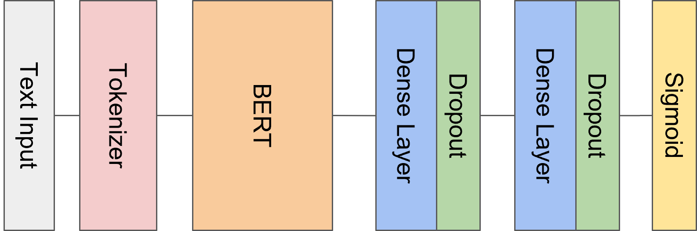






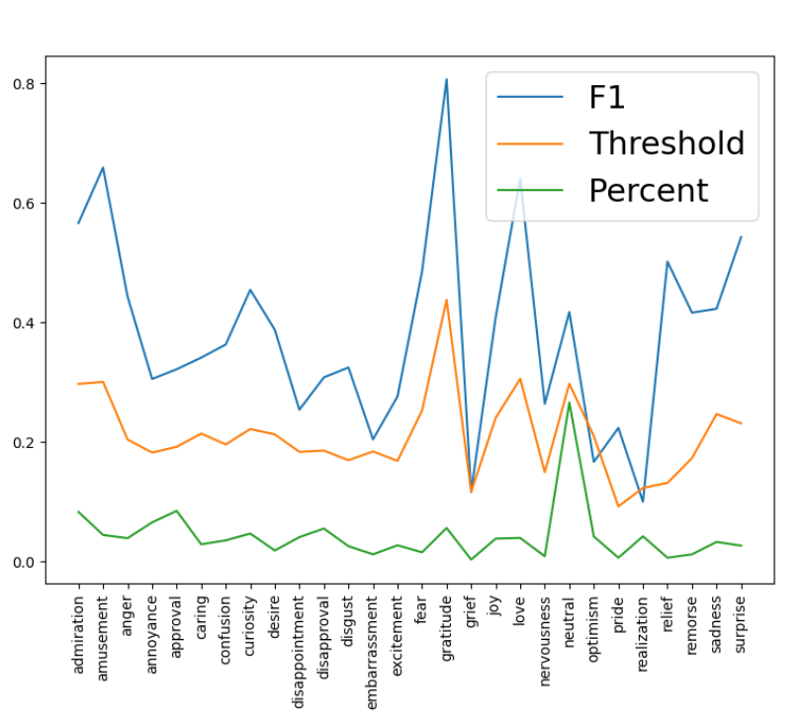



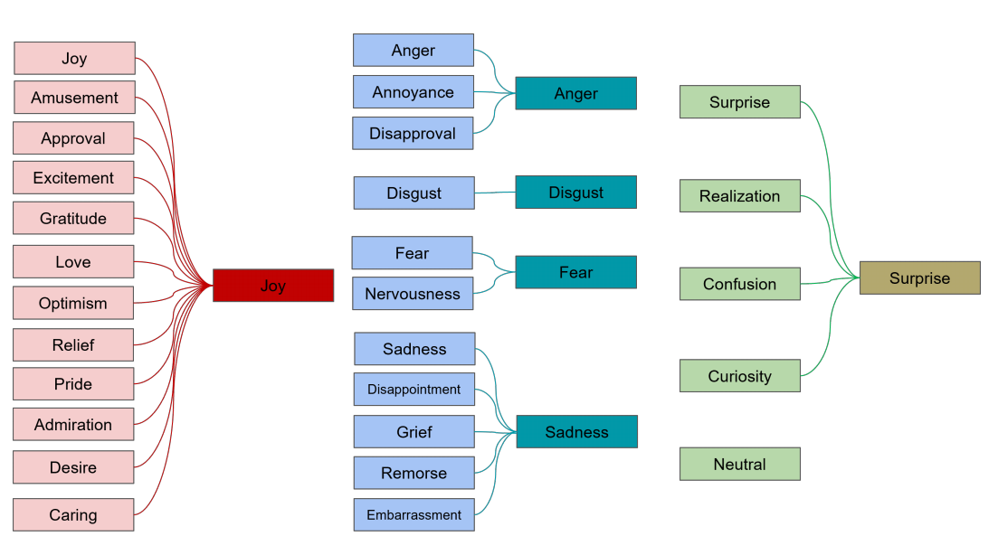
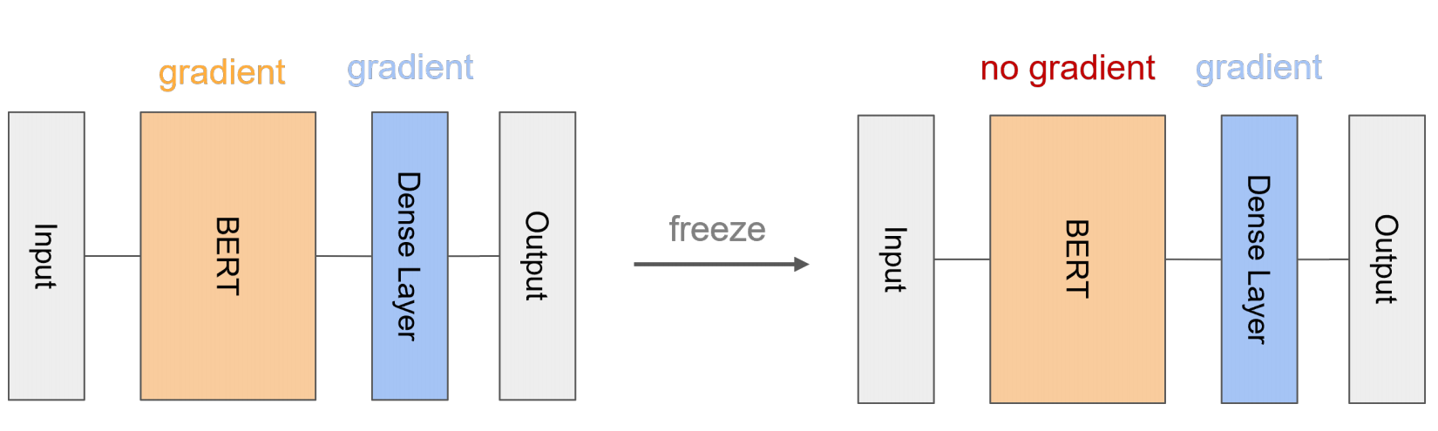
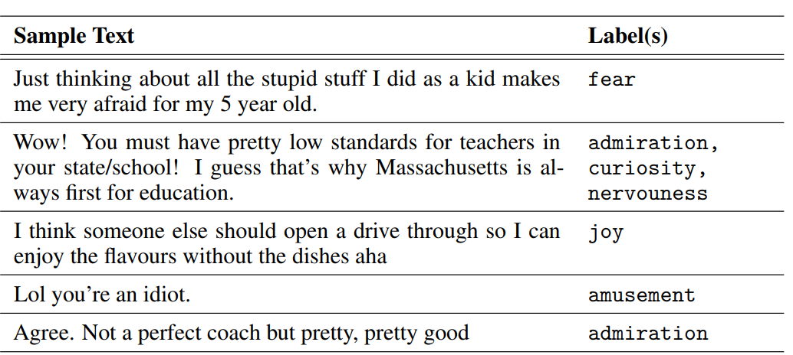
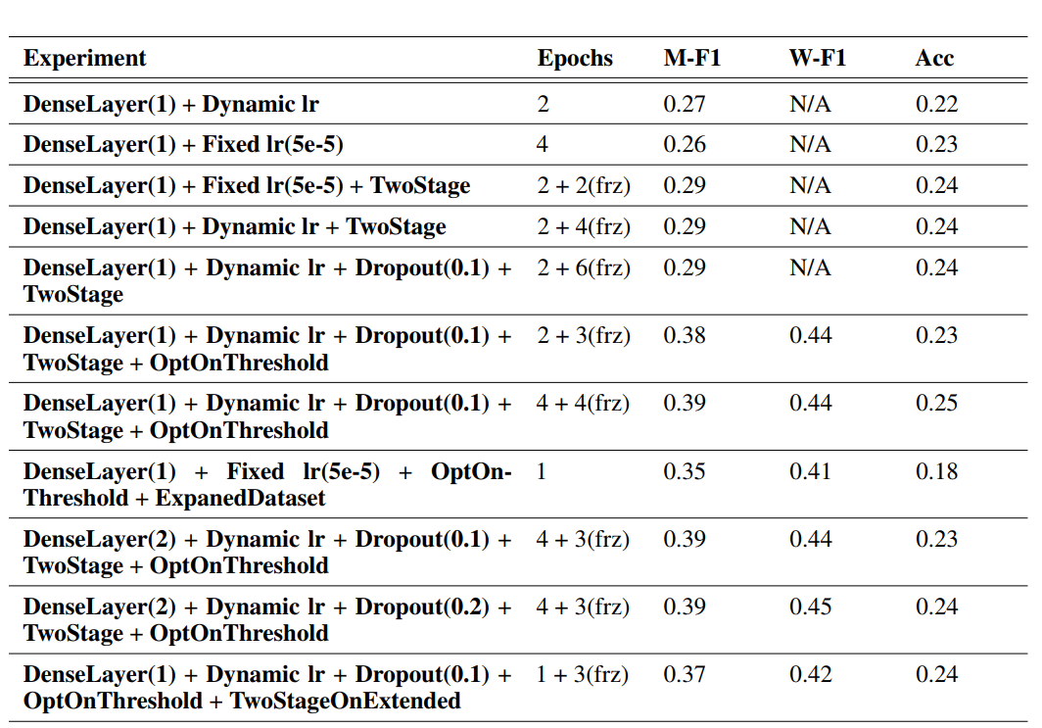
Exploring the Efficacy of BERT on a Fine-Grained Emotion Dataset : GoEmotions
Liangsheng Yin (hnyls2002@sjtu.edu.cn)
Background
Our Approach
Fine-tuned Emotions Classification
Up to 28 kinds like following…
A simple BERT-based model :
work on multi-label classification
Threshold optimization
For each emotion among the 28 labels, specify its threshold, maximizing the F1 score on training set, hoping it would achieve good performance on the validation set.
The threshold result shows that some emotions such as grief , pride, relief is so challenging. And most positive emotion acquires good results!
GoEmotion Dataset
Freeze or not ?
BERT model’s parameters are so huge and well trained. If we continuously training our small dataset on BERT model, it would definitely cause overfitting. To avoid this, we apply a two-stage training for our model : 1. first not freeze the BERT model 2. freeze the BERT model, discard the parameters in our inference head, and train it again.
Task : figure out the emotion!
Experiments
Expanding Dataset : Concatenation
This book reads good. + The joke is so funny.
plus
=
You are so disgusting. + You are adorable.
plus
= ???
Apex Data & Knowledge Management Lab
http://apex.sjtu.edu.cn

