Slide 1

Student’s engagement detection in online classes
Phan Minh Hòa - 20225495

Slide 2
Content
Introduction
Literature Review
Methodology
Experimental Results
Conclusions

Slide 3
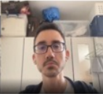
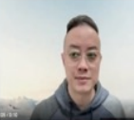
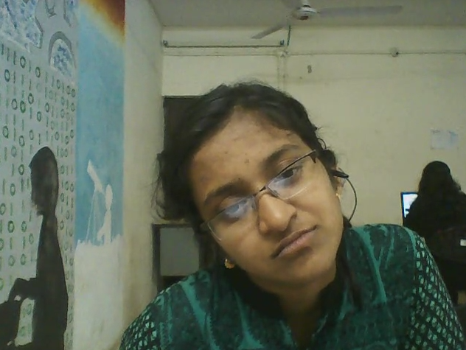
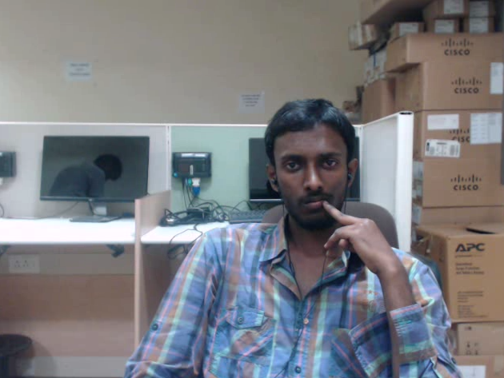
1. Introduction
(1/3)
Problem Statement
Task: Recognize students’ engagement level
Input: 10s clips from students’ webcams
Output: 4 classes
Highly Engage
Engage
Disengage
Highly Disengage

Slide 4
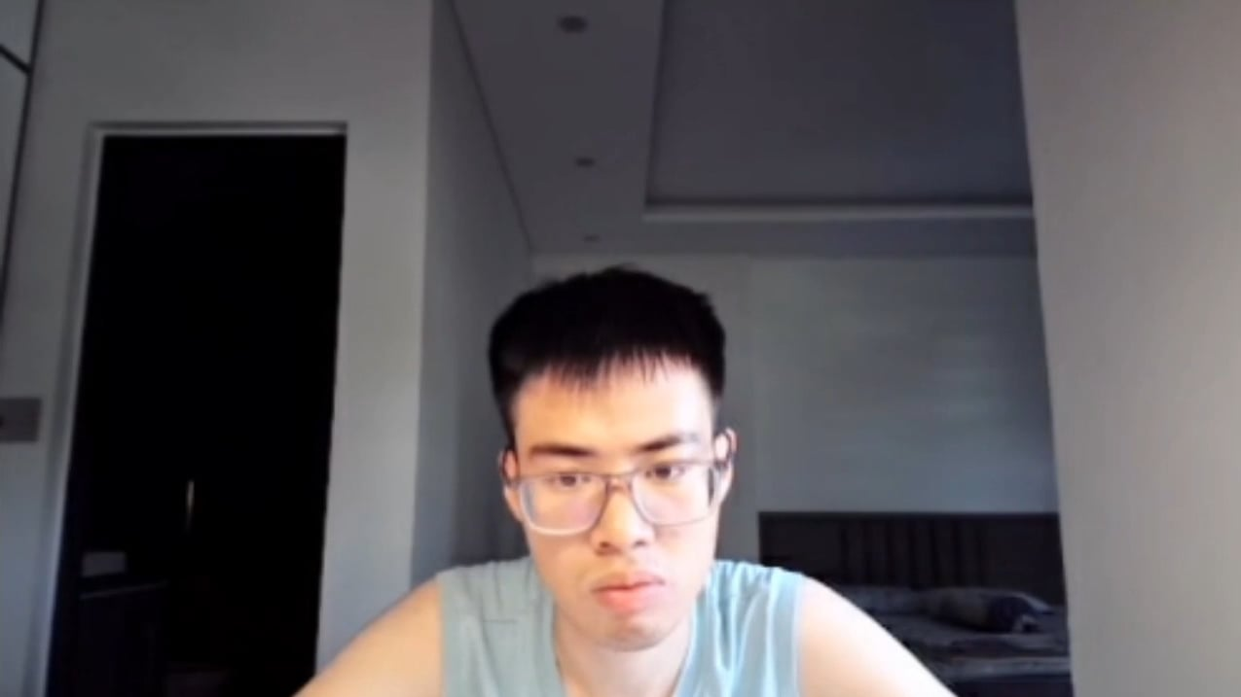
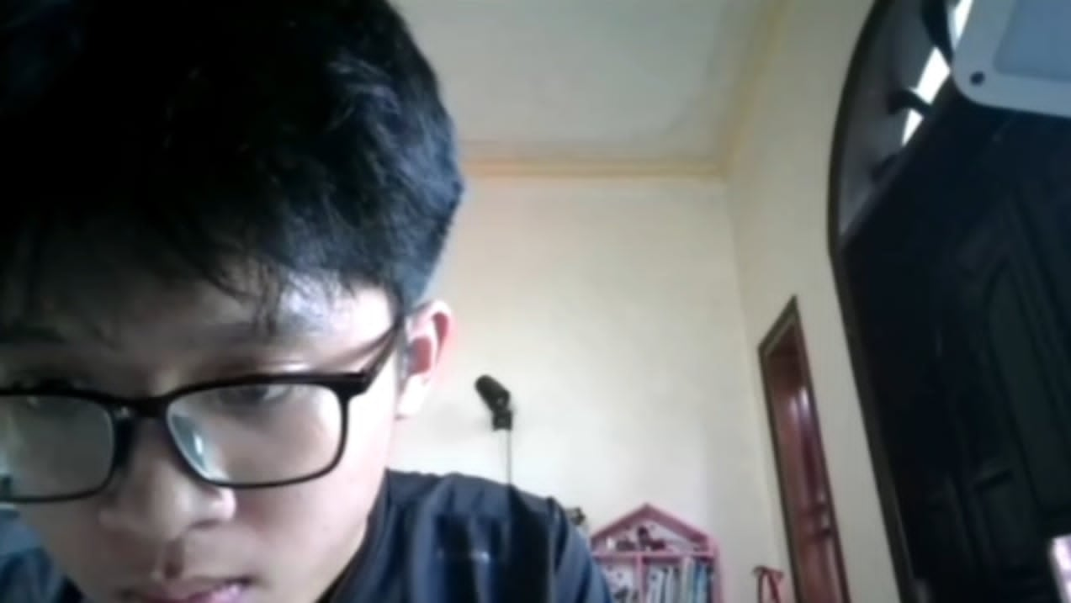
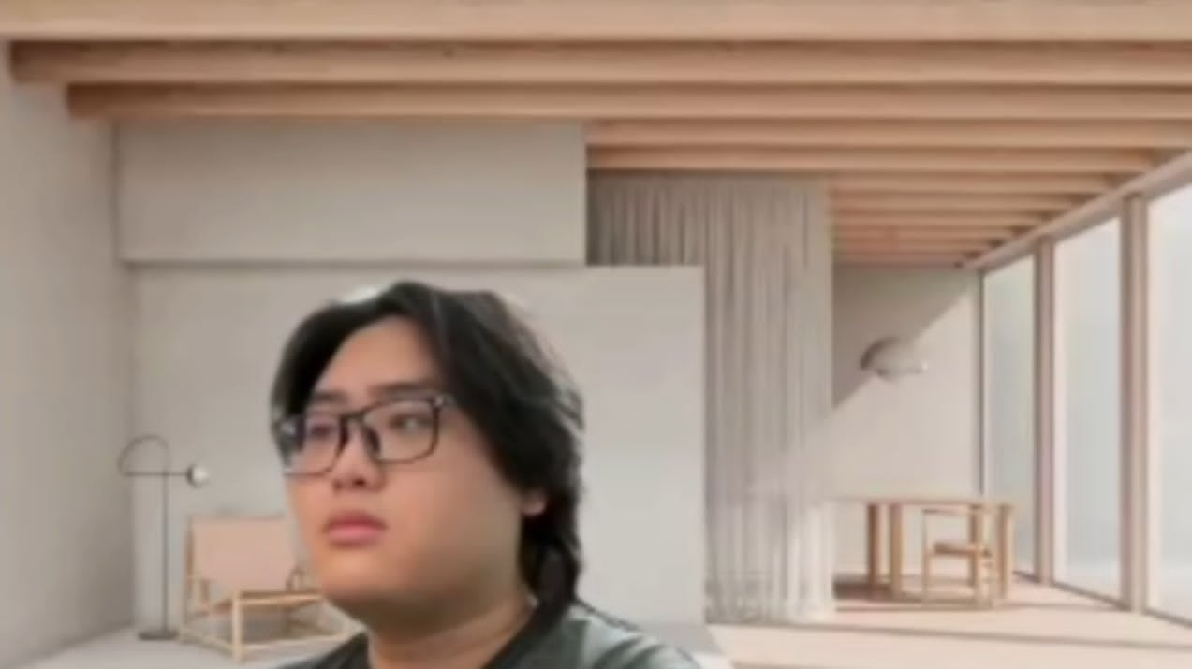
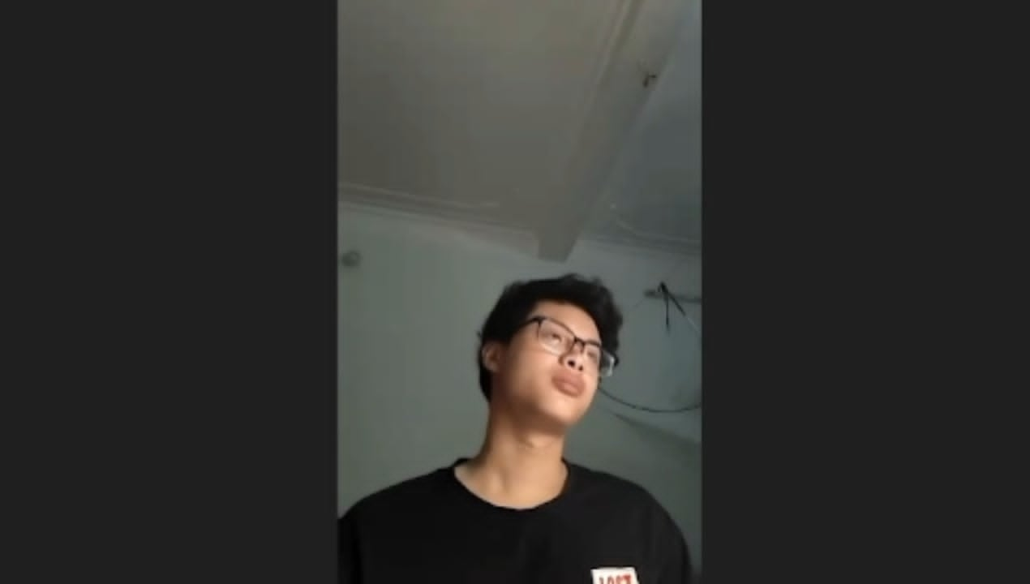
1. Introduction
(2/3)
Key Challenges
Engagement class | CMOSE | DAiSEE | Private
Highly Engage (HE) | 9.6% | 43.8% | 30.6%
Engage (EG) | 69.4% | 50.3% | 58.2%
Disengage (DE) | 18.1% | 5.1% | 8.5%
Highly Disengage (HD) | 2.8% | 0.7% | 2.7%
Ordinality
Imbalance
Angle Diversity

Slide 5
1. Introduction
(3/3)
Research Gaps
Facial features are mixed but are encoded as one block.
Studies mostly use accuracy for evaluation and cross dataset generalisation is limited.
Contributions
New architecture that divide facial features then fuse them.
New private dataset manually labeled from a SOICT online class.
Generalization study using QWK instead of accuracy.

Slide 6
2. Literature Review
(1/1)
Features
Encoder
OpenFace features:
709 features per frame, includes:
Gaze
Eye landmarks
Face landmarks
Head pose
Action units
I3D features:
1024 features per clip
Trained on Kinetics-400
TCN (Temporal Convolutional Network)
LSTM (Long Short-Term Memory)
Transformer

Slide 7
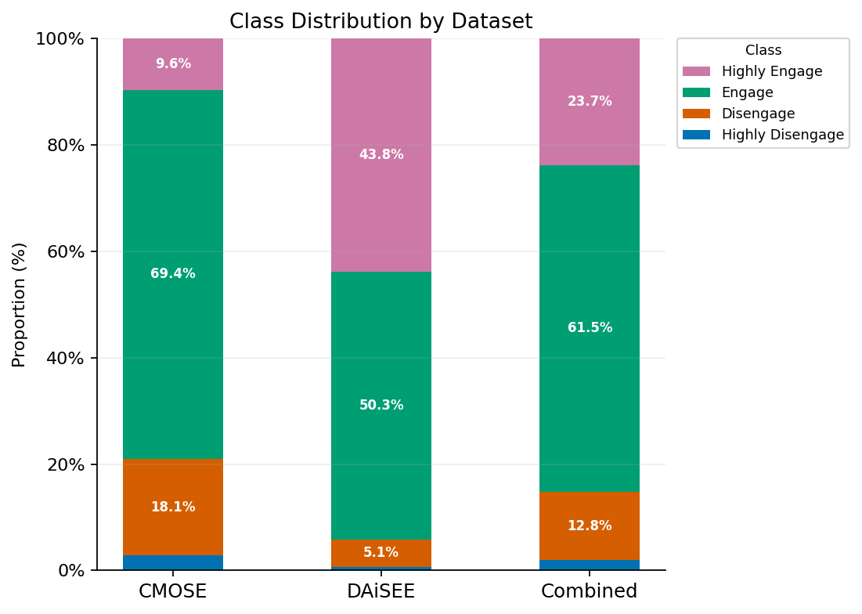
3. Methodology
(1/3)
Public Datasets
Private Datset
366 10-second-long clips
Single annotator
Test only

Slide 8
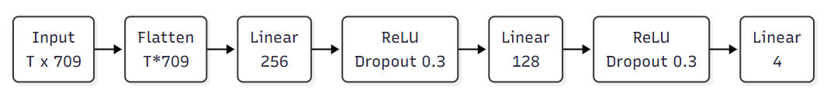
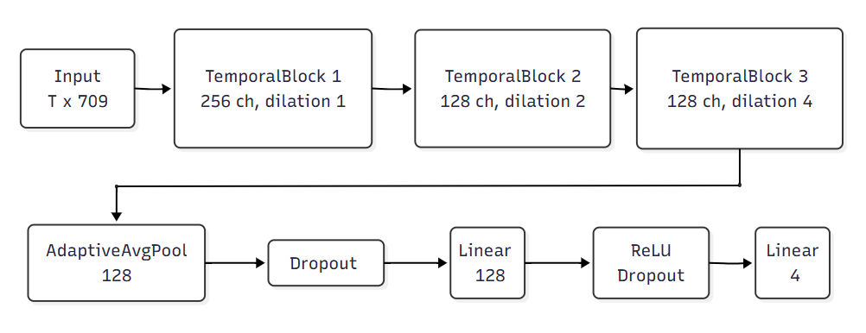
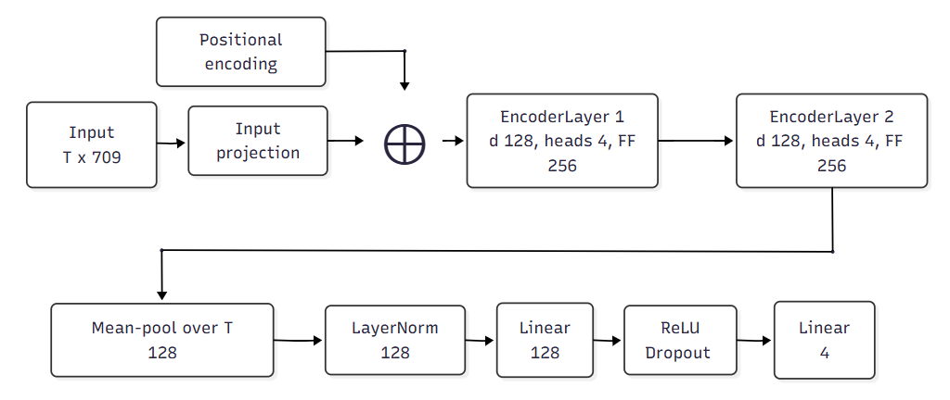
3. Methodology
(2/3)
Baseline Architectures
5 single-encoder baselines:
4 over OpenFace (MLP, TCN, LSTM, Transformer)
1 over I3D (MLP)
Used for
Choosing evaluation method
Set baseline for proposed model

Slide 9
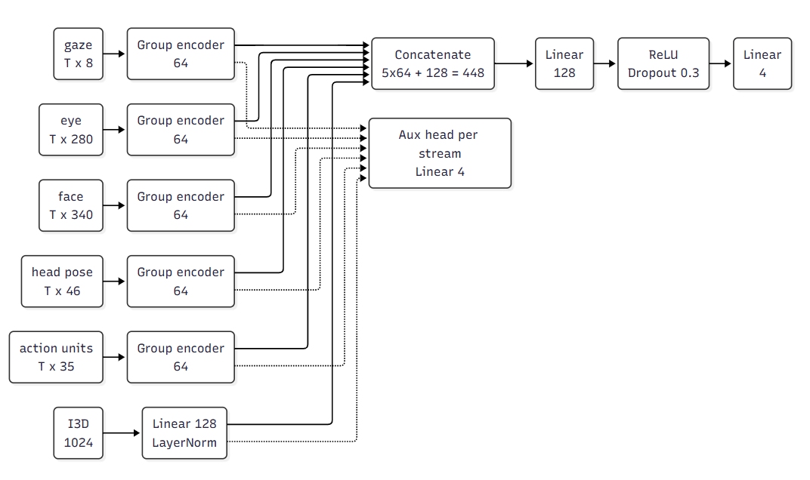
3. Methodology
(3/3)
Hybrid Architecture
Openface features are split into 5 groups
Each group have its own encoder (TCN/LSTM/Transformer)
I3D motion stream is optional
Each stream have auxiliary head
Total of 486 configurations

Slide 10
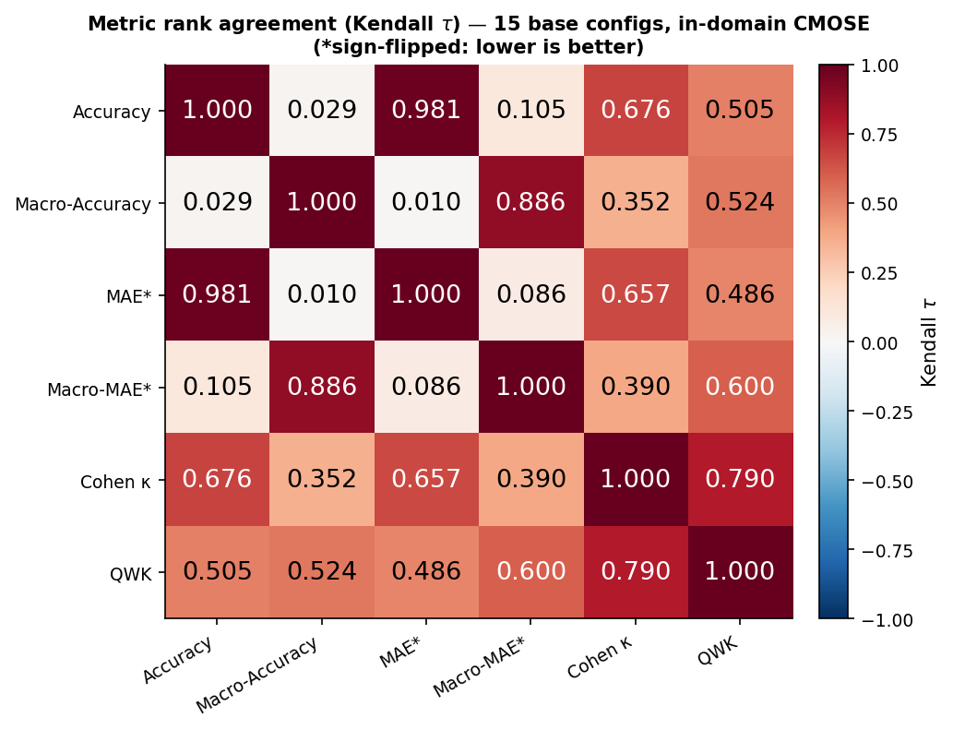
4. Experimental Results
(1/6)
Baseline Models - CMOSE in-domain
2 groups of metrics appears
Accuracy, MAE, Cohen’s Kappa
Macro Accuracy, Macro MAE.
QWK bridges the two groups.

Slide 11
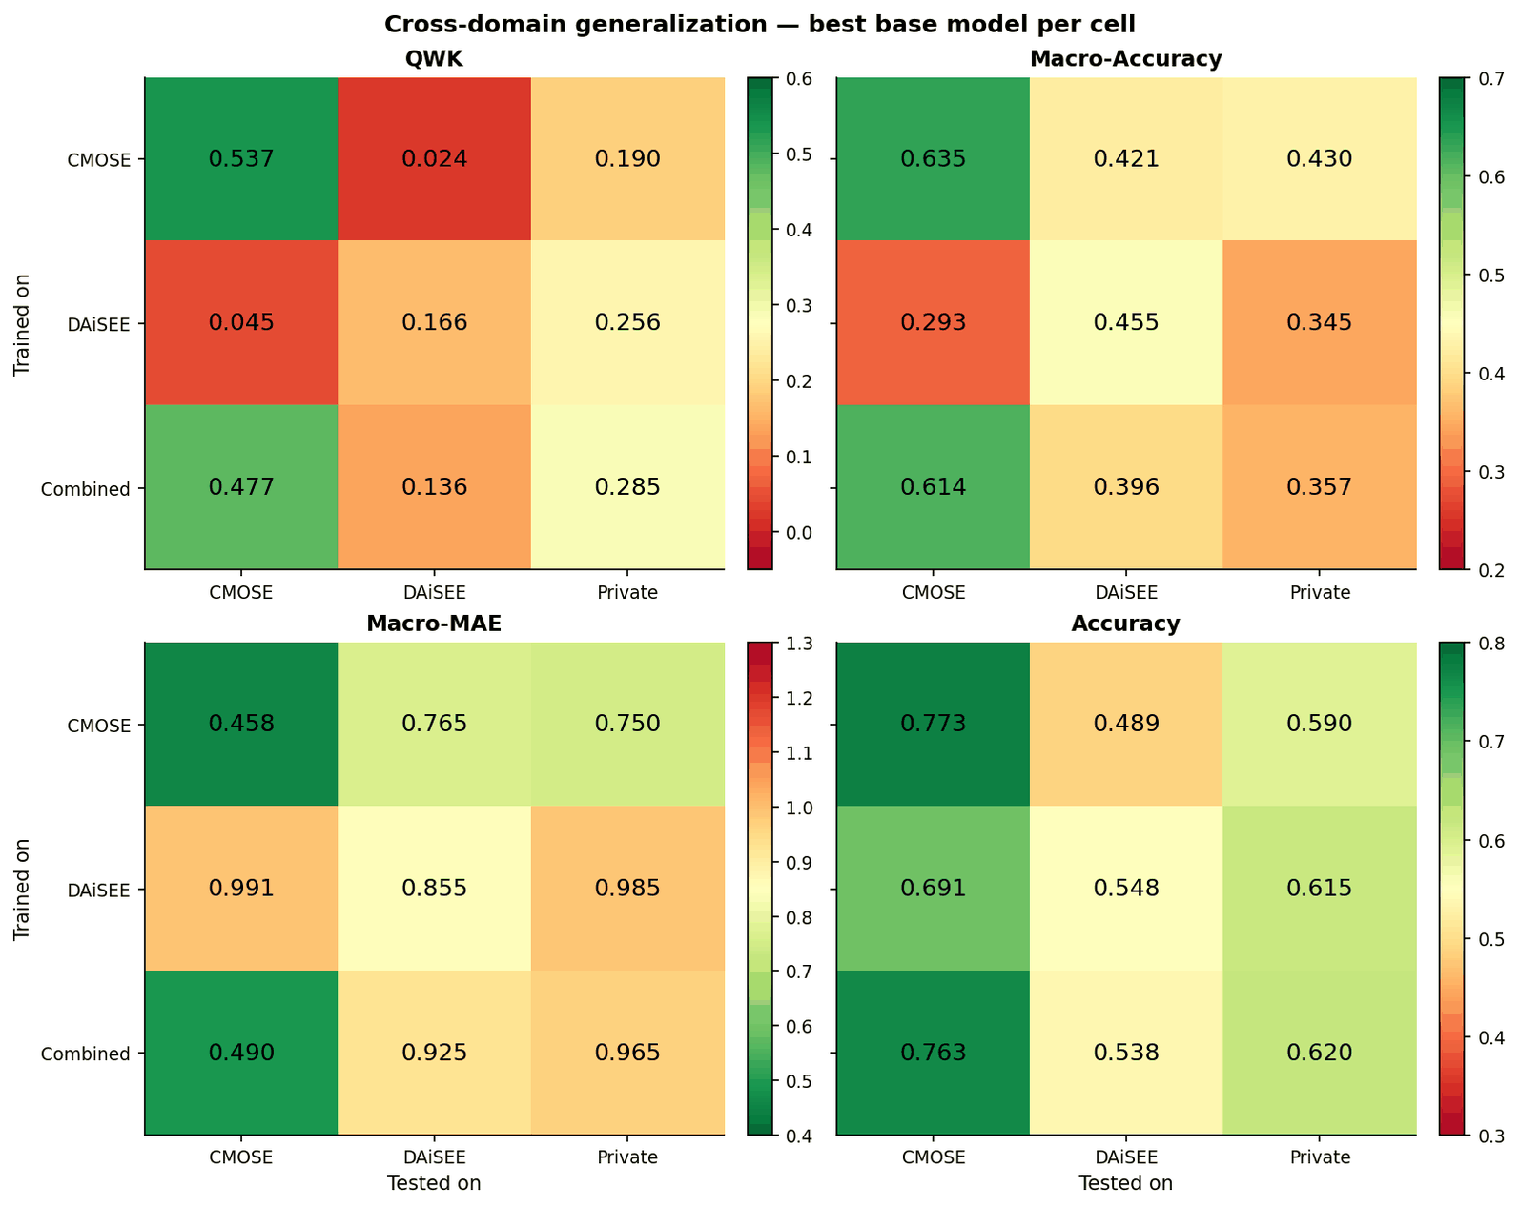
4. Experimental Results
(2/6)
Baseline Models – Cross dataset
Accuracy stay high off-diagonal.
QWK collapse to near zero shows low transferability.
QWK is chosen as primary metric.

Slide 12
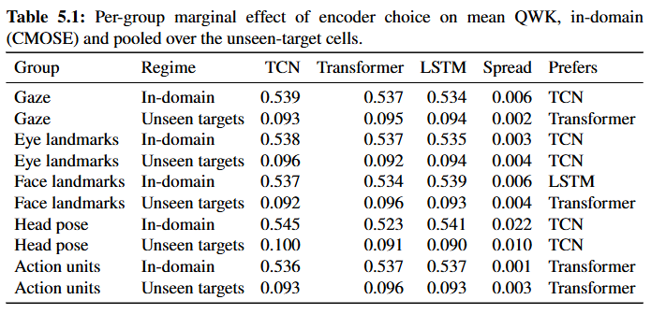
4. Experimental Results
(3/6)
Proposed Hybrid Models Ablation – CMOSE in-domain
Feature groups don’t show clear preference.
Head pose lightly prefers TCN.

Slide 13
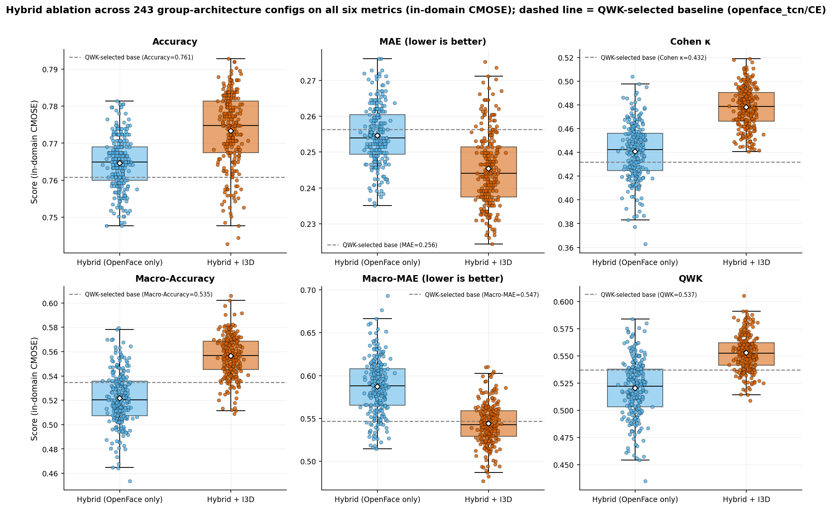
4. Experimental Results
(4/6)
Proposed Hybrid Models Ablation – CMOSE in-domain
I3D motion stream highly improve performance.

Slide 14
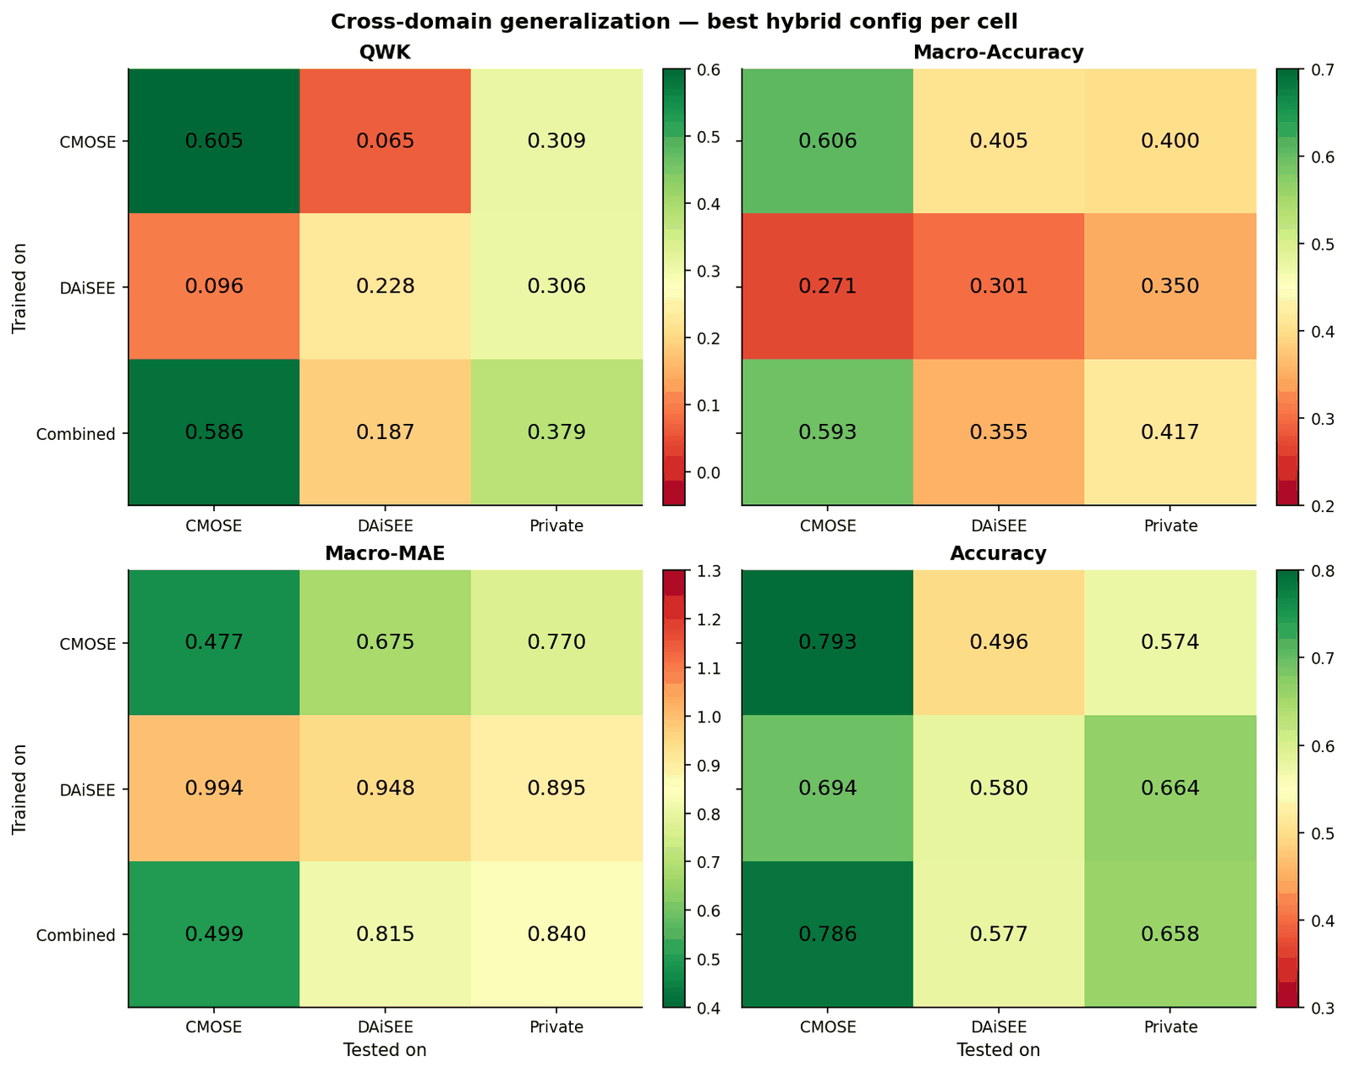
4. Experimental Results
(5/6)
Proposed Hybrid Models Ablation – Cross dataset
Proposed model outperform baseline model.
QWK = 0.605 (+ 0.068, in-domain)
QWK = 0.379 (+ 0.094, private set)
Transferability is still a problem.

Slide 15
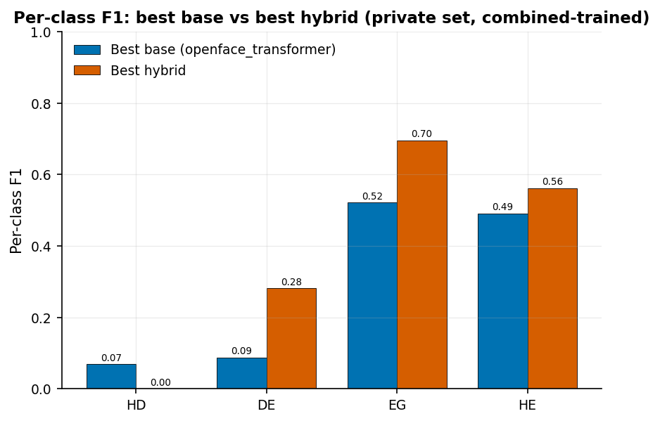
4. Experimental Results
(6/6)
Private Dataset Comparison
Proposed model have higher per-class F1 score.
Transferability of HD class remain a challenge under severe class imbalance.

Slide 16
5. Conclusions
(1/2)
Conclusions
Architecture - decompose-and-fuse; +0.068 QWK in-domain; interpretable.
Private dataset - 366 clips, the decisive deployment probe.
Generalization - transfer collapses; QWK exposes it; +0.094 on private.

Slide 17
5. Conclusions
(2/2)
Limitations
Future Work
Private dataset
Too small to train on
Single annotator
Modest in-domain gain
Private dataset
Larger dataset
More structured labeling system
Target HD class
Learned group encoders

Slide 18
THANK YOU !

Slide 20
Backup Slides

Slide 21
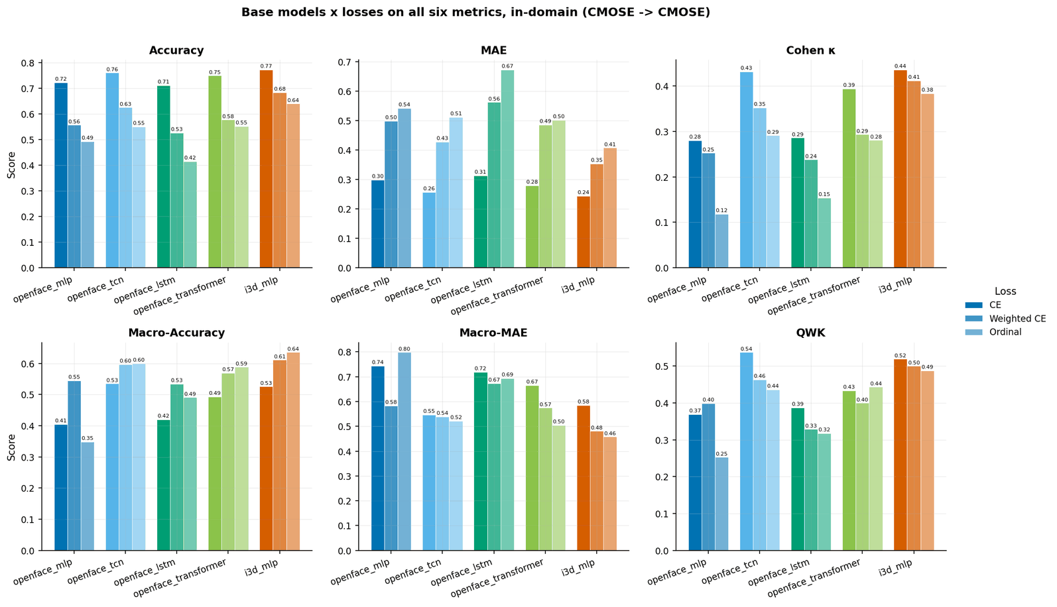
Backup Slides

Slide 22
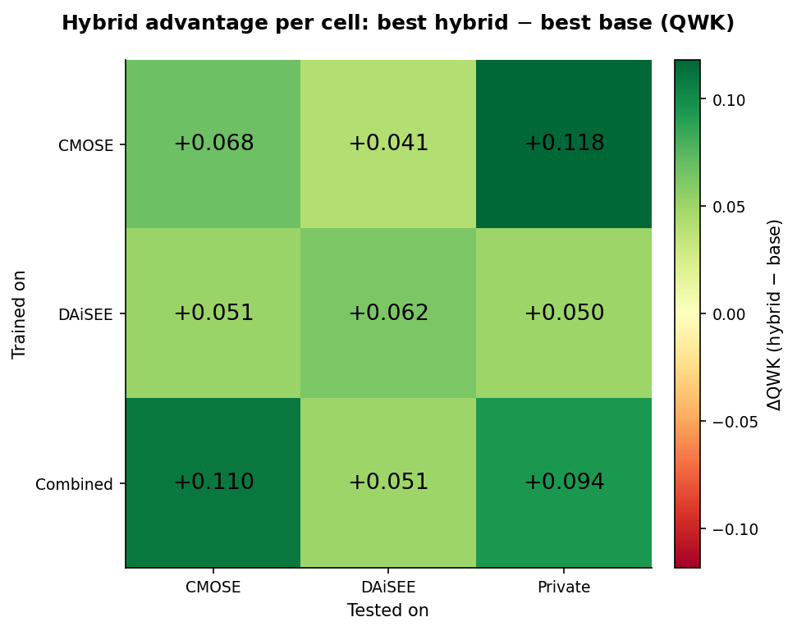
Backup Slides

Slide 23
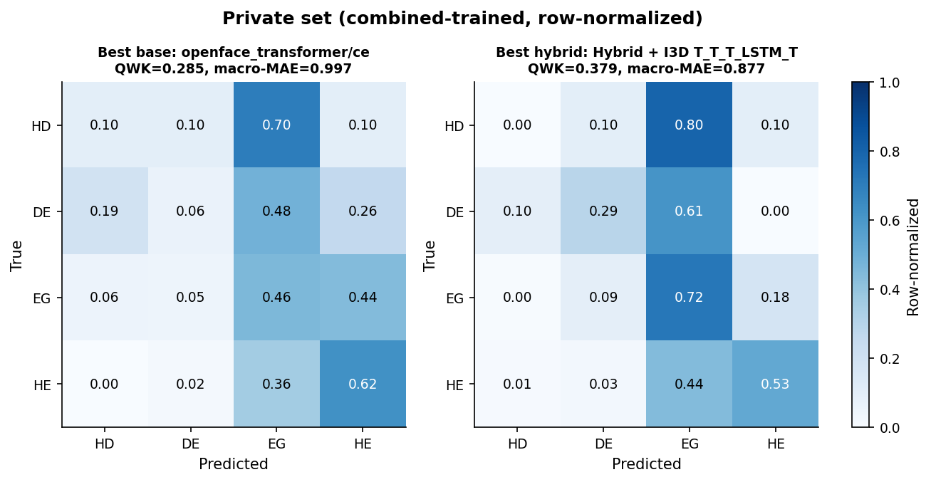
Backup Slides

Slide 24
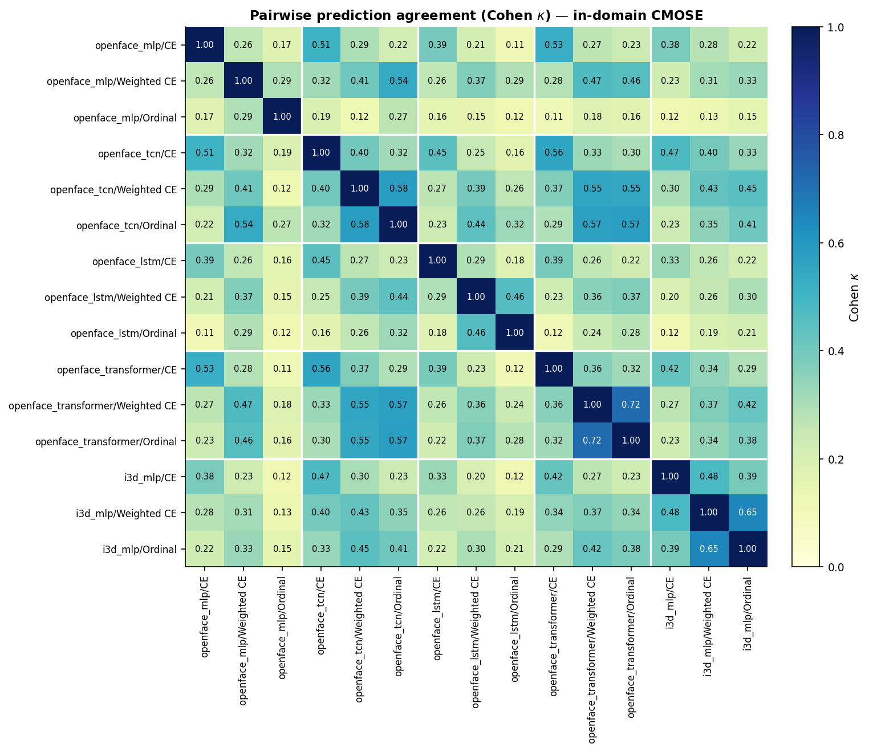
Backup Slides

