Slide 2

Student’s engagement detection in online classes
Phan Minh Hòa - 20225495

Slide 3
Content
Introduction
Literature Review
Methodology
Experimental Results
Conclusions

Slide 4
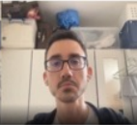
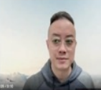
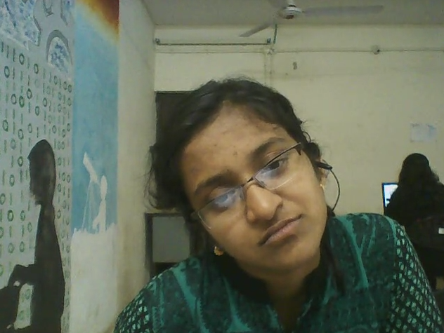
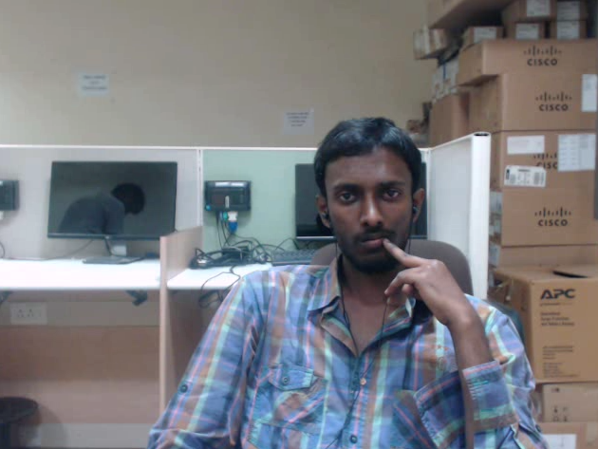
1. Introduction
Problem Statement
Task: Recognize students’ engagement level
Input: 10s clips from students’ webcams
Output: 4 classes
Highly Engage (HE)
Engage (EG)
Disengage (DE)
Highly Disengage (HD)

Slide 5
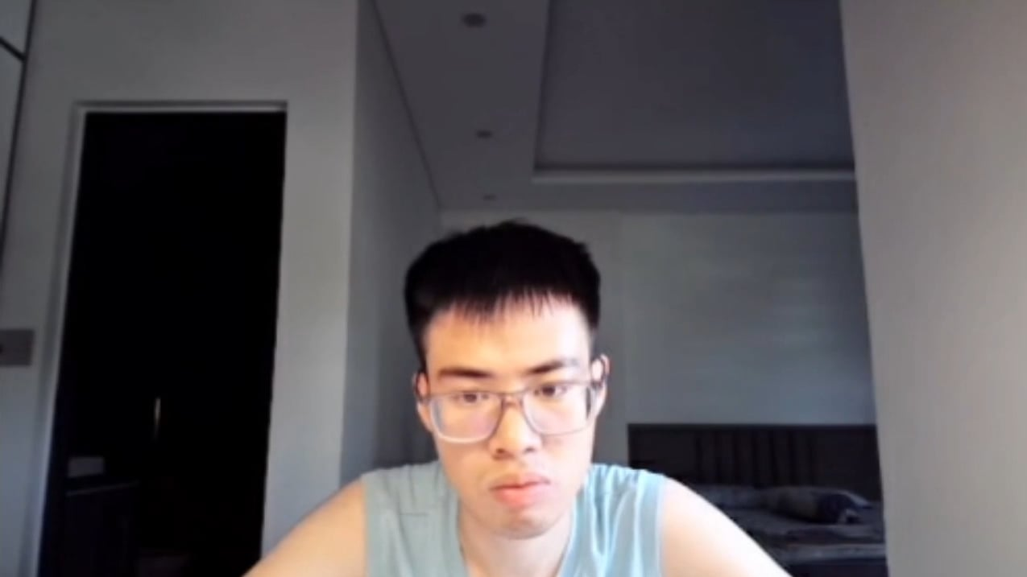
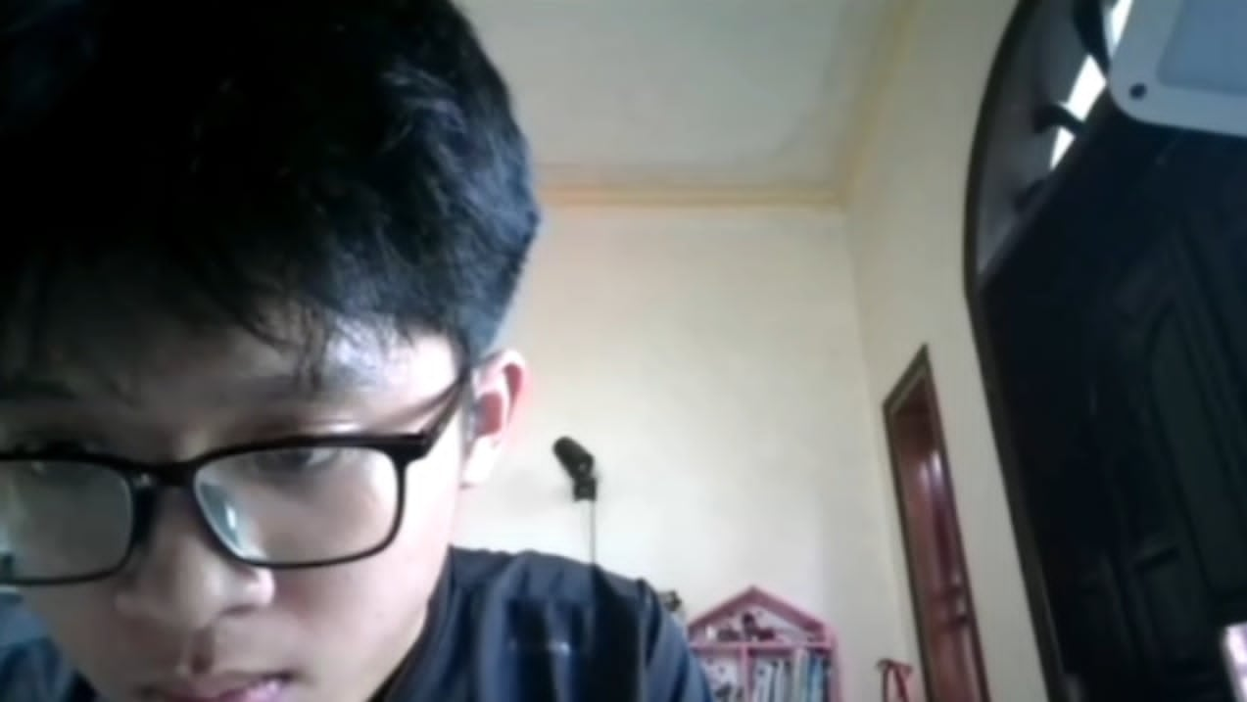
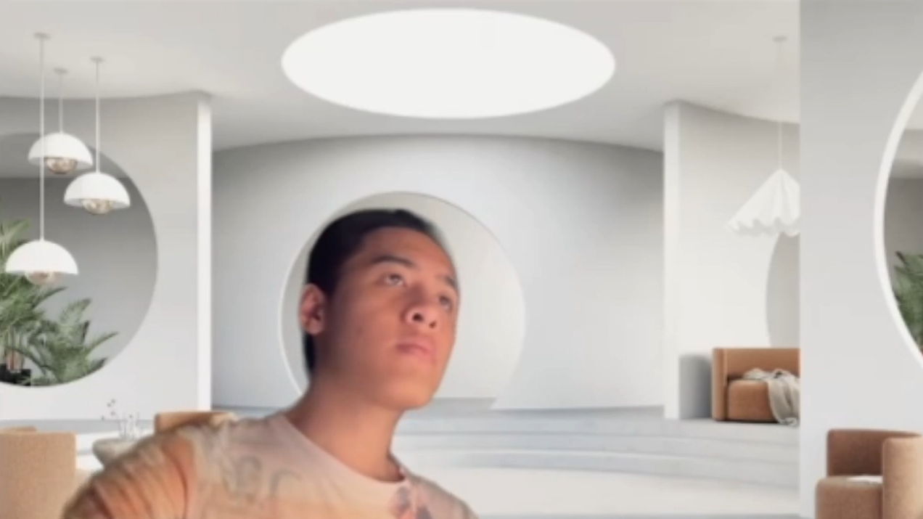
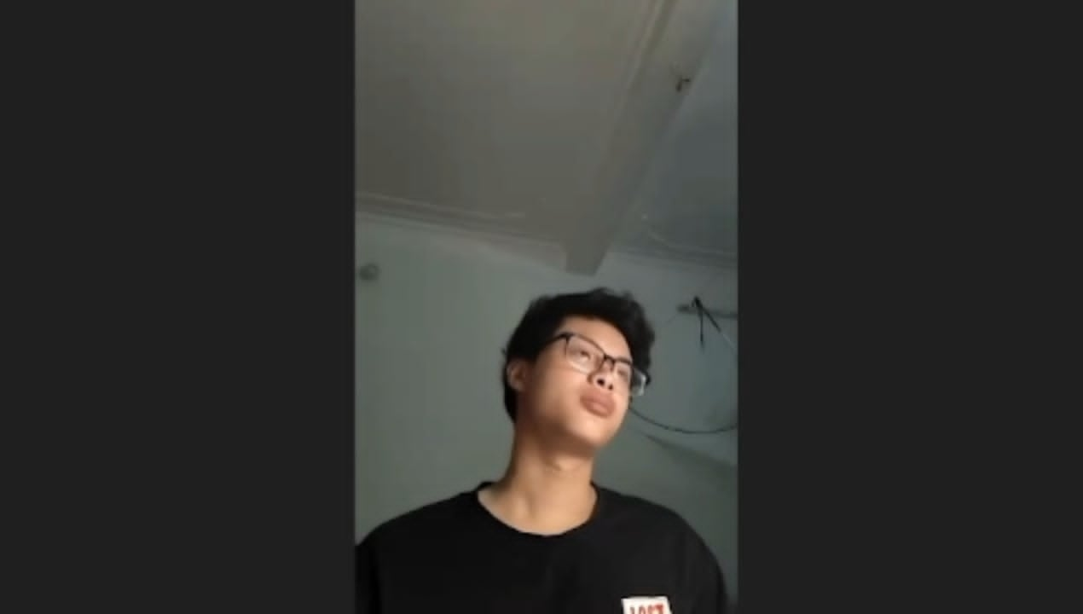
1. Introduction
Key Challenges
Class | CMOSE | DAiSEE | Private
HE | 9.6% | 43.8% | 30.6%
EG | 69.4% | 50.3% | 58.2%
DE | 18.1% | 5.1% | 8.5%
HD | 2.8% | 0.7% | 2.7%
Ordinality
Imbalance
Angle Diversity

Slide 6
1. Introduction
Research Gaps
Facial features are mixed but are encoded as one block.
Studies mostly use accuracy for evaluation and cross dataset generalisation is limited.
Contributions
New hybrid architecture.
New private dataset manually labeled from a SOICT online class.
Generalization study using QWK instead of accuracy.

Slide 7
2. Literature Review
Features
OpenFace features:
709 facial features per frame.
I3D features:
1024 features per clip
Trained on Kinetics-400
Encoder
TCN (Temporal Convolutional Network)
LSTM (Long Short-Term Memory)
Transformer

Slide 8
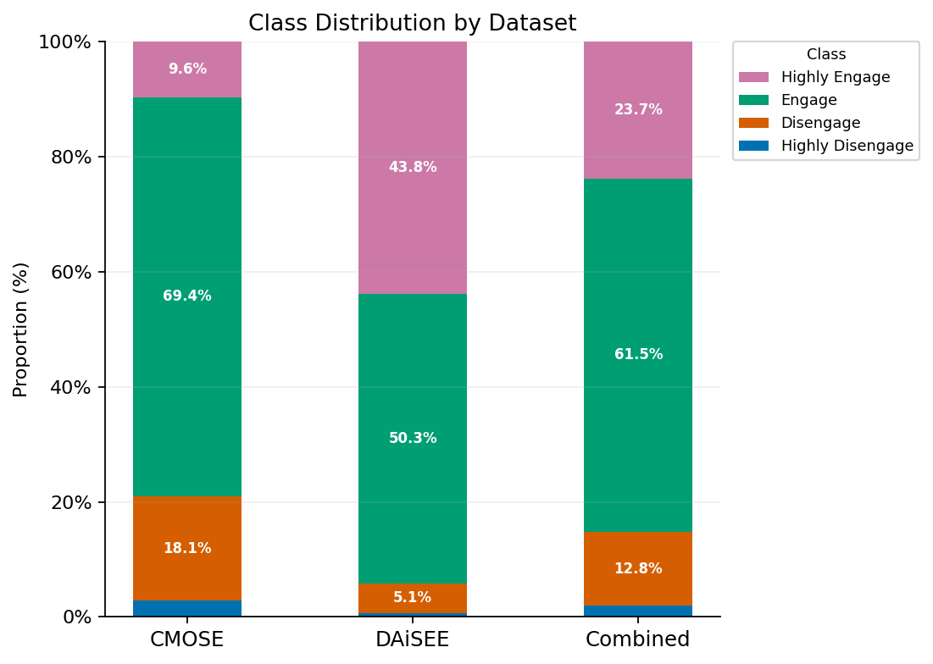
3. Methodology
Public Datasets
CMOSE
DAiSEE
Combined
Private Datset
366 10-second-long clips
Single annotator
Test only

Slide 9
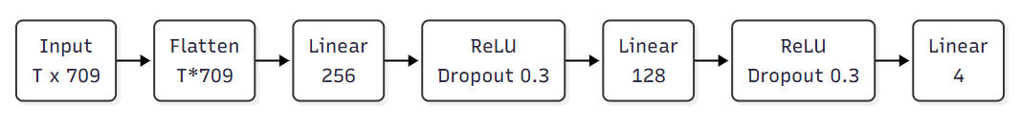
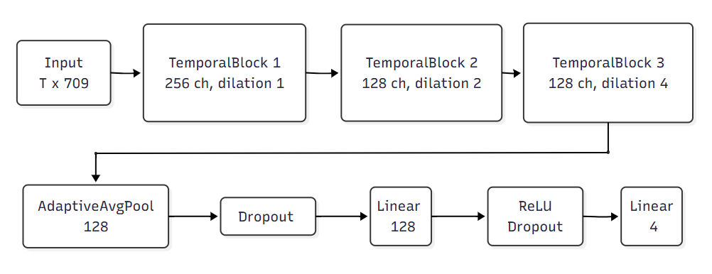
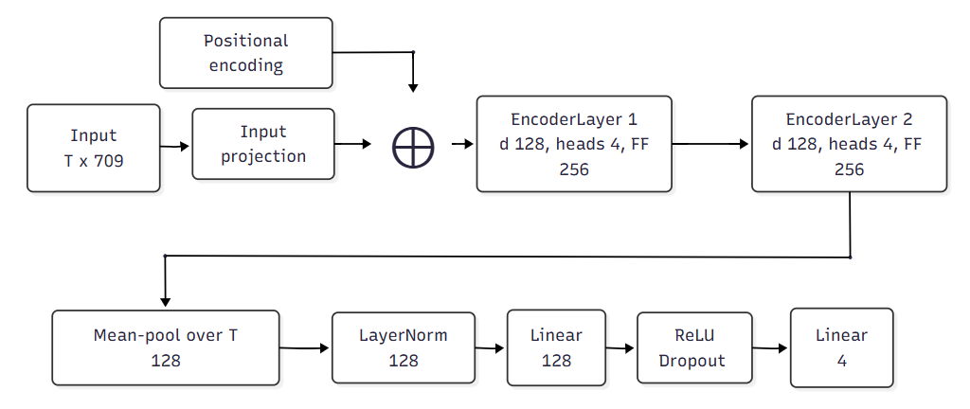
3. Methodology
Baseline Architectures
5 single-encoder baselines:
4 over OpenFace (MLP, TCN, LSTM, Transformer)
1 over I3D (MLP)
Used for
Choosing evaluation method
Set baseline for proposed model

Slide 10
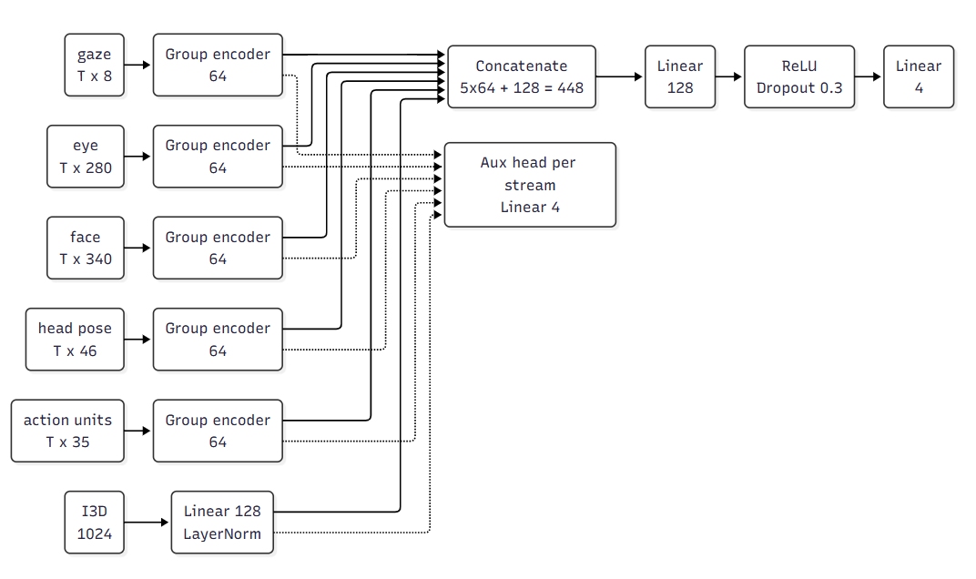
3. Methodology
Hybrid Architecture
Openface features are split into 5 groups
Each group have its own encoder (TCN/LSTM/Transformer)
I3D motion stream is optional
Each stream have auxiliary head
Total of 486 configurations

Slide 11
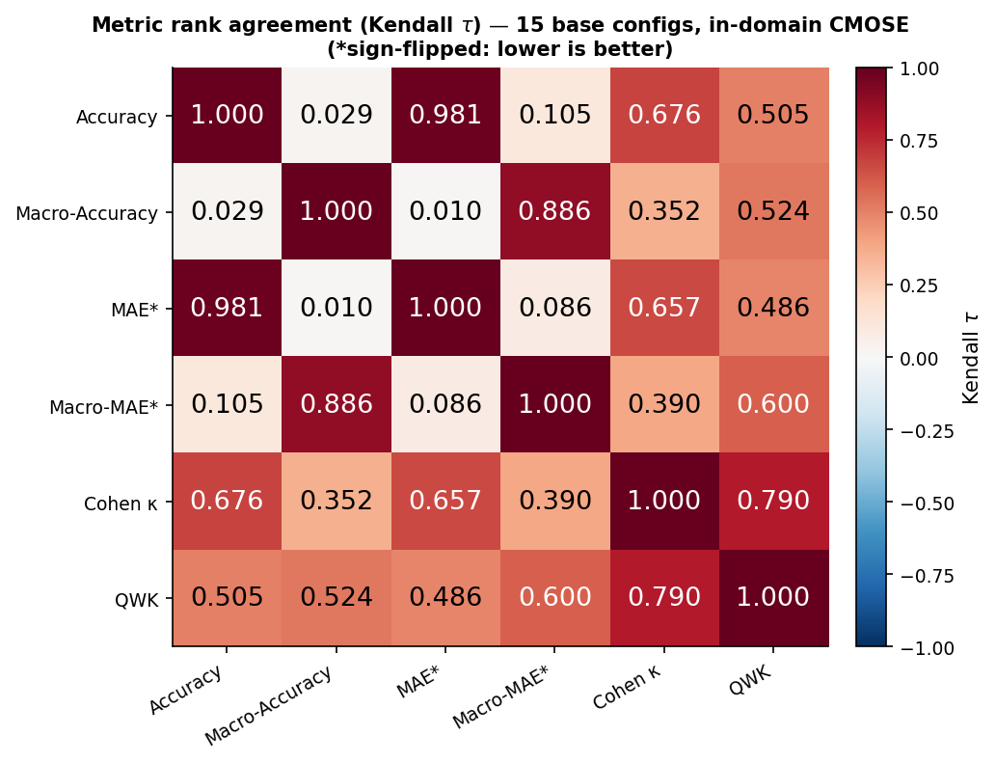
4. Experimental Results
Baseline Models - CMOSE in-domain
2 groups of metrics
Accuracy, MAE, Cohen’s Kappa
Macro Accuracy, Macro MAE.
QWK bridges the two groups.

Slide 12
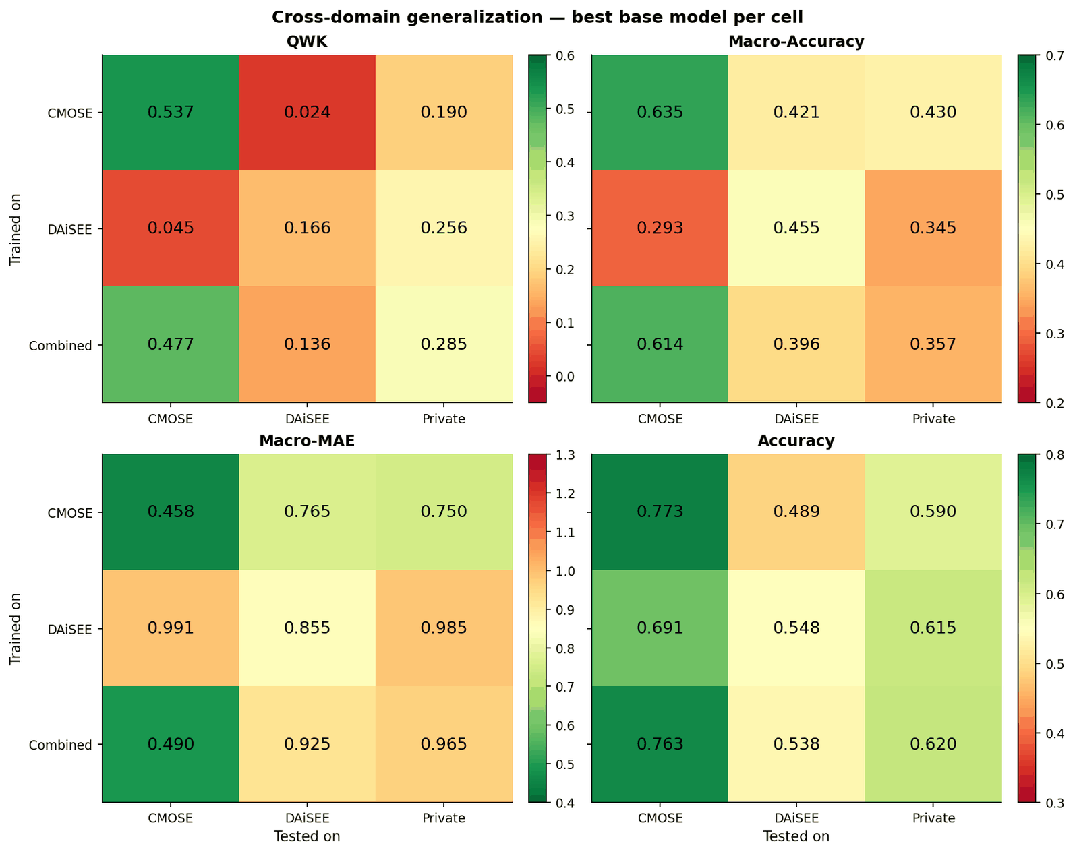
4. Experimental Results
Baseline Models – Cross dataset
Accuracy stay high off-diagonal.
QWK collapse to near zero shows low transferability.
QWK is chosen as primary metric.

Slide 13
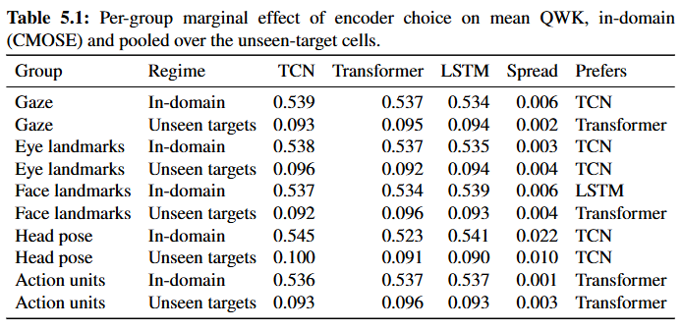
4. Experimental Results
Proposed Hybrid Models Ablation – CMOSE in-domain
Feature groups don’t show clear preference.
Head pose lightly prefers TCN.

Slide 14
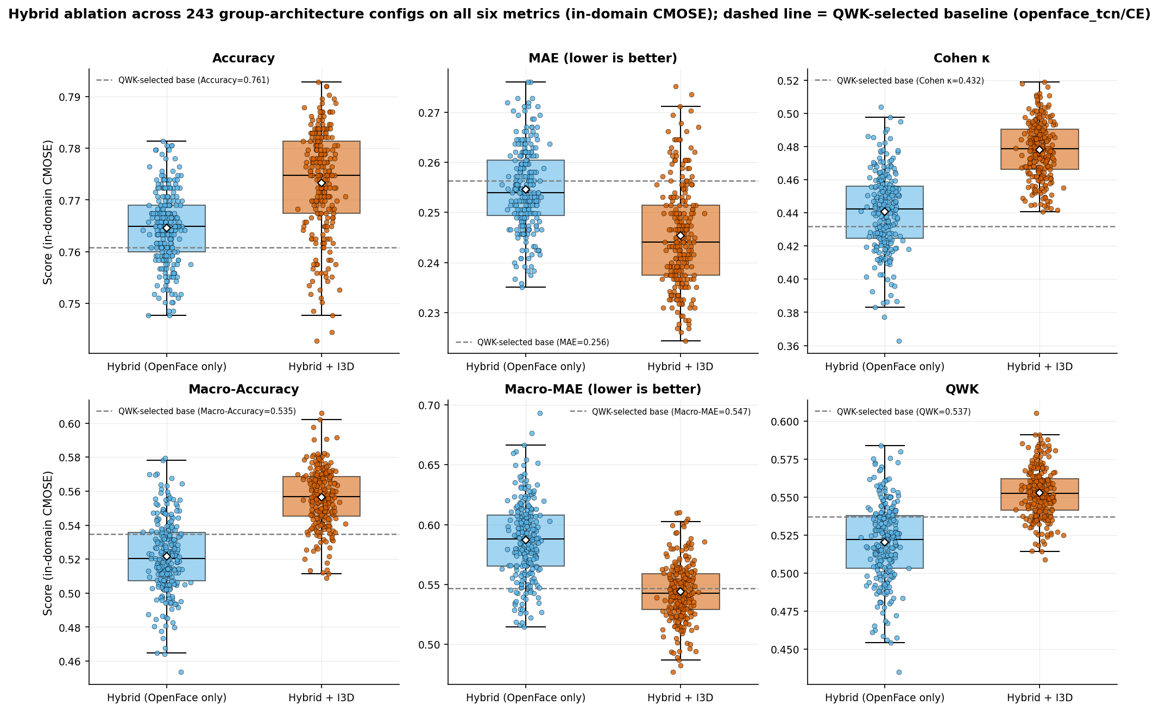
4. Experimental Results
Proposed Hybrid Models Ablation – CMOSE in-domain
I3D motion stream highly improve performance.

Slide 15
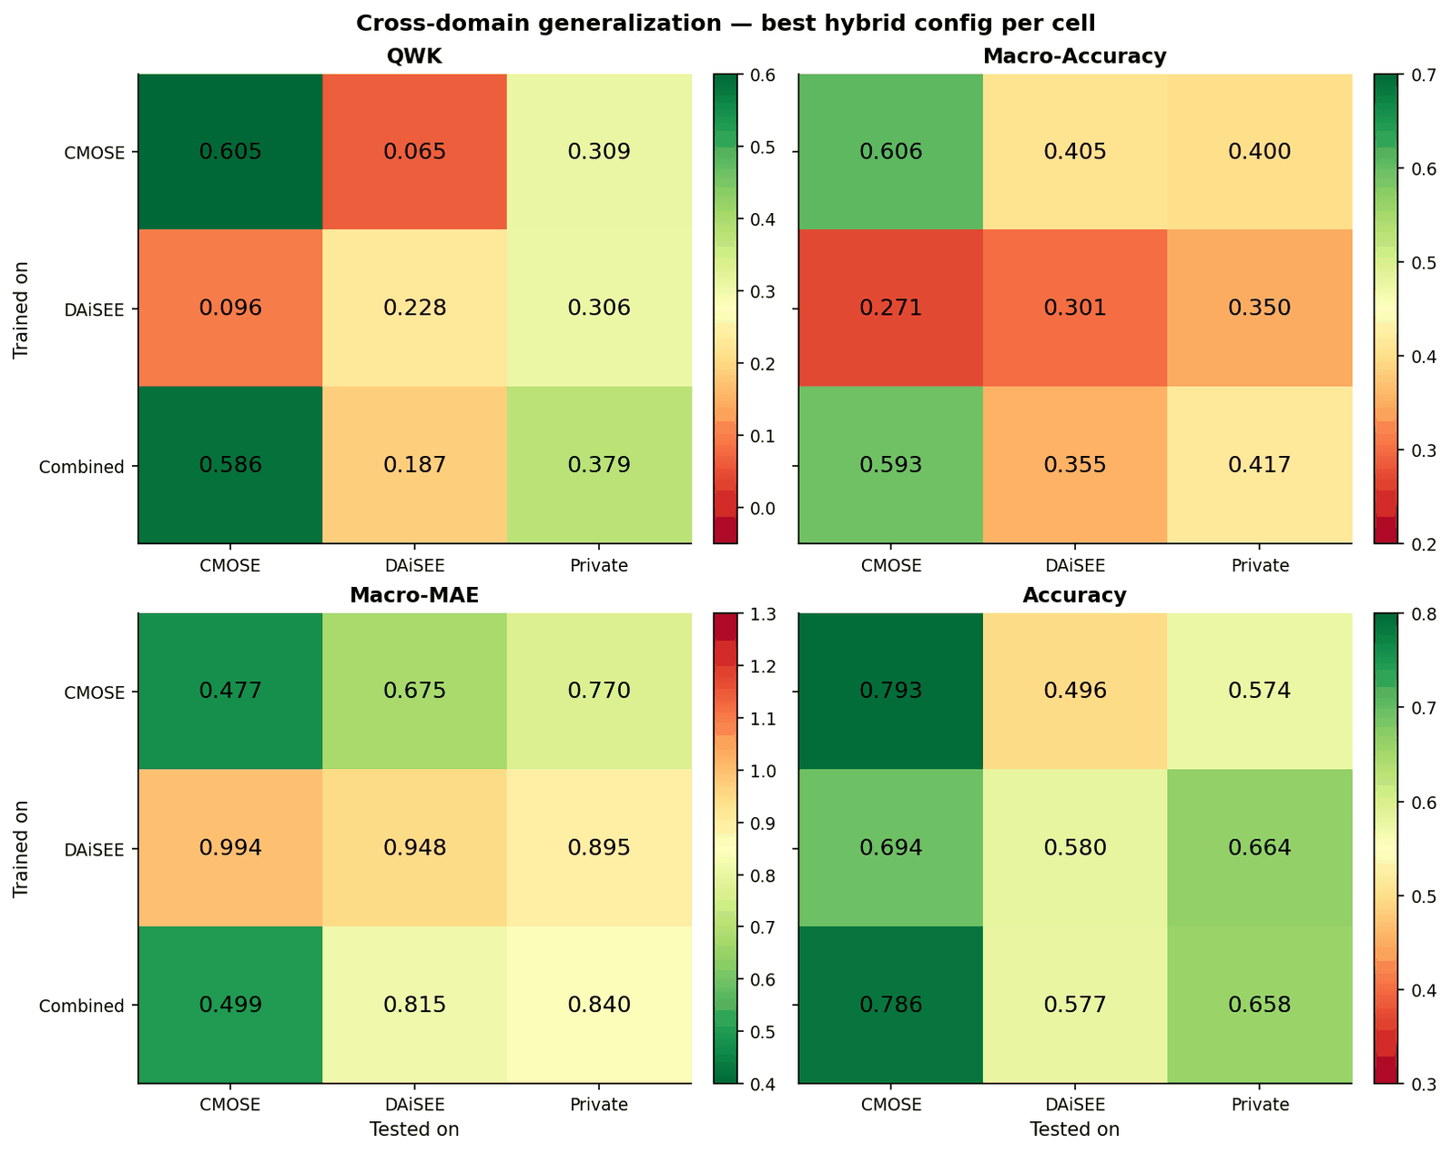
4. Experimental Results
Proposed Hybrid Models Ablation – Cross dataset
Proposed model outperform baseline model.
QWK = 0.605 (+ 0.068, in-domain)
QWK = 0.379 (+ 0.094, private set)

Slide 16
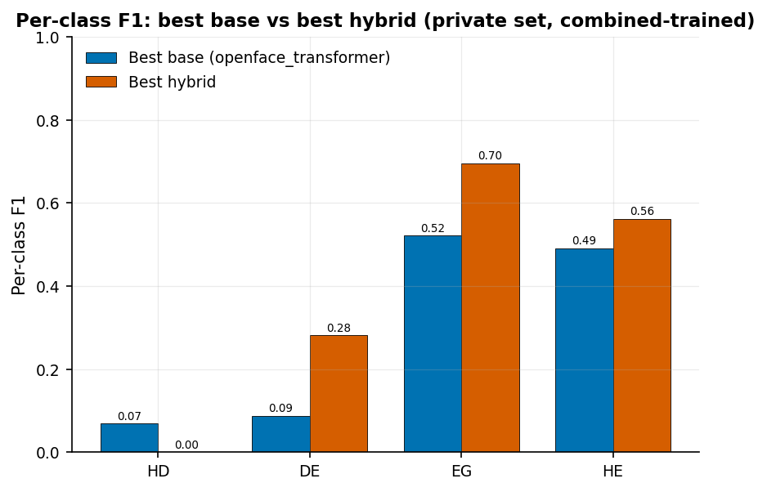
4. Experimental Results
Private Dataset Comparison
Proposed model have higher per-class F1 score.
F1 score of HD class collapsed

Slide 17
5. Conclusions
Conclusions
Architecture:
New hybrid architecture
+0.068 QWK in-domain
+ 0.094 QWK on private set
Private dataset:
366 clips.
Manually labeled.
Generalization:
Low QWK exposes low transferability

Slide 18
2. Literature Review
Limitations
Private dataset
Too small to train on
Single annotator
Inability to discriminate class HD
Future Work
Private dataset
Larger dataset
More structured labeling system
Target HD class
Learned group encoders

Slide 19
THANK YOU !

Slide 20
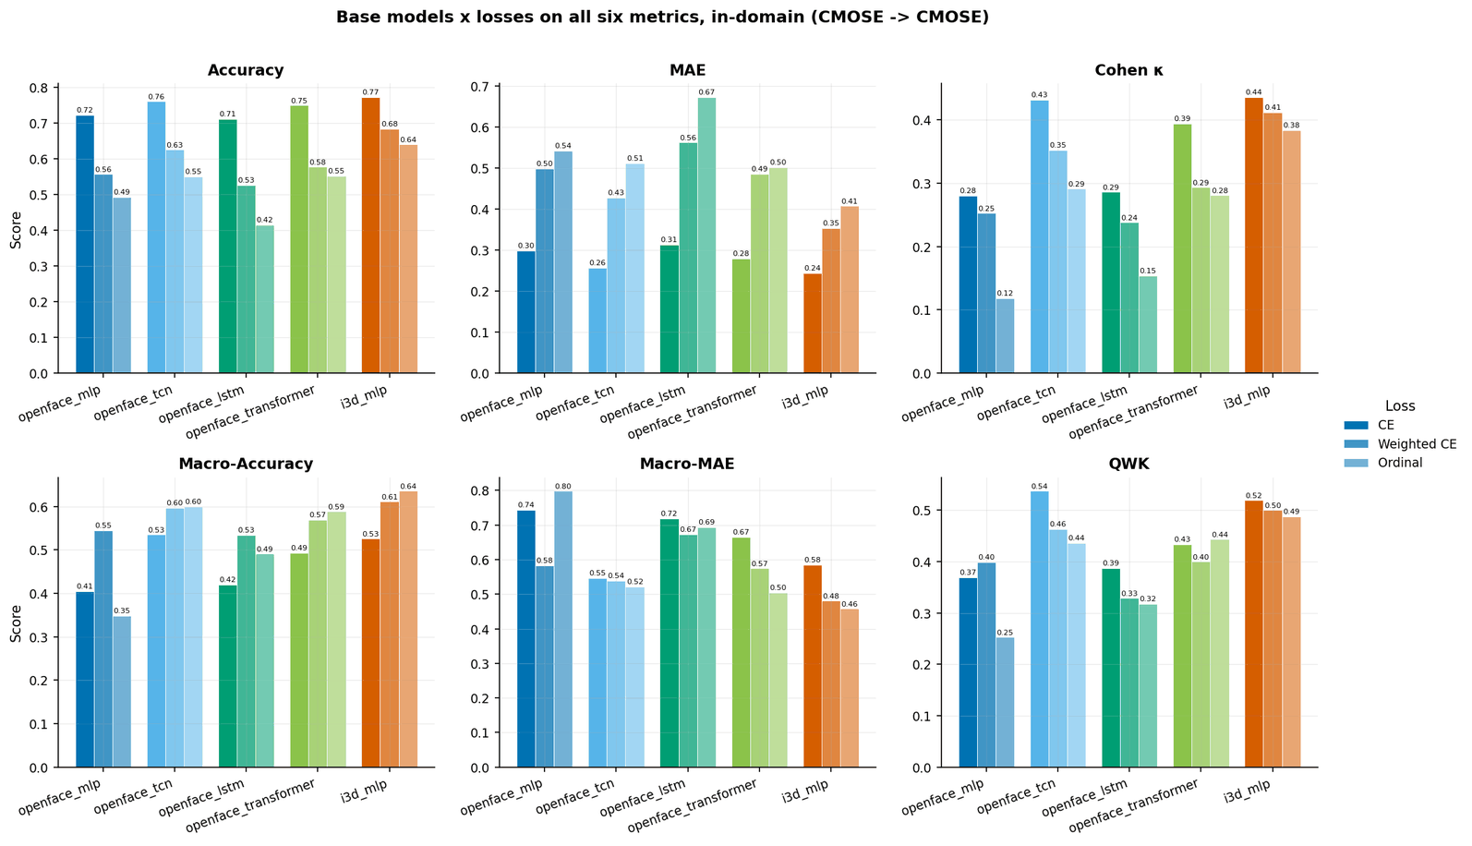
Backup Slides

Slide 21
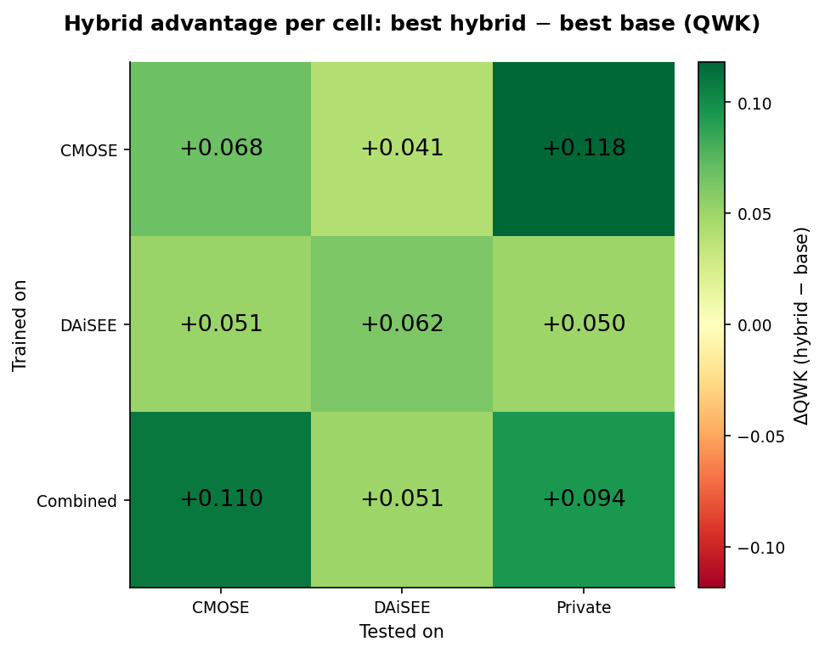
Backup Slides

Slide 22
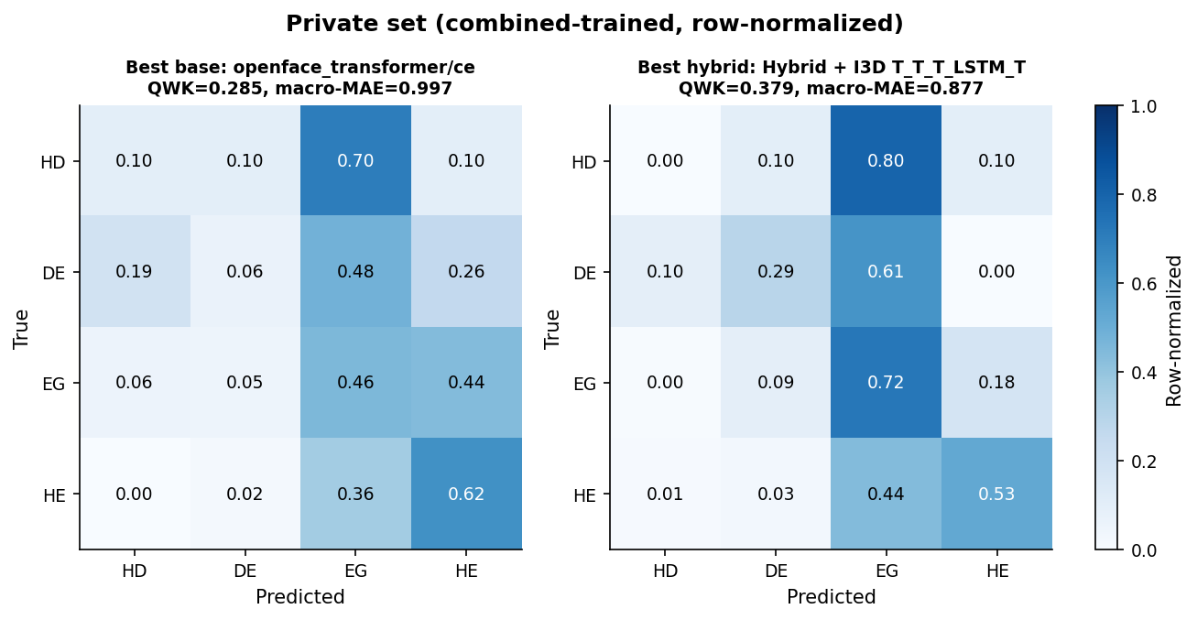
Backup Slides

Slide 23
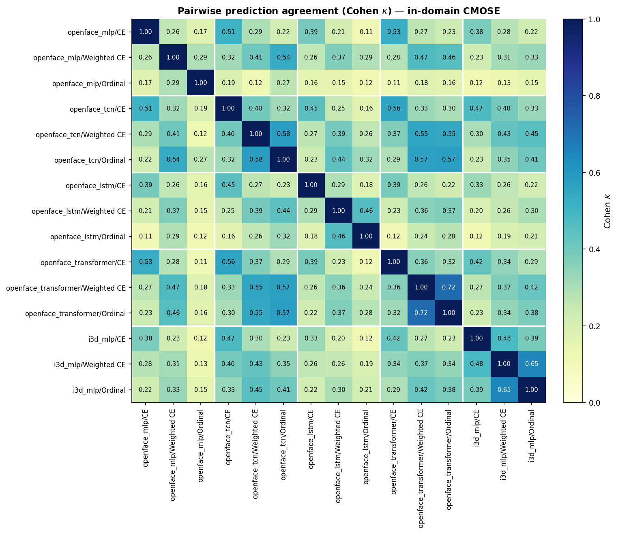
Backup Slides

