Slide 1

Student Engagement Recognition from Facial and Video Features:
A Comparison of transferability of OpenFace, I3D, and Multimodal Temporal Models from CMOSE dataset to Vietnamese online class

Slide 2
Content
Motivation
Problem Statement
Dataset
Feature Extraction
Architectures
Losses & Metrics
Results
Conclusion

Slide 3
1. Motivation
Online courses / hybrid courses (b-learning) is popular.
Make up session of offline course are sometime hosted online.
During online session, lecturer often lack visual feedback from student: Engagement, Confusion, Tiredness,…
Current research did not fully examine uncontrolled environment, especially university in Vietnam.

Slide 4
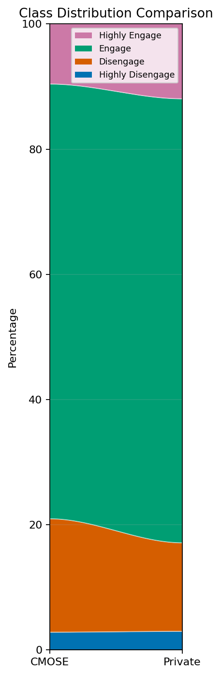
2. Problem Statement
Recognize students’ engagement level from facial features and video features.
Input:
10s clips of online classes
Output:
4 classes: HE/E/D/HD
Problem:
Class inbalance: datasets dominated by class “Engage”
Domain shift

Slide 5
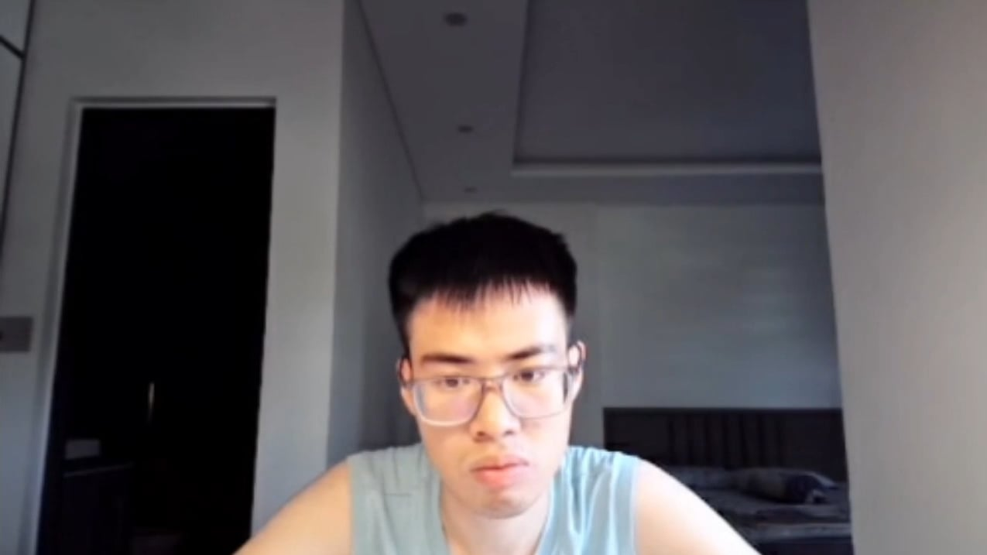
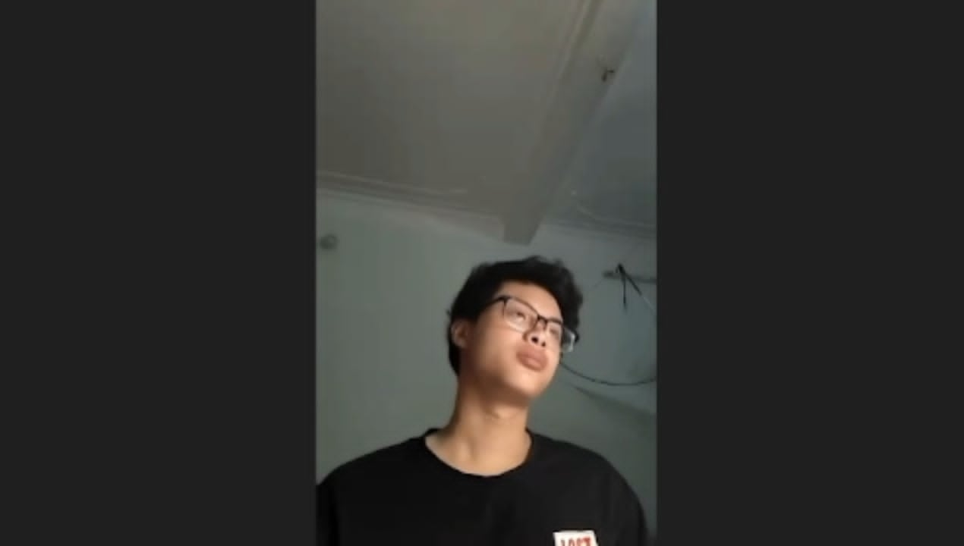
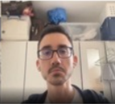
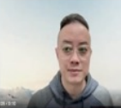
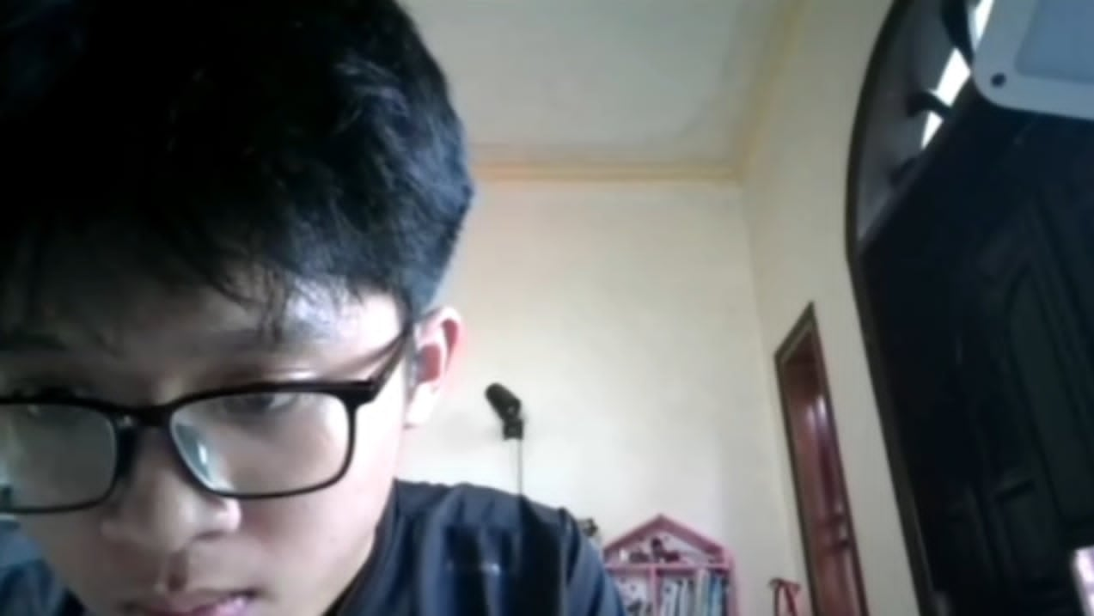
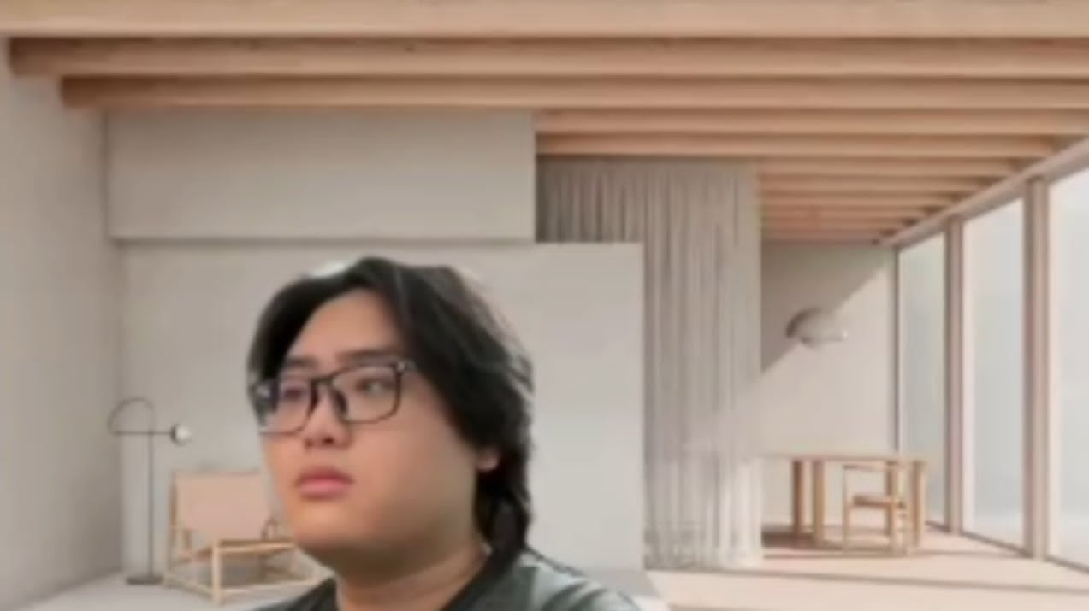
3. Datasets
CMOSE dataset
12197 instances
train/eval/test = 72/18/10
Online presentation training class
Our dataset
368 instances
Online class of SOICT

Slide 6
4. Feature Extraction
OpenFace features:
709 features per frame, includes:
Gaze
Head pose
Face landmark
Eye landmark
Shape/PDM
Action unit
I3D features:
1024 features per clip
Trained on Kinetics-400

Slide 7
5. Architectures
MLP
TCN, LSTM, Transformer
Pipelines

Slide 8
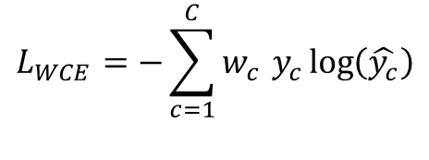
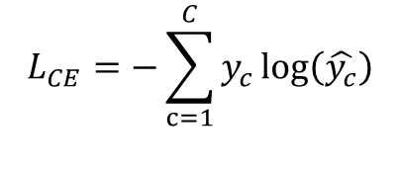
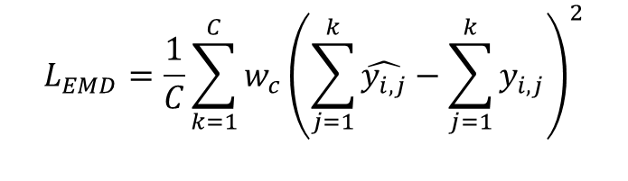
6. Losses & Metrics
CE loss:
$$L_{CE}=−\sum_{c=1}^{C}{y_{c}}\log\left(\hat{y_{c}}\right)$$
Weighted CE loss:
$$L_{WCE}=−\sum_{c=1}^{C}{{w_{c }y}_{c}\log\left(\hat{y_{c}}\right)}$$
Squared EMD loss:
$$L_{EMD}=\frac{1}{C}\sum_{k=1}^{C}{w_{c}{\left(\sum_{j=1}^{k}{\hat{y_{i,j}}}−\sum_{j=1}^{k}{y_{i,j}}\right)}^{2}}$$

Slide 9

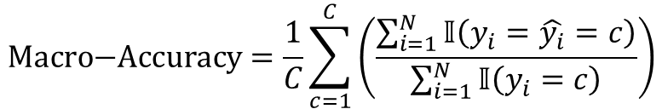
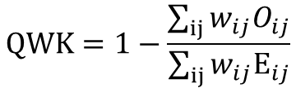
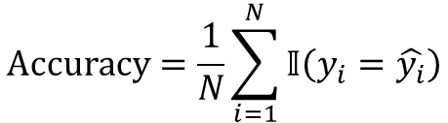

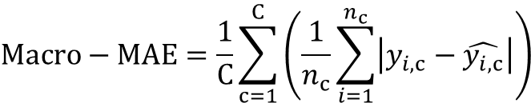
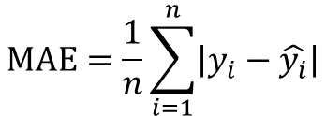
6. Losses & Metrics
Accuracy
Macro Accuracy
$$\text{Accuracy}=\frac{1}{N}\sum_{i=1}^{N}{𝕀\left(y_{i}=\hat{y_{i}}\right)}$$
$$\text{Macro}\text{−}\text{Accuracy}=\frac{1}{C}\sum_{c=1}^{C}{\left(\frac{\sum_{i=1}^{N}{𝕀\left(y_{i}=\hat{y_{i}}=c\right)}}{\sum_{i=1}^{N}{𝕀\left(y_{i}=c\right)}}\right)}$$
MAE
Macro MAE
$$Macro−MAE=\frac{1}{C}\sum_{c=1}^{C}{\left(\frac{1}{n_{c}}\sum_{i=1}^{n_{c}}{\left|y_{i,c}−\hat{y_{i,c}}\right|}\right)}$$
$$MAE=\frac{1}{n}\sum_{i=1}^{n}{\left|y_{i}−\hat{y_{i}}\right|}$$
Cohen’s Kappa
Quadratic Weighted Kappa
$$κ=\frac{P_{O} − P_{E}}{1 − P_{E}}$$
$$QWK=1−\frac{\sum_{ij}{w_{ij}O_{ij}}}{\sum_{ij}{w_{ij}E_{ij}}}$$
$$w_{ij}=\frac{{\left(i−j\right)}^{2}}{{\left(n−1\right)}^{2}}$$

Slide 10
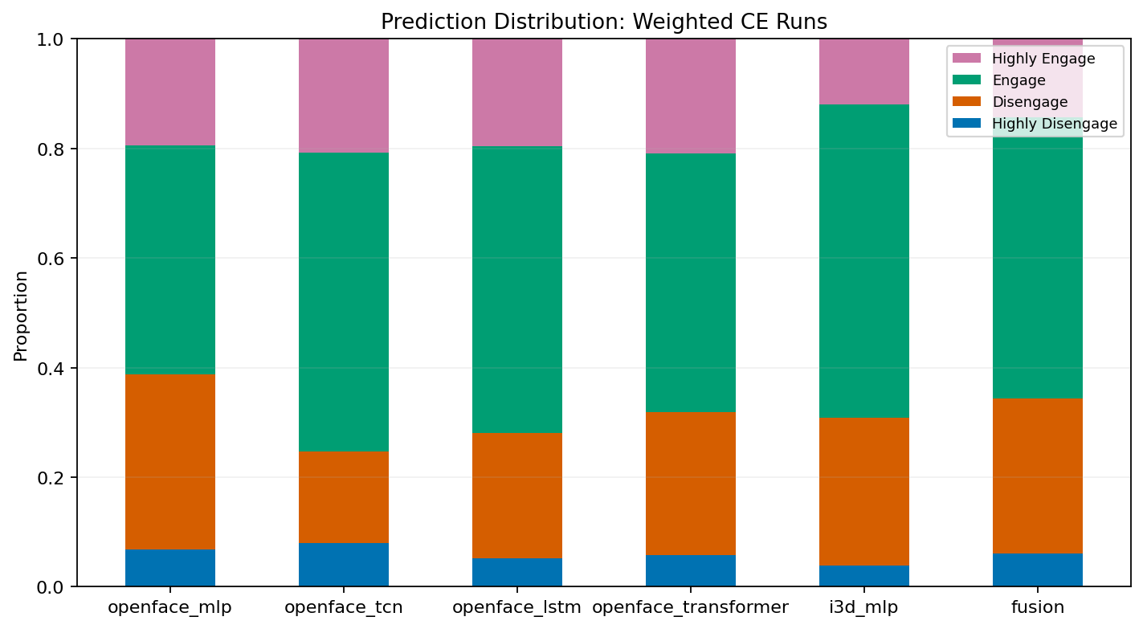
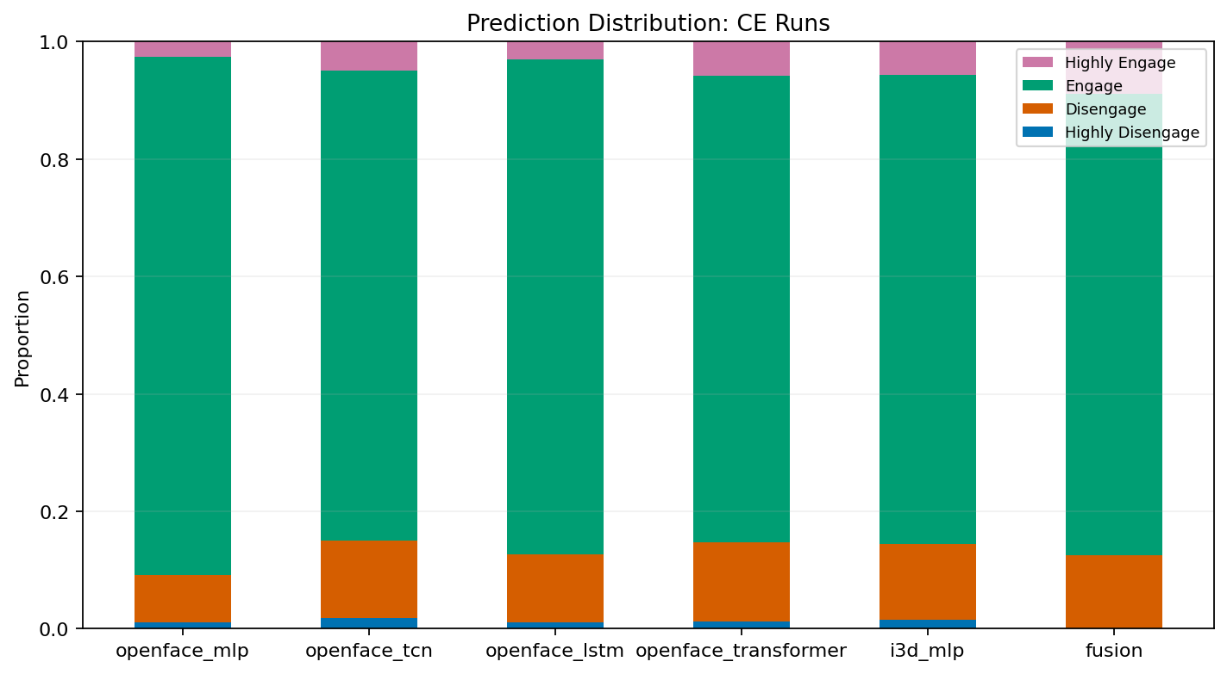
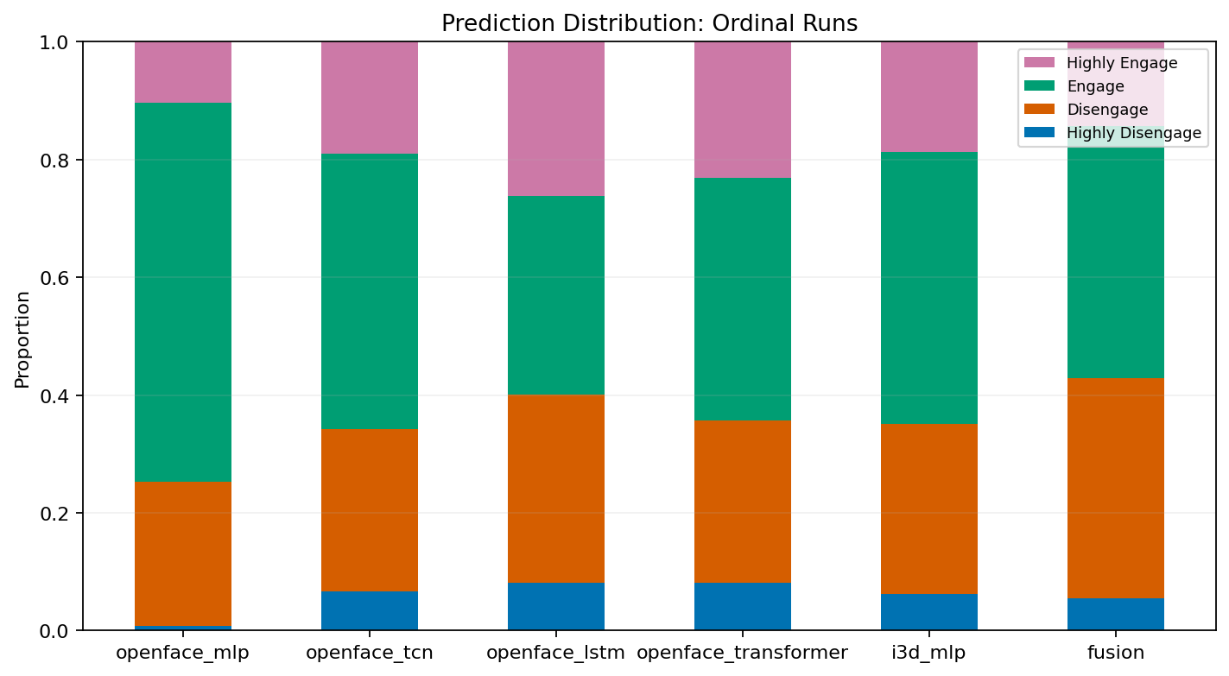
7. Result
On CMOSE dataset
CE loss exploit class imbalance,
causes class copalse.
Weighted CE still have bias.
Ordinal produce more diverse output.

Slide 11
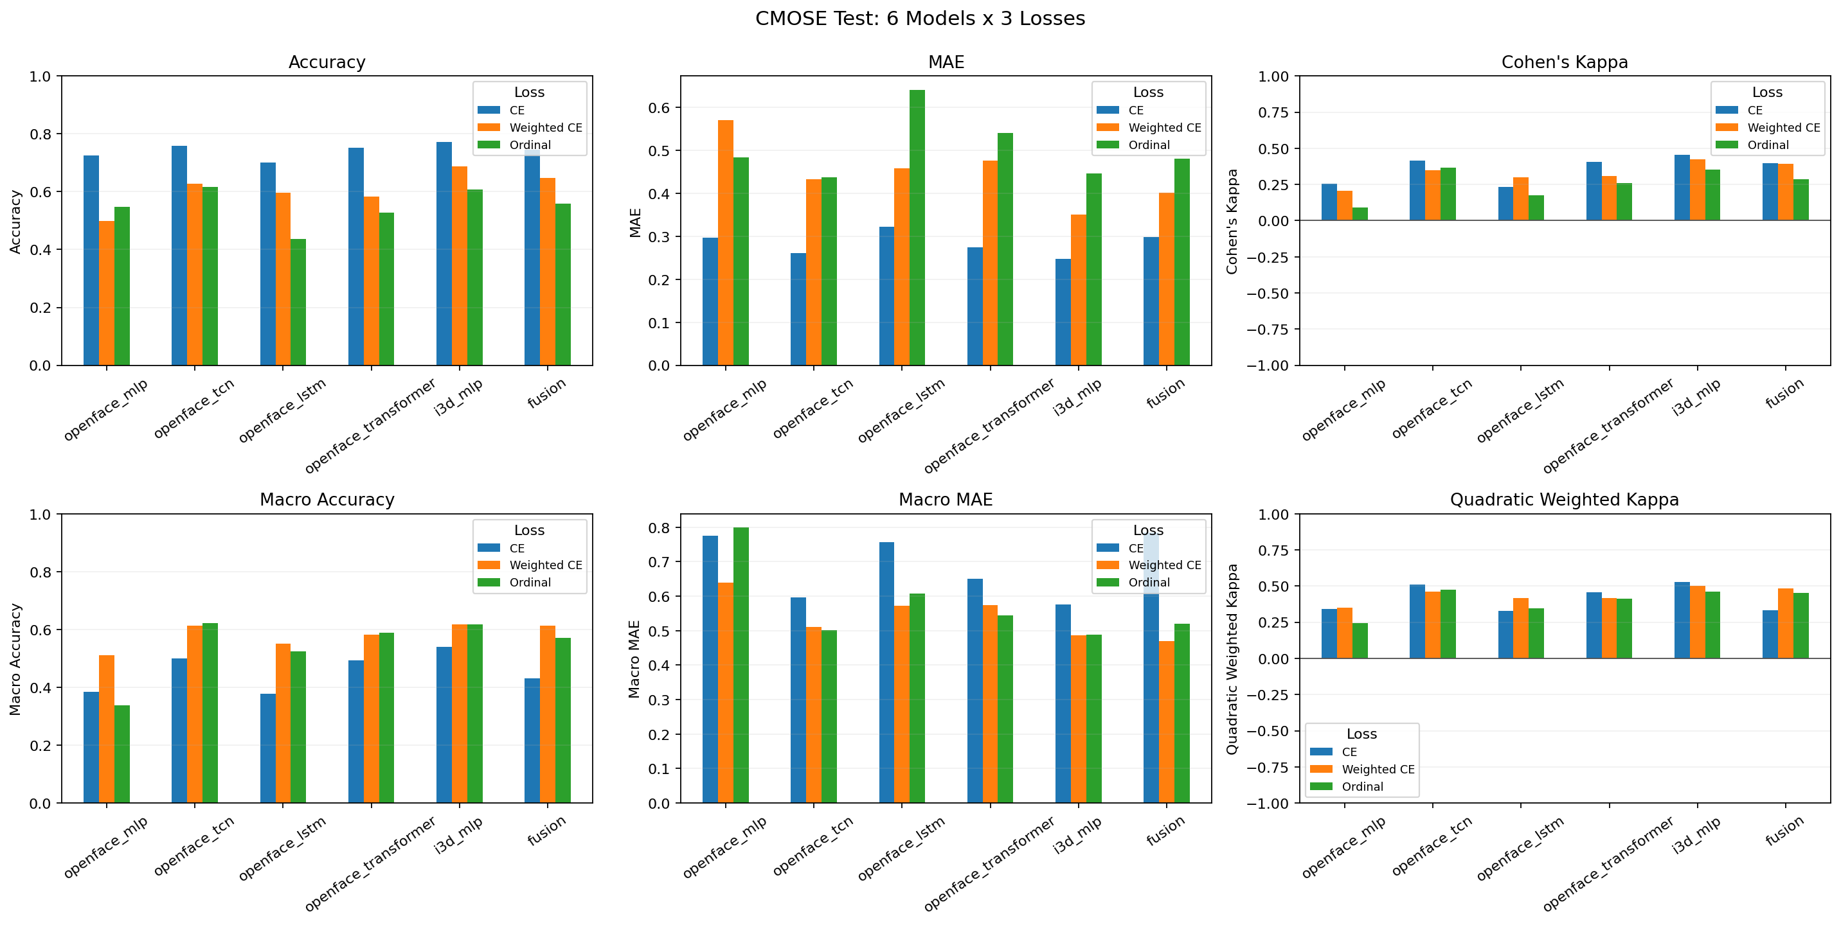
7. Result
On CMOSE dataset
CE are best at accuracy and MAE.
Weighted CE and Ordinal outperform in macro metrics.
Architecture is less impactful.

Slide 12
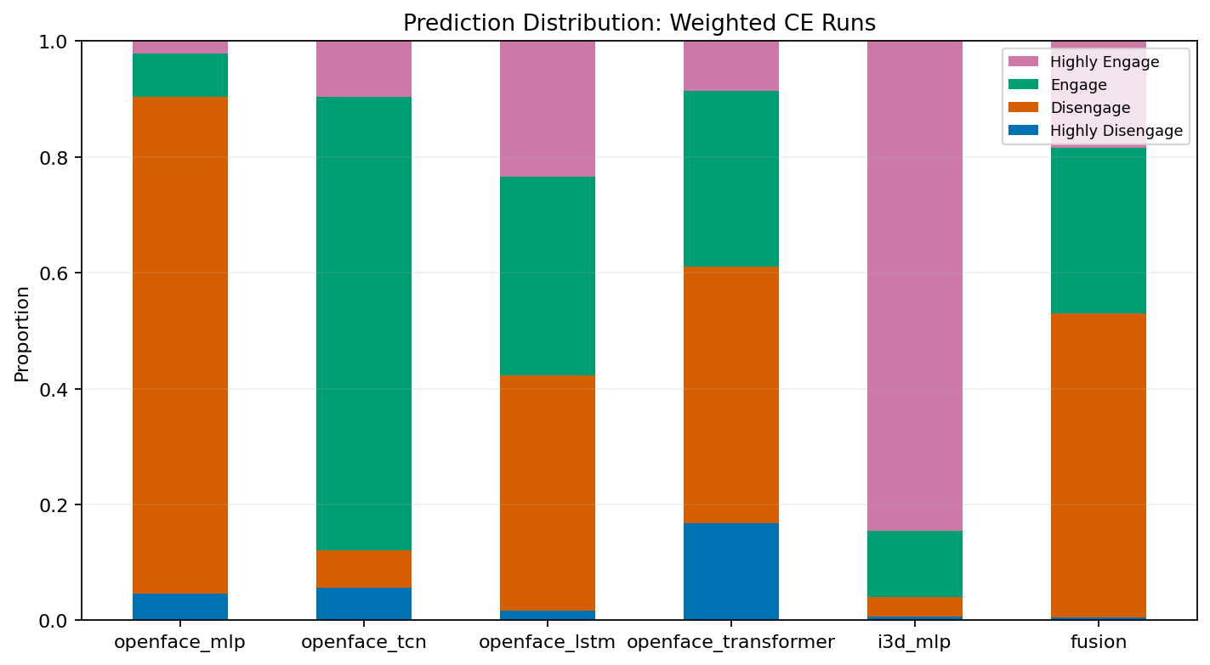
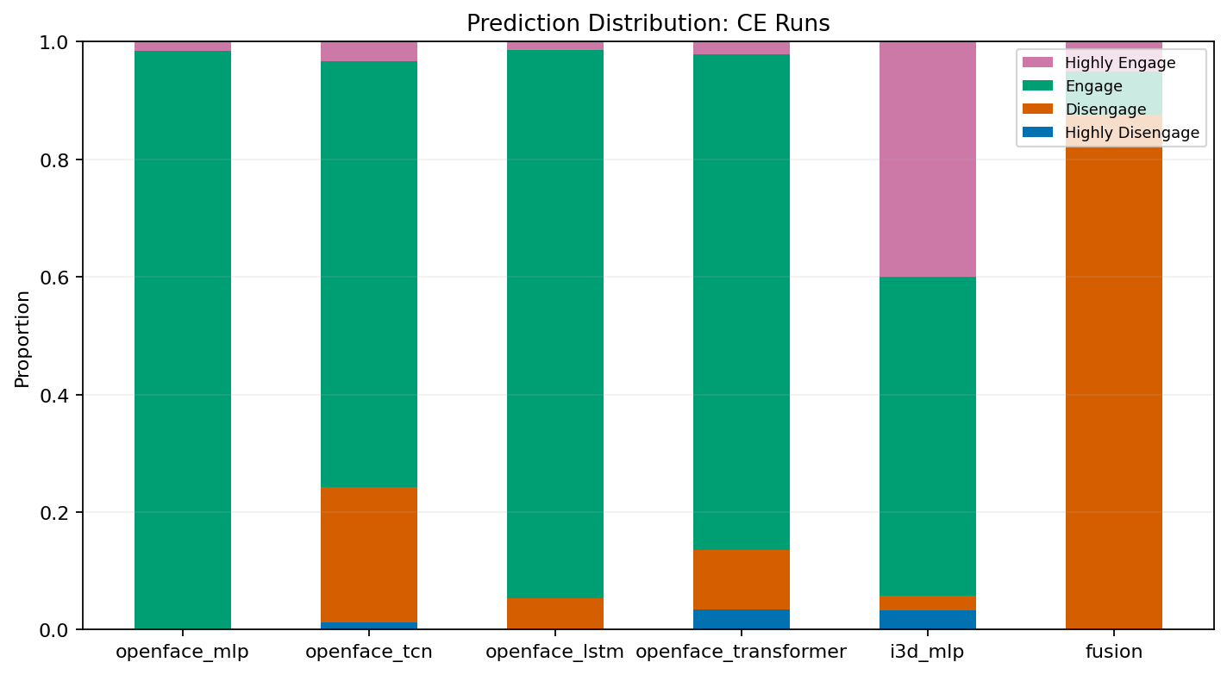
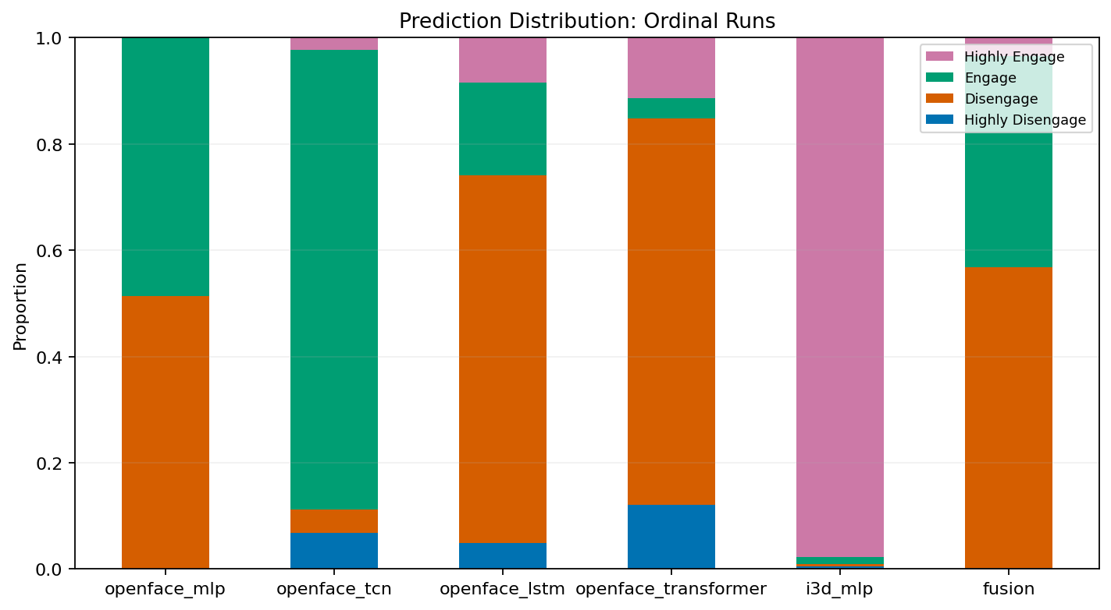
7. Result
On private dataset
CE models collapse even harder on private data.
Model using I3D features have extreme prediction distribution shift.

Slide 13
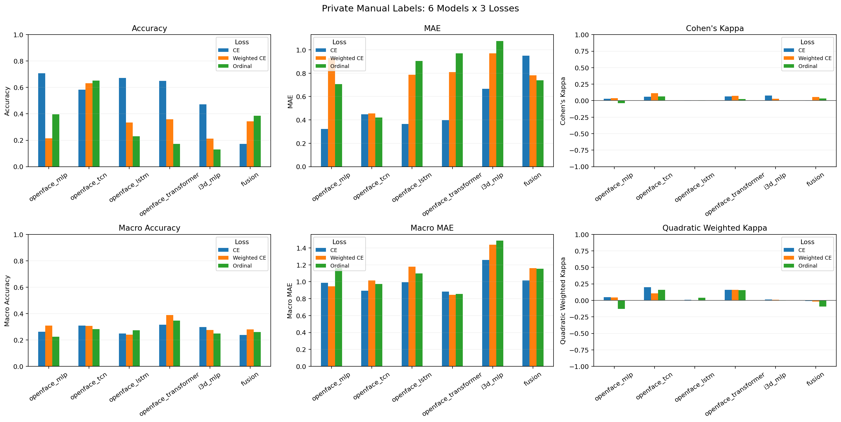
7. Result
On private dataset
High accuracy despite high Macro MAE is misleading.
All models suffer significant domain shift.
TCN and Transformer using Weighted CE and Ordinal Loss are more robust.

Slide 14
8. Conclusion
Contribution:
Collected and labeled a small online engagement dataset of Vietnamese online class.
Compared loss functions and architectures for ordinal engagement recognition.
Limitation:
No configuration fully overcame domain shift.
Future work:
Use more diverse training data.
Expand private dataset.
Modality-robust fusion that transfer well on private dataset.

Slide 15
THANK YOU !

