Slide 1

E-COMMERCIAL SHOP
END PROJECT (30 March – 17 May)
Member:
1. TRAN CAM HOA
2. LE NGUYEN VIET THANG

Slide 2
Learn knowledge
PHP – TypeScript (pending)
Jquery – JavaScript – CSS to animations
Install environment to develop project
Learn technology, management system (JIRA)
Researches knowledge about IT
Learn GIT’s and others features

Slide 3
NOTE
Read requirements and research business.
Communication (5W1H and clear requirement).
Improve technical (5W1H, different, compare, trending, cost, version, …).

Slide 4

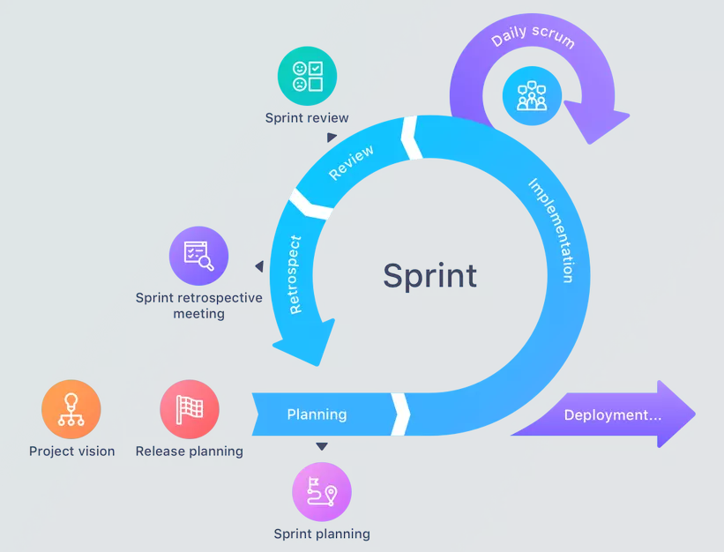
REVIEW + RESTROPECTIVE
Review tasks:
What was done yesterday?
What will you do today?
What is your blocker?
Restropective:
Good.
Not Good.
Improve

Slide 5
SUMMARY
1. Each member shares about what you learn, experience and future development.
2. What difficulties do you have when working on projects and working with me?
3. Advantages & disadvantages.
4. Solutions & Learn. (research, timing, description: task and steps, point to estimate time to better planning.)

Slide 6
THANK YOU, HOÀ.

