Slide 1

Brainstorming, prototyping, just InMind
SE130239 - Võ Hoàng Phúc
SE130342 - LÊ HỒNG NGUYÊN
Se130264 - Vũ Thị Ngọc Mai
SE130572 - ĐẶNG KHOA VĂN
SE130566 - Hoàng Anh Thắng
SE130449 - Văn Thành Phương Đạt

Slide 2
What is Brainstorming?

Slide 3

Brainstorming is a group problem-solving method that involves the spontaneous contribution of creative ideas and solutions. This technique requires intensive, freewheeling discussion in which every member of the group is encouraged to think aloud and suggest as many ideas as possible based on their diverse knowledge. Analysis, discussion or criticism / commenting is only allowed when the meeting is over and the outcome of the evaluation phase is over.

Slide 4



Brainstorming has many uses but is most often in the areas of:
Advertising- Develop ideas for advertising periods.
Problem solving - problems, new ways of addressing, impact analysis, and evaluation of problems.
Process management - Find ways to improve work efficiency and product handling .

Slide 5


Managing topics - object identification, risk level, distributions, work schedules, resources, roles and responsibilities, tips, issues.
Team Building - Create sharing and discuss ideas while encouraging people in the team to think.

Slide 6
The benefits of Brainstorming in Business Analysis

Slide 7



What's benefits of Brainstorming in business analysis?
Brainstorms allow for others to freely propose ideas
These are easy to learn and perform
The costs for a brainstorming session are very low
There are only a few basic rules to follow
Because the ideas are not criticized or rejected during a brainstorming session, interesting proposals can be refined gradually
Joint brainstorming improves the working atmosphere

Slide 8
How to Facilitate a Brainstorming Session?

Slide 9


1. Prepare a shared space

Slide 10

2. Set the rules

Slide 11
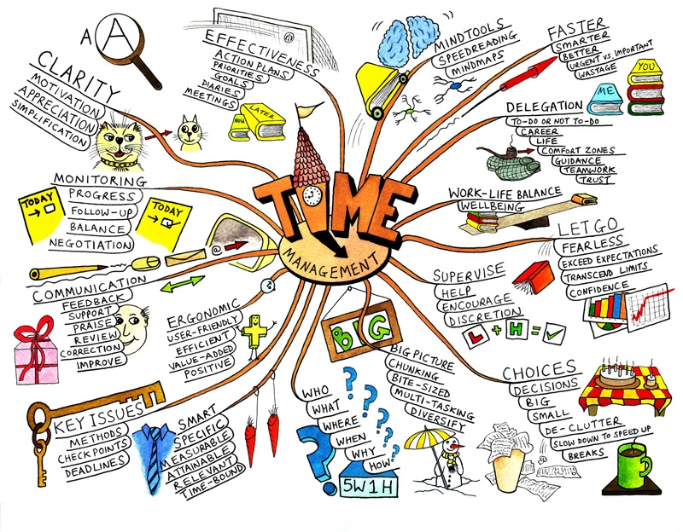
3. Time-Box everything

Slide 12

4. Write everything down

Slide 13
Prototyping

Slide 14

What is prototyping?

Slide 15
2 Type:
Throw-away prototyping
Evolutionary prototyping

Slide 16
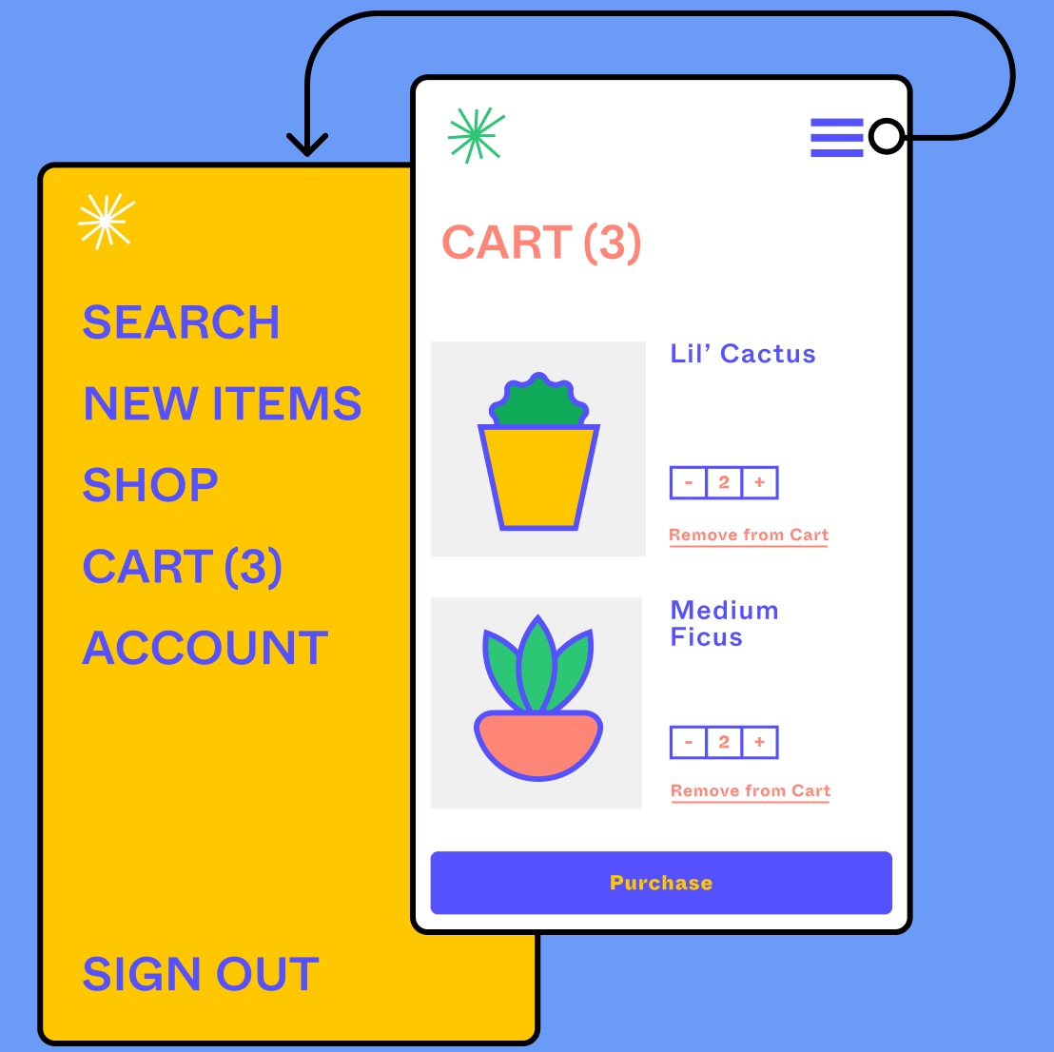
Advantages and disadvantages:

Slide 17
The value of prototyping:
Convey to stakeholders how soulution should work and what it should do
Prototyping is used in triggering discussions
Sometimes, prototypes are included in requirements specification document for sign-off by stakeholders
Particularly obvious in complex domains

Slide 18
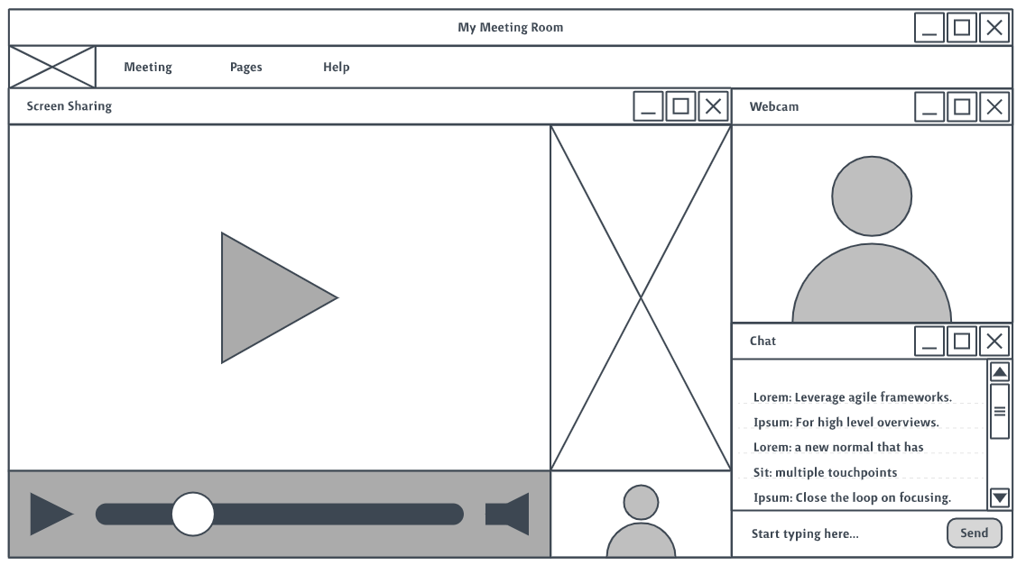

Slide 19

Should you use Prototypes every time?

Slide 20

THANK YOU FOR WATCHING

