Slide 1
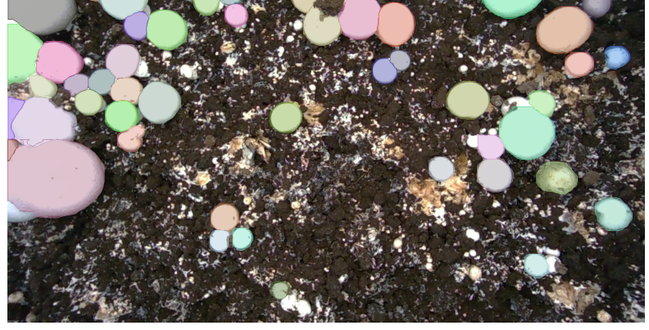
DIGITAL IMAGE & VIDEO PROCESSING
Mushroom Detection,
Segmentation &
Area Measurement
A reproducible M18K V2 project using YOLOv8n-seg and classical Otsu thresholding
WB-only instance masks
Team 10 · November 2026
Notes:
Introduce the team and the title. Our task is to identify individual White Button mushrooms in crowded cultivation-bed images. We reproduce YOLOv8 segmentation on M18K V2, implement a classical image-processing comparison, and demonstrate counting and projected mask-area measurement. The live demo is based on a saved checkpoint, not a newly trained model. Transition: why is instance-level detection harder than simply identifying white pixels?

Slide 2
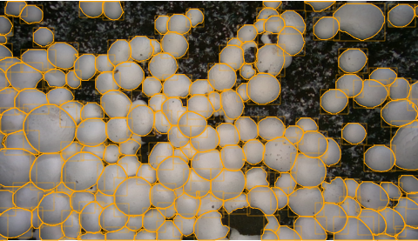
MOTIVATION
The problem: many touching mushrooms in one frame
One RGB image
→ Individual mushroom masks
→ Mushroom count
→ Visible area per mushroom (px²)
Touching caps can merge into one bright region—instance separation matters.
Example: densely packed mushroom caps with original COCO outlines
Source: executed M18K V2 experiments and final course report (Nov 2026)
02
Notes:
These are real dataset images. A cultivation bed can contain more than a hundred mushrooms in one view. For practical counting, binary foreground alone is insufficient; two touching caps may be one connected white blob. The project takes one RGB image and returns separate masks, counts and pixel areas. Note that px² is projected image area, not actual physical size.

Slide 3
DATA
M18K V2: 4,495 indexed images, extreme class imbalance
4,495
699,731
858
RGB images
WB annotations
BB annotations
3,596 train · 449 val · 450 test
99.88% of all annotations
Only 0.12% of annotations
Images by split
Why it matters
Train
3,596
The class imbalance makes BB performance difficult to interpret and motivates WB-only modeling.
Validation
449
Test
450
Source: executed M18K V2 experiments and final course report (Nov 2026)
03
Notes:
The accessible, COCO-indexed copy of M18K V2 contains 4,495 images across the three original splits. The two categories are BB and WB, but almost every label is WB. The original paper used an earlier dataset and must not be treated as numerically identical to ours. The BB class has very few labeled instances; this is important when interpreting the overall two-class mAP.

Slide 4
PROJECT TIMELINE
What we completed: a four-day experimental workflow
DAY 1
DAY 2
DAY 3
DAY 4
EDA
Reproduction
Error analysis
MVP + extension
Dataset audit, RGB-D examples, class balance
Two YOLOv8n-seg models and held-out testing
Prediction inspection and 30-image area pilot
450-image area study, Otsu experiment, inference demo
Final deliverable: working WB inference + per-instance count / area outputs + comparable baseline evidence
Source: executed M18K V2 experiments and final course report (Nov 2026)
04
Notes:
This is the project chronology. Day 1 focused on exploring and validating the dataset. Day 2 reproduced a YOLO segmentation approach. Day 3 began qualitative and area-error analysis. Day 4 completed the full-test area study and the course-rubric Otsu experiment, and delivered a runnable notebook. Our final presentation summarizes this completed work and openly separates further research directions from completed milestones.

Slide 5
METHODS
Two approaches: learned instances versus classical foreground
LEARNED PIPELINE
RGB image
→
YOLOv8n-seg
→
Masks + boxes
→
Count + area
CLASSICAL PIPELINE
RGB → gray
→
Gaussian + Otsu
→
Morphology
→
Connected regions
A region is not always a mushroom: touching caps merge under connected-component counting.
Source: executed M18K V2 experiments and final course report (Nov 2026)
05
Notes:
We compare two different levels of representation on the same dataset. YOLOv8n-seg predicts each mushroom separately and gives a mask, box and confidence. The classical baseline converts to grayscale, optionally smooths, thresholds by Otsu, applies morphology and counts connected components. This allows a technical comparison for the image-processing course while explaining why instance learning can outperform pixel thresholding for counts in crowded scenes.

Slide 6
ALGORITHM VERIFICATION
Core algorithm implemented from scratch: Otsu thresholding
256-bin histogram
For each candidate gray-level threshold t:
10 / 10
1 Partition gray pixels into foreground / background
selected real images
2 Compute between-class variance
3 Select the threshold with maximum variance
Same threshold + 100% binary-pixel agreement with OpenCV
Verified correctness of the Otsu implementation ≠ accurate mushroom instance segmentation.
Source: executed M18K V2 experiments and final course report (Nov 2026)
06
Notes:
Our self-implemented Otsu algorithm uses the probability histogram of an eight-bit grayscale image. For each valid threshold, it computes between-class variance and chooses the maximizer. We compared each scratch threshold and every output pixel to OpenCV using identical inputs. On 10 real selected images, results matched exactly. This validates the implementation, but not Otsu as a reliable mushroom-instance method. In the next experiment we test it against ground-truth masks.

Slide 7
450-IMAGE HELD-OUT TEST
YOLOv8n-seg reproduction: strong WB, weak BB
Model / class
Mask AP@50
Mask AP@50:95
Box AP@50
Two-class — overall
0.4995
0.3963
0.5066
Two-class — WB
~0.9890
~0.7870
~0.9920
Two-class — BB
0.0095
0.0057
0.0213
WB-only — WB
0.9906
0.7974
0.9921
Key interpretation
Two-class mAP is averaged over both classes; BB has only 97 test annotations. The WB-only test uses WB-only ground truth.
Source: executed M18K V2 experiments and final course report (Nov 2026)
07
Notes:
Both YOLOv8n-seg models were trained for 10 epochs using 640-pixel input size and pretrained weights. The two-class model predicts BB and WB, and the WB-only model predicts one class. The overall two-class mask AP50 is about 0.50 because it averages over both classes, including extremely weak BB. WB-specific AP50 is near 0.99 in both experiments. The WB-only model has mask AP50:95 0.7974. These are held-out test results for all 450 images, but the label configurations differ, so we cannot infer that removing BB alone caused any improvement.

Slide 8
PUBLISHED REFERENCE
Reproducing the approach ≠ matching the original benchmark
Zakeri et al. (2025) — YOLOv8-N segmentation
Our experiment
0.712
0.846
M18K V2
Published AP at 640
Published AP at 1280
WB-only class
Original M18K benchmark
Higher image resolution
Mask AP@50:95 = 0.7974
Different dataset and evaluation details → not a direct “we beat the paper” comparison.
Source: executed M18K V2 experiments and final course report (Nov 2026)
08
Notes:
The original M18K paper is the motivation for our reproduction. Its Table 2 reports YOLOv8-N segmentation AP of 0.712 at image size 640 and 0.846 at 1280. These are published reference numbers. Our images come from a different V2 dataset, class distribution and training setup, and its reported AP column is not fully harmonized with our Ultralytics mask AP50:95. We therefore do not claim to outperform the original publication, only to reproduce the general detection and instance-segmentation workflow.

Slide 9
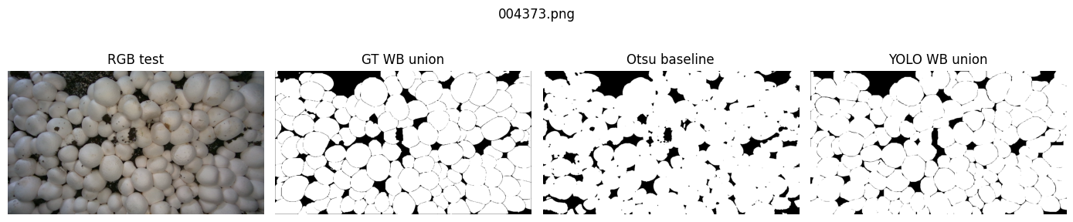
BASELINE COMPARISON
On the same 10 test images, YOLO separates instances better
0.8662
0.9201
121.2
7.3
Otsu union IoU
YOLO union IoU
Otsu count MAE
YOLO count MAE
Connected regions merge
Predicted union of masks
Instances / image
Instances / image
Source: executed M18K V2 experiments and final course report (Nov 2026)
09
Notes:
The four-panel figure shows the same test image: RGB, union of COCO WB ground-truth masks, Otsu foreground, and union of YOLO instance masks. In 10 seeded test images the mean foreground-union IoU was 0.866 for Otsu and 0.920 for YOLO. But the clearest practical difference is counting: component-based Otsu count MAE reached 121.2, whereas YOLO had 7.3. Union IoU is a pixel metric and does not assess whether touching mushrooms are correctly separated. This small sample is diagnostic, not a population-wide benchmark.

Slide 10
10-IMAGE SAMPLE
Ablation: not every processing block helps every metric
Classical variant
Mean union IoU
Mean Dice
Count MAE
Full: Gaussian + Otsu + morphology
0.8662
0.9269
121.2
Without Gaussian blur
0.8709
0.9296
122.1
Without morphology
0.8648
0.9260
122.5
What changed?
Removing blur slightly increased union IoU, but worsened count error.
Removing morphology slightly reduced both mask overlap and counting quality.
Source: executed M18K V2 experiments and final course report (Nov 2026)
10
Notes:
This experiment tests one change at a time, which is the spirit of ablation. Starting from grayscale, Gaussian, Otsu, morphology and connected components, we disable the Gaussian step, then separately disable morphology. Removing Gaussian actually improves union IoU slightly but makes counts a little worse. Removing morphology decreases IoU and makes count error slightly worse. These modest changes show why it is misleading to say every extra step always improves every metric. The 10-image sample is a scope limitation.

Slide 11
450-IMAGE STUDY
Full-test area evaluation: 68,794 matched WB instances
For each predicted binary mask:
68,794
Area (px²) = number of mask pixels
Matched / 70,192 GT
GT coverage: 98.01%
Greedy 1-to-1 matching with mask IoU ≥ 0.50
211.4 px²
Mean absolute area error
Calculated on matched pairs
8.81%
Mean relative area error
Median: 7.31%
3,388 unmatched predictions · 1,398 unmatched GT
Source: executed M18K V2 experiments and final course report (Nov 2026)
11
Notes:
The evaluation covers all 450 test images. For each detected mushroom, the binary segmentation mask is brought to the original image resolution and the foreground pixels are counted. A predicted mask is matched to at most one COCO ground-truth mask if their mask IoU is at least 0.5. There are 68,794 matched instances out of 70,192 ground-truth annotations. On matched pairs, mean absolute area error is 211.4 pixels squared and mean relative error is 8.81 percent. We report unmatched predictions and GT separately; their areas are not included in these matched-error averages.

Slide 12
ERROR ANALYSIS
Small mushrooms have the largest relative area errors
Mean relative area error
GT matching coverage
Small (bottom 33%)
15.4%
94.3%
Smallest area group
Medium (33–66%)
7.9%
≈ 99.8–99.9%
Large (top 34%)
3.5%
Medium / large groups
86.1% of matched predictions have larger mask areas than the COCO labels (positive bias).
Source: executed M18K V2 experiments and final course report (Nov 2026)
12
Notes:
Error size varies considerably with mushroom size. For the smallest third of ground-truth mushrooms, mean relative area error is 15.4 percent, versus 7.9 percent for the middle group and 3.5 percent for the large group. Small mushrooms also have worse matching coverage, 94.3 percent compared with almost 99.9 percent for the larger groups. Most area errors are positive: about 86 percent of matched predicted masks cover more pixels than their ground-truth COCO polygons. This is an annotation-relative tendency, not a claim about true physical cap dimensions.

Slide 13
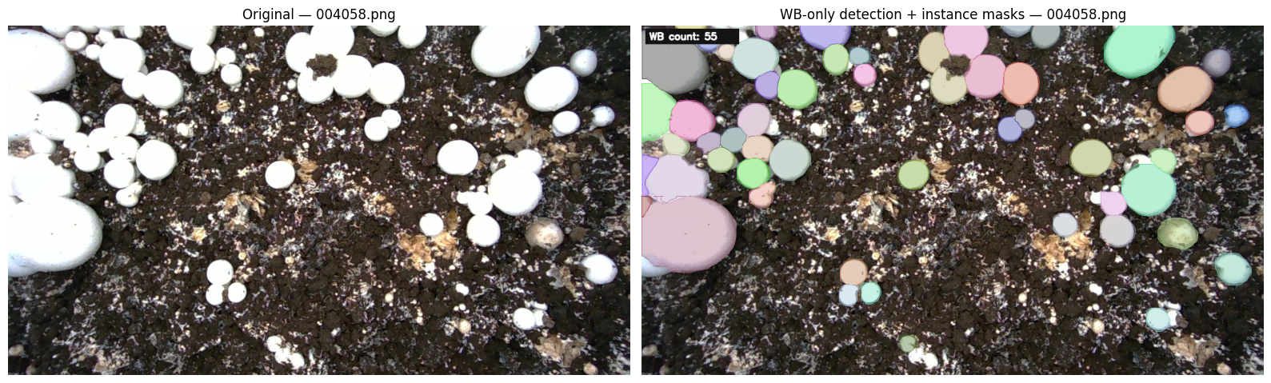
INFERENCE DEMONSTRATION
Working MVP: predict, count, measure, export
One sample: RGB input → colored WB instance masks
10 test images · 1,551 predicted WB instances · annotated PNGs + mask-ID images + CSV + ZIP
Source: executed M18K V2 experiments and final course report (Nov 2026)
13
Notes:
This slide shows real images from the executed cleaned inference notebook. The demo downloads Khang’s WB-only checkpoint, reads test RGB images, runs segmentation, visualizes each detected mask, counts instances and measures their per-mask area in pixels squared. It exports images and machine-readable CSVs. On the selected 10 images, 1,551 predicted WB instances were generated. This number is a demo prediction total, not a verified ground-truth count or an AP score. We can switch to the live Colab notebook at this point if the presentation setting allows it.

Slide 14
DISCUSSION
Where the evidence is strong—and where it is limited
SUPPORTED BY COMPLETED RUNS
LIMITATIONS / NEXT STEPS
450-image YOLO held-out test evaluation
Otsu comparison uses only 10 test images
450-image WB projected-area study
Possible dataset near-duplicates / label anomalies remain unverified
Otsu implementation verified against OpenCV
Areas are px², not depth-calibrated mm²
Working WB-only Colab inference demo
Standalone CLI / Gradio and short demo video remain submission tasks
Source: executed M18K V2 experiments and final course report (Nov 2026)
14
Notes:
Our strongest evidence comes from the full 450-image YOLO test and full 450-image projected-area evaluation. The implementation of Otsu is independently verified against OpenCV and the inference demo executes. We must also explain limitations. The classical experiment has only 10 images; image similarity and annotation concerns remain unresolved and are not evidence of proven leakage. Pixel area is not physical area. The course rubric also asks for a standalone command-line, Streamlit or Gradio demo and a short video, so the Colab notebook by itself does not fully satisfy that particular application-format requirement.

Slide 15
CONCLUSION
A functioning mushroom
segmentation + measurement MVP
0.9906
0.7974
8.81%
WB mask AP@50
WB mask AP@50:95
Area relative error
450-image test
450-image test
68,794 matched WB masks
Next research directions: depth-calibrated measurement and improved dense-instance separation.
Questions?
Core references: Zakeri et al., Computers (2025), DOI 10.3390/computers14050199; Otsu, IEEE TSMC (1979); Ultralytics YOLOv8; OpenCV.
Notes:
To conclude, our project provides a functioning RGB-based White Button mushroom segmentation, counting and pixel-area workflow. We trained two YOLO configurations and evaluated them on the predefined test set. Our WB-only model achieved mask AP50 of 0.9906 and AP50:95 of 0.7974. Across matched instances in a full-test area analysis, the mean relative area error was 8.81 percent. A classical Otsu baseline implemented from scratch gives us an explanatory comparison of foreground segmentation versus instance separation. Future work includes depth-calibrated physical size and dense-scene improvements. Thank you; we welcome questions.

