Slide 1


K-Nearest Neighbors

Slide 2
CONTENTS OF THIS TEMPLATE
Nearest Neightbor Classifiers
The KNN classification algorithm
Pos and Cons of KNN
Application of KNN

Slide 3
Nearest Neightbor Classifiers
01

Slide 4
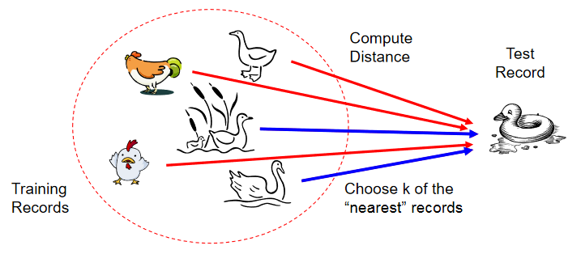
Nearest Neightbor Classifiers
If it walks like a duck, quacks like a duck, then it’s probably a duck

Slide 5
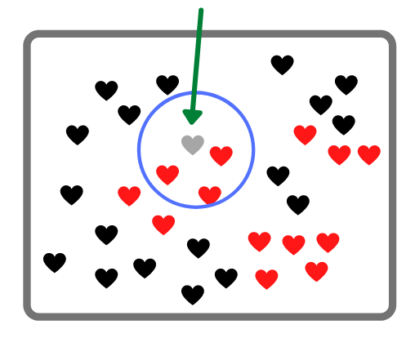
Nearest Neightbor Classifiers
Requires
The set of stored records
Distance Metric to compute disance between records
The value of k, the number of nearest neightbors to retrieve
To classify an unknown record:
Compute distance to other training records
Identify k nearest neighbors
Use class labels of nearest neighbors to determine the class label of unknown record
(e.g., by taking majority vote)

Slide 6
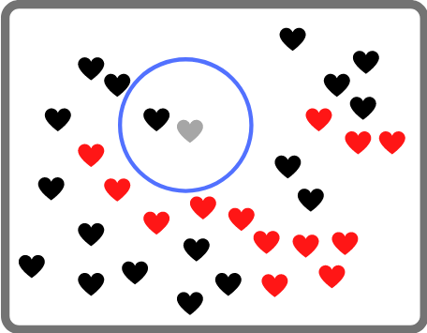
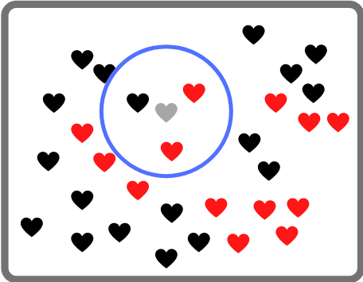
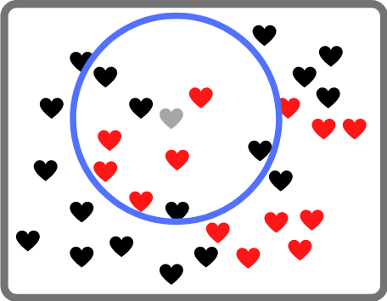
Nearest Neightbor Classifiers
1-Nearest Neightbor
3-Nearest Neightbor
9-Nearest Neightbors
K-nearest neighbors of a record x are data points that have the k smallest distance to x

Slide 7



Nearest Neightbor Classifiers
Compute distance between tow points
Euclidean distance:
Manhatten distance
Q-norm distance

Slide 8
The KNN classification algorithm
02

Slide 9
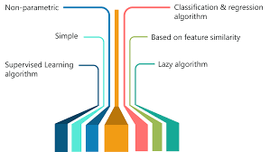
KNN algorithm
K-Nearest Negihtbors (KNN)
Simple, but a very powerful classification algorithm
Classifies based on a similarity measure
Non-parametric
Lazy learning
Does not “learn” until the test example is given
Whenever we have a new data to classify, we find its KNN from the training data.

Slide 10


KNN algorithm
Let k be the number of nearest neighbors and D be the set of training examples

Slide 11
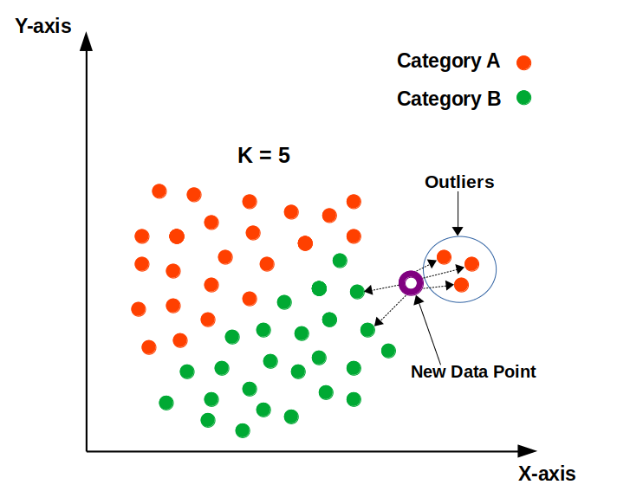
KNN algorithm

Slide 12
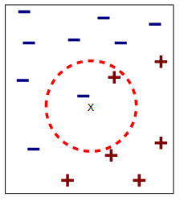
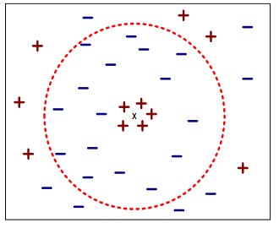
KNN algorithm
Choosing value of k
K is too small:
Sesnitive to noise points
K is too large:
neightborhood may include points from other classes

Slide 13
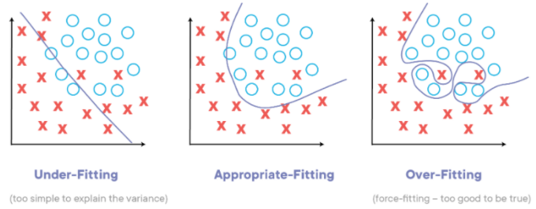
KNN algorithm
How to Find the Ideal K?.
Using odd numbers, fit a KNN classifier for each number.
Create predictions.
Further evaluate the performance using the predictions produced in step 2.
Compare results across each model and decide on the one with the least error

Slide 14
Pos and Cons of KNN
Pros Simplistic algorithm).
Efficient method for small datasets.
Utilises “Lazy Learning.” In doing so, the training dataset is stored and is used only when making predictions
Cons Large datasets take longer to process.
Requires feature scaling, and inability to do will result in wrongful predictions.
Noisy data can result in over-fitting or under-fitting of data.

Slide 15
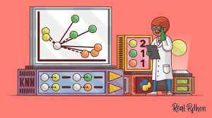
Application of KNN
Text mining
Agriculture
Finance
Medical
Facial recognition
Recommendation systems (Amazon, Hulu, Netflix, etc)

Slide 16
TITLE
03
You can enter here the subtitle if you need it

Slide 18
TITLE
04

Slide 20
TITLE
05
You can enter here the subtitle if you need it

Slide 22
TITLE
06
You can enter here the subtitle if you need it

Slide 24
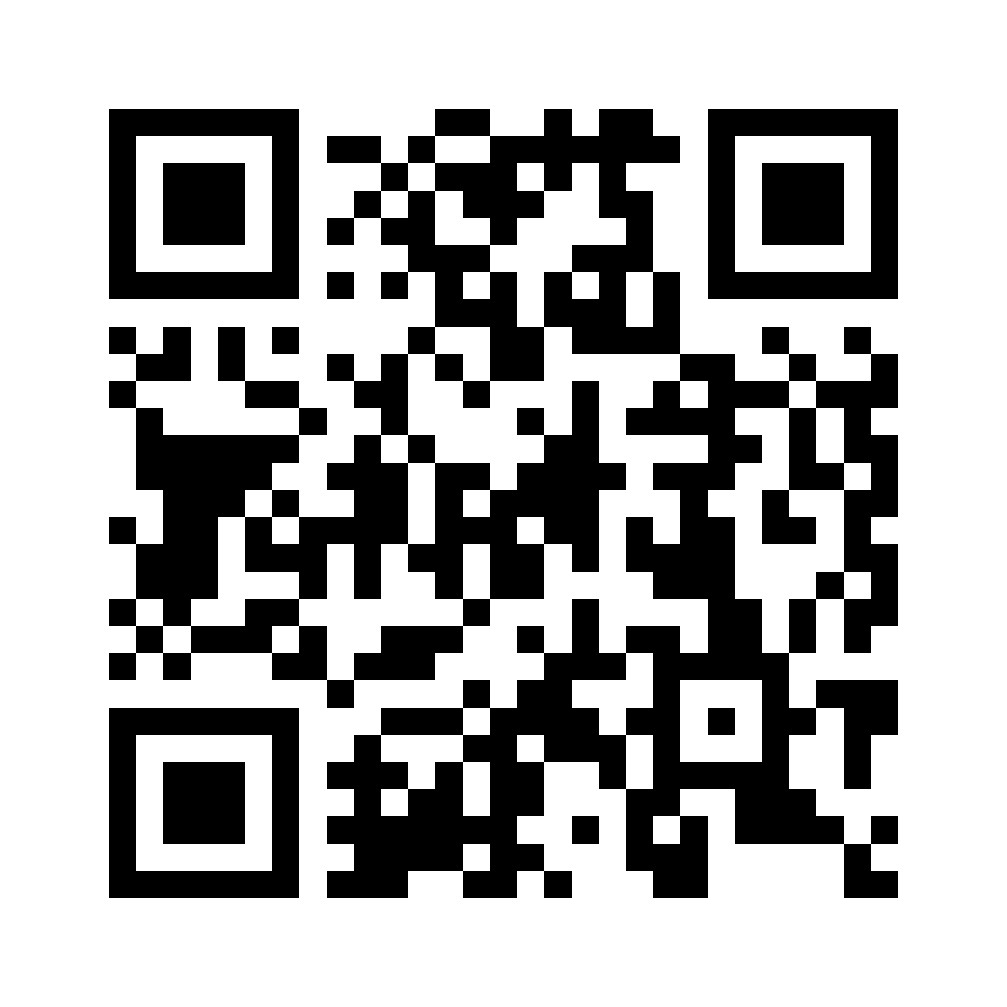
THANKS FOR LISTENING!
Does anyone have any questions?
cs.uit.ai.club@gmail.com
http://aiclub.cs.uit.edu.vn/

