Slide 1
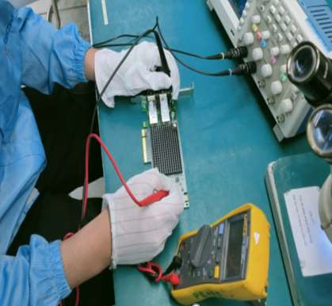
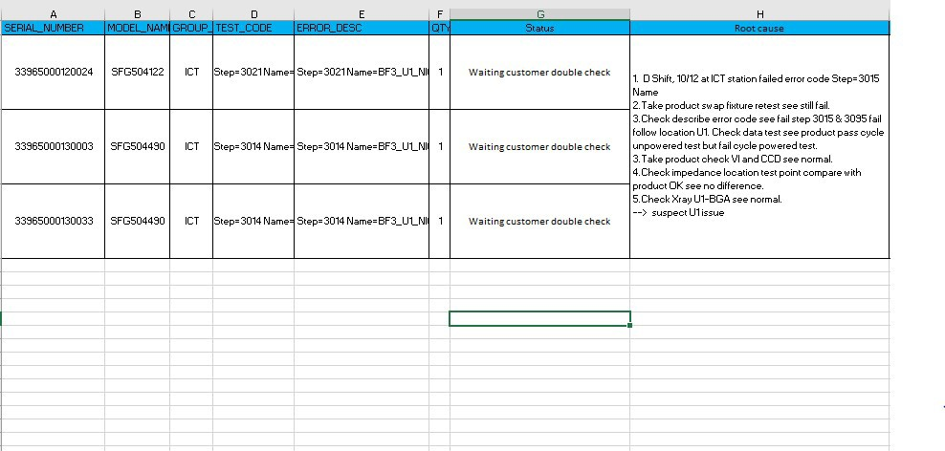
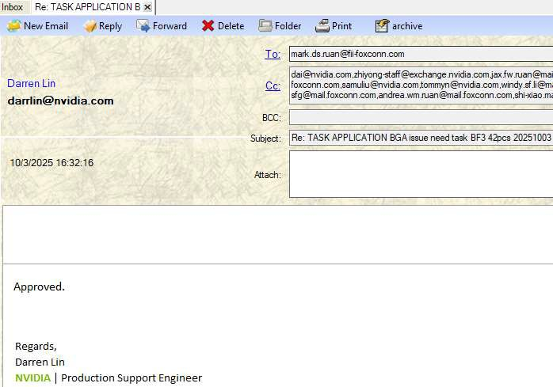
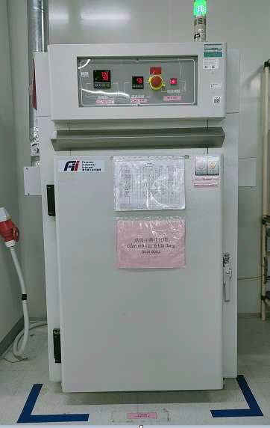
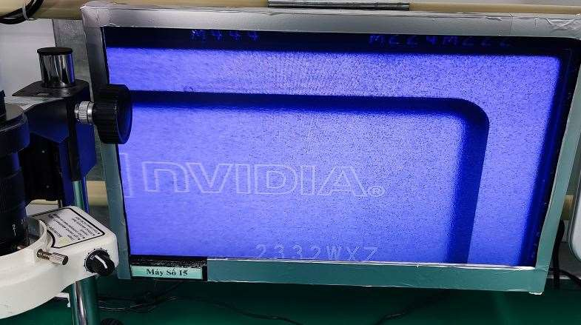
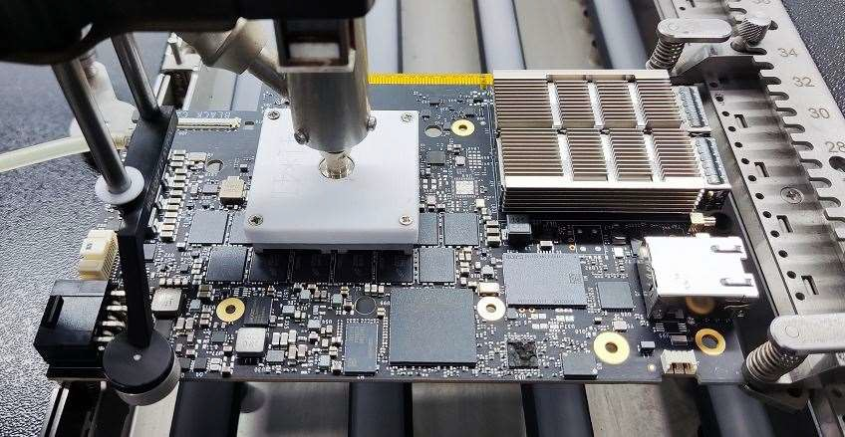
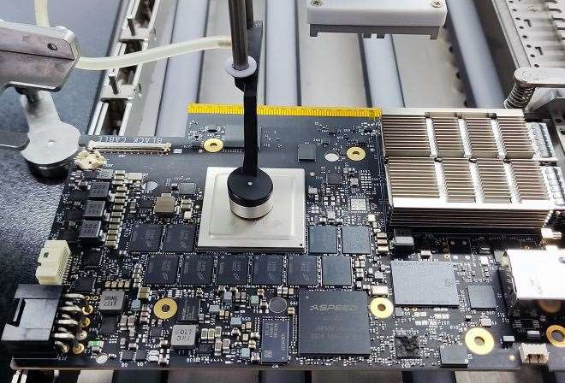
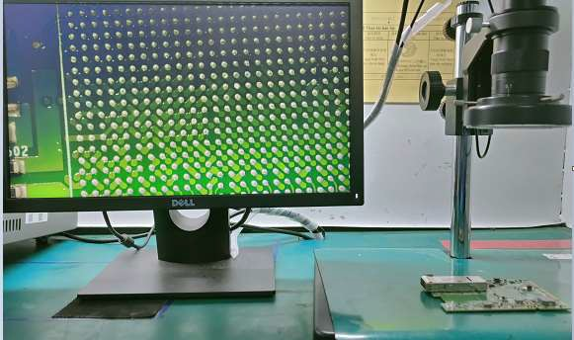
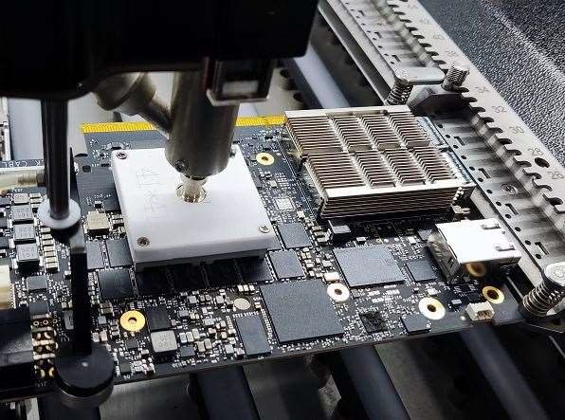
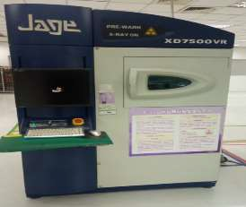
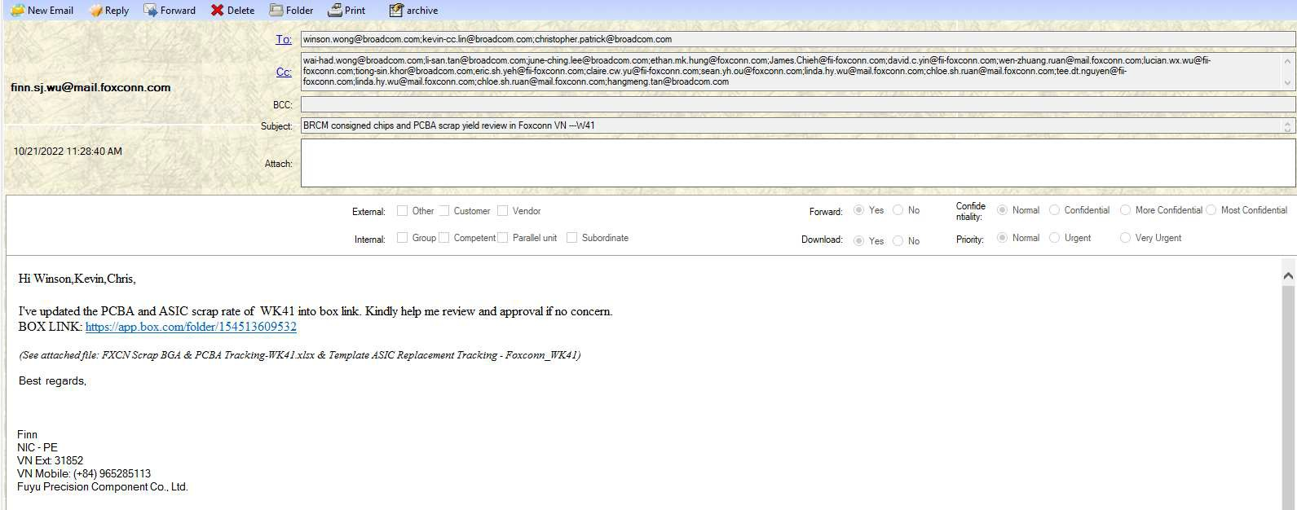
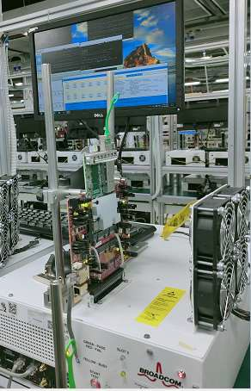
FXCN - REWORK BGA FLOWCHART
1. FXCN
suspect failure detect by BGA
2. Send list units fail to SPE
approval
3. Customer SPE approved
4. Baking the board
Remove BGA, Clean BGA Pad (RE)
FXCN suspect failure error code related BGA(SoC)
IN RE room
Send list units fail to SPE approval(PE/PM)
Visual Inspection BGA PAD under microscope(RE)
5.Inspecting component after baking
7. Remove BGA, Clean BGA PAD
8. Visual Inspection BGA PAD under
microscope
6.Place PCBA into machine
Customer approved change BGA
Place New BGA into PCBA and Solder by machine (RE)
Check in
Check in
Production line
Baking the board
Measure, X-ray, ICT, FCT
Fail
9. Place new BGA into PCBA and
solder by machine
10. Measure, X-ray, ICT, FT
11. Send out weekly scrap report to customer
12. Close return board to
Product line
Check Out
Pass
Check Out
Inspecting component after baking (RE)
Summary Scrap weekly report to customer (RE)
IN RE room
Place PCBA into machine and setup temperature parameters (RE)
Close return boards to product line
RE area
Production line area
Data Procedure

