Slide 1


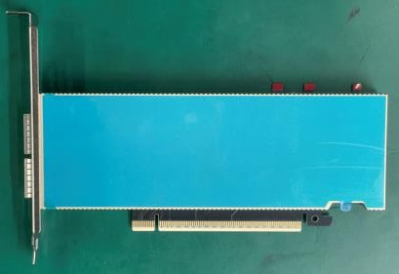
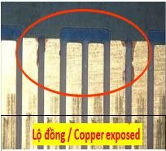
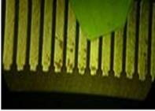
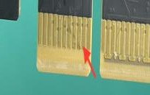


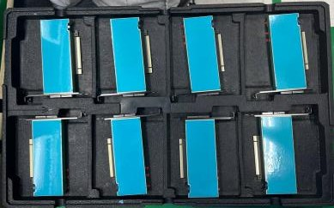
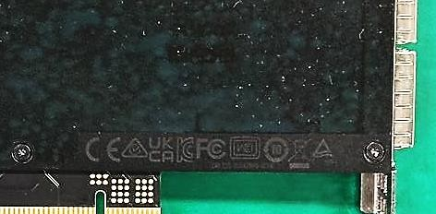
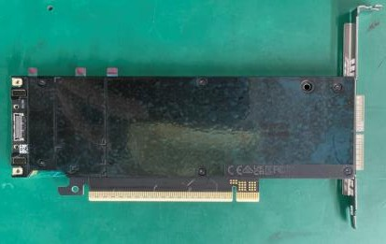
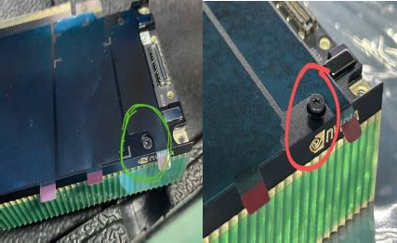
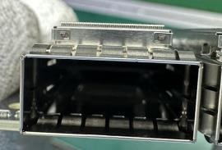
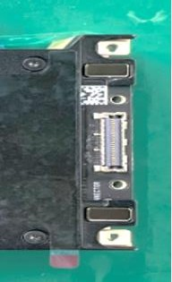
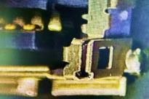
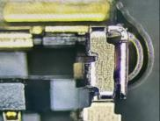
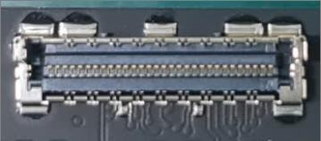
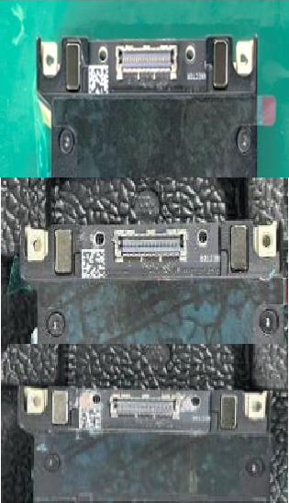
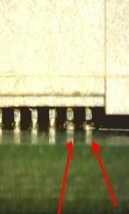
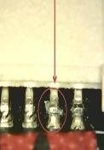
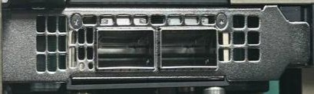
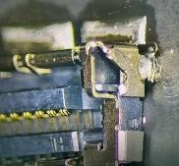
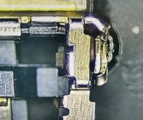
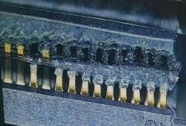
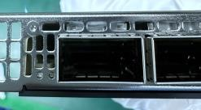
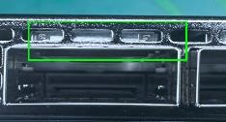
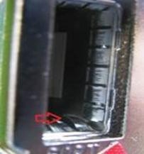
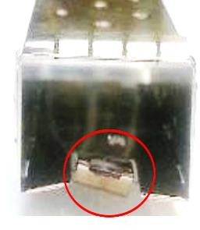
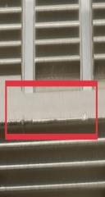
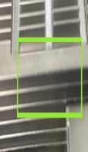
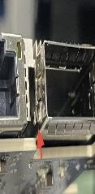
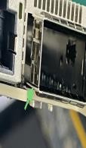
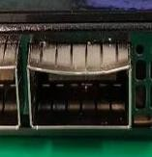
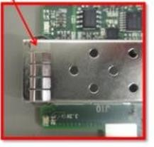
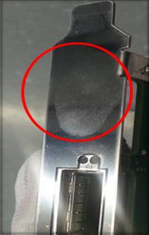

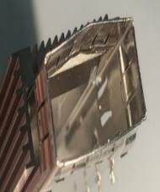

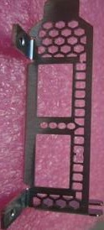
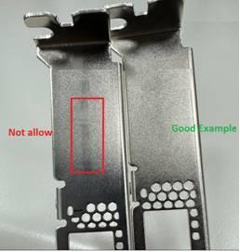


Foxconn Industrial Internet Co.,Ltd QUI ĐỊNH THAO TÁC TIÊU CHUẨN
Product
SFG024965
Station
Visual inspection_FATP_VI
Equipment, tool
NA
Document code
SOP-NVG-NV855B1-01
Version
A
Page
10-5
Material code
060106-2130003
Material :
Operation steps :
Top Side inspection (H1)
  Inspect the PCBA and Top surface for any signs of breakage, cracks (H1)
1.2. Golden finger: During visual inspection, if the golden finger is found to be dirty, scratched, oxidized, exposed copper, flux-contaminated, or discolored, judge it as NG. Please refer to the NG image as shown in (H2).
Bottom Side inspection (H3)
  Inspect the BOT surface to ensure there are no signs of breakage, cracks, deformation, etc. (H3)
  Check the screws: Q'ty, floating, deformation, screw should be completely smooth (H4)
  The contact pins are solder well and no exist pin in air, no foreign objects,polarity (H5)
  Inspection the connector without wraping, damaged or other NG, reference OK, NG (H5.1), (H5.2)
  Marlinh appearance is not blurred (H6).
Check the side surface
  Check bracket: Clear print on clear, scratched, dirty, deformed, wrong material as (H7)
  Look at the sides of the cage connector check that the latches mechanism are not damage, bent or deform, rust.. (H8)
3.3. Cage - Latch Mechanism pory inspection: not bent ,collapse ,bents down,no foreign objects,broken (H9)
3.4. No excess thermal grease on the cage port. Refer to H10 for OK/NG criteria.Criteria: Refer to (H10.1).
4. OK product, scan barcode on the PCBA , place it in the specified position, direction as (H11)
Hình biểu thị：
Material name
Quantity
Dung dịch IPA 90%
N/A
H1
TOP side
H2
Equipment name
Equipment:
Magnification lamp
Specification
Quantity
Feeler gauge
10X
1
N/A
1
Wipping cloth N/A 1
Attention item :
When handling requires wearing ESD finger rubber-gloves, ESD gloves,
activated carbon mask.
When handling requires wearing electrostatic wire
Test distance: The product is 60cm away from the eye, the test angle is from 40-45° (For cage, heatsink & bracket)
Light Condition: >1000lux
When detecting errors, it is necessary to judge using IPC610 and QC book , DOC003410 bond inspection documents to judge
When operating, only hold edge of PCBA, prevent to touch the components on PCBA and gold finger, don't wear the ring and nail tip.
Create R_ when PCB is error and handle follow the NG product process, place into the NG position
Use the ion fan blow on the operation position.
Using magnification lamp to inspect the gold finger and the position can't jugde outside.
A clean cloth only use for 12 pcs gold finger
Before open line of each shift, must to clean solution bottle
Change frequency: the finger rubber-gloves 4 hours/ time, gloves 1 days/ time. If it is torn or dirty, replace it immediately.
Only scan 1 times, if second time still can't scan, inform to line leader.
It is possible to use the cloth that instilled IPA solution to clean the dirty positions
NG images for illustration only
foreign objects
Scratch + dirty
Missing Gold Layer
H11
H6
H3
BOT side
H4
OK
NG
H10.1
A
B
H5.2
OK
H5.1
OK
NG
H5
Visual Inspection Area
Criteria: Excess thermal grease in Area B → NG; in Area A → OK.
H10
NG
NG
OK
NG
H9
H8
H7
Deformed CAGE
Edge of the spring bent upward
Broken
Damage, scratch
OK
Snaps bend
Snaps OK
warped cage
Lack of one of the cage wings

