Slide 1

BRADFORD BULLS · SPONSORSHIP VISIBILITY REVIEW
What the shirt is
actually worth on screen
LogoLens measures every sponsor mark, frame by frame, across two complete broadcasts — then puts that evidence next to the club's own pricing.
MEASURE
BENCHMARK
REVIEW
DECIDE
Visibility per asset
Against club pricing
Find the real gaps
Price with evidence
MSc dissertation project · LogoLens computer-vision system · Findings presentation
1
Notes:
Open by naming the one question this whole project answers: when a sponsor pays for a place on the shirt, how much broadcast exposure do they actually get, and does the club's price list match it? Say that everything you are about to show comes from two complete Bradford Bulls matches, measured automatically, not from a sample of highlights.

Slide 2
THE BOTTOM LINE
Three findings the club can act on
Measured broadcast visibility is stable and repeatable — but it does not line up with how the shirt is currently priced.
SHORTS
FRONT TORSO
REPEATABILITY
ALIGNMENT
3.07×
0.41×
ρ 0.846
0 / 16
43.1% of measured visibility sits on the shorts. They are priced at 14%.
The chest block carries 41% of the price but 16.7% of measured visibility.
Asset ordering barely moved between the two matches. Mean shift: 0.93 pp.
No asset's price matches its measured visibility. 9 sit above, 7 below.
The system is consistent. The price list is the part that moves.
Across both matches LogoLens ranked the same three assets at the top — KLG, Bartercard and Top Notch. That stability is what makes the mismatch with the current allocation worth a conversation: it is not measurement noise, it is a structural difference between where the club places value and where the camera actually spends its time.
Source: LogoLens full-match analysis of two complete Bradford Bulls broadcasts (home kit 2025/26), sampled at 2 frames per second. Club allocation = current management percentage; it totals 95%, LogoLens totals 100%.
2
Notes:
This is the slide to land hard. Three messages: (1) the shorts are the most visible real estate on the kit and the cheapest; (2) the chest carries the price but not the exposure; (3) the measurement repeats across matches, so this is a real pattern, not a one-off reading. Stress that none of this says the club is wrong — chest sponsorship carries value beyond broadcast. It says the broadcast component is now measurable and can be put on the table.

Slide 3
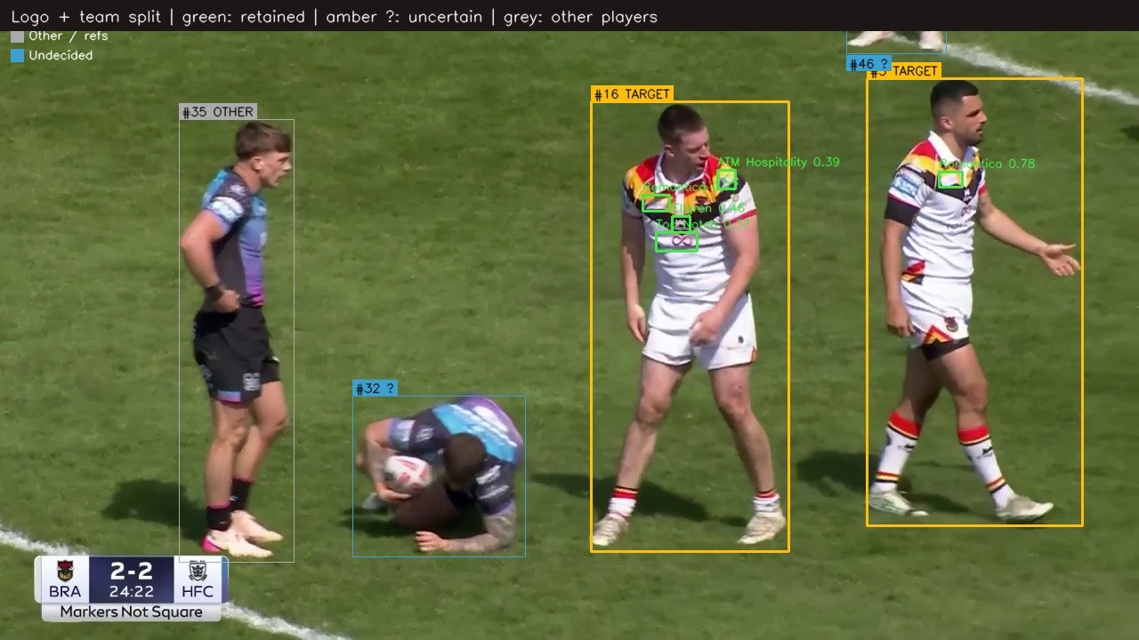
EVIDENCE BASE
What was measured, and how
Every number in this deck traces back to a frame, a timestamp and a detection.
2
complete match broadcasts — no highlight sampling
16
sponsor assets on the 2025/26 home kit
2 fps
analysis rate across the full 80 minutes
0.933
detector mAP@0.50 on three unseen matches
Actual system output: Bradford players kept (amber), opponents and officials discarded (grey), each sponsor mark boxed with its confidence score.
1
2
3
4
5
6
Detect the mark
Track it over time
Keep only Bradford players
Place it on the body
Score its visibility
Aggregate to a % share
3
Notes:
Keep this short. The two points that matter to a club audience: we watched the whole match, not the highlights, and the system only counts logos on Bradford players — opponent kit and pitch-side boards are filtered out. The frame on screen is real system output, so you can point at it.

Slide 4
HOW A LOGO IS SCORED
Six things measured on every appearance
A logo is not simply present or absent. Each appearance is weighted by how well it could actually be seen.
Size
Position
Clarity
How much of the screen the mark fills.
How close to the centre of frame it sits.
How confidently the model can read it.
Square-rooted, so one huge close-up cannot dominate the season.
Centre of screen scores ~1.0; far corners drop to ~0.1.
Blurred, shadowed or folded marks score lower.
Orientation
Duration
Frequency
How square-on the mark is to camera.
How long a continuous appearance lasts.
How many separate times it appears.
Corrects for marks stretched by an oblique camera angle.
Under 1s counts half; over 5s counts 1.2× — sustained exposure is worth more.
Segments are counted separately, so repeat exposure accumulates.
Visibility of one appearance = Size × Position × Clarity × Orientation × Duration weight × seconds on screen
An asset's percentage is its share of the total quality-weighted exposure across the whole match. The individual factors are stored per detection, so any one of them can be switched off and the percentages recalculate instantly.
4
Notes:
The point of this slide is credibility. Anyone can count frames. What makes this defensible is that a logo tucked in a corner at 40 pixels does not count the same as one filling the centre of a close-up. Mention the last line: because the factors are stored separately, the club can ask 'what if we don't care about position?' and get an answer in seconds rather than a re-run.

Slide 5
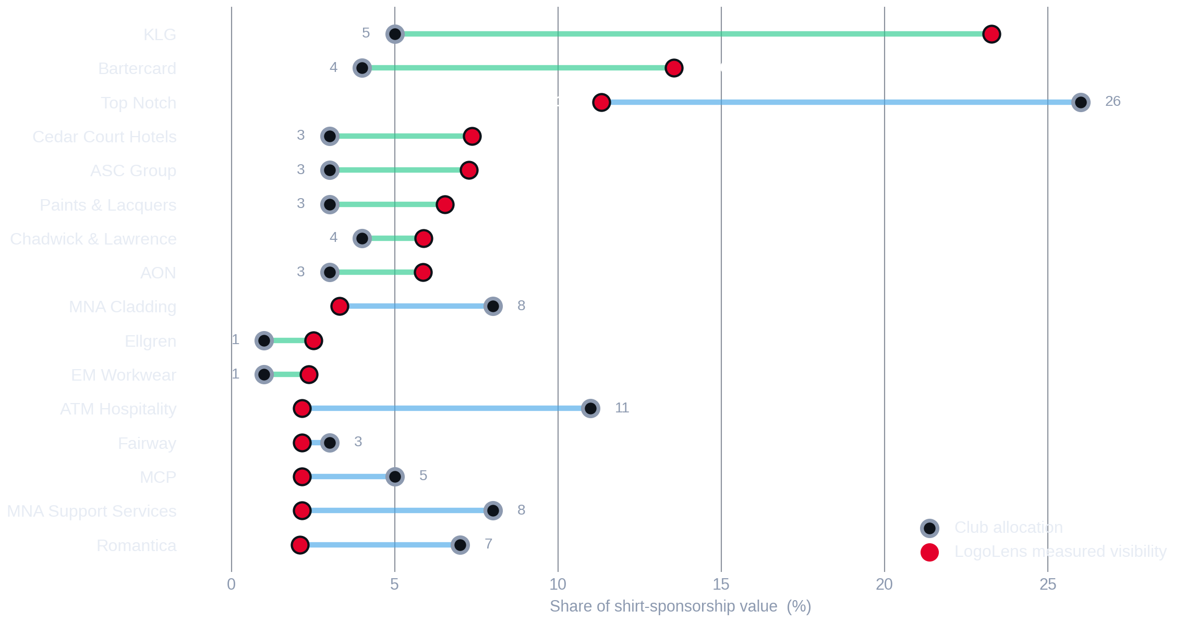
HEADLINE COMPARISON
Measured visibility against club allocation
All 16 shirt assets, ranked by how much broadcast exposure they actually received across the two matches.
MEASURED ABOVE PRICE
KLG, Bartercard and the whole shorts block deliver far more screen time than their share of the price suggests.
PRICE ABOVE MEASURED
Top Notch, ATM Hospitality and the collar marks carry a premium that broadcast visibility alone does not explain.
Source: LogoLens full-match analysis of two complete Bradford Bulls broadcasts (home kit 2025/26), sampled at 2 frames per second. Club allocation = current management percentage; it totals 95%, LogoLens totals 100%.
5
Notes:
Walk the chart top to bottom. Grey ring = what the club charges for that asset as a share of the shirt. Red dot = what LogoLens measured. The length of the line is the disagreement. The single most striking row is the top one: KLG on the back of the shorts is the most-seen mark on the kit and one of the cheapest. The second is Top Notch — a quarter of the price, an eighth of the visibility.

Slide 6
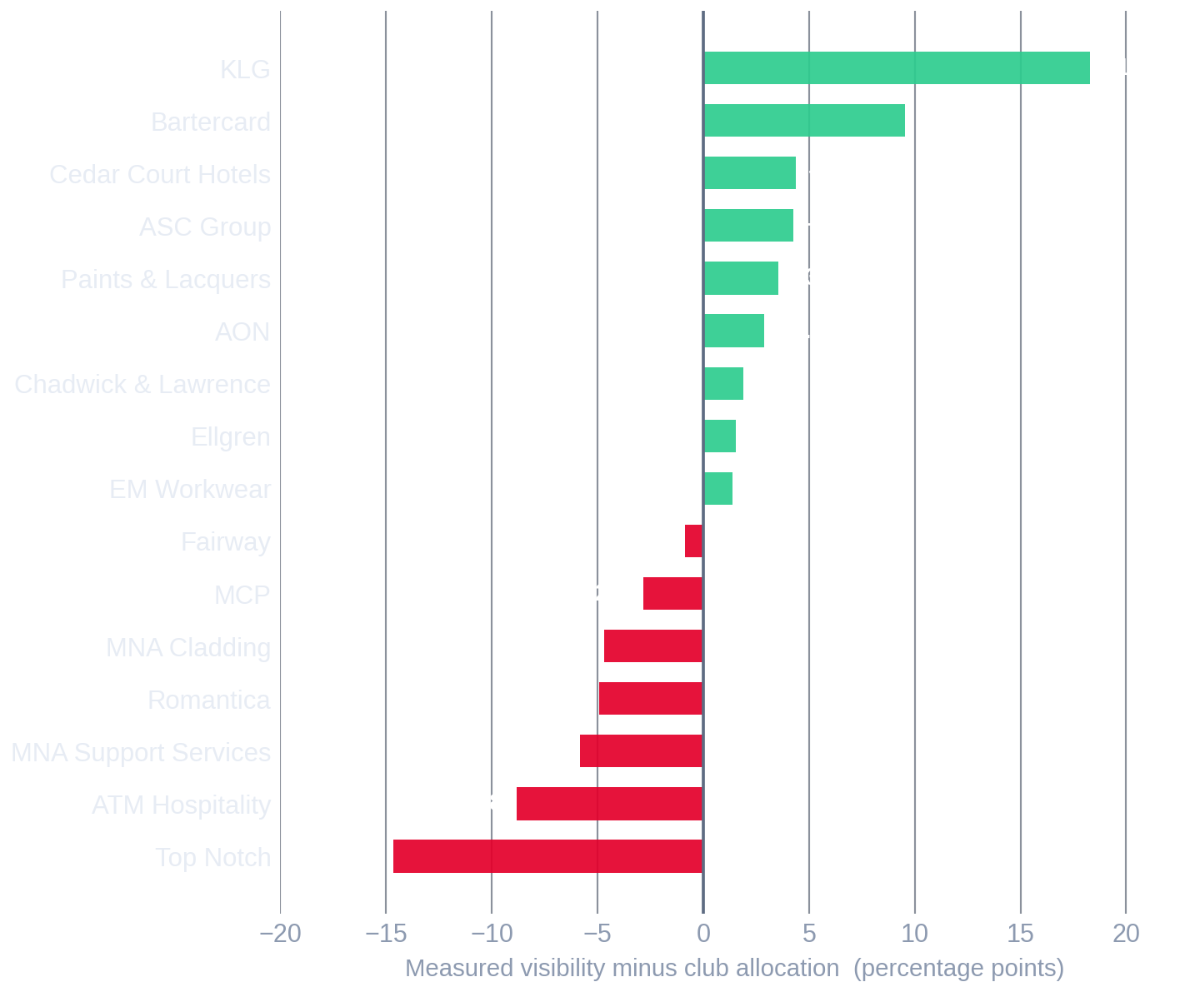
WHERE THE MONEY SITS
The size of each gap, in percentage points
Positive = the asset delivers more broadcast visibility than its price implies.
KLG · Top back of shorts
+18.3 pp
23.3% of measured visibility, 5% of the price. The single largest commercial gap on the kit.
Bartercard · Sleeve 3
+9.6 pp
13.6% measured against 4% priced — the sleeve that sits toward camera in contact.
Top Notch · Main sponsor
−14.7 pp
26% of the price, 11.3% of measured visibility. The premium needs a non-broadcast justification.
ATM Hospitality · Sleeve 2
−8.8 pp
11% priced, 2.2% measured. The far sleeve is rarely toward camera.
Source: LogoLens full-match analysis of two complete Bradford Bulls broadcasts (home kit 2025/26), sampled at 2 frames per second. Club allocation = current management percentage; it totals 95%, LogoLens totals 100%.
6
Notes:
This is the commercial slide. Two things to be careful about when you say them out loud. First, a positive gap is not automatically a price rise — it is a renewal argument and a packaging opportunity. Second, a negative gap is not automatically a price cut: the main sponsor buys hoardings, hospitality and brand association that this system does not measure. What changed is that the broadcast slice of that bundle now has a number attached to it.

Slide 7
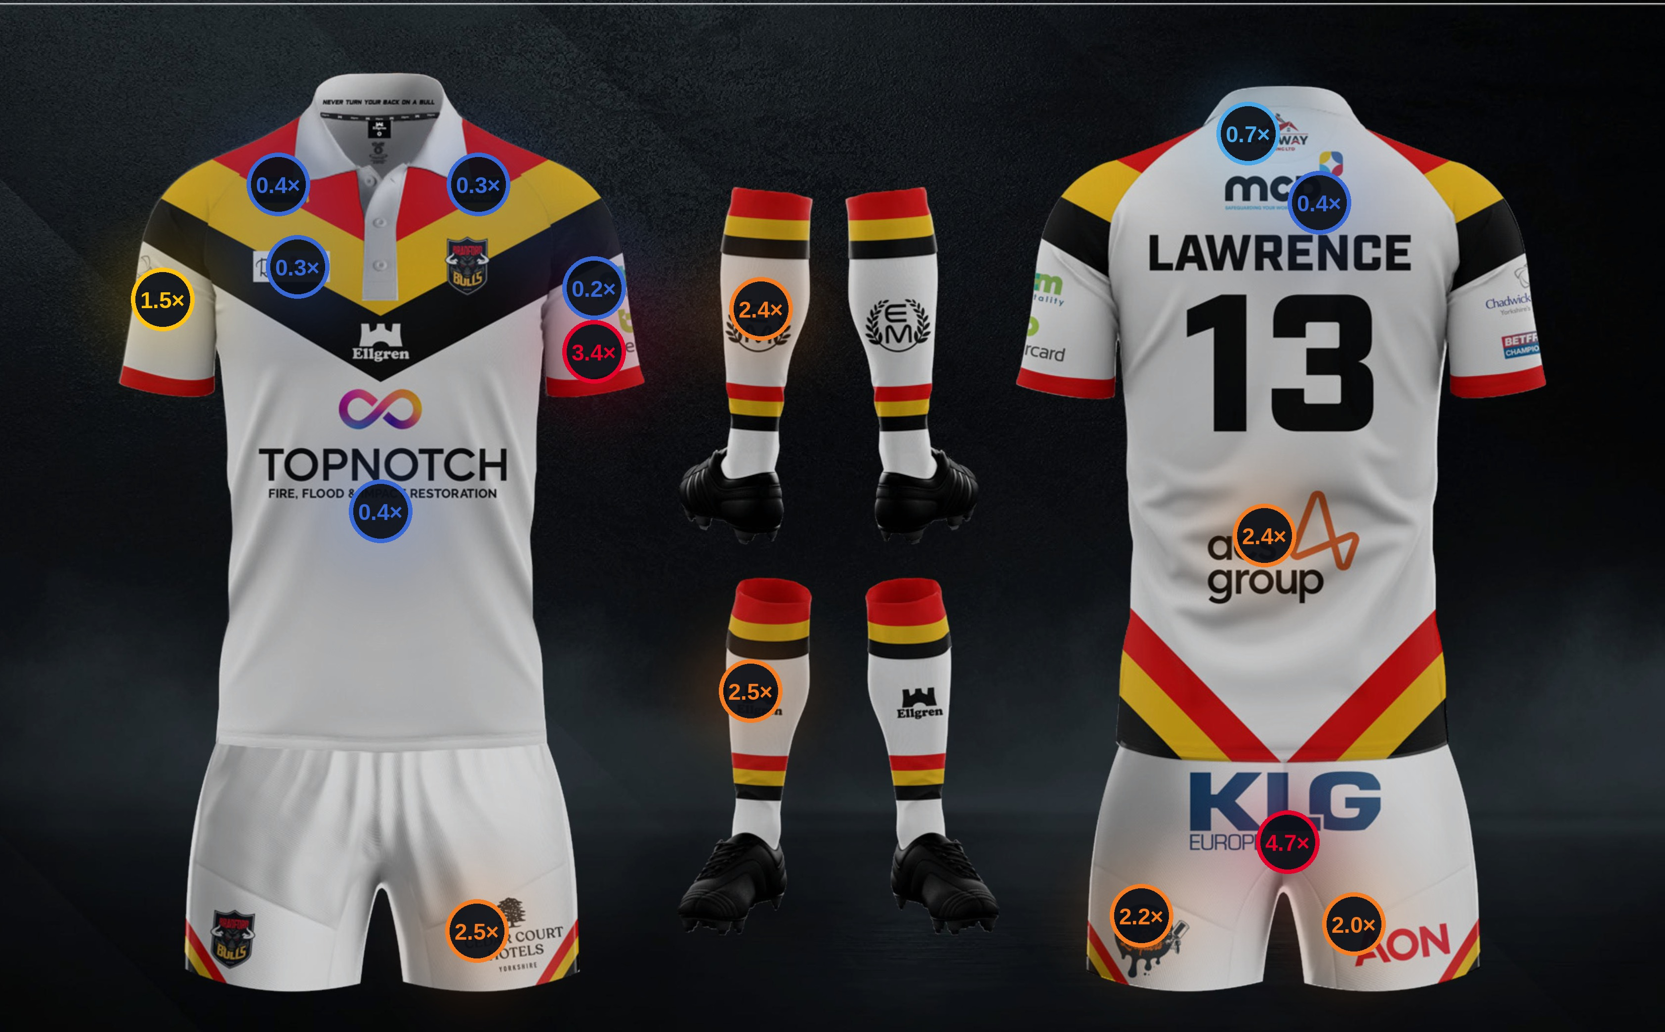
THE SAME PICTURE ON THE KIT
Measured visibility ÷ club allocation, by position
READING THE MAP
≥ 3.0×
Far more seen than priced
1.8 – 3.0×
Materially under-priced
1.15 – 1.8×
Modestly under-priced
0.85 – 1.15×
In line
< 0.85×
Priced above measured visibility
The pattern is positional
Everything below the waist reads warm — the shorts and socks are seen far more than they are priced. Everything around the collar reads cold. Broadcast cameras spend their time on the contact area, not the shoulders.
Ratio = mean LogoLens visibility share ÷ club allocation share. Kit artwork: Bradford Bulls 2025/26 home playing kit.
7
Notes:
This is the slide people will photograph. Let it breathe. The marker on each position is measured visibility divided by the club's price share: above 1.0 means the camera gives it more than the price list does. Point at the back of the shorts (4.7×) and then at the collar (0.3×) — that contrast is the whole argument in one image.

Slide 8
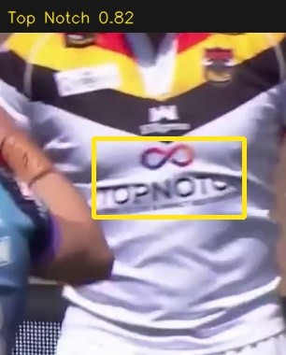
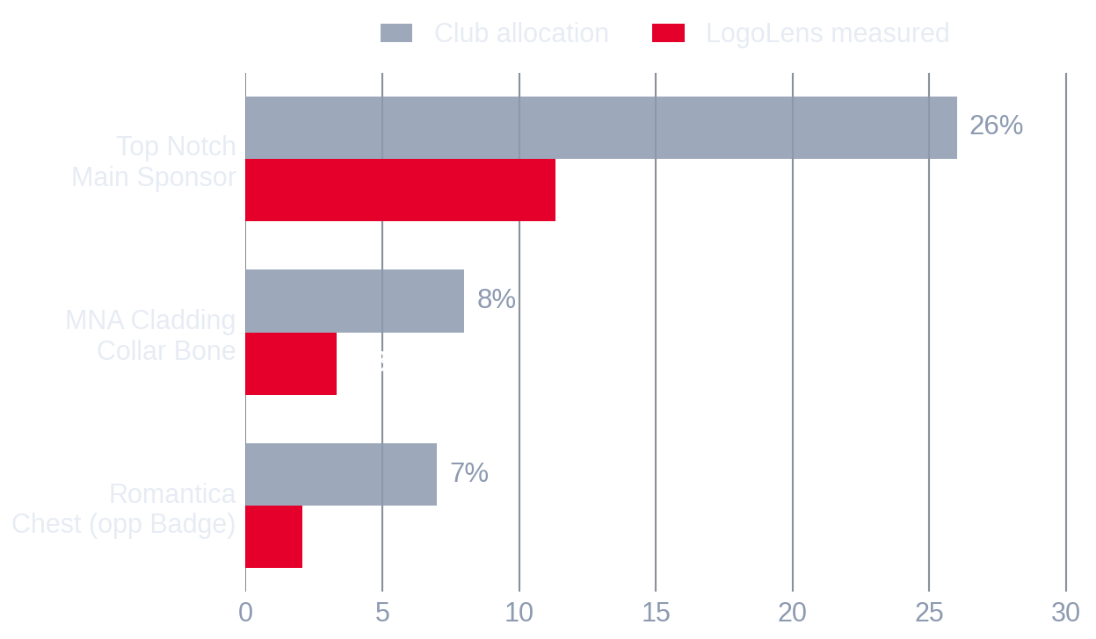
PLACEMENT REVIEW · FRONT TORSO
Chest and collar: the price block
Top Notch, MNA Cladding and Romantica together carry 41% of the shirt price and 16.7% of measured broadcast visibility.
MEASURED VISIBILITY ÷ CLUB ALLOCATION
0.41×
Club allocation
41%
Measured visibility
16.7%
Detected: Top Notch, confidence 0.82
What this means commercially
The main sponsor is still the most-detected single mark on the front of the shirt — it simply does not carry four times the exposure that four times the price implies. A chest position is bought for brand association and for every still photograph, programme and press image, none of which this system measures.
Source: LogoLens full-match analysis of two complete Bradford Bulls broadcasts (home kit 2025/26), sampled at 2 frames per second. Club allocation = current management percentage; it totals 95%, LogoLens totals 100%.
8
Notes:
Zone slide for front torso. Give the headline ratio first, then let the bar chart do the detail. The evidence crop on the right is a real detection from the footage — use it if anyone asks whether the system is really reading the mark or just guessing from position.

Slide 9
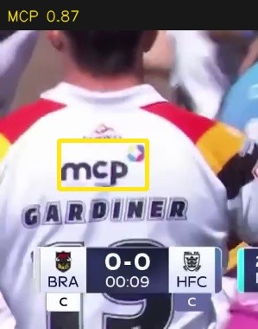
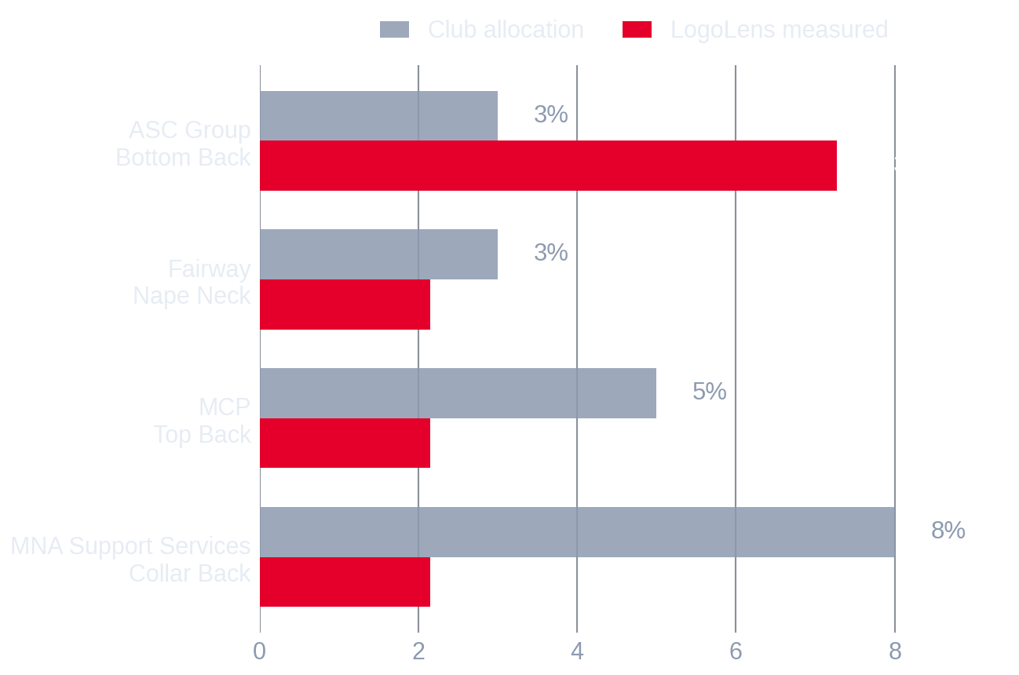
PLACEMENT REVIEW · BACK / NECK
Back and collar: broadly in proportion
19% of the price against 13.7% of measured visibility — the closest match of any block, but with one important caveat.
MEASURED VISIBILITY ÷ CLUB ALLOCATION
0.72×
Club allocation
19%
Measured visibility
13.7%
Detected: MCP, confidence 0.87
What this means commercially
ASC Group on the lower back performs well above its price; MCP, Fairway and the back collar sit below it. Note the caveat: three back-top positions currently share a single visibility anchor, so their individual numbers should be read as a group rather than as three independent readings.
Source: LogoLens full-match analysis of two complete Bradford Bulls broadcasts (home kit 2025/26), sampled at 2 frames per second. Club allocation = current management percentage; it totals 95%, LogoLens totals 100%.
9
Notes:
Zone slide for back / neck. Give the headline ratio first, then let the bar chart do the detail. The evidence crop on the right is a real detection from the footage — use it if anyone asks whether the system is really reading the mark or just guessing from position.

Slide 10
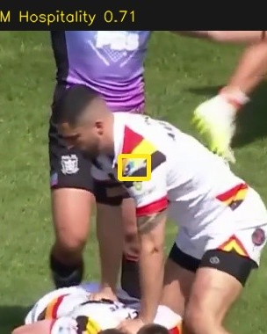
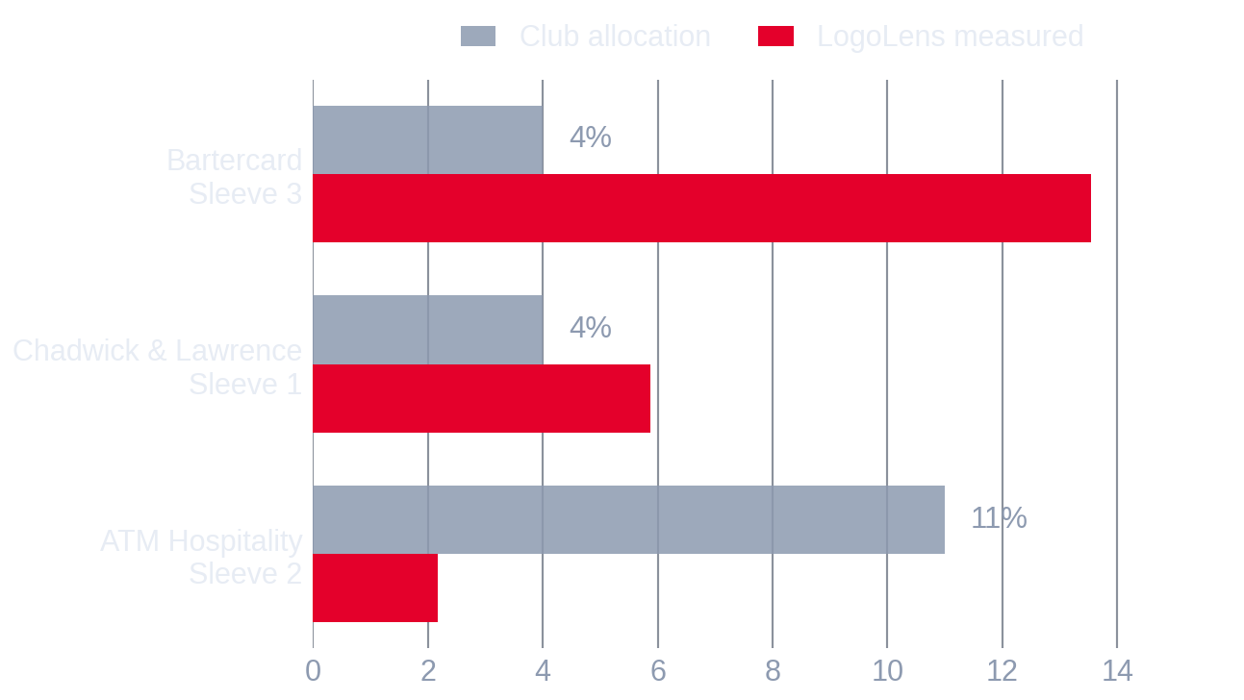
PLACEMENT REVIEW · SLEEVES
Sleeves: the same price, very different exposure
19% priced against 21.6% measured. The block matches — but the three sleeve positions inside it do not.
MEASURED VISIBILITY ÷ CLUB ALLOCATION
1.14×
Club allocation
19%
Measured visibility
21.6%
Detected: ATM Hospitality, confidence 0.71
What this means commercially
Bartercard measures 13.6% on a 4% price; ATM Hospitality measures 2.2% on an 11% price. Two sleeve slots, a 2.75× price difference, and the cheaper one is seen six times more often. This is the clearest case in the whole analysis where the block total hides the real story.
Source: LogoLens full-match analysis of two complete Bradford Bulls broadcasts (home kit 2025/26), sampled at 2 frames per second. Club allocation = current management percentage; it totals 95%, LogoLens totals 100%.
10
Notes:
Zone slide for sleeves. Give the headline ratio first, then let the bar chart do the detail. The evidence crop on the right is a real detection from the footage — use it if anyone asks whether the system is really reading the mark or just guessing from position.

Slide 11
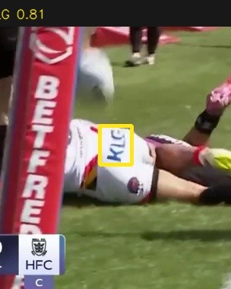
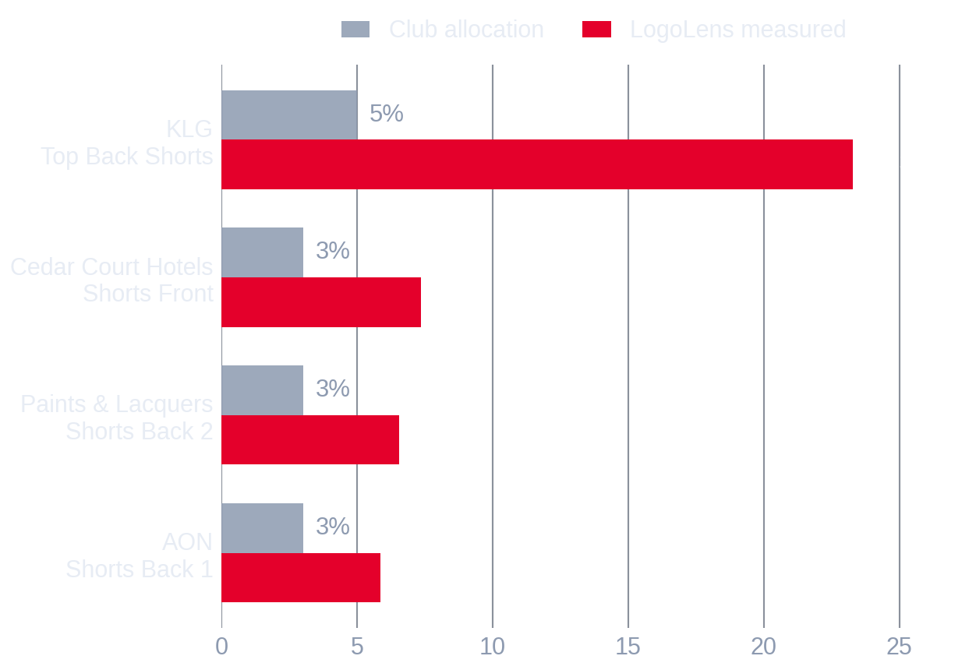
PLACEMENT REVIEW · SHORTS
Shorts: the most under-priced real estate on the kit
14% of the price, 43.1% of measured broadcast visibility — a 3.07× difference, and the strongest signal in the analysis.
MEASURED VISIBILITY ÷ CLUB ALLOCATION
3.07×
Club allocation
14%
Measured visibility
43.1%
Detected: KLG, confidence 0.81
What this means commercially
Rugby league is played low. Rucks, tackles and play-the-ball sequences put the shorts squarely in the centre of the frame in close and medium camera work, which is where the broadcast spends most of its time. All four shorts positions measure above their price, and KLG on the top back is the single most-seen mark on the kit.
Source: LogoLens full-match analysis of two complete Bradford Bulls broadcasts (home kit 2025/26), sampled at 2 frames per second. Club allocation = current management percentage; it totals 95%, LogoLens totals 100%.
11
Notes:
Zone slide for shorts. Give the headline ratio first, then let the bar chart do the detail. The evidence crop on the right is a real detection from the footage — use it if anyone asks whether the system is really reading the mark or just guessing from position.

Slide 12
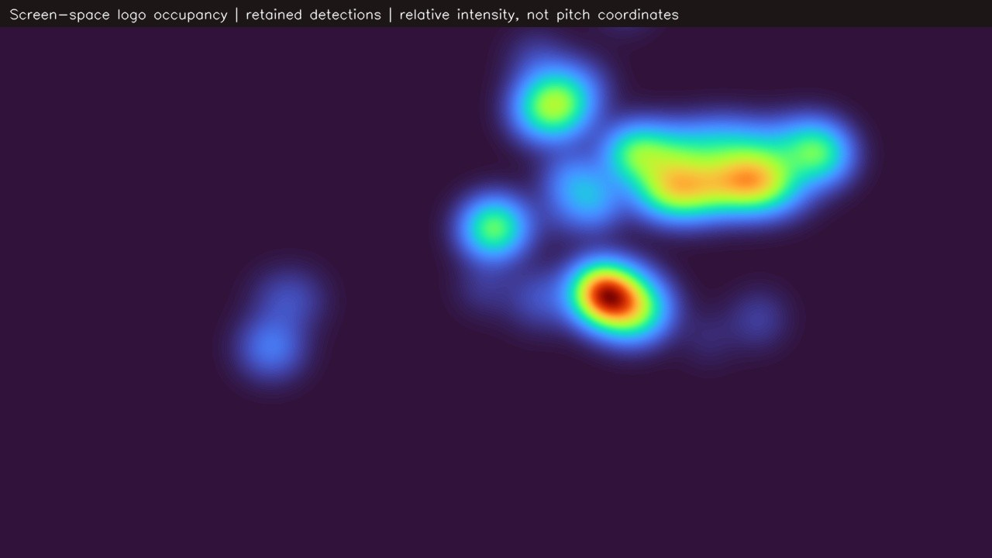
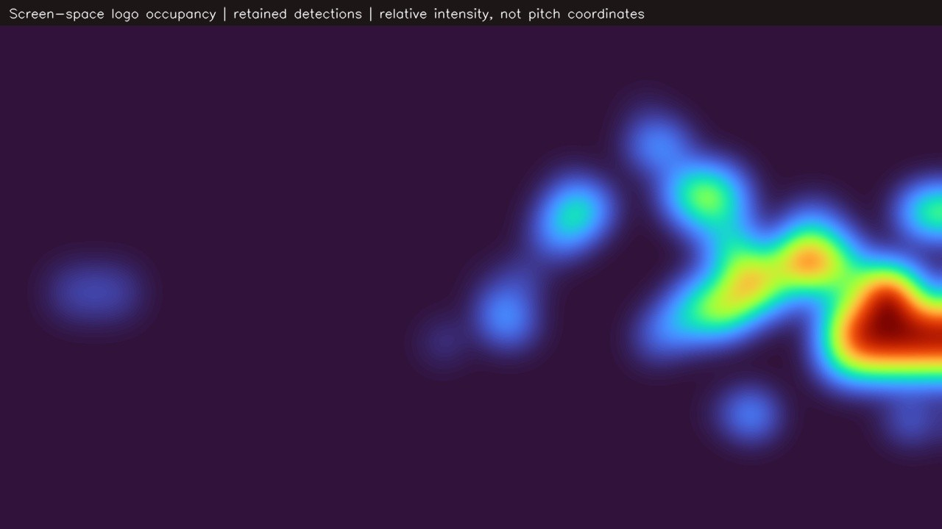
SCREEN-SPACE EXPOSURE
Where sponsor marks actually land in frame
Heat shows where retained Bradford logo detections sat on screen. Brighter means more logo-seconds in that part of the picture.
Close / contact passage
Wide tactical passage
Detections cluster around the tackle area — centre-right of frame, roughly waist height. Shorts and lower-back marks sit exactly here.
Exposure spreads and weakens. Marks drift toward the edge of frame, where the position weighting reduces their value.
Heatmaps are relative intensity of retained logo detections in screen space, from two representative passages of the analysed footage. Not pitch coordinates.
12
Notes:
Explain what the heat is and what it is not. It is screen-space: where on the television picture the logos appeared. It is not pitch position and it is not player running data. The commercial read is simple — the camera lives around the contact area, and the kit real estate that sits in the contact area is the shorts and lower back.

Slide 13
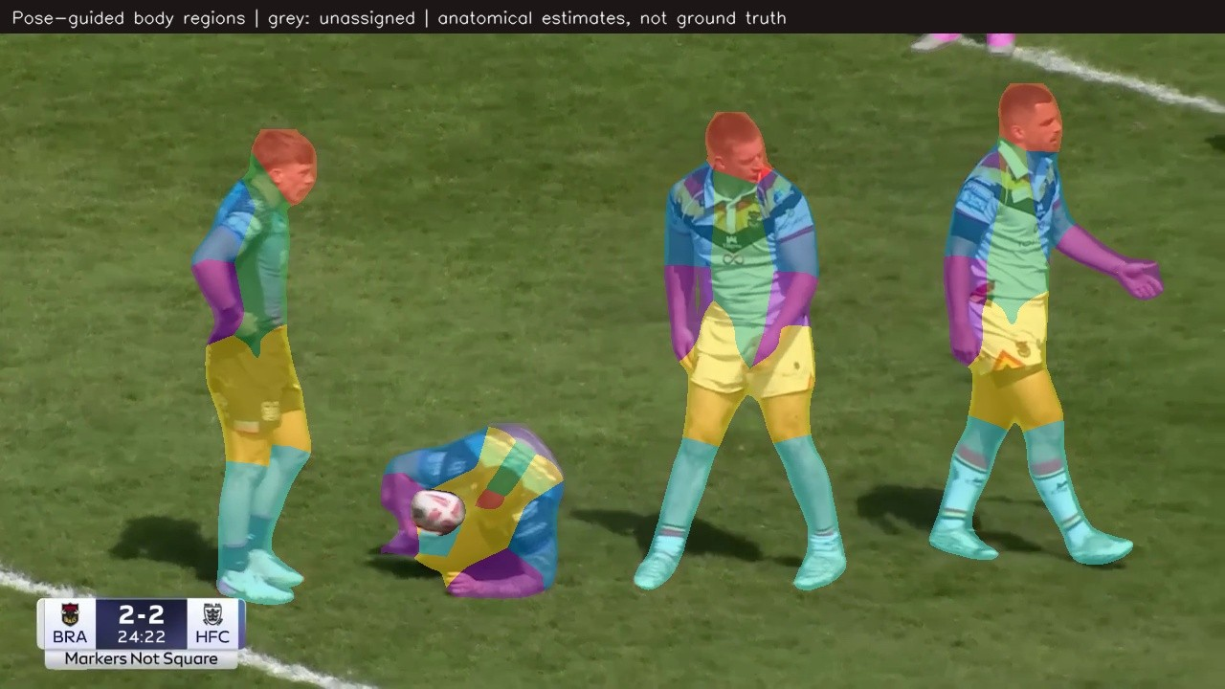
LIVE DEMONSTRATION
The system working on real Bradford footage
Both clips are unedited system output. Click either to play.
Detection and team filtering
Body-zone attribution
Every sponsor mark is boxed with its confidence. Bradford players are kept (amber), opponents and officials are discarded (grey), uncertain players are held back rather than guessed. Only kept detections earn exposure.
Each player is broken into anatomical regions from pose keypoints, so a mark can be tied to chest, back, sleeve, shorts or socks. Grey means the system had insufficient evidence and declined to assign.
Clips: artifacts/bradford_review/tackle_team_split.mp4 and tackle_body.mp4 — real Bradford v Hull FC footage, home kit.
13
Notes:
Play the left clip first and narrate it: boxes appear, brand names and confidence scores are on screen, and notice that the opponent in dark kit is greyed out — their sponsors never enter Bradford's numbers. Then the right clip: this is how the system knows a mark is on the shorts rather than the shirt. If a clip does not autoplay on the venue machine, the files sit beside the deck in the artifacts folder.

Slide 14
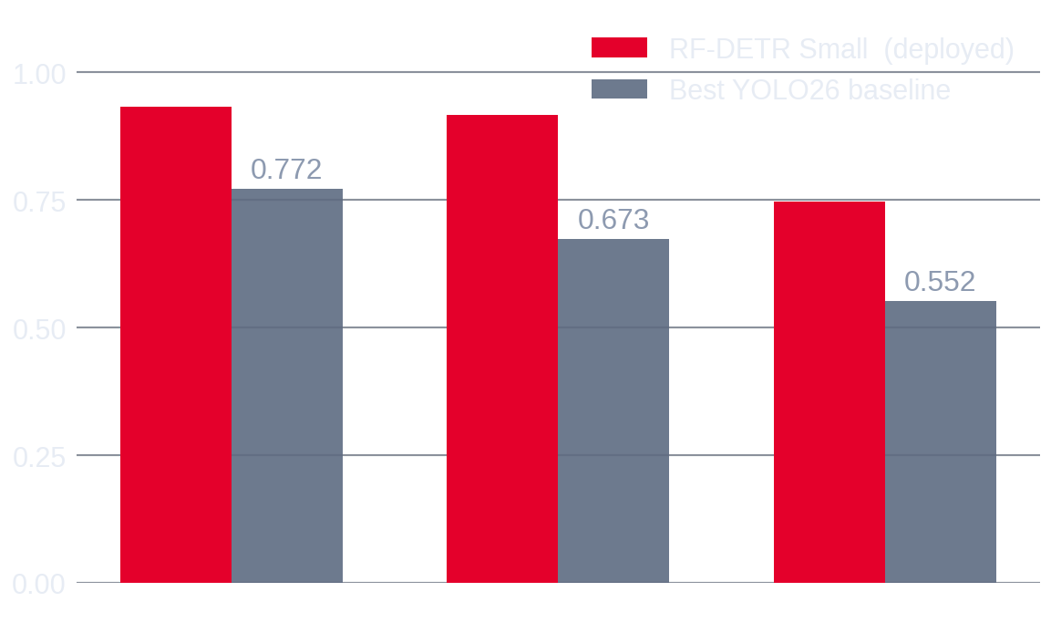
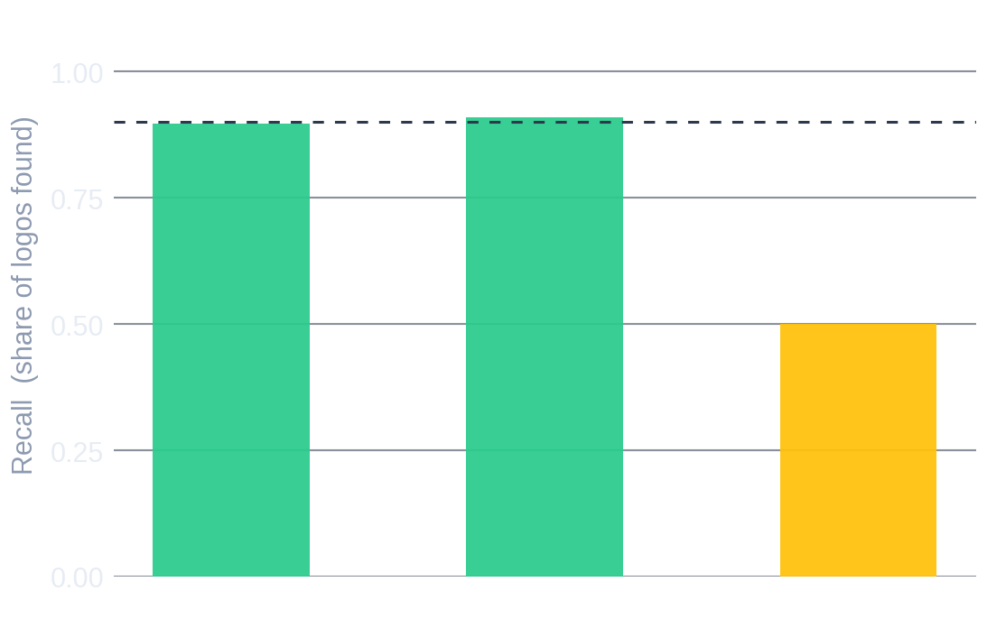
MODEL PERFORMANCE
How accurate is the detector?
Measured on three complete matches the model had never seen, against hand-annotated ground truth.
MAP@0.50
0.933
on unseen matches
F1 SCORE
0.898
at the operating point
SPEED
19.8 fps
50 ms per frame, single GPU
Detection accuracy against three unseen matches — the deployed model versus the strongest conventional baseline trained on identical data.
The one weakness worth declaring: on wide tactical shots the model finds only half the marks. It rarely invents them — it misses them.
HONEST CHECK
0.917
with sparse classes removed
Detector: RF-DETR Small at 896 px, evaluated on 61 held-out images / 165 boxes across three unseen matches. Baseline: best of three YOLO26 variants trained on the identical split.
14
Notes:
Two honest points make this slide trustworthy rather than salesy. One: the same model scores 0.998 when tested on matches it has already seen and 0.933 on new ones — we report the harder number. Two: four sponsor classes have very few test examples, and removing them moves the headline from 0.933 to 0.917, which we also report. Wide-shot recall of 0.500 means exposure during wide play is under-counted, so today's visibility figures are conservative.

Slide 15
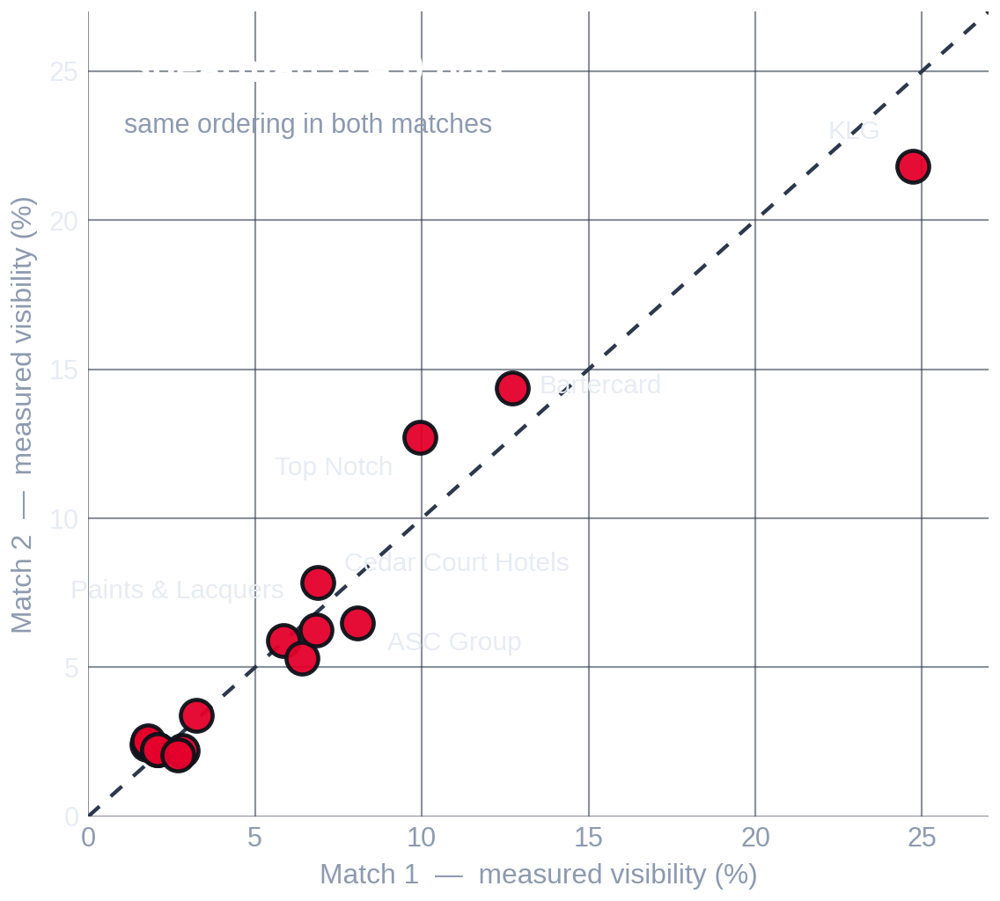
REPEATABILITY
Does the answer hold from match to match?
Each point is one sponsor asset. If the system were unstable, the points would scatter away from the diagonal.
Same top three, both matches
KLG, Bartercard and Top Notch held the top three measured positions in match 1 and match 2.
Movement is small
The average asset moved 0.93 percentage points between matches; the largest single move was 2.91 points.
No gap direction flipped
Every asset that measured above its price in match 1 did so again in match 2, and the same for those below.
But two matches is a pilot
This is strong evidence of a pattern, not season-level proof. A fuller set of fixtures should be measured before structural repricing.
Source: LogoLens full-match analysis of two complete Bradford Bulls broadcasts (home kit 2025/26), sampled at 2 frames per second. Club allocation = current management percentage; it totals 95%, LogoLens totals 100%.
15
Notes:
This slide pre-empts the obvious challenge: 'you only watched two games.' The answer is that the two games agree with each other very closely, which means the measurement is repeatable — and then be the first to say that two matches is a pilot, not a season. That honesty is what makes the recommendation on the next slides credible.

Slide 16
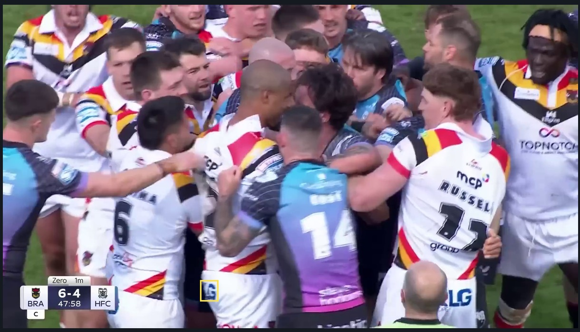
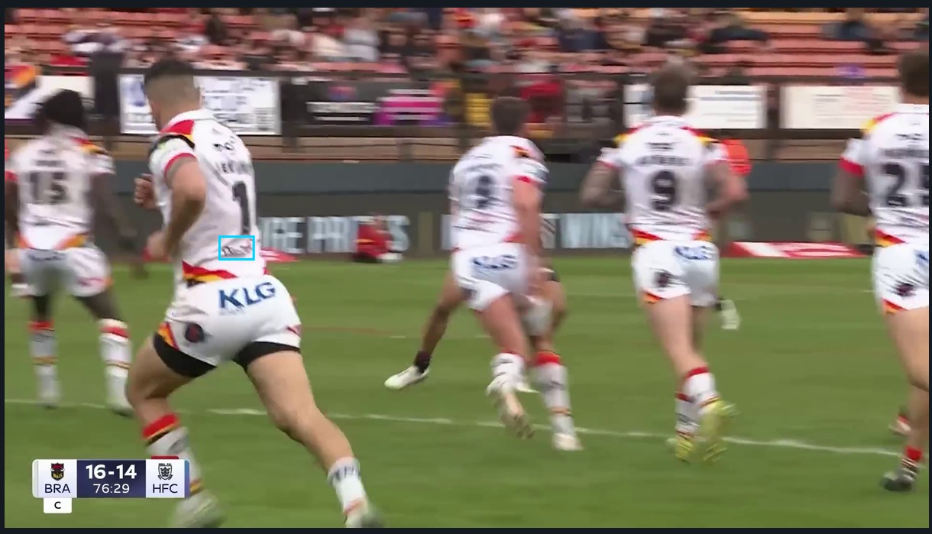
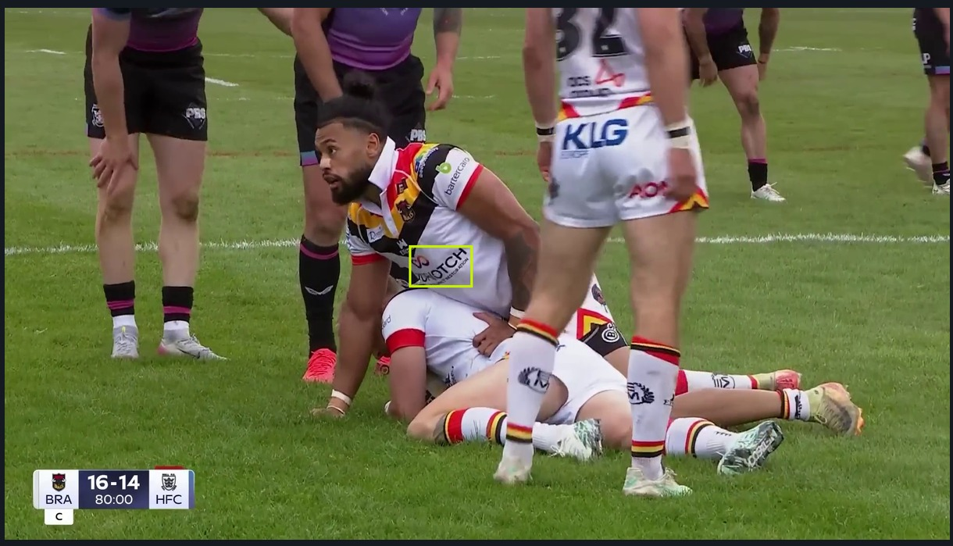
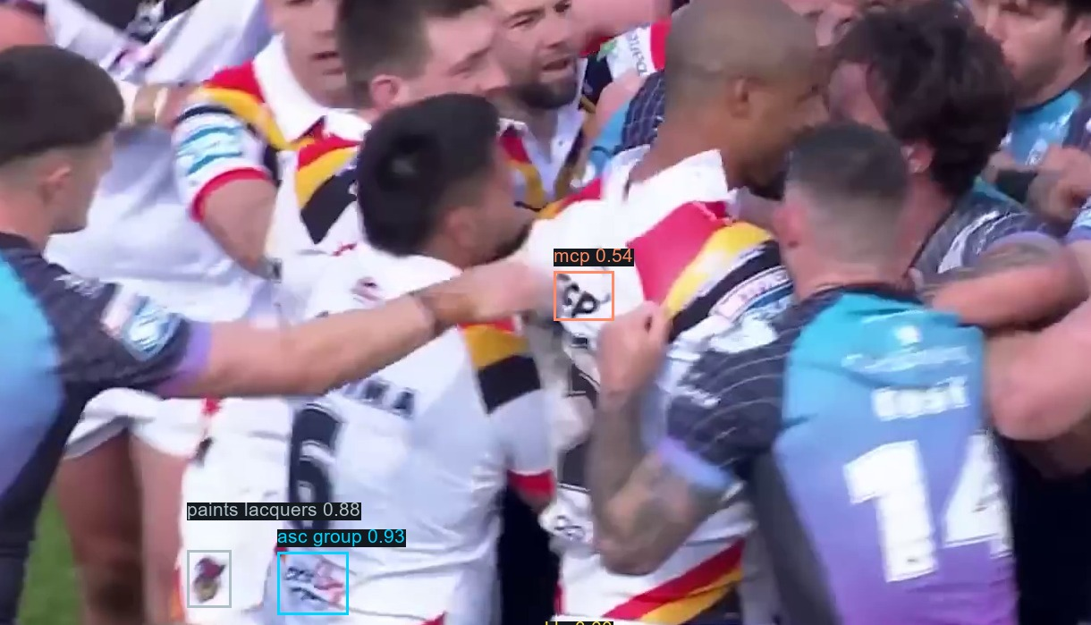
LIMITATIONS
Where the system struggles — and what that costs
Every example below is real output from the analysed footage.
Occlusion
Motion blur
Camera angle
Crowded phases
Players cover each other constantly. Partly hidden marks score lower or are missed entirely.
Small marks on sprinting players go soft. Lower-back and sleeve logos suffer most.
An oblique view distorts the mark. The system corrects for shape but confidence still falls.
Scrums and melees stack players. Attribution to the right player becomes harder.
What this means for the numbers
• Wide-shot recall is 0.500, so total exposure is under-counted in wide passages — the figures are conservative, not inflated.
• Three back-top positions share one visibility anchor, so read them as a group rather than individually.
• LogoLens measures broadcast visibility only — not attention, recall, hospitality, exclusivity or activation value.
• Club allocation totals 95% and LogoLens totals 100%; rescaling to 95% changes no gap direction.
16
Notes:
Do not rush this slide — volunteering the weaknesses is what earns you the right to the recommendations. The single most important sentence: because the system misses logos in wide play rather than inventing them, the exposure numbers are conservative. If anything, the gaps you have just seen are understated.

Slide 17
PRACTICAL VALUE
What Bradford Bulls can do with this
The output is evidence for a commercial conversation, not an automatic price list.
Price with evidence
Repackage the inventory
Defend the premium positions
Bring a measured delivery figure to every renewal instead of an asserted one. The number is reproducible and traceable to timestamps.
Shorts and lower-back positions are currently sold cheaply relative to what they deliver. They can be bundled, upgraded or re-tiered.
Where price sits above broadcast visibility, document the non-broadcast value — hospitality, stills, digital, association — explicitly.
Report to sponsors
Prove the rate card
Scale to more fixtures
Give each partner a per-match summary of their own delivery: seconds, appearances, quality and share. That is a retention tool.
Turn the shirt from a list of positions into a measured inventory with a defensible internal logic.
The same pipeline runs on any broadcast of the home kit with no extra annotation, building a season-level picture.
Use it as decision evidence — not as an automatic pricing engine.
The recommendation is a hybrid review: the club's commercial judgement, the LogoLens measurement, and a written rationale wherever the two differ by more than a few points.
17
Notes:
Close the commercial argument here. The one line to repeat: this does not replace commercial judgement, it gives that judgement something to point at. If a sponsor asks why their sleeve costs what it costs, there is now an answer with a number on it.

Slide 18
NEXT STEPS
From a two-match pilot to a season-level system
Four steps, in the order they should happen.
01
Confirm the inventory map
The club signs off which brand sits in which kit position, and the current price share for each. Everything downstream depends on this being right.
Club · 1 week
02
Extend to more fixtures
Run the same pipeline over a broader set of complete home-kit broadcasts to convert a stable pilot into a season-level baseline.
Automated · per match
03
Validate against manual review
Hand-check timing and readability on a stratified sample, and measure how much wide-shot play is being under-counted.
Joint · 2–3 weeks
04
Run the pricing review
Take the measured delivery, the current rate card and a documented rationale into the next renewal cycle.
Commercial · next cycle
LogoLens turns broadcast footage into asset-level sponsorship evidence.
18
Notes:
End on the sequence, not on the technology. The club does one thing first — confirm the inventory map — and everything else follows from it. Offer to run the next fixture as soon as the footage is available.

Slide 19
APPENDIX
Full 16-asset comparison
Club allocation, measured visibility in each match, the mean, and the gap.
SPONSOR
KIT POSITION
CLUB %
MATCH 1
MATCH 2
MEAN AI %
GAP PP
KLG
Top Back Shorts
5
24.73
21.82
23.27
+18.27
Bartercard
Sleeve 3
4
12.72
14.38
13.55
+9.55
Top Notch
Main Sponsor
26
9.95
12.71
11.33
-14.67
Cedar Court Hotels
Shorts Front
3
6.87
7.86
7.37
+4.37
ASC Group
Bottom Back
3
8.07
6.48
7.28
+4.28
Paints & Lacquers
Shorts Back 2
3
6.83
6.25
6.54
+3.54
Chadwick & Lawrence
Sleeve 1
4
5.85
5.90
5.88
+1.88
AON
Shorts Back 1
3
6.42
5.32
5.87
+2.87
MNA Cladding
Collar Bone
8
3.25
3.38
3.31
-4.69
Ellgren
Socks front
1
2.82
2.22
2.52
+1.52
EM Workwear
Socks back
1
2.68
2.05
2.37
+1.37
ATM Hospitality
Sleeve 2
11
1.80
2.53
2.17
-8.84
MNA Support Services
Collar Back
8
2.08
2.23
2.16
-5.84
MCP
Top Back
5
2.08
2.23
2.16
-2.84
Fairway
Nape Neck
3
2.08
2.23
2.16
-0.84
Romantica
Chest (opp Badge)
7
1.77
2.41
2.09
-4.91
Source: LogoLens full-match analysis of two complete Bradford Bulls broadcasts (home kit 2025/26), sampled at 2 frames per second. Club allocation = current management percentage; it totals 95%, LogoLens totals 100%.
19
Notes:
Leave-behind slide. Everything on it is reproducible from the two match reports. Offer to send the underlying Excel exports.

