Slide 1
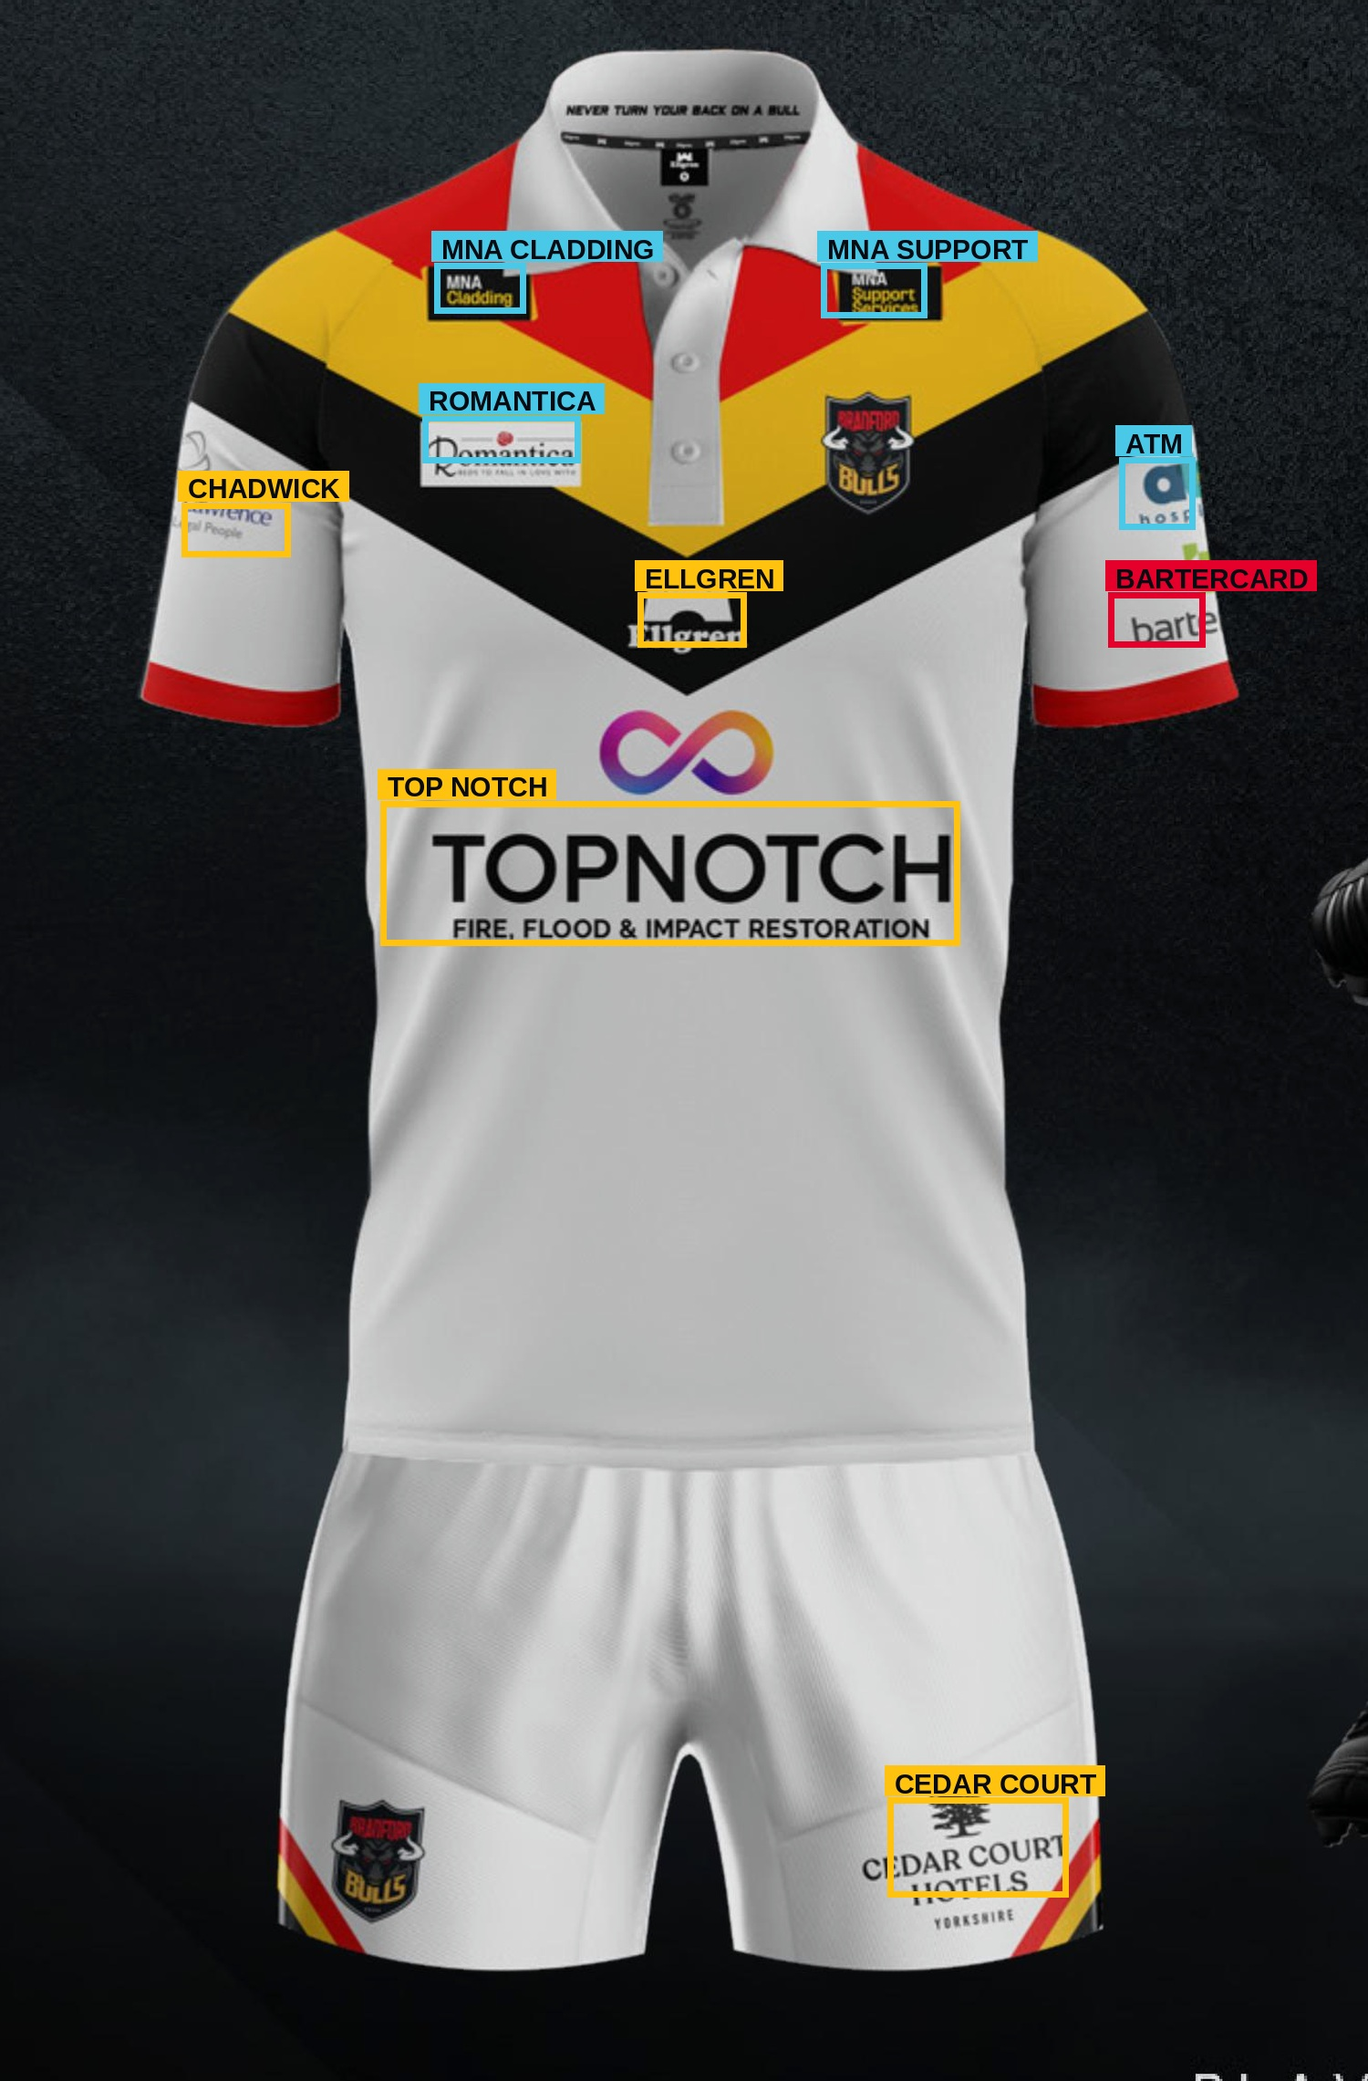
BRADFORD BULLS · SPONSORSHIP VISIBILITY REVIEW
What the shirt
is really worth
on screen
Every sponsor mark on the kit, measured frame by frame across two complete broadcasts — then placed next to what the club charges for it.
LogoLens · MSc Applied AI & Data Analytics, University of Bradford · in partnership with Bradford Bulls
Notes:
Open with the picture on the right: that is the Bradford home shirt as the system sees it — every sponsor mark found and named automatically. Then the question: each of those positions has a price, but nobody has ever measured what each one actually delivers on screen. That is what this project did, across two complete matches.

Slide 2
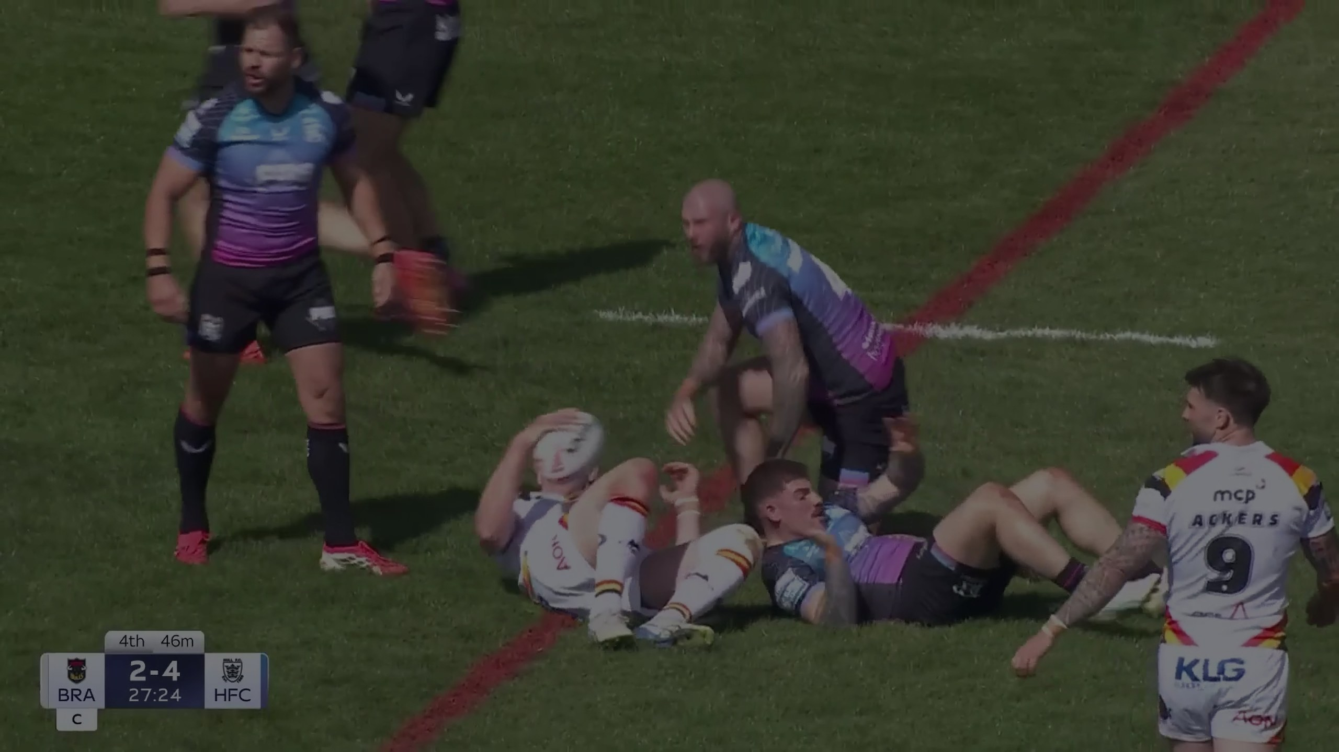
THE PROBLEM
Sixteen sponsors.
Sixteen prices.
Zero measurement.
The shirt is sold as sixteen separate positions, each with its own share of the price. That split is set by commercial judgement and precedent — not by anything anyone has counted. So when a sponsor asks what they got for their money, the honest answer today is an estimate.
Priced
Checked
Reported
by judgement, not evidence
by hand, on clips, occasionally
as presence, not as exposure
02
Notes:
Set up the gap before you show the solution. The club is not doing anything unusual — almost every club prices shirt positions this way. The point is simply that nobody has ever had the measurement, so there has been nothing to check the price list against.

Slide 3
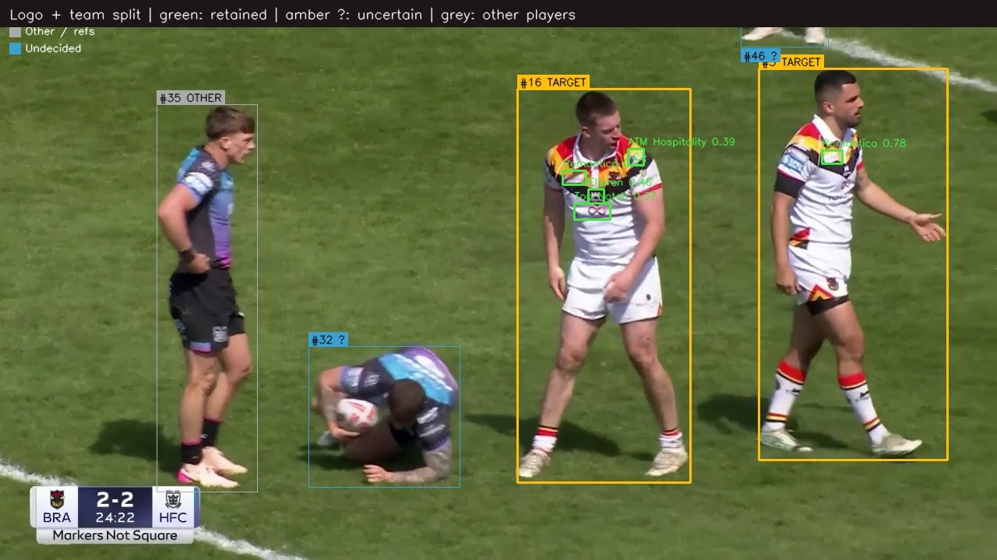
THE SOLUTION
From broadcast footage to a per-sponsor number
It watches the whole match, finds every sponsor mark on a Bradford player, and scores how well each one could actually be seen.
01
Find
Every sponsor mark in every sampled frame.
02
Follow
Link the same mark across frames into an appearance.
03
Filter
Keep Bradford players only — discard opponents, officials and boards.
04
Place
Tie each mark to a body zone: chest, back, sleeve, shorts, socks.
05
Score
Weight it by size, position, clarity, angle and duration.
06
Total
Convert to a share of the whole shirt's exposure.
Real system output. Bradford players kept (amber), opponents and officials discarded (grey), each mark boxed and named with its confidence.
03
Notes:
Six steps, but only three matter to a club audience. One: it watches the whole match, not a clip. Two: it only counts Bradford players — opponent kit and pitch-side boards never enter the numbers. Three: a mark in the corner of a wide shot does not count the same as one filling a close-up.

Slide 4
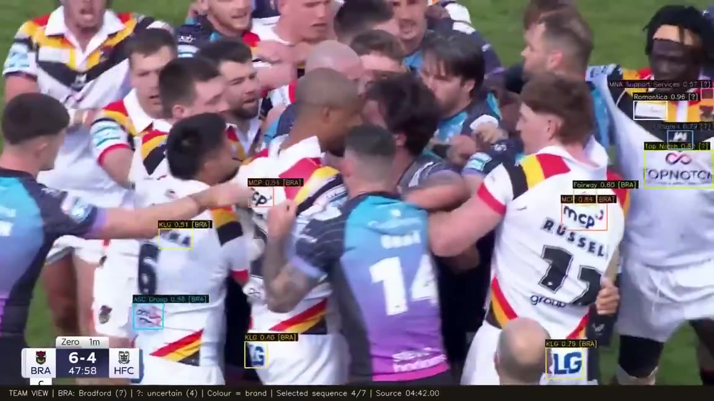
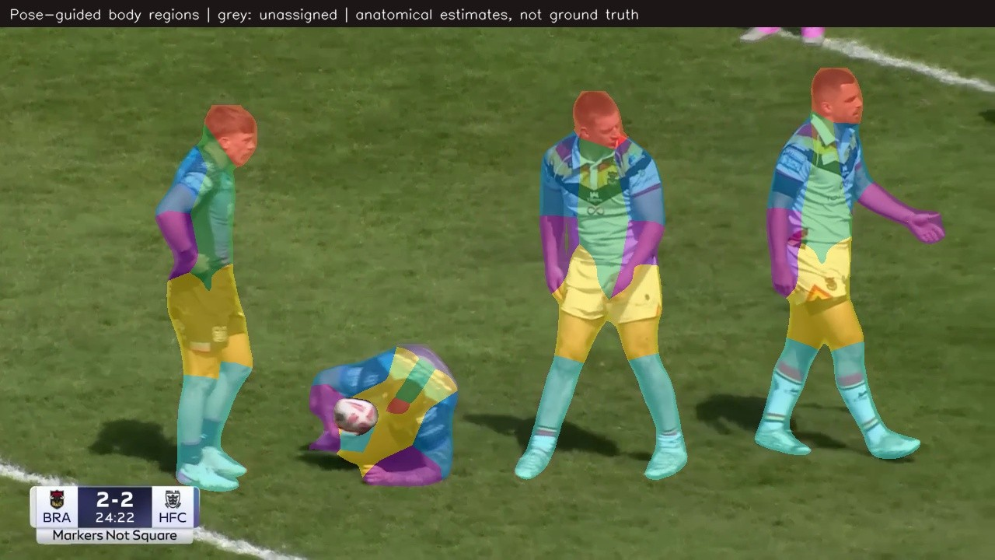
SEE IT WORK
Ninety seconds of real Bradford footage
Unedited system output. Box colour = sponsor brand. BRA = confirmed Bradford player. ? = not enough evidence, held back rather than guessed.
How it knows it is the shorts
Each player is broken into body regions from pose keypoints, so a mark can be tied to chest, back, sleeve, shorts or socks. Grey means the system had too little evidence and declined to assign.
Around 00:52 a ruck brings ten marks into a single frame.
Seven passages from one match · source timecode burned in · click to play
Clips: artifacts/deck_media/demo_team_split_90s.mp4 and artifacts/bradford_review/tackle_body.mp4 — Bradford v Hull FC, home kit.
04
Notes:
Play the large clip and narrate lightly: boxes appear as marks become readable, the opponent in dark kit is never counted, and around fifty seconds a ruck brings ten marks into one frame. Then the small clip — that is how the system knows a logo is on the shorts rather than the shirt. Both files also sit in the artifacts folder if a venue machine will not play them.

Slide 5
HOW IT IS SCORED
A logo is not just present or absent
Every appearance is weighted by how well it could actually be seen. These are the six things measured on each one.
01
02
03
04
05
06
Size
Position
Clarity
Angle
Duration
Frequency
How much of the screen it fills
How near the centre of frame
How readable it is
How square-on to camera
How long it holds
How often it returns
size × position × clarity × angle × duration weight × seconds on screen
Each factor is stored per detection rather than baked into one number, so the club can ask “what if position did not matter?” and see the answer immediately instead of waiting for a re-run.
An asset's percentage is its
share of all that quality-weighted
exposure across the whole match.
05
Notes:
This is the credibility slide. The line to say out loud: anybody can count frames — the reason these numbers are worth arguing over is that a mark tucked in a corner at forty pixels does not score the same as one filling the centre of a close-up.

Slide 6
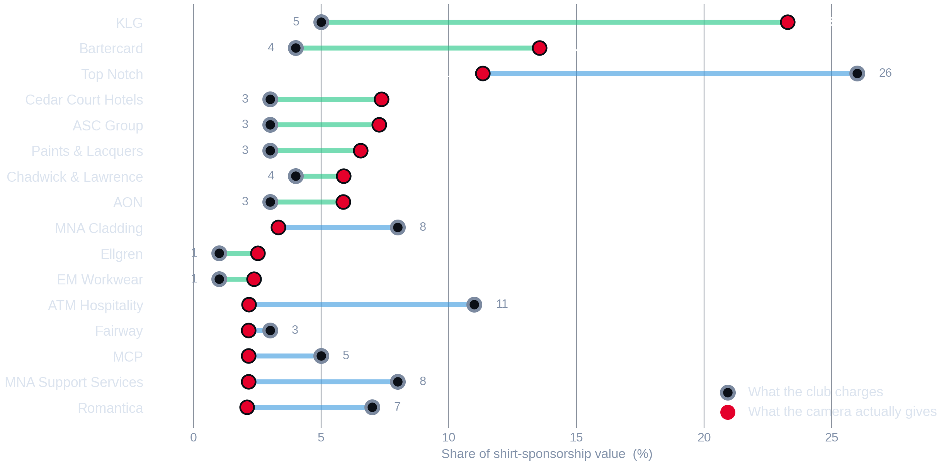
01
FINDING ONE
The camera and the price list disagree
Nine assets deliver more
KLG gets 23.3% of all measured exposure on a 5% share of the price — the most-seen mark on the kit.
Seven deliver less
Top Notch holds 26% of the price and 11.3% of the exposure. ATM Hospitality: 11% against 2.2%.
None of them match
Not one of the sixteen is priced in line with what it was measured to deliver.
Two complete Bradford Bulls broadcasts, home kit 2025/26, analysed at 2 frames per second. “What the club charges” is the current management allocation (totals 95%); LogoLens totals 100%.
06
Notes:
Walk it top to bottom. Hollow ring is the price share, red dot is the measured share, and the line between them is the disagreement. Two rows carry the whole conversation: KLG at the top, and Top Notch third. Everything after this slide is either explaining that picture or testing whether to believe it.

Slide 7
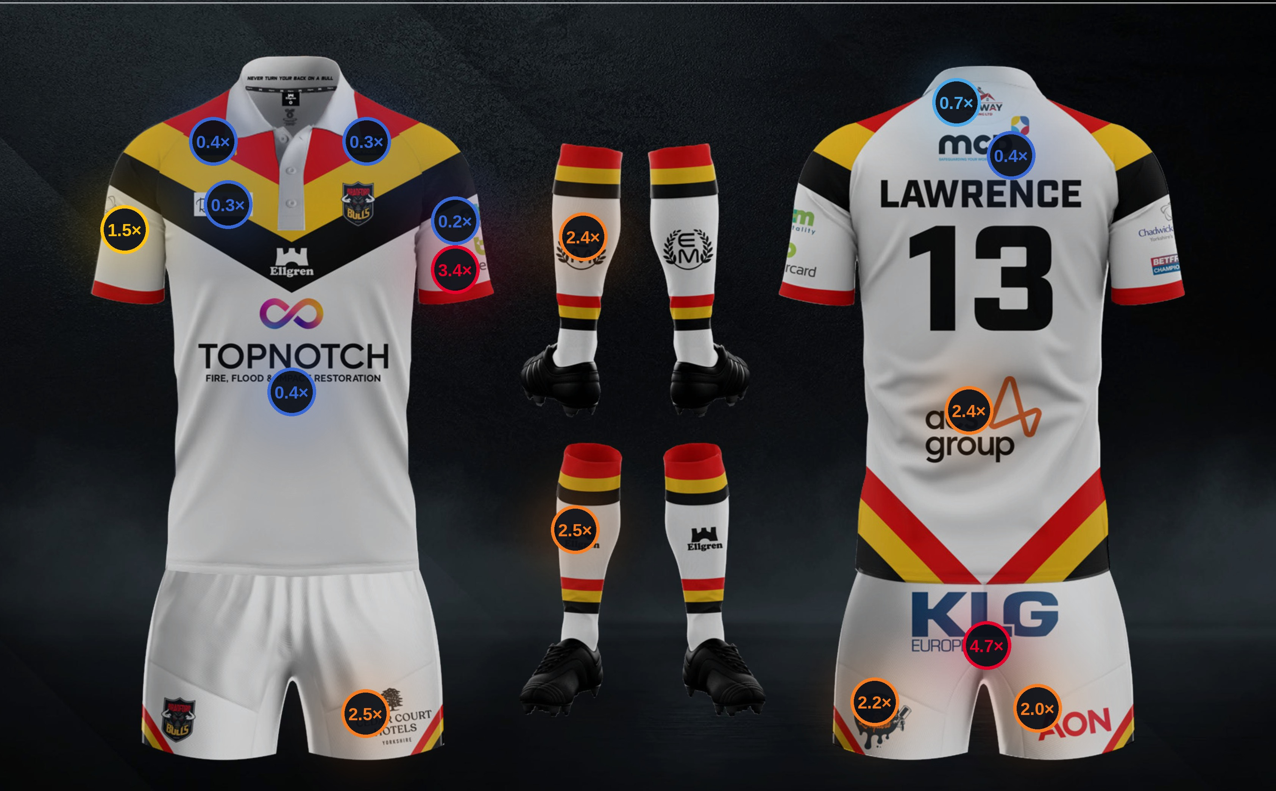
02
FINDING TWO
The pattern is positional,
not brand by brand
CAMERA ÷ PRICE, BY POSITION
≥ 3.0×
far more seen than priced
1.8 – 3.0×
materially under-priced
1.15 – 1.8×
modestly under-priced
0.85 – 1.15×
about right
< 0.85×
priced above what it delivers
Everything below the waist runs hot.
Everything at the collar runs cold.
Broadcast cameras live around the contact area — and the contact area is shorts and lower back, not shoulders.
Ratio = mean measured visibility share ÷ club allocation share. Kit artwork: Bradford Bulls 2025/26 home playing kit.
07
Notes:
This is the slide people photograph, so give it room. One number on each position: what the camera gave it divided by what the club charges for it. Point at the back of the shorts at 4.7×, then at the collar at 0.3×. That contrast is the entire argument in one picture.

Slide 8
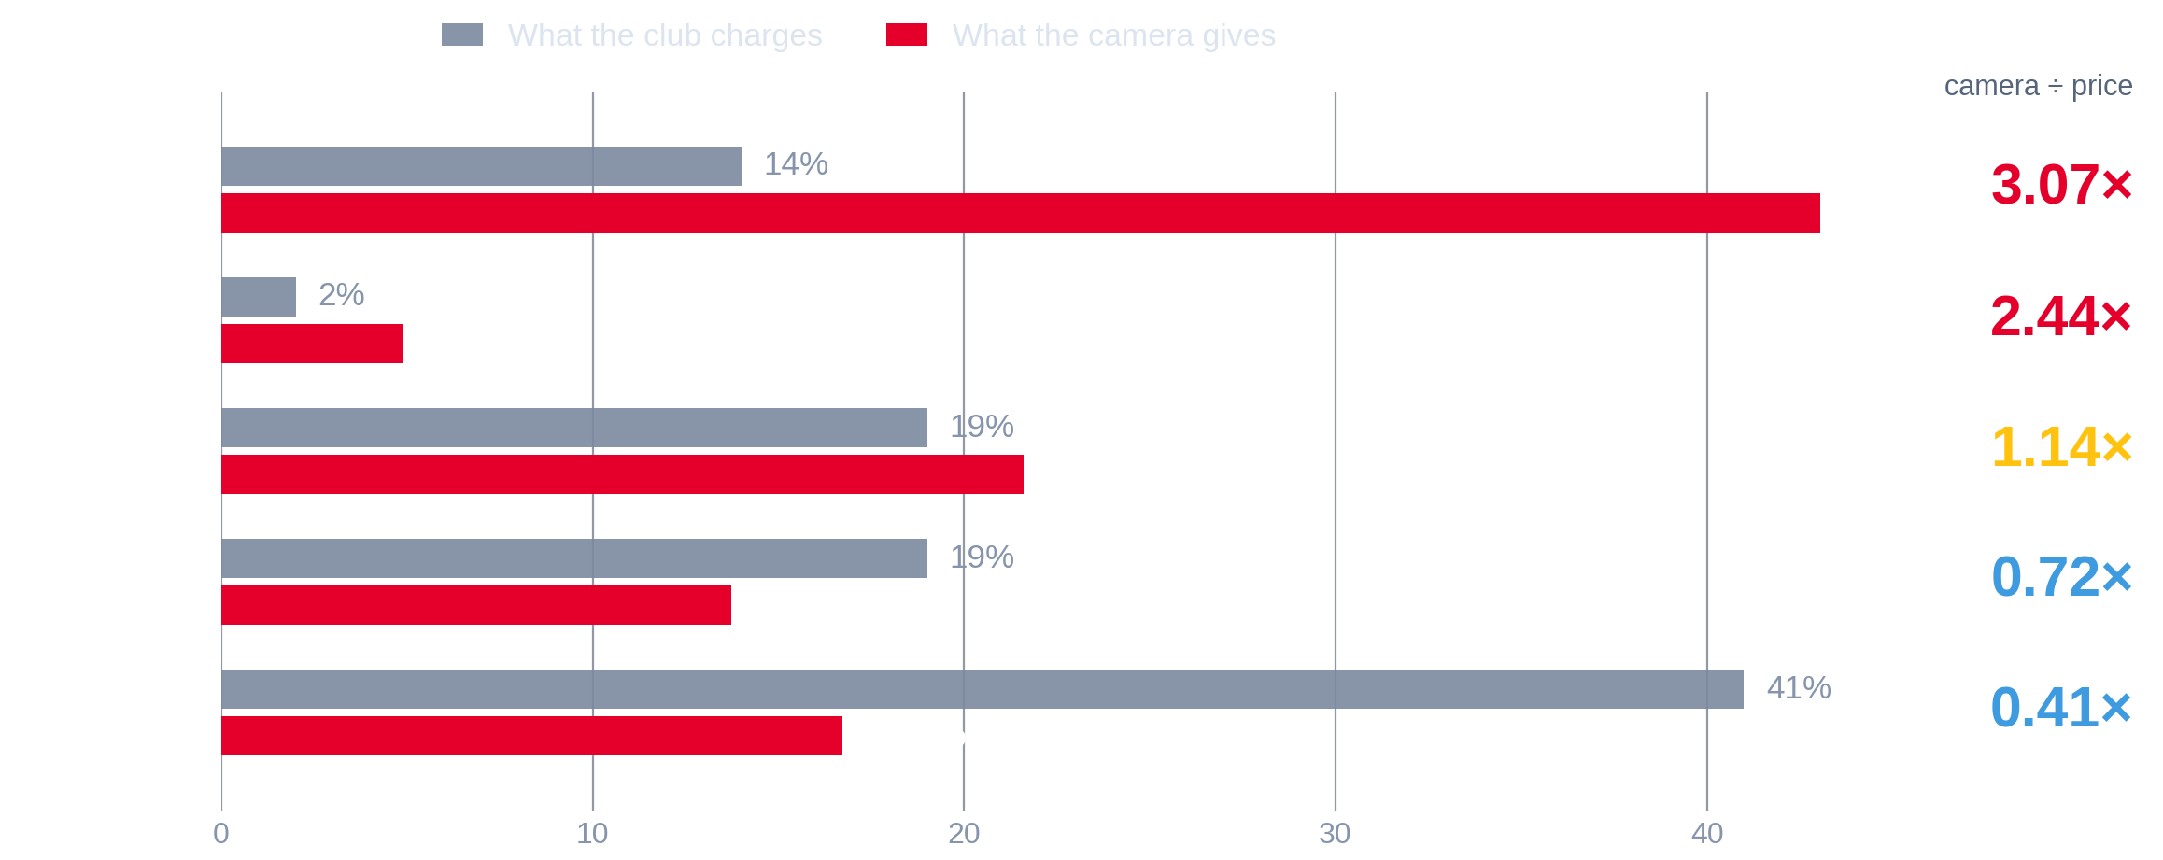
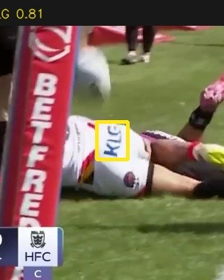
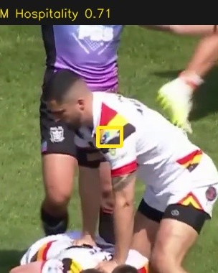
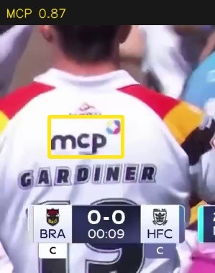
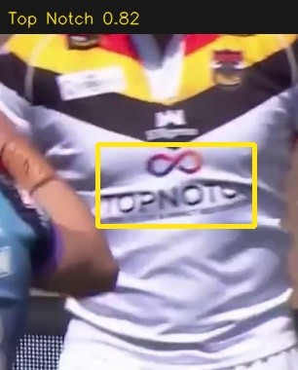
03
FINDING THREE
Grouped by placement, the split is stark
Shorts
Sleeves
Back
Chest
Real detections from the analysed footage — one per placement group. The system reads the mark itself, not just the position it expects.
Shorts carry the match.
The chest carries the price.
The group total can hide the story.
Rugby league is played low. Rucks, tackles and play-the-ball put the shorts in the centre of close and medium camera work — where the broadcast spends most of its time. All four shorts positions measure above their price.
Top Notch, MNA Cladding and Romantica hold 41% of the shirt price and 16.7% of the exposure. That premium is real, but it is bought with brand association, stills and press — not with broadcast seconds.
Sleeves match almost exactly at block level, 19% against 21.6%. Inside that block, Bartercard measures 13.6% on a 4% price while ATM Hospitality measures 2.2% on an 11% price.
Two complete Bradford Bulls broadcasts, home kit 2025/26, analysed at 2 frames per second. “What the club charges” is the current management allocation (totals 95%); LogoLens totals 100%.
08
Notes:
This replaces four separate placement slides — everything a club needs is in the one picture. The three notes underneath are the three arguments: shorts are under-sold, the chest premium needs a non-broadcast justification, and the sleeve block hides a six-fold difference between two positions sold at a 2.75× price difference.

Slide 9
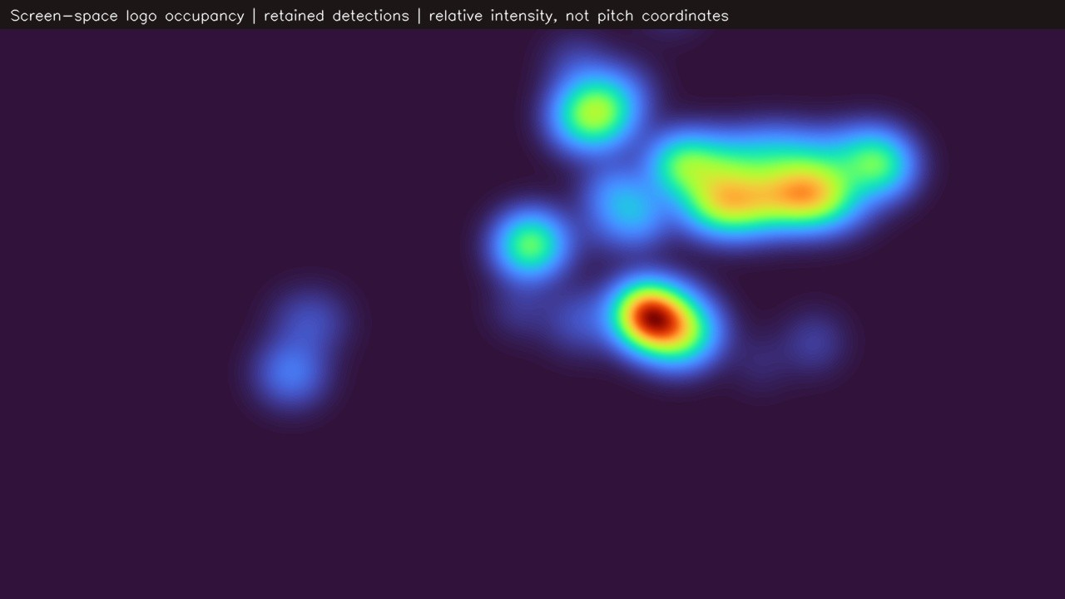
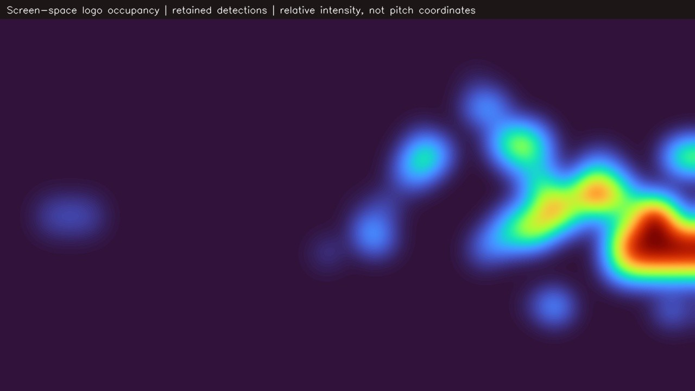
04
FINDING FOUR
Exposure lands where the contact is
Heat shows where the retained sponsor marks actually sat on the television picture. It is screen position, not pitch position.
Close and contact play
Wide tactical play
Marks concentrate centre-right at roughly waist height. Shorts and lower-back positions sit exactly there.
Exposure spreads, weakens and drifts to the edge of frame, where the position weighting cuts its value.
Relative intensity of retained logo detections in screen space, from two representative passages of the analysed footage.
09
Notes:
Be precise about what this is: where on the television picture the logos appeared. Not pitch coordinates, not player running data. The commercial read is one sentence — the camera lives around the contact area, and the kit that sits in the contact area is the shorts and the lower back.

Slide 10
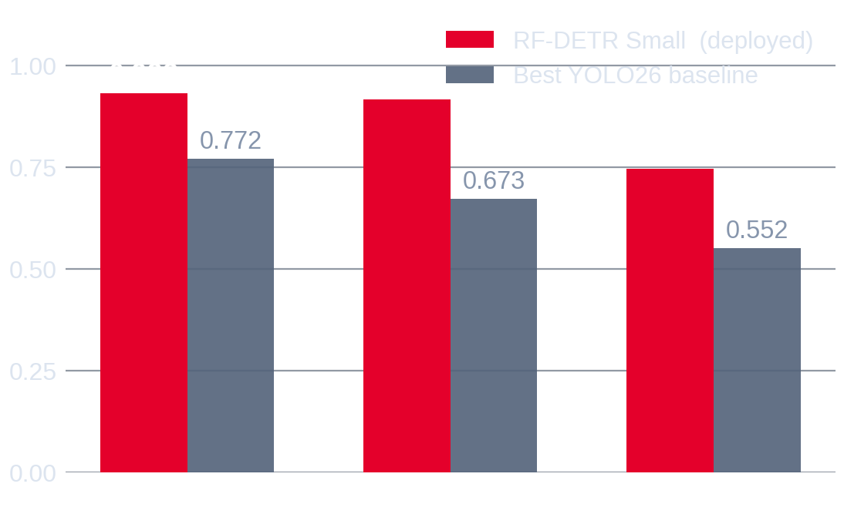
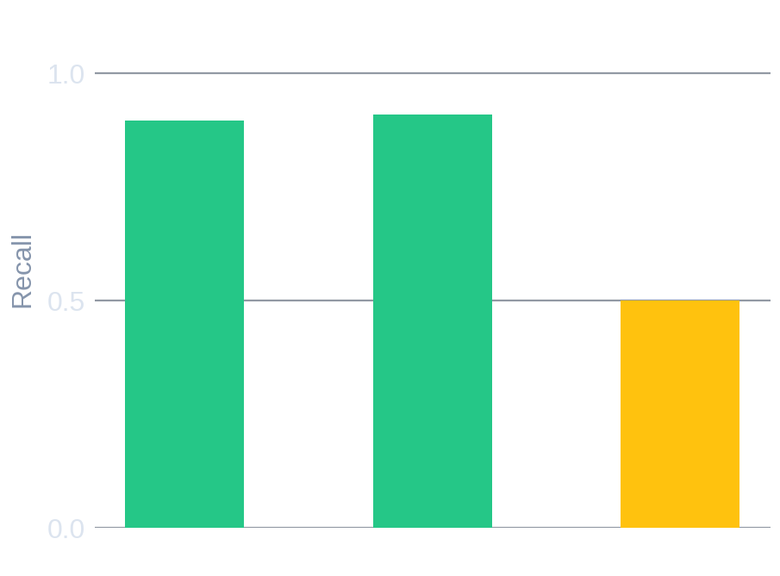
HOW FAR TO TRUST IT
Strong where it matters, and honest about the rest
ACCURACY
0.933
mAP@0.50, unseen matches
REPEATABLE
ρ 0.846
same ordering in both matches
HONEST CHECK
Detection accuracy on three matches the model had never seen, against the strongest conventional baseline trained on identical data.
The weakness worth declaring: on wide shots the model finds only half the marks. It rarely invents them — it misses them, so the exposure figures run conservative.
0.917
with sparse classes removed
Two matches, not a season.
Occlusion, blur and angle cost detections.
Broadcast visibility only.
Strong pilot evidence. Not yet proof at season level.
Players cover each other; small marks on moving players go soft.
Not attention, recall, hospitality, exclusivity or activation.
RF-DETR Small at 896 px, evaluated on 61 held-out images / 165 boxes across three unseen matches. Baseline: best of three YOLO26 variants on the identical split.
10
Notes:
Volunteering the weaknesses is what earns the right to the recommendations. The same model scores 0.998 on matches it has already seen and 0.933 on new ones — we report the harder number. And because it misses marks in wide play rather than inventing them, the gaps you saw earlier are if anything understated.

Slide 11
WHAT IT IS WORTH
Four things Bradford Bulls can do on Monday
The output is evidence for a commercial conversation — not an automatic price list.
Walk into renewals with a number
Re-tier the inventory
Every partner conversation currently rests on assertion. This replaces it with a measured delivery figure that traces back to timestamps.
Shorts and lower-back positions are sold cheaply relative to what they deliver. They can be bundled, upgraded or moved up the rate card.
Defend the premium positions
Report back to sponsors
Where the price sits above measured exposure, write down the non-broadcast value explicitly — stills, hospitality, digital, association.
Give each partner their own per-match summary: seconds, appearances, quality and share. That is a retention tool, not just a report.
Use it as decision evidence, not as a pricing engine: club judgement, LogoLens measurement, and a written rationale wherever the two disagree.
11
Notes:
Close the commercial argument here. The one line worth repeating: this does not replace commercial judgement, it gives that judgement something to point at. If a sponsor asks why their sleeve costs what it costs, there is now an answer with a number attached.

Slide 12
NEXT
From a two-match pilot to a season-level system
Four steps, in the order they should happen.
01
02
03
04
Confirm the map
Extend the evidence
Validate by hand
Run the pricing review
Club signs off which brand sits in which position and the current price share.
Run the same pipeline over a broader set of complete home-kit broadcasts.
Check timing and readability on a stratified sample; measure the wide-shot shortfall.
Measured delivery, current rate card and a documented rationale into the renewal cycle.
CLUB · 1 WEEK
AUTOMATED · PER MATCH
JOINT · 2–3 WEEKS
COMMERCIAL · NEXT CYCLE
Nothing here needs new annotation. The pipeline runs on any broadcast of the home kit as soon as the footage is available.
12
Notes:
End on the sequence, not the technology. The club does one thing first — confirm the inventory map — and everything else follows. Offer to run the next fixture as soon as the footage exists.

Slide 13
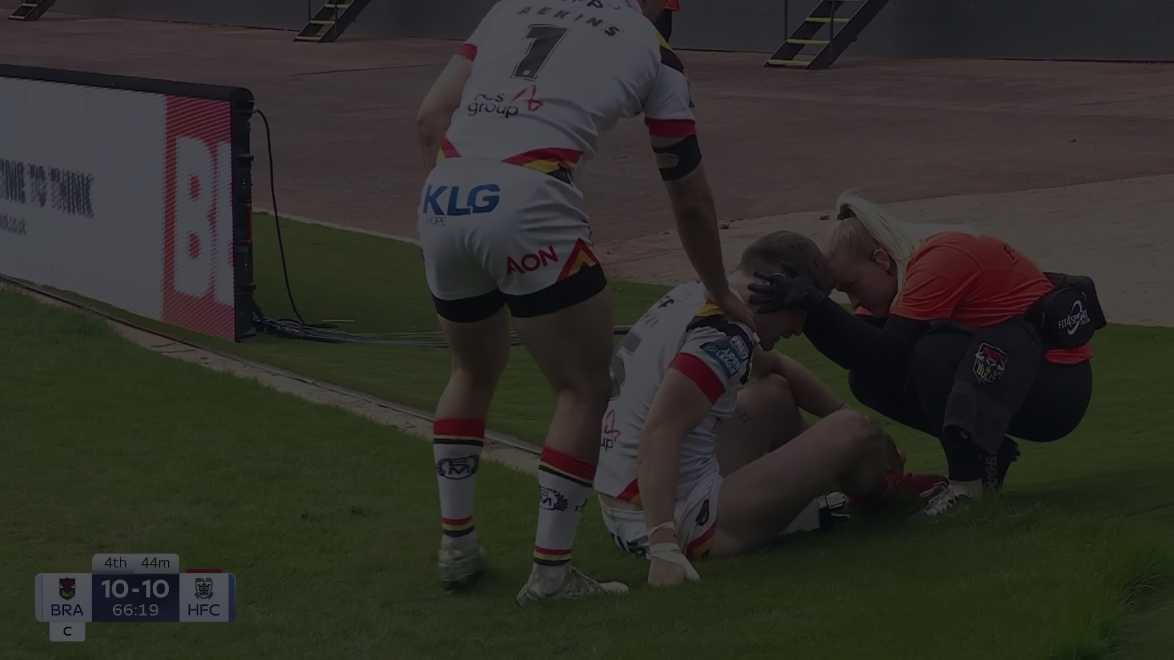

IN ONE LINE
Broadcast footage,
turned into
sponsorship evidence.
The measurement is stable. The pricing map is the part worth revisiting — with the club's judgement leading and the evidence alongside it.
The full LogoLens film · 2:23
Narrated overview of the project, the pipeline and the partnership. Click to play if there is time.
LogoLens · University of Bradford · in partnership with Bradford Bulls
13
Notes:
If the room has time, play the film — it covers the team, the partnership and the pipeline in two and a half minutes. If not, finish on the line on the left and go to questions.

Slide 14
APPENDIX
All sixteen assets
Club allocation, measured visibility in each match, the mean and the gap.
SPONSOR
KIT POSITION
PRICE %
MATCH 1
MATCH 2
CAMERA %
GAP PP
KLG
Top Back Shorts
5
24.73
21.82
23.27
+18.27
Bartercard
Sleeve 3
4
12.72
14.38
13.55
+9.55
Top Notch
Main Sponsor
26
9.95
12.71
11.33
-14.67
Cedar Court Hotels
Shorts Front
3
6.87
7.86
7.37
+4.37
ASC Group
Bottom Back
3
8.07
6.48
7.28
+4.28
Paints & Lacquers
Shorts Back 2
3
6.83
6.25
6.54
+3.54
Chadwick & Lawrence
Sleeve 1
4
5.85
5.90
5.88
+1.88
AON
Shorts Back 1
3
6.42
5.32
5.87
+2.87
MNA Cladding
Collar Bone
8
3.25
3.38
3.31
-4.69
Ellgren
Socks front
1
2.82
2.22
2.52
+1.52
EM Workwear
Socks back
1
2.68
2.05
2.37
+1.37
ATM Hospitality
Sleeve 2
11
1.80
2.53
2.17
-8.84
MNA Support Services
Collar Back
8
2.08
2.23
2.16
-5.84
MCP
Top Back
5
2.08
2.23
2.16
-2.84
Fairway
Nape Neck
3
2.08
2.23
2.16
-0.84
Romantica
Chest (opp Badge)
7
1.77
2.41
2.09
-4.91
Two complete Bradford Bulls broadcasts, home kit 2025/26, analysed at 2 frames per second. “What the club charges” is the current management allocation (totals 95%); LogoLens totals 100%.
14
Notes:
Leave-behind slide. Every figure reproduces from the two match reports; offer to send the underlying Excel exports.

