Slide 1
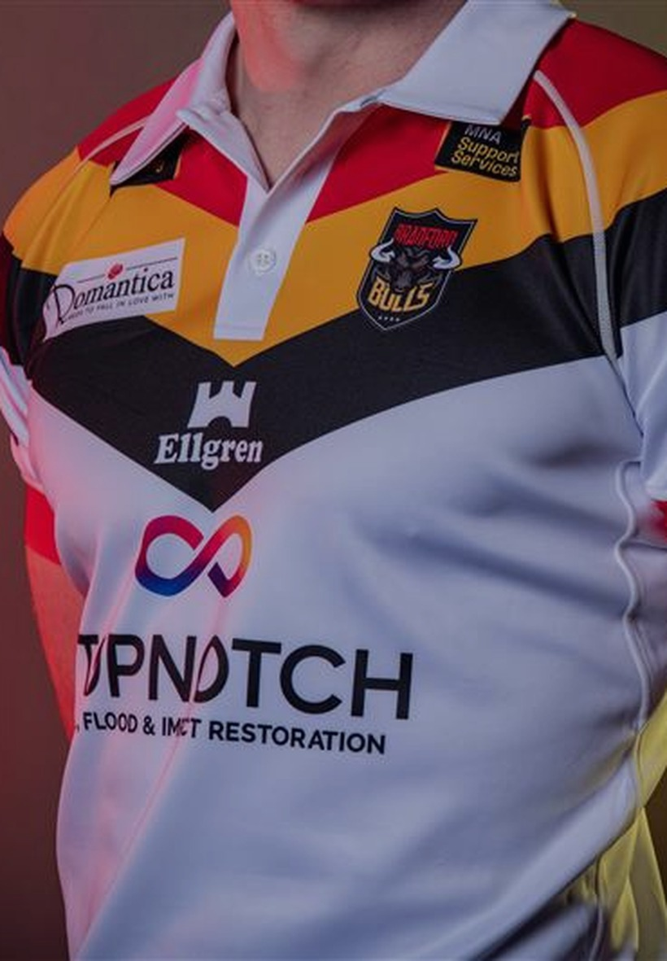
BRADFORD BULLS · SPONSORSHIP VISIBILITY REVIEW
What the shirt
is really worth
on screen
Every sponsor mark on the kit, measured frame by frame across two complete broadcasts — then placed next to what the club charges for it.
LogoLens · MSc Applied AI & Data Analytics, University of Bradford · in partnership with Bradford Bulls
Notes:
Open with the picture on the right: that is the Bradford home shirt as the system sees it — every sponsor mark found and named automatically. Then the question: each of those positions has a price, but nobody has ever measured what each one actually delivers on screen. That is what this project did, across two complete matches.

Slide 2
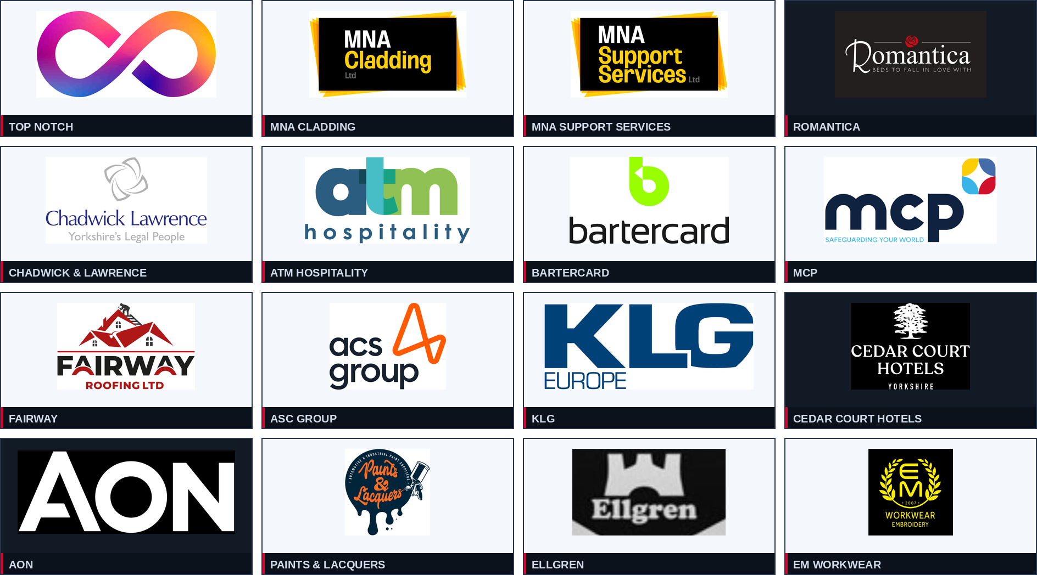
THE PROBLEM
Sixteen sponsors.
Sixteen prices.
Zero measurement.
The shirt is sold as sixteen separate positions, each with its own share of the price. That split is set by commercial judgement and precedent — not by anything anyone has counted. So when a sponsor asks what they got for their money, the honest answer today is an estimate.
The 2025/26 home kit inventory
Priced
by judgement, not by evidence
Sixteen brand positions, from the main chest sponsor down to the socks. Every one carries a share of the price. Not one of them has ever carried a measurement of what it actually delivers on screen.
Checked
by hand, on clips, occasionally
Reported
as presence, not as exposure
Sponsor artwork supplied by the club. Home kit only; the away-kit main sponsor is outside this analysis.
02
Notes:
Put the inventory on screen so the room sees the scale of the problem. Sixteen separate commercial relationships on one shirt. The club is not doing anything unusual — almost every club prices positions this way. The point is that nobody has ever had the measurement, so there has been nothing to check the price list against.

Slide 3
OVERALL FINDINGS
Five results, before any of the detail
Everything that follows is an explanation of, or a test of, these five statements.
43.1%
of all measured broadcast visibility sits on the shorts.
The club prices the shorts at 14%.
16.7%
of measured visibility sits on the front torso.
The club prices it at 41%.
ρ 0.846
rank stability between the two matches. The measurement repeats;
the average asset moved 0.93 points.
ρ −0.075
rank agreement between the price list and measured visibility.
Effectively none.
0 of 16
assets are priced in line with what they were measured to deliver.
Nine sit above, seven below.
Two complete Bradford Bulls broadcasts, home kit 2025/26, analysed at 2 frames per second. “What the club charges” is the current management allocation (totals 95%); LogoLens totals 100%.
03
Notes:
Give the room the answer first. Two structural findings about where value sits, one that says the measurement is repeatable, one that says the price list and the camera do not agree, and one that says this is not about a single rogue asset. Say plainly: none of this means the club is wrong. It means the broadcast component of the price now has a number attached.

Slide 4
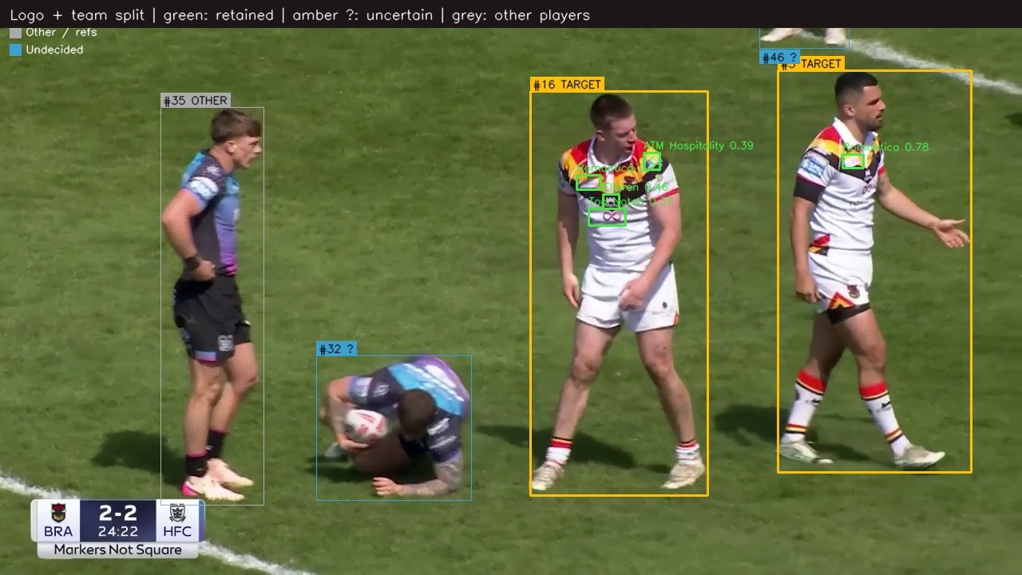
THE SOLUTION
From broadcast footage to a per-sponsor number
It watches the whole match, finds every sponsor mark on a Bradford player, and scores how well each one could actually be seen.
01
Find
Every sponsor mark in every sampled frame.
02
Follow
Link the same mark across frames into an appearance.
03
Filter
Keep Bradford players only — discard opponents, officials and boards.
04
Place
Tie each mark to a body zone: chest, back, sleeve, shorts, socks.
05
Score
Weight it by size, position, clarity, angle and duration.
06
Total
Convert to a share of the whole shirt's exposure.
Real system output. Bradford players kept (amber), opponents and officials discarded (grey), each mark boxed and named with its confidence.
04
Notes:
Six steps, but only three matter to a club audience. One: it watches the whole match, not a clip. Two: it only counts Bradford players — opponent kit and pitch-side boards never enter the numbers. Three: a mark in the corner of a wide shot does not count the same as one filling a close-up.

Slide 5
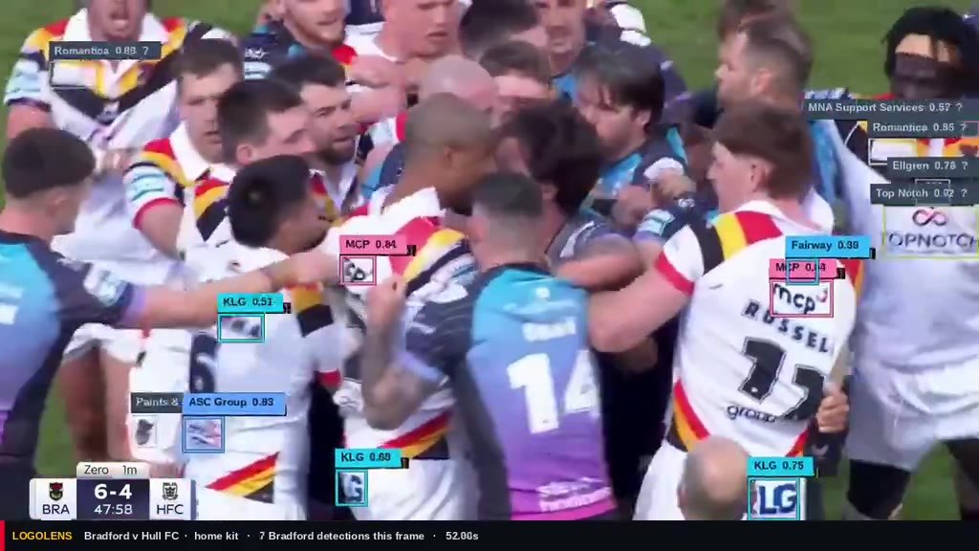
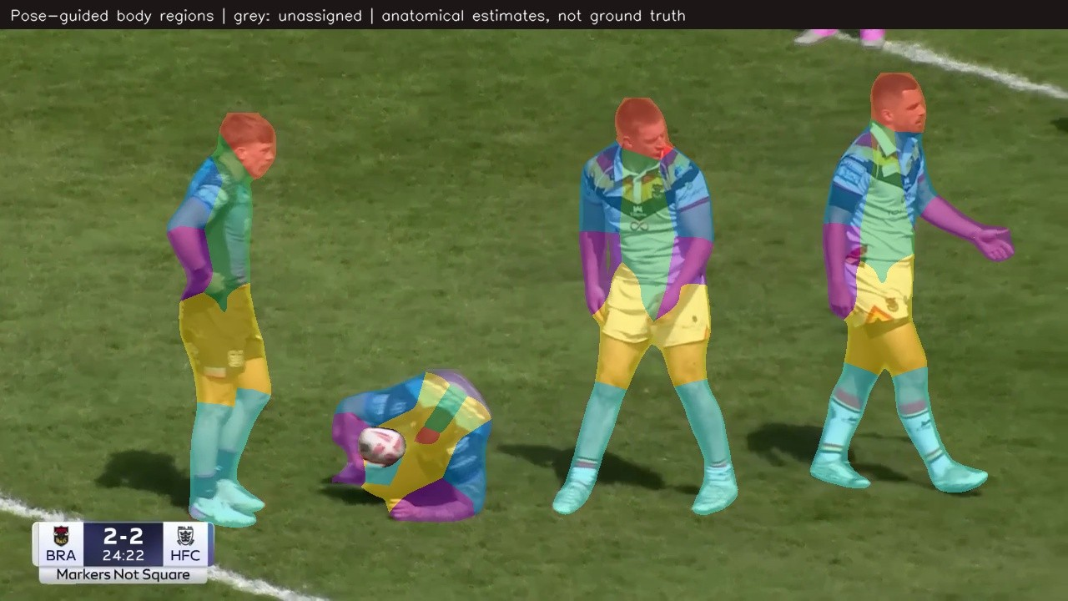
DEMONSTRATION · DETECT
Ninety seconds of real Bradford footage
Unedited system output. Coloured box = sponsor mark counted for Bradford. Grey box with ? = not confirmed as a Bradford player, so it earns nothing.
How it knows it is the shorts
Each player is broken into body regions from pose keypoints, so a mark can be tied to chest, back, sleeve, shorts or socks. Grey means the system had too little evidence and declined to assign.
Around 00:52 a ruck brings ten marks into a single frame.
Seven passages from one match · 15 sponsor brands detected · click to play
Ninety-second sequence from Bradford v Hull FC, home kit. Boxes and labels are redrawn from the pipeline's own detection output — the same detections, presented more legibly.
05
Notes:
Play the large clip and narrate lightly: boxes appear as marks become readable, the opponent in dark kit is never counted, and around fifty seconds a ruck brings ten marks into one frame. Then the small clip — that is how the system knows a logo is on the shorts rather than the shirt.

Slide 6
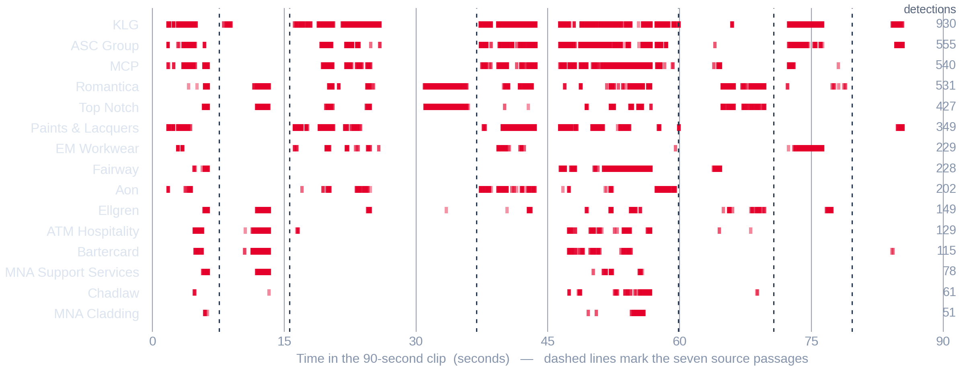
DEMONSTRATION · TRACK AND EVALUATE
The same ninety seconds, as data
Every mark on the clip you just watched, tracked through time. Each tick is one detection on a Bradford player; fainter ticks are lower-confidence reads.
15
sponsor brands picked up on Bradford players in a single 90-second clip.
Continuous bands
are sustained appearances. Isolated ticks are glimpses that earn far less.
Gaps matter
as much as marks. A brand off screen earns nothing, which is what makes the totals meaningful.
Source: artifacts/bradford_showcase/showcase_detections.json — 4,574 retained detections on Bradford players across the clip's seven passages. Detection counts are per sampled frame, not unique logos.
06
Notes:
This is the step between the video and the percentages. Point at KLG: almost continuously present. Point at MNA Cladding near the bottom: fifty-one detections in ninety seconds. The percentage each sponsor ends up with is this picture, weighted by how well each mark could be seen, summed across a whole match instead of ninety seconds.

Slide 7
HOW IT IS SCORED
A logo is not just present or absent
Every appearance is weighted by how well it could actually be seen. These are the things measured on each one.
01
02
03
04
05
06
07
Size
Position
Clarity
Angle
Duration
Frequency
Occlusion
How much of the screen the mark fills
How near the centre of frame it sits
How readable the mark is
How square-on it is to camera
How long a continuous appearance holds
How many separate times it returns
How much of the mark is hidden
size × position × clarity × angle × duration weight × seconds
On occlusion, to be exact
Each factor is stored per detection rather than baked into one number, so the club can ask “what if position did not matter?” and see the answer immediately instead of waiting for a re-run. An asset's percentage is its share of all that quality-weighted exposure across the whole match.
Occlusion is not scored as a separate number today. A partly hidden mark reaches the score twice: through a smaller box and through a lower clarity reading. A fully hidden mark simply earns nothing. An explicit occlusion percentage would need instance-level annotation the project does not yet have.
07
Notes:
This is the credibility slide. Anybody can count frames — the reason these numbers are worth arguing over is that a mark tucked in a corner at forty pixels does not score the same as one filling the centre of a close-up. Be straight about the occlusion panel on the right if it is asked about: it is handled, but not as its own published number.

Slide 8
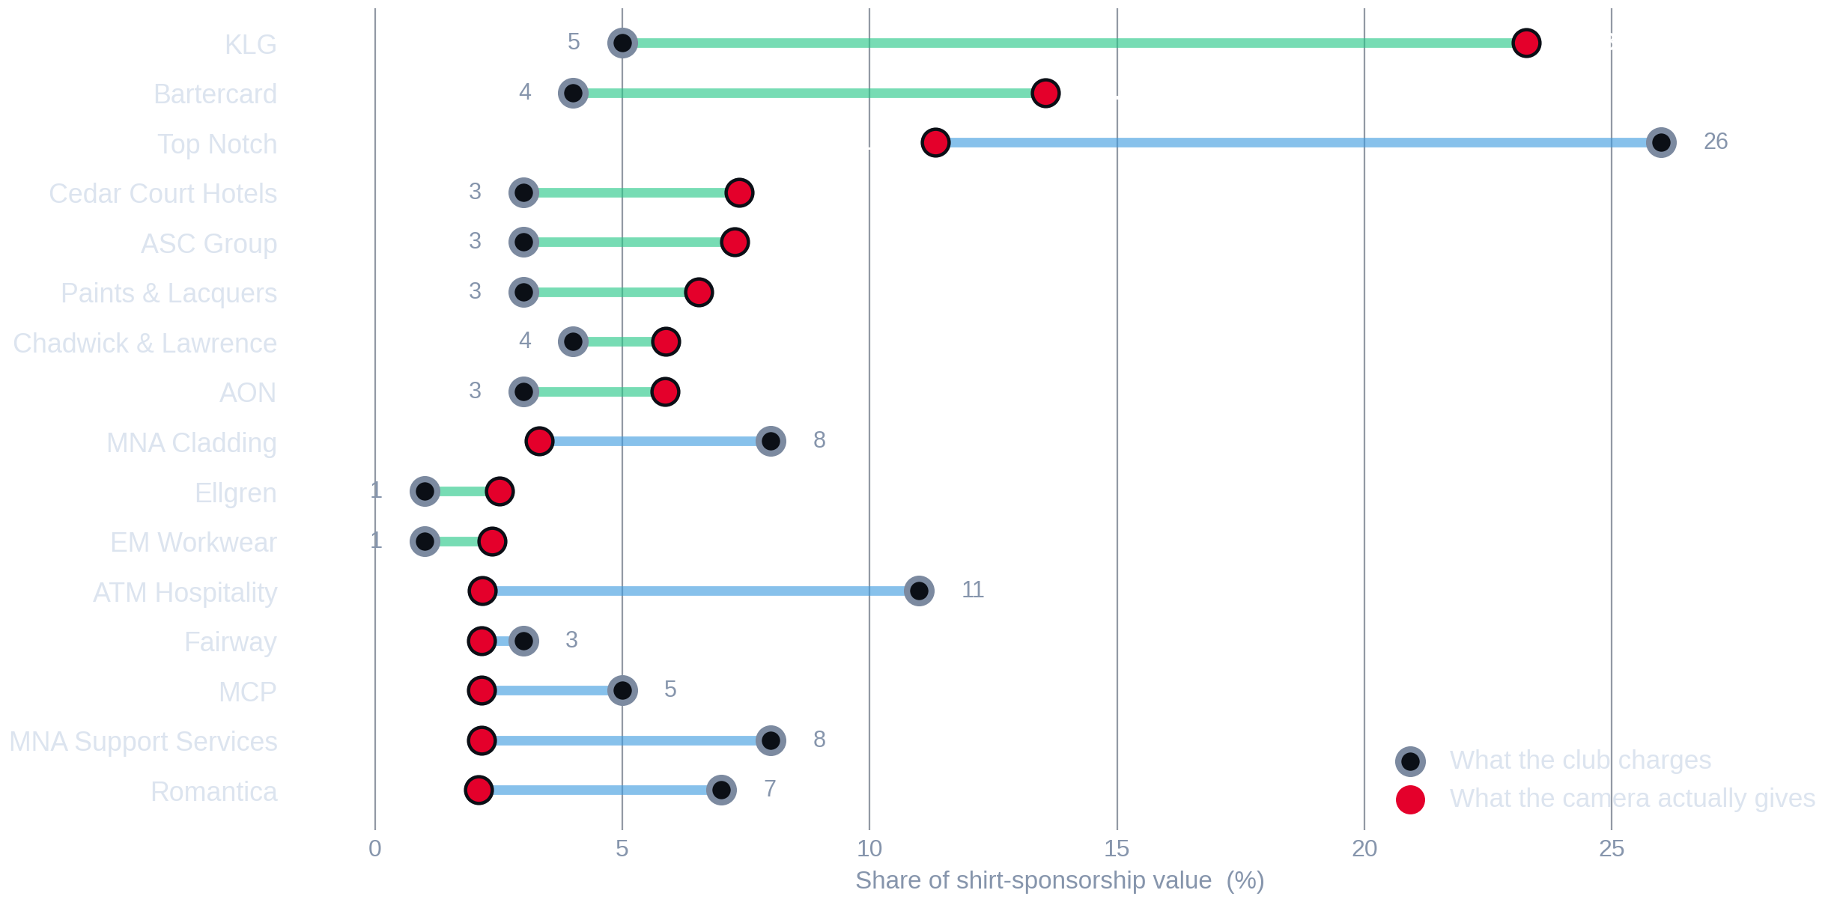
01
FINDING ONE
The camera and the price list disagree
Nine assets deliver more
KLG gets 23.3% of all measured exposure on a 5% share of the price — the most-seen mark on the kit.
Seven deliver less
Top Notch holds 26% of the price and 11.3% of the exposure. ATM Hospitality: 11% against 2.2%.
None of them match
Not one of the sixteen is priced in line with what it was measured to deliver.
Two complete Bradford Bulls broadcasts, home kit 2025/26, analysed at 2 frames per second. “What the club charges” is the current management allocation (totals 95%); LogoLens totals 100%.
08
Notes:
Walk it top to bottom. Hollow ring is the price share, red dot is the measured share, and the line between them is the disagreement. Two rows carry the whole conversation: KLG at the top, and Top Notch third.

Slide 9
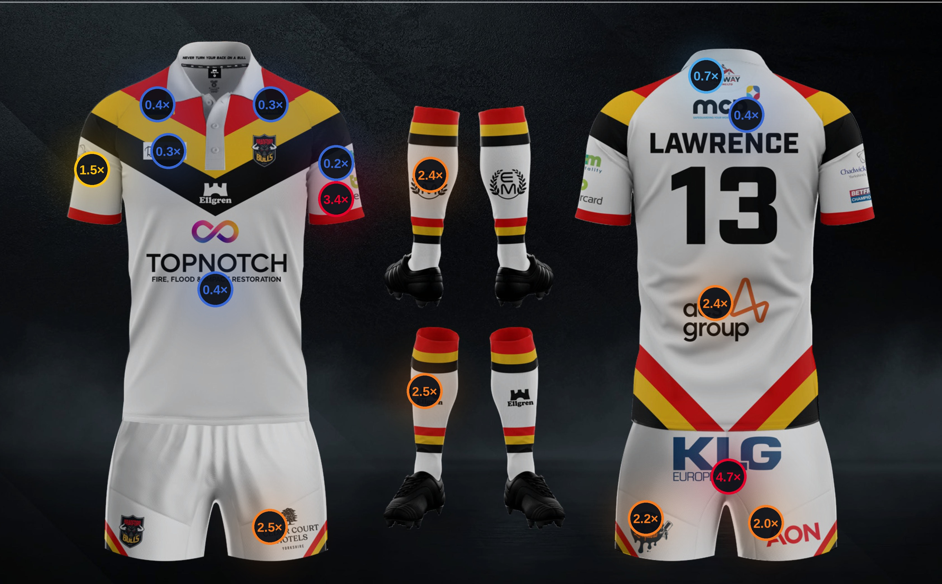
02
FINDING TWO
The pattern is positional,
not brand by brand
CAMERA ÷ PRICE, BY POSITION
≥ 3.0×
far more seen than priced
1.8 – 3.0×
materially under-priced
1.15 – 1.8×
modestly under-priced
0.85 – 1.15×
about right
< 0.85×
priced above what it delivers
Everything below the waist runs hot.
Everything at the collar runs cold.
Broadcast cameras live around the contact area — and the contact area is shorts and lower back, not shoulders.
Ratio = mean measured visibility share ÷ club allocation share. Kit artwork: Bradford Bulls 2025/26 home playing kit.
09
Notes:
This is the slide people photograph, so give it room. One number on each position: what the camera gave it divided by what the club charges for it. Point at the back of the shorts at 4.7×, then at the collar at 0.3×.

Slide 10
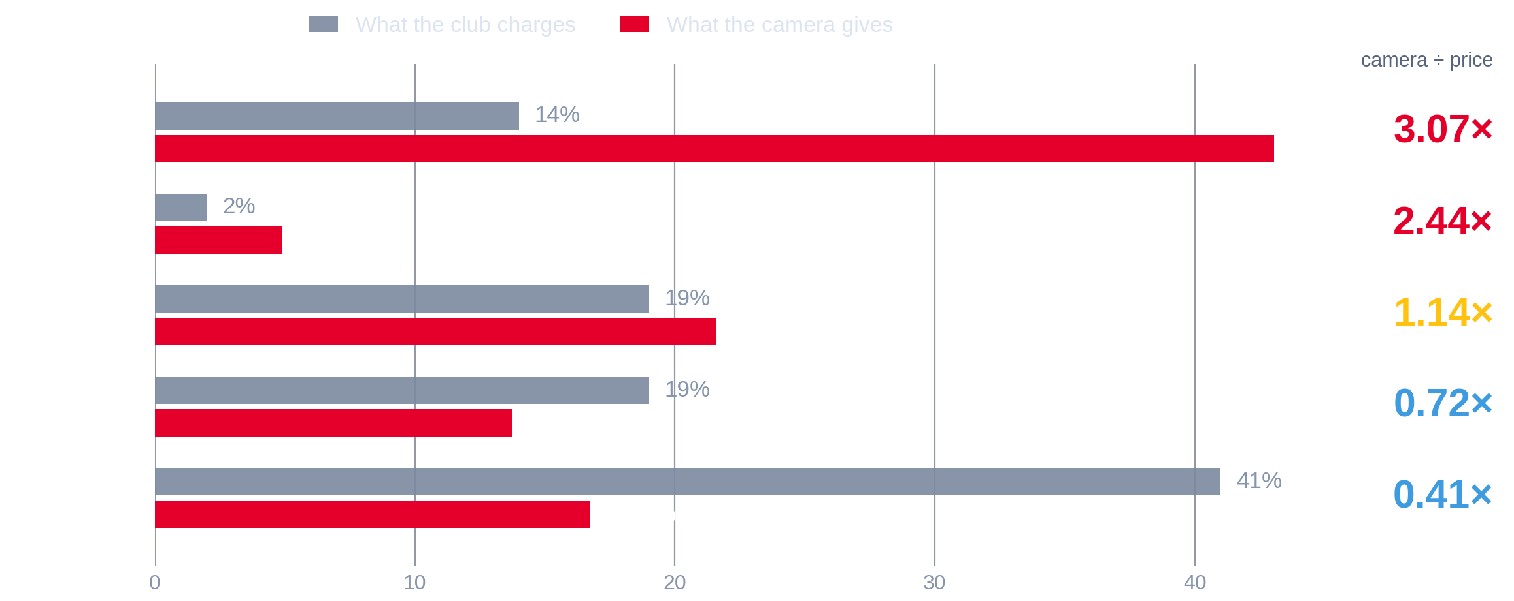
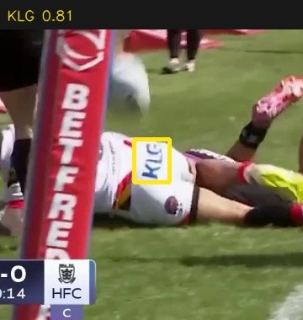
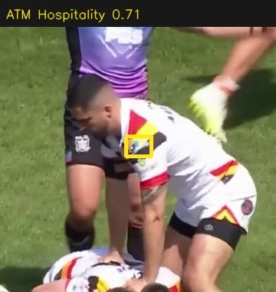
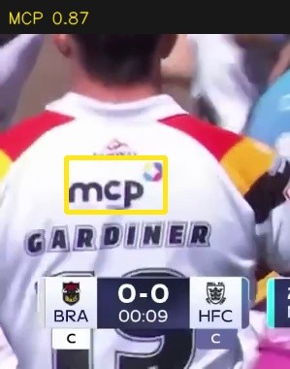
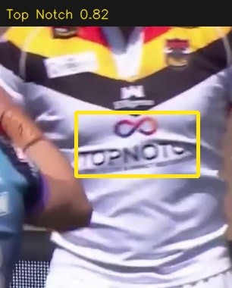
03
FINDING THREE · OVERVIEW
Grouped by placement, the split is stark
Shorts
Sleeves
Back
Chest
Real detections from the analysed footage — one per placement group. The system reads the mark itself, not just the position it expects.
Shorts carry the match.
The chest carries the price.
The group total can hide the story.
Rugby league is played low. Rucks, tackles and play-the-ball put the shorts in the centre of close and medium camera work — where the broadcast spends most of its time. All four shorts positions measure above their price.
Top Notch, MNA Cladding and Romantica hold 41% of the shirt price and 16.7% of the exposure. That premium is real, but it is bought with brand association, stills and press — not with broadcast seconds.
Sleeves match almost exactly at block level, 19% against 21.6%. Inside that block, Bartercard measures 13.6% on a 4% price while ATM Hospitality measures 2.2% on an 11% price.
Two complete Bradford Bulls broadcasts, home kit 2025/26, analysed at 2 frames per second. “What the club charges” is the current management allocation (totals 95%); LogoLens totals 100%.
10
Notes:
The overview first — the next slide takes the four areas one at a time. Three arguments here: shorts are under-sold, the chest premium needs a non-broadcast justification, and the sleeve block hides a six-fold difference between two positions sold at a 2.75× price difference.

Slide 11
03
FINDING THREE · AREA BY AREA
Manual score against AI score, one area at a time
Chest / front torso
Back and collar
Sleeves
Shorts
Top Notch · conf 0.82
MCP · conf 0.87
ATM Hospitality · conf 0.71
KLG · conf 0.81
Manual
41%
19%
19%
14%
Manual
Manual
Manual
AI
16.7%
AI
13.7%
AI
21.6%
AI
43.0%
0.41×
0.72×
1.14×
3.07×
Top Notch alone holds 26 of the 41 points. The premium is real — it is just not bought with broadcast seconds.
The closest block of the four. ASC Group on the lower back over-delivers; the three collar marks sit below their price.
Matches at block level and splits violently inside it: Bartercard 13.6% on 4%, ATM Hospitality 2.2% on 11%.
The strongest signal in the analysis. All four positions over-deliver and KLG is the single most-seen mark on the kit.
Manual = current club allocation for the whole area. AI = mean measured visibility share across the two matches. Bars share a common 0–45% scale.
11
Notes:
This is the area-by-area slide the brief asked for, kept to one page. For each area: what the club charges, what the system measured, the ratio, and a real detection from the footage. Work left to right — the ratio climbs from 0.41 at the chest to 3.07 at the shorts, and that progression is the whole commercial story.

Slide 12
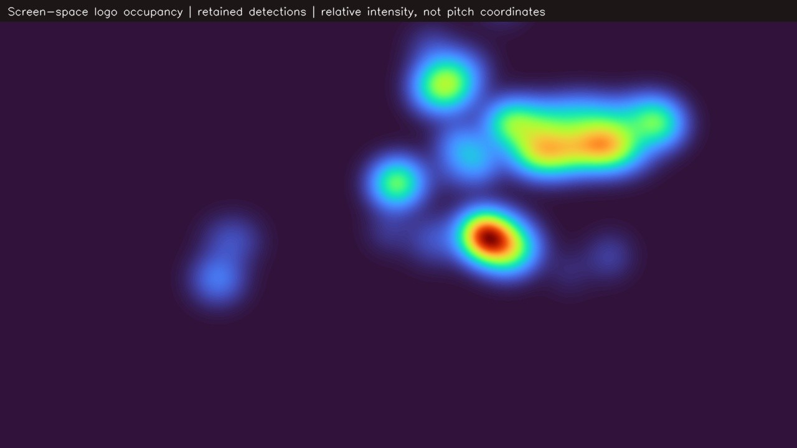
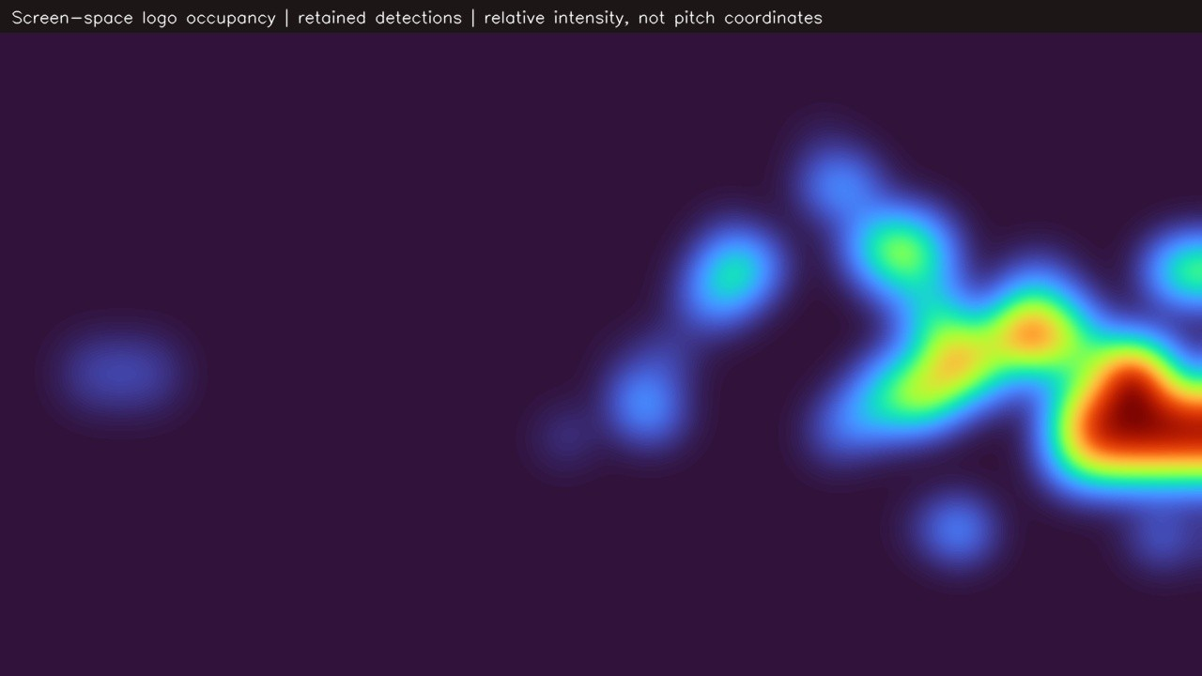
04
FINDING FOUR
Exposure lands where the contact is
Heat shows where the retained sponsor marks actually sat on the television picture. It is screen position, not pitch position.
Close and contact play
Wide tactical play
Marks concentrate centre-right at roughly waist height. Shorts and lower-back positions sit exactly there.
Exposure spreads, weakens and drifts to the edge of frame, where the position weighting cuts its value.
Relative intensity of retained logo detections in screen space, from two representative passages of the analysed footage.
12
Notes:
Be precise about what this is: where on the television picture the logos appeared. Not pitch coordinates, not player running data. The commercial read is one sentence — the camera lives around the contact area, and the kit that sits in the contact area is the shorts and the lower back.

Slide 13
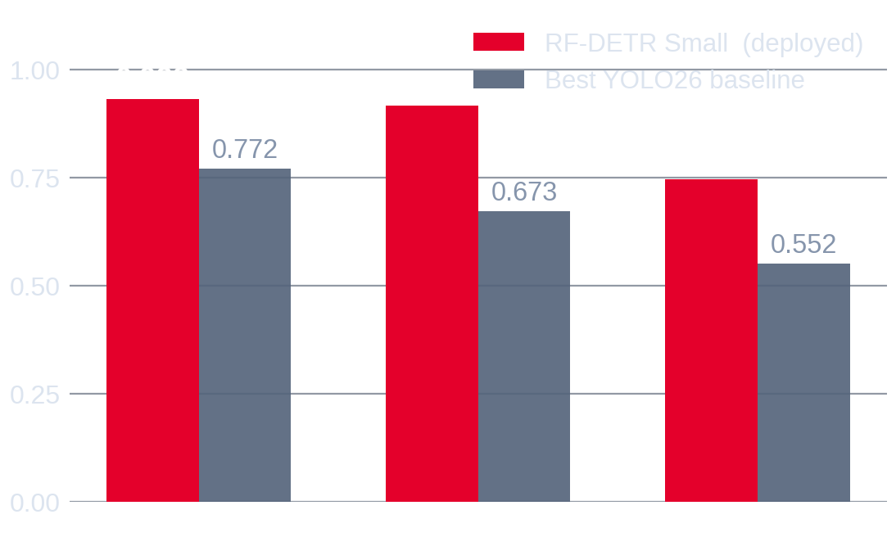
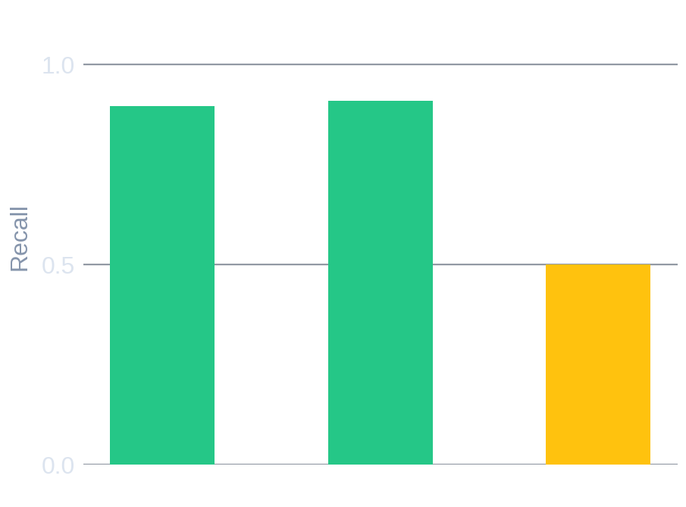
MODEL PERFORMANCE
How accurate is the detector?
Measured on three complete matches the model had never seen, against hand-annotated ground truth.
UNSEEN MATCHES
0.933
mAP@0.50
LOCALISATION
0.917
mAP@0.75
BEST F1
0.898
at the operating point
The deployed detector against the strongest conventional baseline trained on identical data, scored by one evaluator on the same held-out images.
The weakness worth declaring: on wide shots the model finds only half the marks. It rarely invents them — it misses them, so the exposure figures run conservative.
SPEED
19.8 fps
0.998 on familiar footage, 0.933 on new
0.917 once sparse classes are removed
50 ms per frame, one GPU
No frame-level manual labels exist yet
We report the harder number. The gap is evaluation optimism, not skill.
Four brands have fewer than five test boxes; taking them out costs 1.7 points.
So detection accuracy is validated; visibility scoring is not yet.
RF-DETR Small at 896 px, evaluated on 61 held-out images / 165 boxes across three unseen matches. Baseline: best of three YOLO26 variants on the identical split.
13
Notes:
Two honest points make this trustworthy rather than salesy. The same model scores 0.998 on matches it has already seen and 0.933 on new ones, and we report the harder number. And because it misses marks in wide play rather than inventing them, the gaps shown earlier are if anything understated.

Slide 14
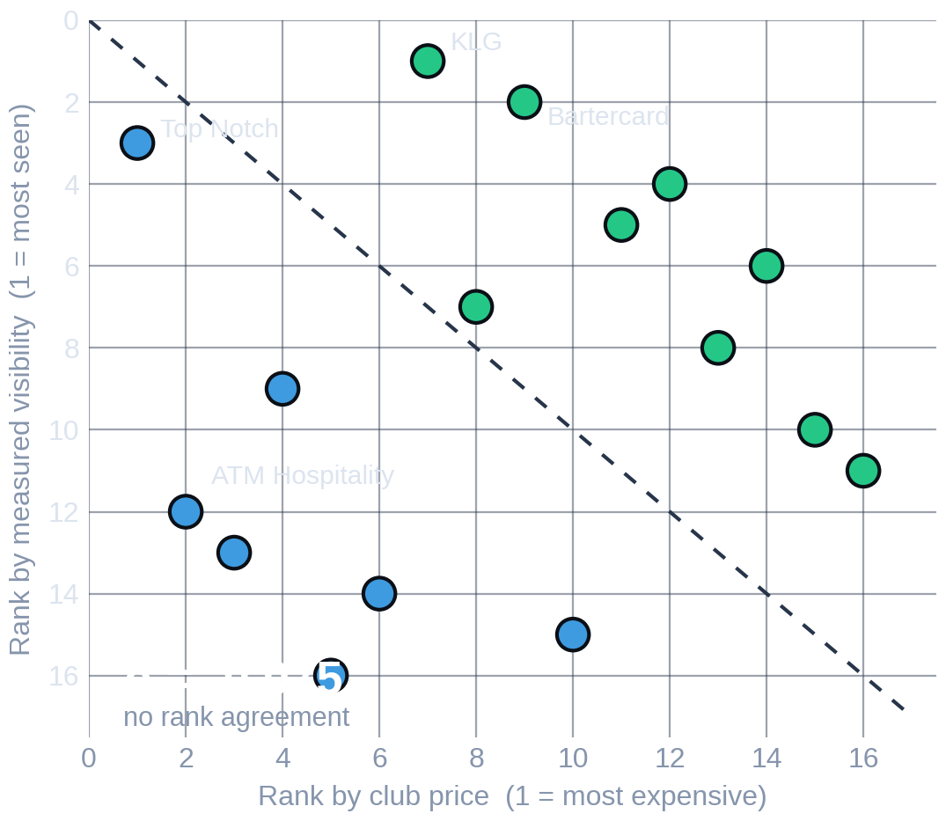
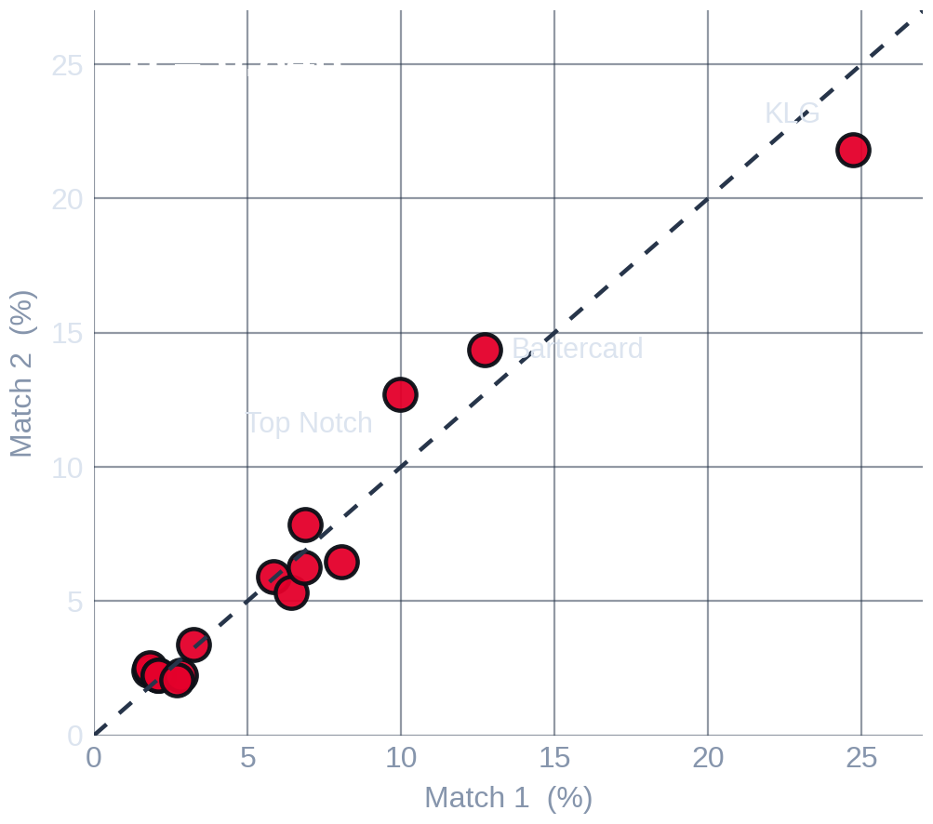
AI AGAINST MANUAL ASSESSMENT
It agrees with itself, not with the price list
AGREEMENT WITH THE CLUB
ρ −0.075
Effectively no rank agreement between price and measured visibility.
AGREEMENT WITH ITSELF
ρ 0.846
Strong rank stability between the two matches.
AVERAGE DISAGREEMENT
5.6 pp
Mean absolute gap per asset; the largest is 18.3 points.
Each asset by its rank in the club's price list against its rank by measured visibility. Agreement would sit on the dashed line.
The same measurement run on two different matches — the system agreeing with itself.
What can and cannot be claimed: the detector is validated against hand-annotated boxes; the visibility score is not yet validated against a human timing the same footage. That study is the next piece of work, not a finished result.
Two complete Bradford Bulls broadcasts, home kit 2025/26, analysed at 2 frames per second. “What the club charges” is the current management allocation (totals 95%); LogoLens totals 100%.
14
Notes:
This slide answers the obvious question — how do we know the AI is right and the club is wrong? The honest answer is that we do not claim that. What we can show is that the system agrees with itself across two matches and does not agree with the price list, and that the disagreement is systematic rather than random. Validating the visibility score against a human timer is listed as next work rather than dressed up as a result.

Slide 15
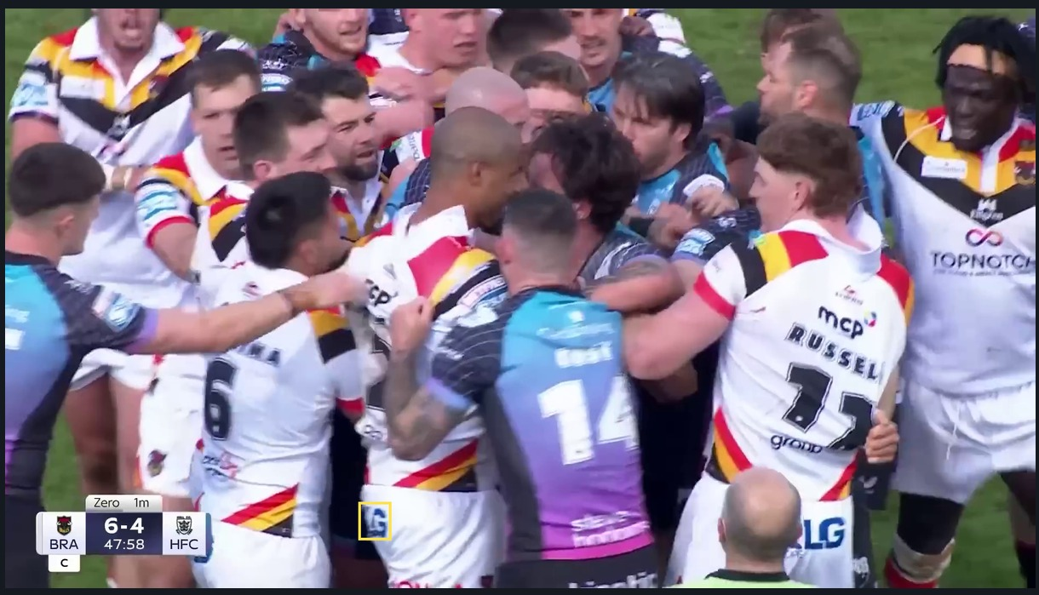
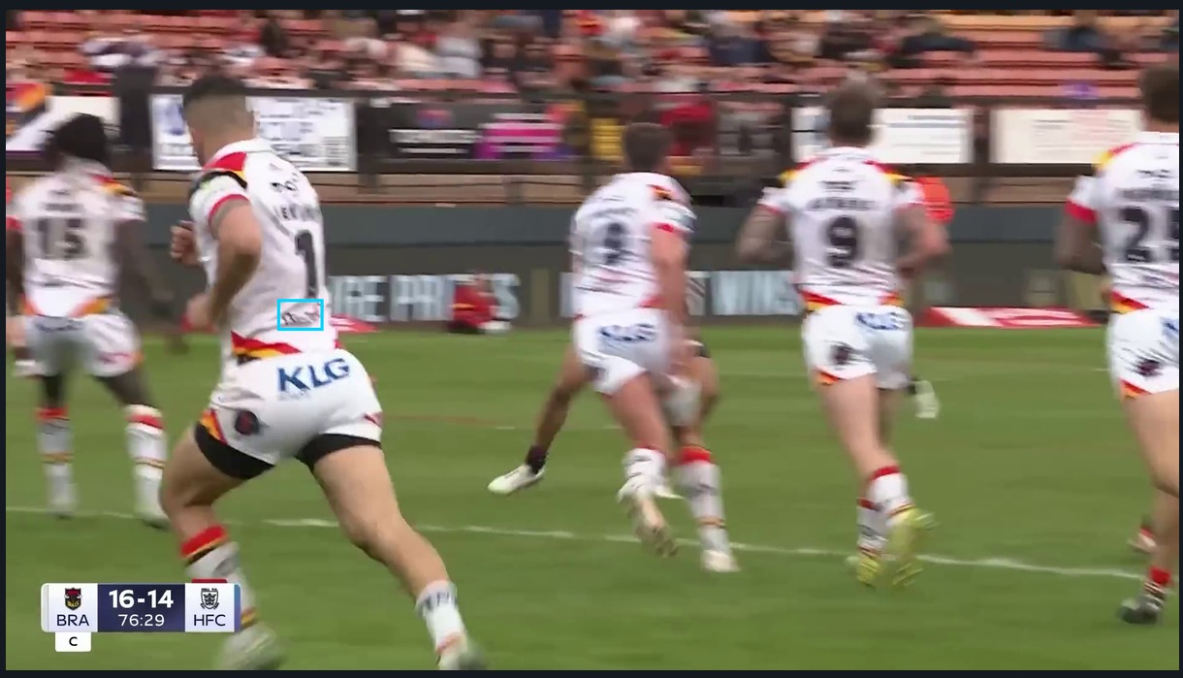
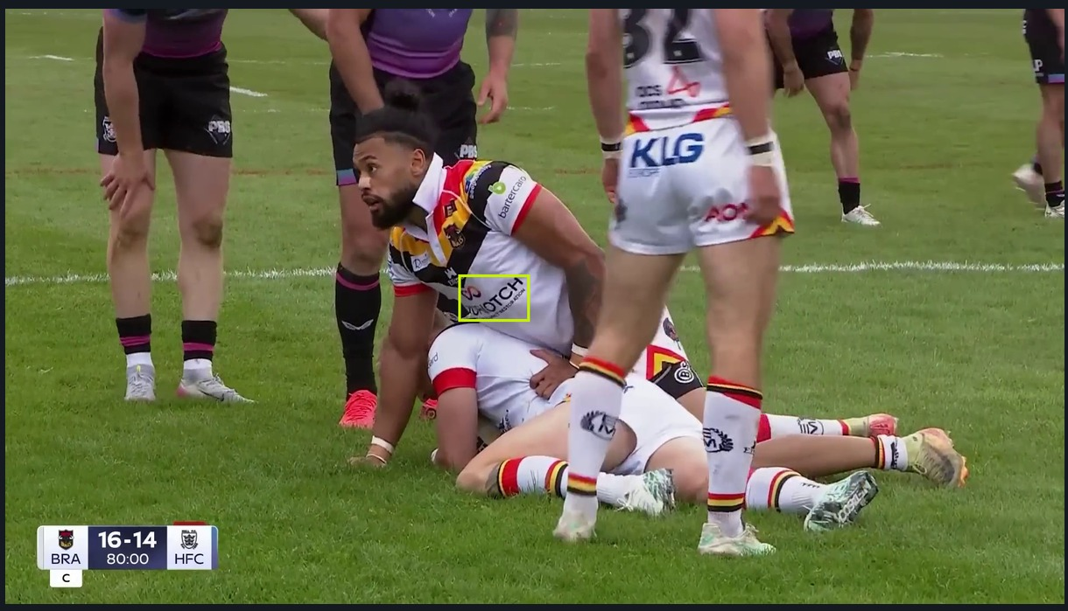
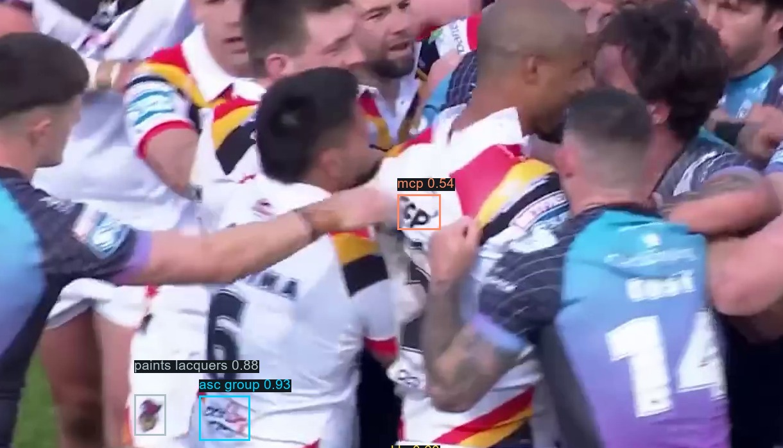
CHALLENGES
Where the footage fights back
Every example below is real output from the analysed match, not a staged illustration.
Occlusion
Movement and blur
Camera angle
Crowded phases
Players cover each other constantly. A partly hidden mark scores lower; a fully hidden one earns nothing at all.
Small marks on sprinting players go soft. Lower-back and sleeve logos suffer most.
An oblique view stretches and distorts the mark. The system corrects for shape, but confidence still falls.
Scrums and rucks stack players. Tying each mark to the right player becomes much harder.
Video quality sets the floor
Wide play is under-counted
Three back positions share an anchor
Lower source resolution and heavy compression shrink a mark below what any detector can read.
Recall falls to 0.500 on wide shots, so totals are conservative rather than inflated.
Top back, nape and collar back are read as a group, not as three independent readings.
Examples selected from artifacts/bradford_showcase. Confidence is a model output, not a measured occlusion percentage.
15
Notes:
Do not rush this slide — volunteering the weaknesses is what earns the right to the recommendations. The single most important sentence: because the system misses marks rather than inventing them, the exposure numbers are conservative. If anything, the gaps shown earlier are understated.

Slide 16
WHAT THE MODEL RECOMMENDS
One suggested action per asset
Evidence-led starting positions for a pricing review — not automatic price changes. Thresholds are illustrative and the club sets them.
4
5
1
6
Review upward
Modest upside
Hold
Justify the premium
Measured delivery far exceeds price share. Test a stronger asking price, or repackage.
Delivers above its price share. Candidate for bundling or a tier move.
Price and delivery are close enough to leave alone.
Priced above measured delivery. Document the non-broadcast value in writing.
KLG
+18.3
Paints & Lacquers
+3.5
Fairway
-0.8
MCP
-2.8
Bartercard
+9.6
AON
+2.9
MNA Cladding
-4.7
Cedar Court Hotels
+4.4
Chadwick & Lawrence
+1.9
Romantica
-4.9
ASC Group
+4.3
Ellgren
+1.5
MNA Support Services
-5.8
EM Workwear
+1.4
ATM Hospitality
-8.8
Top Notch
-14.7
Bands applied to the mean measured gap in percentage points: ≥ +4.0, +1.0 to +4.0, −2.0 to +1.0, and ≤ −2.0. Illustrative thresholds.
16
Notes:
This is the bridge from measurement to a commercial conversation. Be explicit that the thresholds are a starting point the club can move: above four points of gap is a review upward, below minus two is a position whose premium needs writing down. Nobody is proposing the model sets prices — it sets the agenda for the meeting where prices get set.

Slide 17
PRACTICAL VALUE
What this is worth to Bradford Bulls
The output is evidence for a commercial conversation — not an automatic price list.
Sponsorship valuation
Pricing decisions
Each position now has a measured delivery figure that traces back to frames and timestamps, so the shirt can be valued as an inventory rather than a list of slots.
Shorts and lower-back positions are sold cheaply relative to what they deliver; the chest premium can be defended deliberately rather than by habit.
Evidence-based sponsor talks
Sponsor reporting and retention
Renewal conversations move from assertion to a number both sides can see, with the method open to challenge.
Each partner can be given a per-match summary of their own delivery: seconds, appearances, quality and share of the shirt.
Use it as decision evidence, not as a pricing engine: club judgement, LogoLens measurement, and a written rationale wherever the two disagree.
17
Notes:
Close the commercial argument here. The one line worth repeating: this does not replace commercial judgement, it gives that judgement something to point at. If a sponsor asks why their sleeve costs what it costs, there is now an answer with a number attached.

Slide 18
NEXT STEPS
From a two-match pilot to a season-level system
Four steps in order — then the work that takes it beyond one club.
01
02
03
04
Confirm the map
Extend the evidence
Validate by hand
Run the pricing review
Club signs off which brand sits in which position and the current price share.
Run the same pipeline over a broader set of complete home-kit broadcasts.
Time and readability checked by a human on a stratified sample — the missing validation.
Measured delivery, current rate card and a documented rationale into the renewal cycle.
CLUB · 1 WEEK
AUTOMATED · PER MATCH
JOINT · 2–3 WEEKS
COMMERCIAL · NEXT CYCLE
FUTURE WORK
Auto-labelling across clubs
Occlusion and orientation as scored factors
Real-time and multi-sport
Within a league, kit regulations fix where a sponsor mark may sit relative to a shirt's seams and panels. Clubs differ in colourway and artwork, not in placement. A labelled reference kit can therefore seed draft boxes for a new club's kit — correction instead of annotation from nothing.
Instance-level occlusion labels and an oriented-box model would let both enter the score explicitly, instead of arriving indirectly through clarity.
The same pipeline applies to any fixed sponsor roster. A live variant would let the club report delivery during a match rather than after it.
18
Notes:
End on the sequence, not the technology. The club does one thing first — confirm the inventory map — and everything else follows. On future work, the cross-club idea is the one worth landing: because the league's kit regulations fix where marks can sit, a labelled Bradford kit can generate draft annotations for another club's kit, which turns weeks of manual labelling into correction. It has not been tested — say so — but it is the cheapest route to a second club.

Slide 19
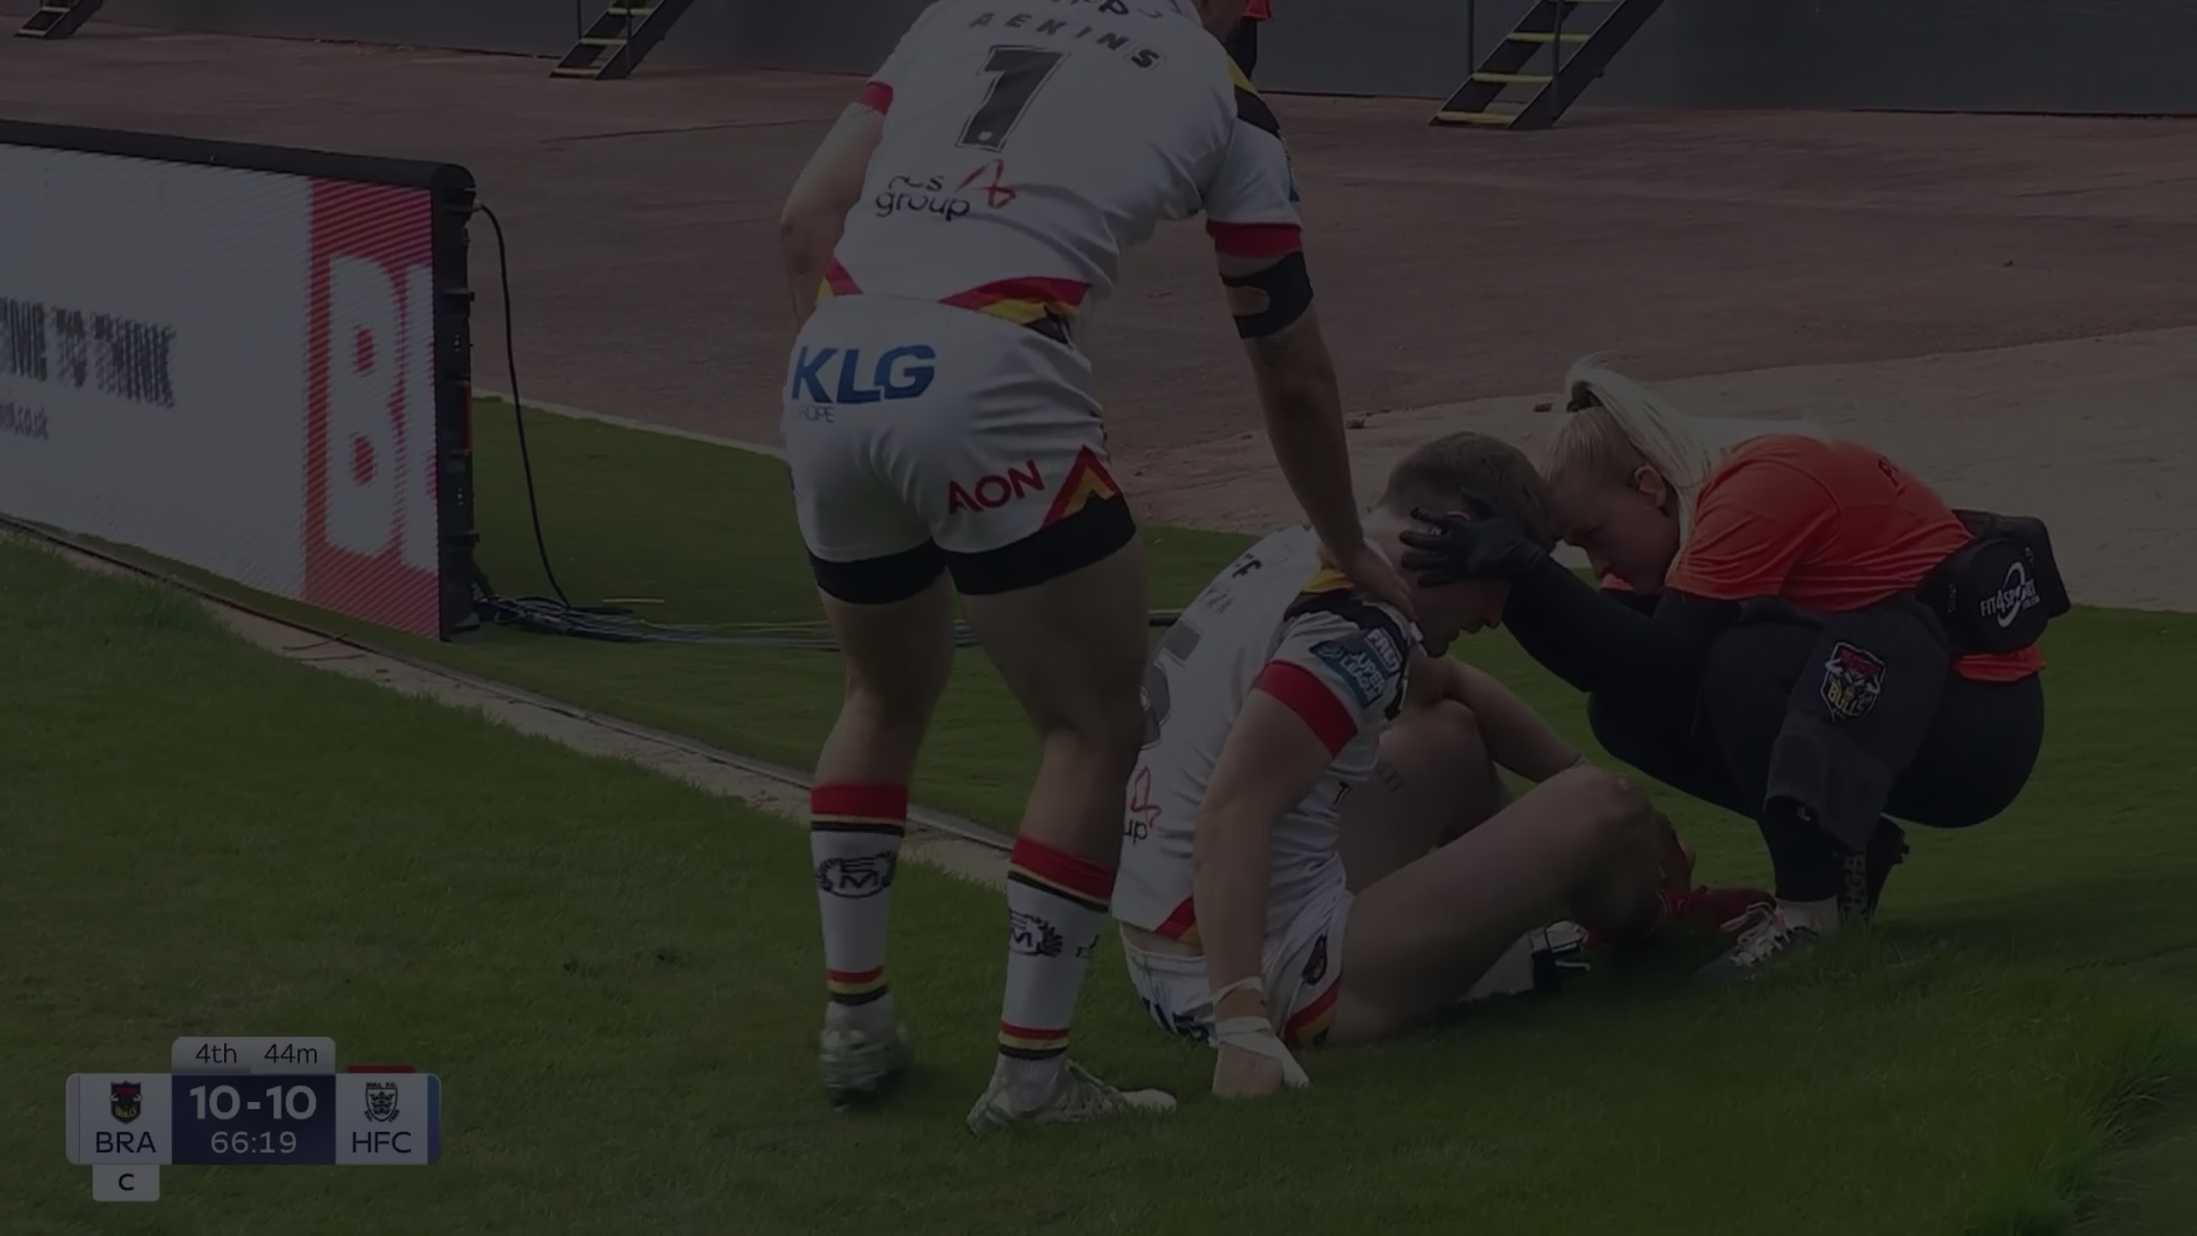
IN ONE LINE
Broadcast footage,
turned into
sponsorship evidence.
The measurement is stable and it is repeatable. The pricing map is the part worth revisiting — with the club's judgement leading and the evidence alongside it.
LogoLens · MSc Applied AI & Data Analytics, University of Bradford · in partnership with Bradford Bulls
19
Notes:
Finish on this line and go to questions. If asked what happens next, point back to step one: the club confirms the inventory map and we run the next fixture as soon as the footage exists.

Slide 20
APPENDIX
All sixteen assets
Club allocation, measured visibility in each match, the mean and the gap.
SPONSOR
KIT POSITION
PRICE %
MATCH 1
MATCH 2
CAMERA %
GAP PP
KLG
Top Back Shorts
5
24.73
21.82
23.27
+18.27
Bartercard
Sleeve 3
4
12.72
14.38
13.55
+9.55
Top Notch
Main Sponsor
26
9.95
12.71
11.33
-14.67
Cedar Court Hotels
Shorts Front
3
6.87
7.86
7.37
+4.37
ASC Group
Bottom Back
3
8.07
6.48
7.28
+4.28
Paints & Lacquers
Shorts Back 2
3
6.83
6.25
6.54
+3.54
Chadwick & Lawrence
Sleeve 1
4
5.85
5.90
5.88
+1.88
AON
Shorts Back 1
3
6.42
5.32
5.87
+2.87
MNA Cladding
Collar Bone
8
3.25
3.38
3.31
-4.69
Ellgren
Socks front
1
2.82
2.22
2.52
+1.52
EM Workwear
Socks back
1
2.68
2.05
2.37
+1.37
ATM Hospitality
Sleeve 2
11
1.80
2.53
2.17
-8.84
MNA Support Services
Collar Back
8
2.08
2.23
2.16
-5.84
MCP
Top Back
5
2.08
2.23
2.16
-2.84
Fairway
Nape Neck
3
2.08
2.23
2.16
-0.84
Romantica
Chest (opp Badge)
7
1.77
2.41
2.09
-4.91
Two complete Bradford Bulls broadcasts, home kit 2025/26, analysed at 2 frames per second. “What the club charges” is the current management allocation (totals 95%); LogoLens totals 100%.
20
Notes:
Leave-behind slide. Every figure reproduces from the two match reports; offer to send the underlying Excel exports.

