Slide 1
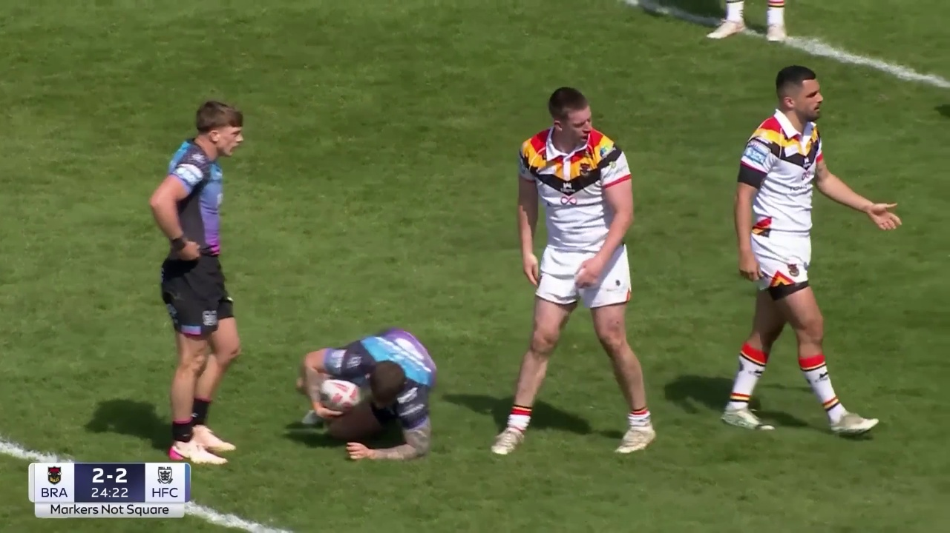
Bradford Bulls
Sponsor visibility in match footage
LogoLens
Evidence from the kit
to the sponsor conversation
Findings, practical demos and sponsorship decisions
Notes:
Prepared from local code execution and stored analyses. All match screenshots are extracted from real footage. Demo source: M08_white_1080p.mp4. No synthetic detection images.

Slide 2
Shorts exposure exceeds its configured weight
Historical saved analyses, before this revision. Human weights normalised from a total of 95.
Notes:
Sources: stored_evidence.json; backend/data/app.db, analyses 7451009139ba and 26d98363c4bd. AI shares recomputed using current location mapping and criteria size, position, confidence, OBB, durationWeight. These are exposure shares, not price recommendations. Stored matches were not rerun after the CV fixes.

Slide 3
The comparison measures exposure, not contract value
Human reference
AI measurement
Configured location weights
Main sponsor: 26
Top back shorts: 5
Share of weighted visible exposure
Match 2 main sponsor: 12.71%
Match 2 top back shorts: 21.82%
Use the difference to review placement value and supporting footage.
No verified rate card or frame-level manual audit is available in the repository.
Notes:
Human values are user-configured weights in location_configs, not verified club prices or manual logo ground truth. Raw weights sum to 95 and are normalised in charts. Never interpret the difference as an accuracy error or a direct price multiplier.

Slide 4
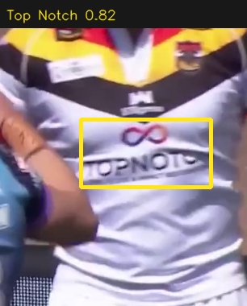
Chest: the main sponsor leads the human weighting
Historical Match 2 shares; image is a fresh detection example from the separate demo footage.
Notes:
{"source":"stored_evidence.json and slide_data.json","imageDetection":{"t":0,"class_id":15,"raw_name":"top_notch_home","brand_key":"top_notch","brand_name":"Top Notch","conf":0.8215709328651428,"xyxy":[1074.7969970703125,424.54473876953125,1235.0103759765625,508.45733642578125],"track_id":2,"frame_w":1280,"frame_h":720,"visibility":0.015218406402116665,"f_size":0.12077908625751832,"f_pos":0.15336715888633665,"f_clarity":0.8215709328651428,"f_obb":1,"body_zone":null,"on_target_team":false,"frame":0,"source_time":18,"owner_state":"uncertain","clip":"wide"},"locationIds":["main-sponsor","collar-bone","chest-opp-badge"],"limitation":"Placement labels and brand mapping need club verification. Detection crop illustrates the named sponsor, not a manual validation label."}

Slide 5
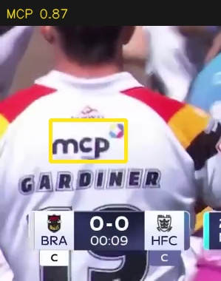
Back: nearby slots share one pose anchor
Historical Match 2 shares; image is a fresh detection example from the separate demo footage.
Notes:
{"source":"stored_evidence.json and slide_data.json","imageDetection":{"t":0.08,"class_id":10,"raw_name":"mcp_home","brand_key":"mcp","brand_name":"MCP","conf":0.8727134466171265,"xyxy":[68.01496887207031,502.6488037109375,170.75552368164062,558.3194580078125],"track_id":5,"frame_w":1280,"frame_h":720,"visibility":0.00898260304874364,"f_size":0.07877943886664306,"f_pos":0.13065247992550794,"f_clarity":0.8727134466171265,"f_obb":1,"body_zone":null,"on_target_team":false,"frame":2,"source_time":18.08,"owner_state":"uncertain","clip":"wide"},"locationIds":["collar-back","top-back","nape-neck","bottom-back"],"limitation":"Collar back, top back and nape neck map to back-top and share its measurement equally; these are not independently resolved slots."}

Slide 6
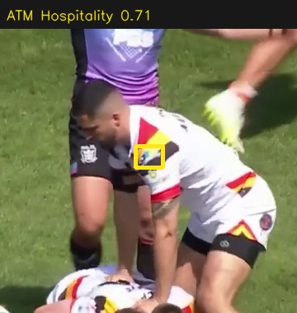
Sleeves: exposure differs between placements
Historical Match 2 shares; image is a fresh detection example from the separate demo footage.
Notes:
{"source":"stored_evidence.json and slide_data.json","imageDetection":{"t":4.84,"class_id":2,"raw_name":"atm_home","brand_key":"atm","brand_name":"ATM Hospitality","conf":0.7140549421310425,"xyxy":[614.124267578125,282.0216064453125,647.7210083007812,308.8848876953125],"track_id":111,"frame_w":1280,"frame_h":720,"visibility":0.02171076258979345,"f_size":0.03129369679520606,"f_pos":0.971597924902829,"f_clarity":0.7140549421310425,"f_obb":1,"body_zone":null,"on_target_team":true,"frame":121,"source_time":88.84,"owner_state":"target","clip":"tackle"},"locationIds":["sleeve-1","sleeve-2","sleeve-3"],"limitation":"Placement labels and brand mapping need club verification. Detection crop illustrates the named sponsor, not a manual validation label."}

Slide 7
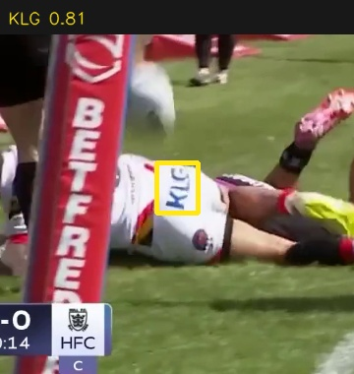
Shorts: both matches show substantial exposure
Historical Match 2 shares; image is a fresh detection example from the separate demo footage.
Notes:
{"source":"stored_evidence.json and slide_data.json","imageDetection":{"t":5.32,"class_id":9,"raw_name":"klg_home","brand_key":"klg","brand_name":"KLG","conf":0.8097805976867676,"xyxy":[302.6059265136719,482.37860107421875,344.1864929199219,533.6095581054688],"track_id":135,"frame_w":1280,"frame_h":720,"visibility":0.01700491136168101,"f_size":0.04807731461118772,"f_pos":0.4367840830433849,"f_clarity":0.8097805976867676,"f_obb":1,"body_zone":null,"on_target_team":false,"frame":133,"source_time":23.32,"owner_state":"other","clip":"wide"},"locationIds":["top-back-shorts","shorts-front","shorts-back-1","shorts-back-2"],"limitation":"Placement labels and brand mapping need club verification. Detection crop illustrates the named sponsor, not a manual validation label."}

Slide 8
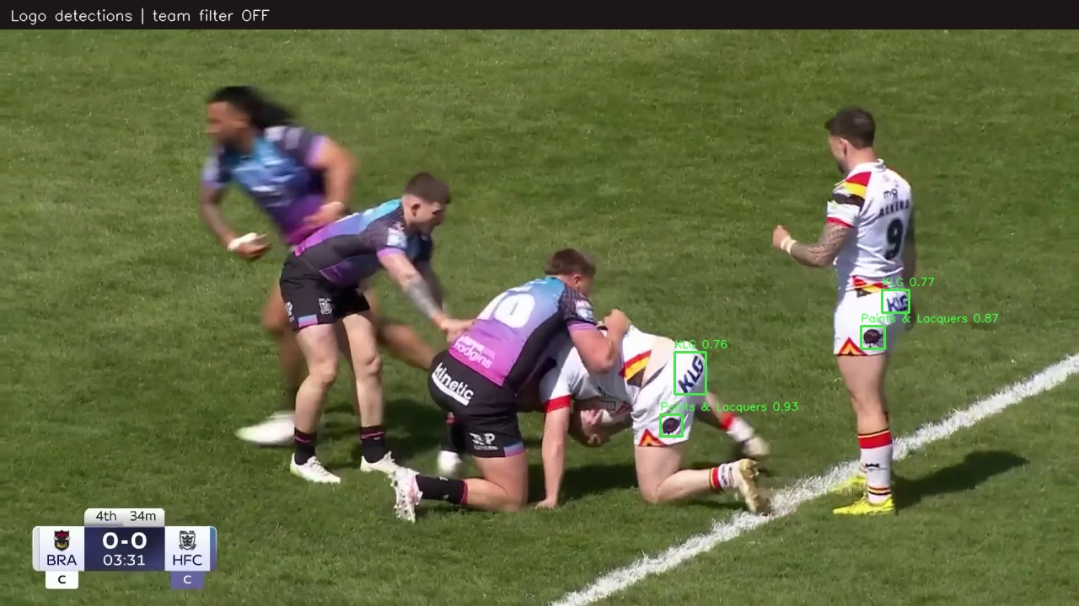
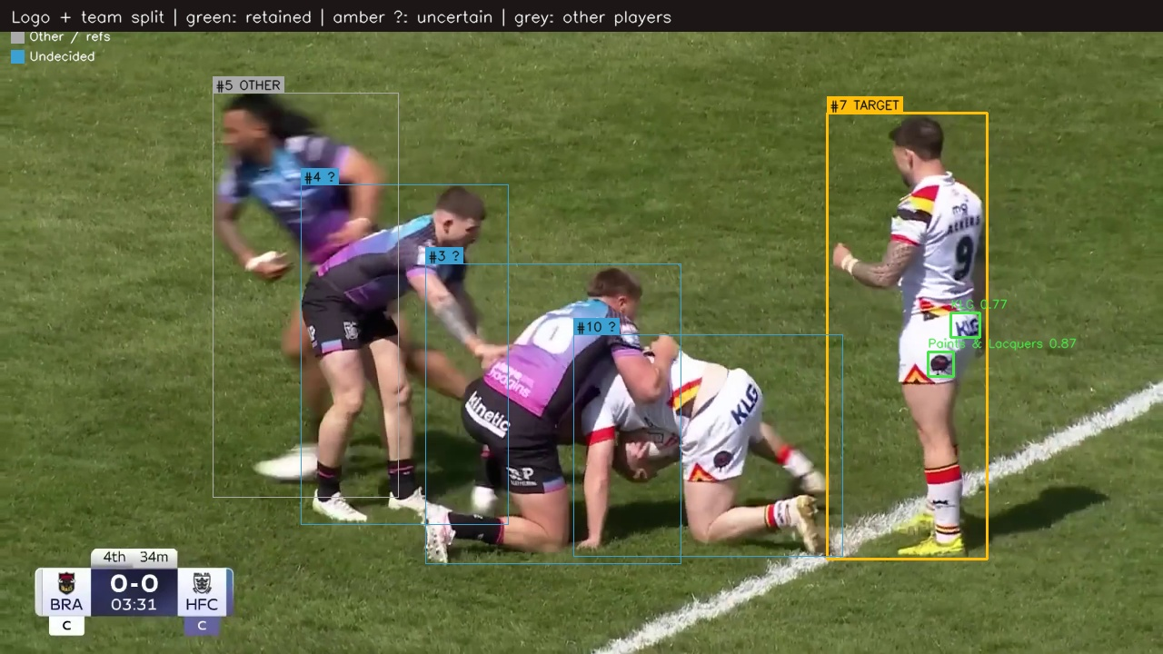
Team attribution changes what enters the analysis
Without team split
With team split
Identical frames and logo detections; only the ownership and team-filter decision changes.
Notes:
Fresh CUDA run: build_club_demo.py. Images at demo frame 175, source offset 18 + 175/25 = 25 seconds. Video files wide_no_split.mp4 and wide_team_split.mp4. Boxes represent predictions, not verified truth.

Slide 9
407 of 583 detection instances pass the team filter
22 seconds at 25 fps. Counts are repeated frame detections, not unique logos or accuracy.
Notes:
Source manifest.json and per-frame *_detections.json. Home-kit colour evidence with temporal votes and broadcast-cut resets. Rejected detections include opponents, unassigned logos and tracks without sufficient evidence under the current policy. No claim that all rejections are correct.

Slide 10
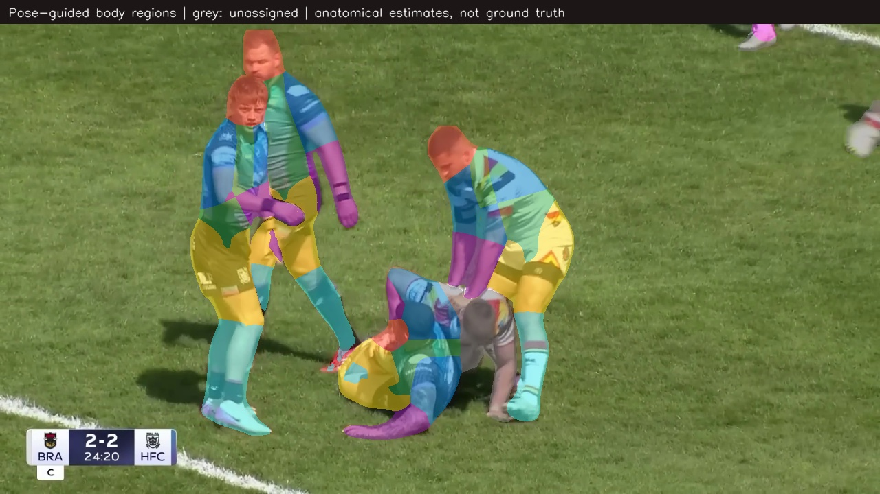
Body regions follow each player’s visible silhouette
Changes
One pose per mask
No invented torso
No duplicate pixel counts
Grey pixels remain unassigned when pose evidence is missing. Colours are anatomical estimates.
Notes:
Source tackle_body.mp4, generated with YOLO11x-seg and YOLO11x-pose, imgsz896, confidence0.35. Baseline dashboard defaults may use smaller models. Anatomical colour regions are not pixel-labelled ground truth and do not distinguish chest from back. Sponsor slot attribution is a separate pipeline stage.

Slide 11
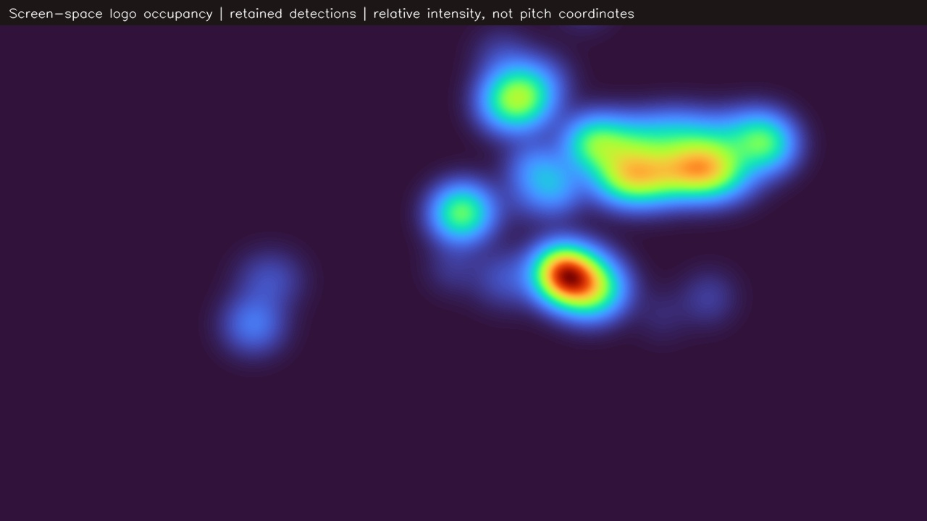
The heatmap shows where retained logos appear
Relative
intensity
Camera framing
affects this view.
This is not a
pitch-position map.
Screen-space occupancy from the 12-second tackle demo; bright areas receive more repeated coverage.
Notes:
Source tackle_detections.json. For every retained bounding box, add 1/fps to covered screen pixels; Gaussian smoothing sigma25px; normalise to maximum for display. All-team anatomical pixel coverage is different from sponsor visibility. No homography or pitch coordinates are estimated.

Slide 12
Each exposure combines time, size and confidence
Duration
Logo size
Time visible in sampled footage
Bounding-box area relative to frame
Position
Clarity
Weight relative to the frame centre
Detector confidence, not legibility truth
Frequency
Occlusion
Repeated exposure events and tracks
Reflected indirectly in detection loss
Confidence is a clarity proxy. Occlusion is not independently measured in the current score.
Notes:
Source backend/app/pipeline/visibility.py, exposure.py and location_breakdown.py. HBB models use OBB factor1. Duration segments depend on sampling and tracking. Confidence cannot establish human readability; no calibrated standalone occlusion metric is present.

Slide 13
Logged detector validation: 85.2% mAP@50
82.6%
73.1%
85.2%
63.9%
Precision
Recall
mAP@50
mAP@50–95
Next validation: label teams and body parts across tackles, cuts and distant shots.
Best logged mAP@50–95 epoch (22). These scores do not validate team identity or body parts.
Notes:
Source runs/yolo26/matchsplit_896_m/results.csv, epoch22: precision .82631, recall .73073, mAP50 .85239, mAP50-95 .63865. args.yaml points to datasets/yolo_matchsplit/data.yaml. These are historical training validation logs; selected weights were used in demos but benchmark was not rerun in this session. No manual body-part or team ground truth was available.

Slide 14
The system keeps a traceable path back to footage
1
2
3
4
Match footage
Logo detection
Team / body
Exposure
Source + timestamp
Box + confidence
Ownership + pose
Duration + weight
Per-frame JSON and a run manifest make each demo reproducible.
Every exported screenshot and video comes from code execution on the source match.
Notes:
Editable conceptual flow diagram. Evidence files: manifest.json, wide_detections.json, tackle_detections.json, stored_evidence.json; runner backend/scripts/build_club_demo.py. Diagram is explanatory, not a generated match scene.

Slide 15
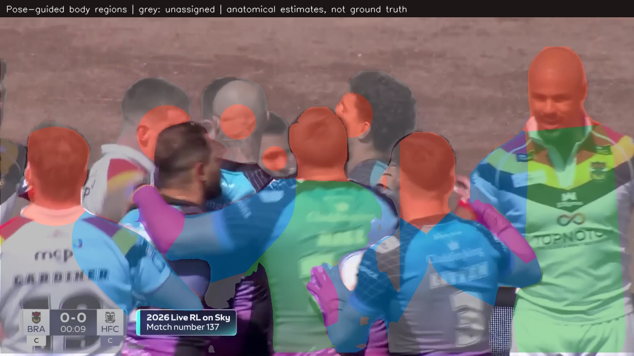
Tackles, camera cuts and small logos remain difficult
Visible limitations
Overlapping players mix kit colours
Missing joints leave uncertain regions
Distant logos lose readable detail
Close kit slots share pose anchors
Unknown labels and reviewable evidence are necessary parts of the output.
Notes:
No claim of perfect segmentation or production accuracy uplift. This revision fixes identified logic errors and passes regression tests, but a labelled rugby evaluation set is needed to quantify improvement. Cut detection is heuristic; calibrated pose-based ownership remains further work.

Slide 16
Bradford Bulls can use the evidence in sponsor reviews
Review high-exposure
placements
Show the sponsor
the footage
Use shorts and chest comparisons to question assumptions in the current weighting.
Pair every placement claim with a dated clip, a visibility measure and its limitations.
Exposure supports commercial judgement; audience, rights and contracts also determine price.
Notes:
Recommended next commercial step: verify the club rate card and placement map, agree a manually labelled evaluation sample, then rerun complete matches with the reviewed pipeline before changing sponsorship prices.

