Slide 1
MSc DISSERTATION SUMMARY
COMPUTER-VISION FRAMEWORK FOR SPONSOR-LOGO DETECTION AND VISIBILITY-QUALITY ASSESSMENT IN SPORTS
Work Package 1: Logo Detection and Visibility Intelligence
A closed-set multi-logo detection system and a transparent prototype framework for turning sponsor-logo detections into auditable visibility evidence — evaluated on unseen Bradford Bulls broadcast footage.
MSc Applied Artificial Intelligence and Data Analytics · University of Bradford
01 / 10

Slide 2
THE PROBLEM
The measurement gap
Every broadcast and highlight clip is already a complete visual record of which sponsor marks appeared — but sponsorship is still priced on precedent, not on that evidence.
Nielsen, Relo Metrics and Blinkfire prove automated exposure tracking is feasible at scale — but their methods and evaluation data are proprietary.
Clubs receiving those reports cannot check a figure against the footage; smaller clubs like Bradford Bulls have no independent means of telling whether a sponsorship is delivering fair value.
THE ASYMMETRY THIS DISSERTATION MEASURES
The same shirt position can be legible in a close-up or a few indistinct pixels in a wide shot. This dissertation puts numbers on exactly that gap.
90%
50%
RECALL, CLOSE & MEDIUM SHOTS
RECALL, WIDE TACTICAL SHOTS
LogoLens · WP1 Summary
2 / 10

Slide 3
AIM & RESEARCH QUESTIONS
Aim & research questions
Aim: develop and evaluate an accurate multi-logo detection system for unseen sports footage, and implement a transparent prototype that converts frame-level detections into auditable visibility evidence.
RQ | Question | Solution
RQ1 | How accurately and efficiently can the system identify multiple known sponsor logos in unseen footage? | Train & evaluate detection models · detect multiple logos simultaneously
RQ2 | How does held-out detection performance vary across logo size, camera distance, lighting and resolution? | Analyse logo size & screen coverage · measure occlusion · assess image quality
RQ3 | How can detections be transformed into a transparent, auditable measure of visibility duration and quality — and what validation is still required? | Measure visibility duration · develop the Logo Visibility Score
LogoLens · WP1 Summary
3 / 10

Slide 4
DATA & EVALUATION DESIGN
Dataset & leakage-aware split
584
1,903
16
15
IMAGES
ANNOTATED BOXES
SPONSOR CLASSES
DISJOINT MATCH GROUPS
Split | Matches | Images | Boxes | Role
Train | 9 | 460 | 1,611 | Weight optimisation & augmentation
Validation | 3 | 63 | 127 | Checkpoint selection & stopping
Test (held-out) | 3 | 61 | 165 | Final evaluation only
The unit of independence is the match, not the frame. An earlier frame-level split let 51 of 56 validation frames share a training frame from the same clip within two seconds.
Why this matters: applying the final checkpoint to familiar match material scores 0.998 mAP@0.50 — on genuinely unseen matches it scores 0.933. The gap is evaluation optimism, not model improvement.
LogoLens · WP1 Summary
4 / 10

Slide 5
MODEL COMPARISON
RF-DETR vs. YOLO26 — one accuracy protocol
Model | Params | mAP@0.50 | mAP@0.75 | mAP[.50:.95] | F1
YOLO26-n | 2.5M | 0.551 | 0.485 | 0.389 | 0.691
YOLO26-s | 10.0M | 0.772 | 0.673 | 0.552 | 0.810
YOLO26-m | 21.8M | 0.747 | 0.618 | 0.529 | 0.822
RF-DETR Small | 31.8M | 0.933 | 0.917 | 0.747 | 0.898
Same images, match-disjoint split, 896px input and scoring code for all four models. RF-DETR Small leads the strongest YOLO26 baseline by +16.1 points at mAP@0.50 and +24.4 points at the stricter mAP@0.75 — but pre-training, capacity and augmentation recipe are not equal, so this is a system-level result, not an architecture ablation.
LogoLens · WP1 Summary
5 / 10

Slide 6
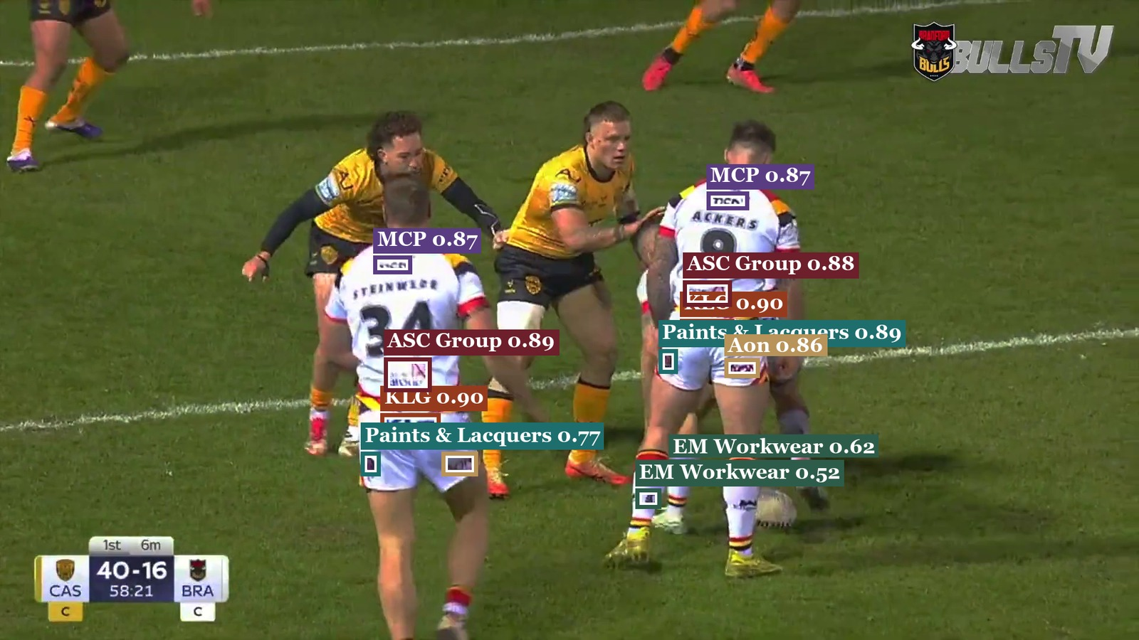
DETECTION LOGO
Headline result — and why it holds up
0.933
0.917
0.747
0.898
19.8
MAP@0.50
MAP@0.75
MAP[.50:.95]
F1 @ CONF 0.35
PRED. FPS
Leakage check
0.998 familiar → 0.933 unseen. The 6.5-point drop is the evaluation-optimism a naive split would have hidden.
Support check
4 of 15 classes carry 7 of 165 test boxes. Restricted mean (n≥5): 0.917 — reported alongside 0.9335.
Stability check
Per-match mAP@0.50: 0.973 / 0.934 / 0.976 — the aggregate is not carried by one match.
Real held-out frame (M_CAS): 12 of 12 matched logos across 6 sponsor classes, no false positive.
LogoLens · WP1 Summary
6 / 10

Slide 7
BREAKDOWN DETECTION
Where detection breaks down
Wide-shot errors are misses, not false alarms
0.897
0.909
The detector doesn't invent remote logos — it fails to record them. This is a predictable, one-directional bias, not random noise.
Consequence: any duration estimate built on this detector will under-count exposure in passages dominated by wide tactical play.
Occlusion is illustrated qualitatively (Figure 8, three-level scale) but not yet quantified across the full held-out set.
0.500
Close-up
(126 boxes)
Medium
(33 boxes)
Wide
(6 boxes)
Recall by camera distance, held-out test set (61 images).
LogoLens · WP1 Summary
7 / 10

Slide 8
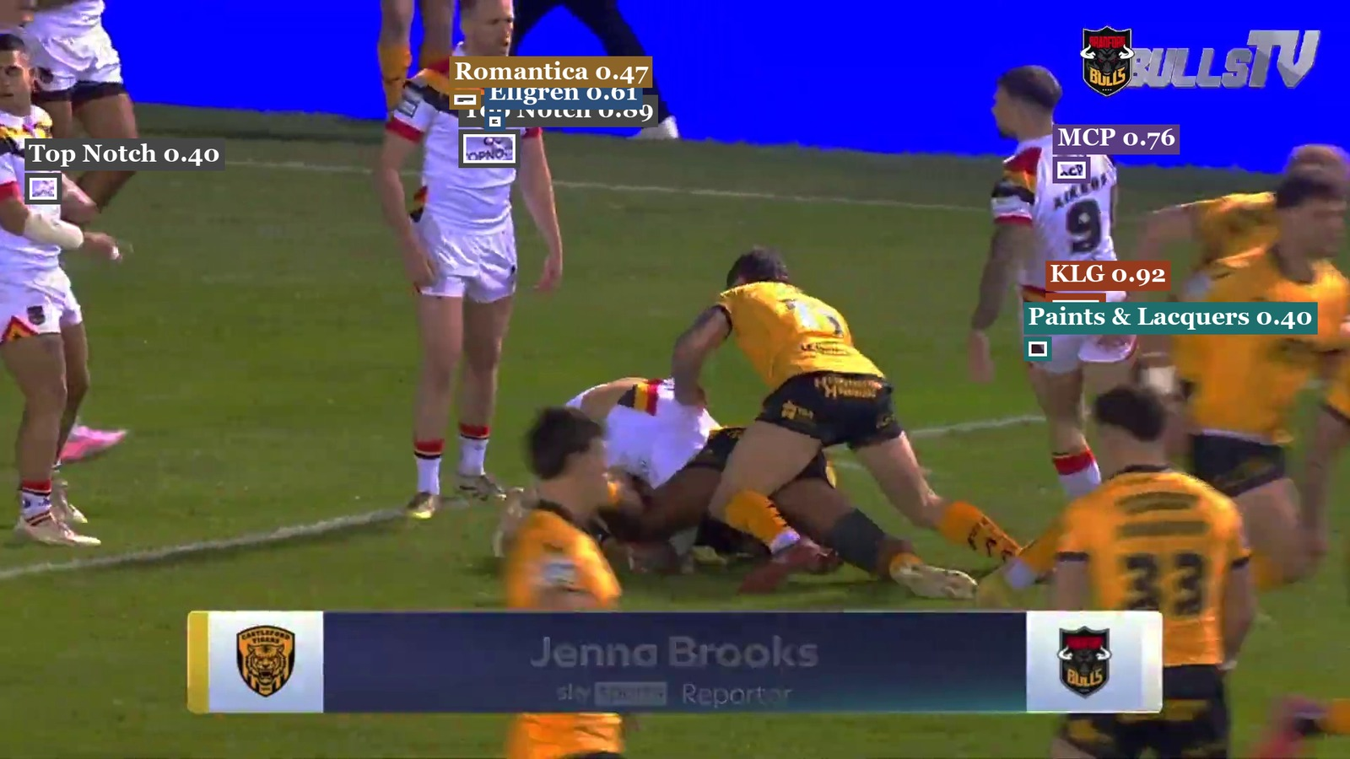
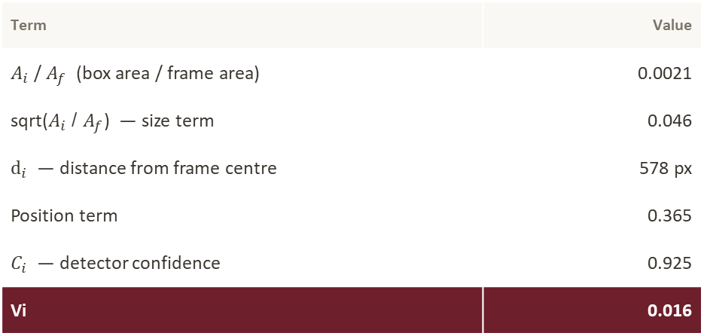
LOGO VISIBILITY
From a detection to a Logo Visibility Score
$$V_{i}={clip}_{\left[0,1\right]}\left(\sqrt{\frac{A_{i}}{A_{f}}}×\exp\left[−\frac{d_{i}^{2}}{{\left(0.3W\right)}^{2}}\right]×c_{i}\right)$$
Worked example — real held-out detection: KLG mark, M_CAS match, t=21.000s, IoU 0.85
Term | Value
$A_{i}$ / $A_{f}$ (box area / frame area) | 0.0021
sqrt($A_{i}$ / $A_{f}$) — size term | 0.046
$ⅆ_{i}$ — distance from frame centre | 578 px
Position term | 0.365
$C_{i}$ — detector confidence | 0.925
Vi | 0.016
KLG mark, confidence 0.925 — real held-out frame, boxes are actual model predictions.
A confident, accurately-matched detection still scores low off-centre — a transparent heuristic, not yet a validated readability measure.
LogoLens · WP1 Summary
8 / 10

Slide 9
MSc DISSERTATION SUMMARY
Thank you
Questions & discussion welcome
MSc Applied Artificial Intelligence and Data Analytics · University of Bradford
LogoLens · WP1 Summary
10 / 10

