Slide 1

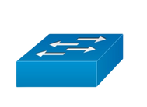

HYPER-V
WAN Switch
pfSense Master
LAN Switch
LAN Clients
Virtural
IP
SYNC
pfSense Backup
DMZ Servers
SYNC link
DMS Switch
DMZ Switch
DMZ Switch
DMZ Servers

