Slide 1

Motorbike Accessories Inventory Management
CAPSTONE PROJECT
Supervisor: Lai Duc Hung
Members:
Pham Minh Hoang (Leader)
Nguyen Truong Thinh (Member)
Do Trung Hieu (Member)
Nguyen Huy Hoang (Member)

Slide 2
agenda
Introduction
Idea & Solution
Demonstration
Conclusion & Future Plans
Q&A

Slide 3
1. introduction

Slide 4
Introduction – RFIM system
Motorbike company’s warehouse can use our system to manage products effectively.
Our team provides a system that integrates RFID technology – called RFIM.
Users can use our system to manage information of motorbike accessories, stock-in, stock-out, stock-take, transfer products products’s process easily.

Slide 5



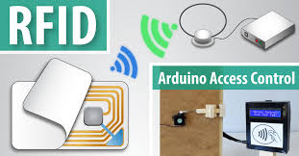
Introduction – terminology
Warehouse Accountant: a user that manages the information of products and facilities that exist in the accessories inventory and does the paperwork.
Stock-keeper: a user that does the processes related to the warehouse management.
Admin: a user that has the responsibility of managing users.
RFID tag: a tag that has unique ID.
RFID scanner : a scanner that scan RFID to identify ID.
Warehouse Accountant
Stock-keeper
Admin
RFID Technology

Slide 6
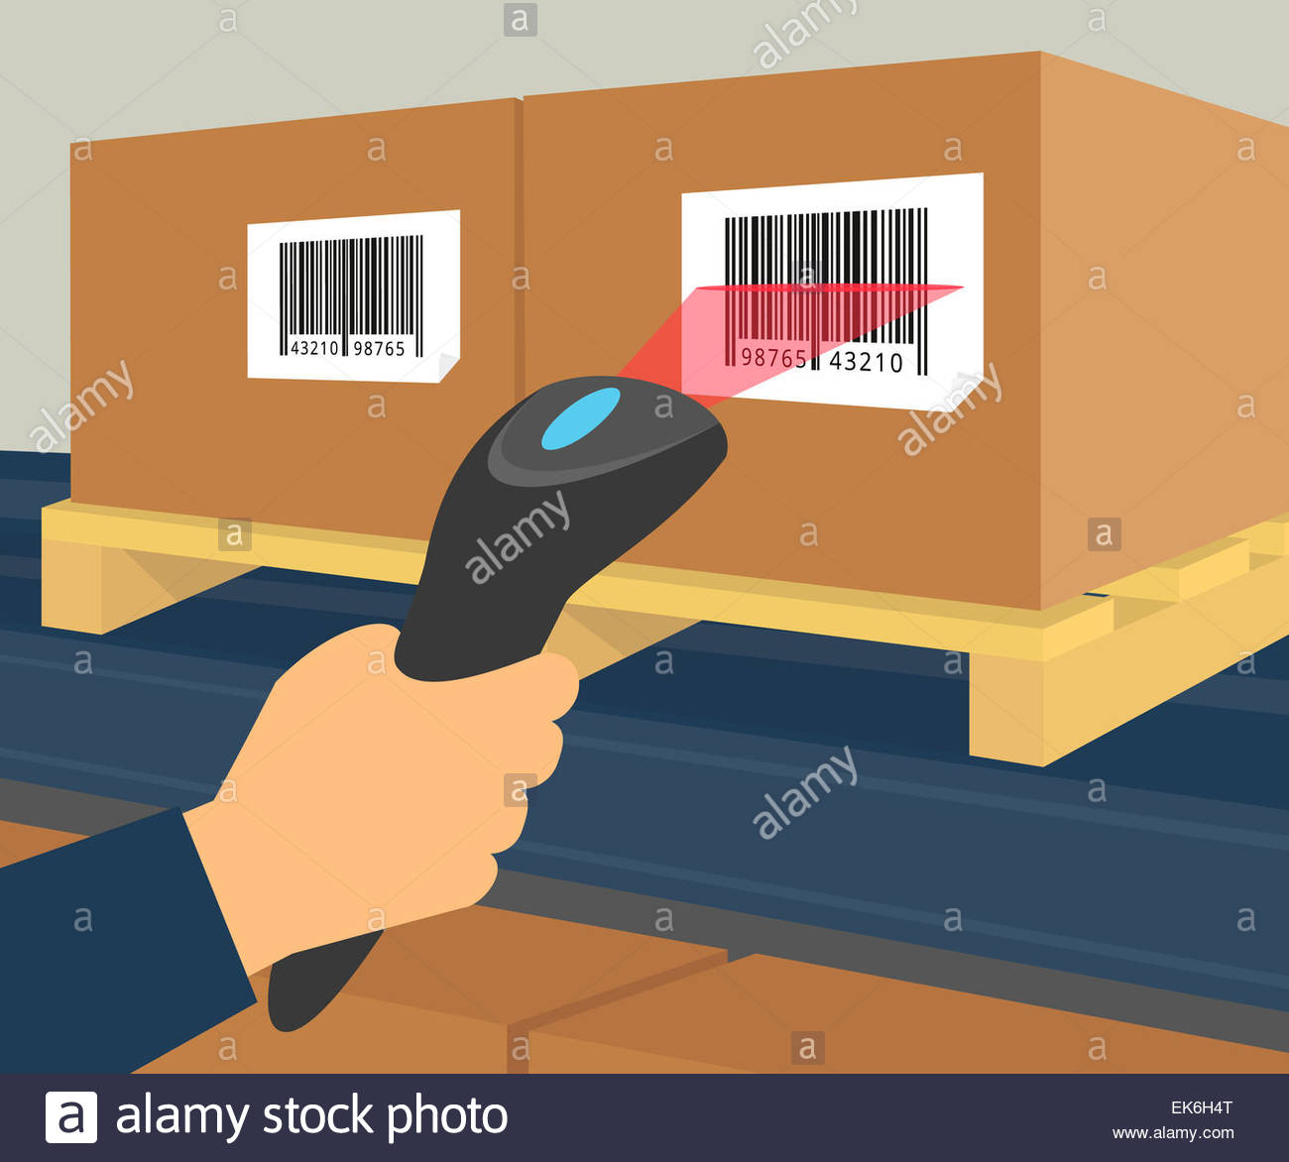

Introduction – CURRENT SITUATION
The motorcycle industry has become one of the fastest growing industries
The most motorcycle manufactures and suppliers manage warehouse with barcode “archetype” or traditional papers method.
Barcode technology
Paperwork

Slide 7
Introduction–CURRENT SITUATION
Disadvantages
Time-consuming
Unclear line of sight
Physical damage
Security problem

Slide 8
2. Idea & solution

Slide 9
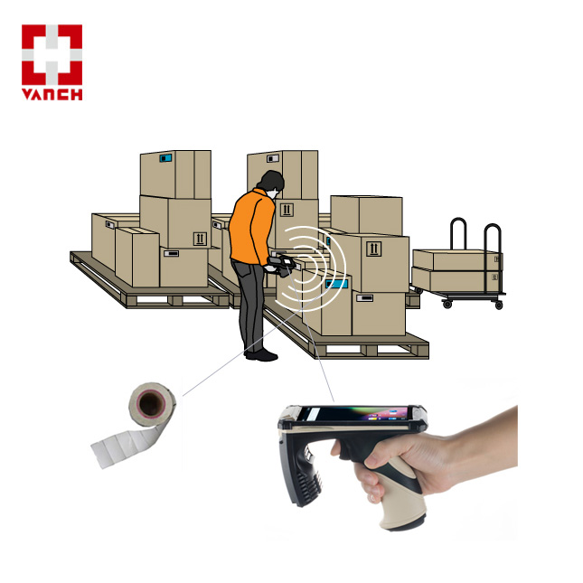
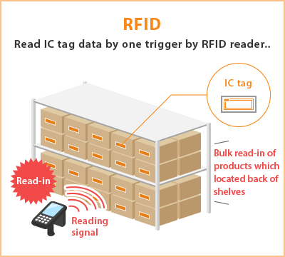
Idea&solution-RFID Technology
Our proposed solution is to build a system called “RFIM”.
The system supports enterprise organizes and manages the inventory by using RFID technology that helps reduce a lot of time when importing, exporting or inventorying products.

Slide 10
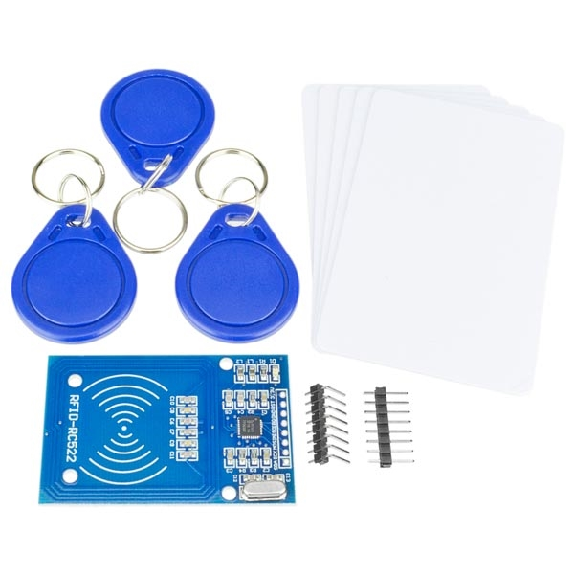
What is rfid ?
RFID is an acronym for “radio-frequency identification” and digital data encoded in RFID tags or smart labels (defined below) are captured by a reader via radio waves.
RFID tags and Arduino scanner

Slide 11
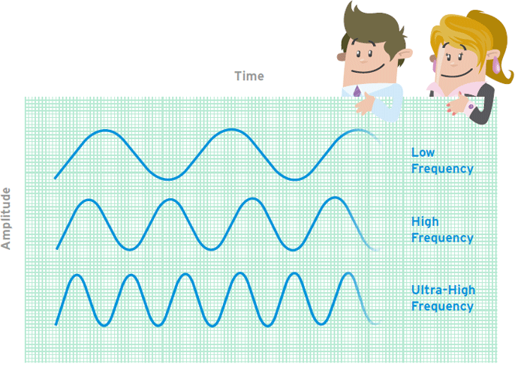
What is rfid?
There are 3 types of RFID:
LF RFID (frequencies from 30KHz to 300KHz) – read scope (10cm).
HF RFID (frequencies from 3 to 30MHz) – read scope( 10cm – 1m).
UHF RFID (frequencies from 300MHz to 3GHz) – read scope( > 12m).
RFID Frequencies

Slide 12
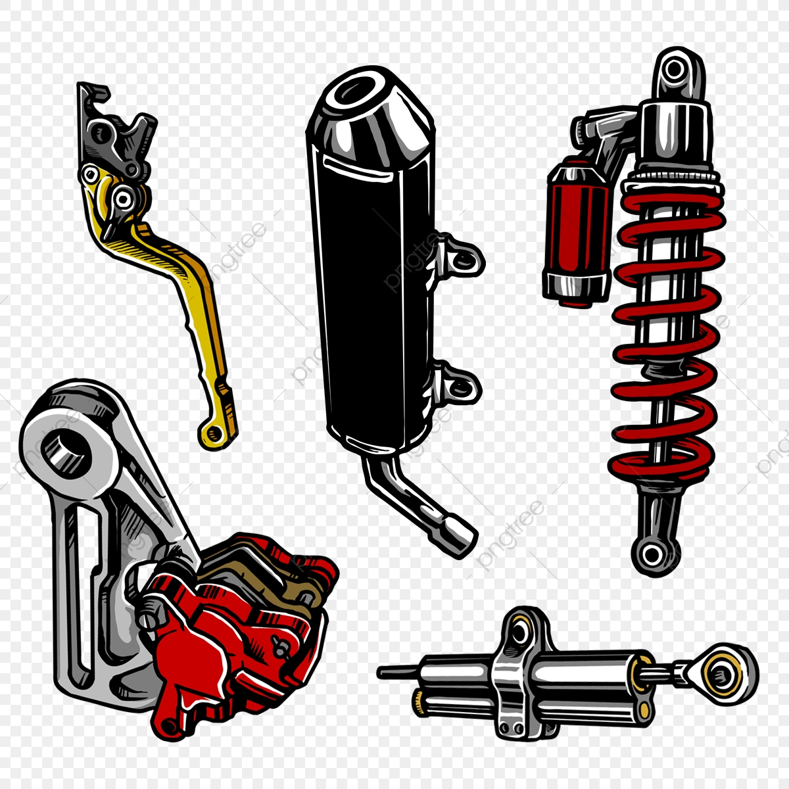
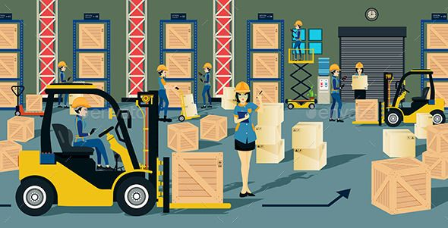

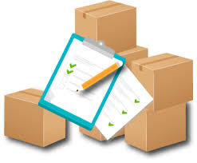
Idea & solution - feature functions
Manage motorbike’s
parts information
Stock-in & Stock-out process
Transfer products from
shelf to other shelf
Stocktake inventory to
check quantity of
products

Slide 13
Idea & solution - advantages
Time-saving: The duration when the staff checks the quantity of importing or exporting products can be reduced because RFID tags can be read more than once at the same time.
Wide range scanning: The RFID reader can be scanned with the range up to 100m.
Durability: Because the RFID tags are made from durable material so that they are really difficult to be damaged.
Security: RFID can be saved by using encryption.

Slide 14
Idea & solution - Disadvantages
The most disadvantageous of RFID is the investing cost. The RFID implementation’s cost is more expensive than the barcode itself because the price of RFID scanner devices and tags is too high.
RFID scanners are affected by metal and liquid.
If multiple tags in the same area respond at the same time, the collision can occur

Slide 15
3. demonstration

Slide 16
DEMonstration
Scenario 1: Create a goods receipt
Scenario 2: Register package
Scenario 3: Stock-in process
Scenario 4: Transfer product
Scenario 5: Stocktake inventory
Scenario 6: Create a goods issue
Scenario 7: Stock-out process

Slide 17

Scenario 1: create goods receipt
create goods
receipt
sent to
prepare to
stock in
create goods
receipt
sent to
create good
receipt
sent to
Stock-keeper
Warehouse Accountant

Slide 18
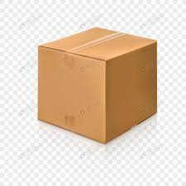
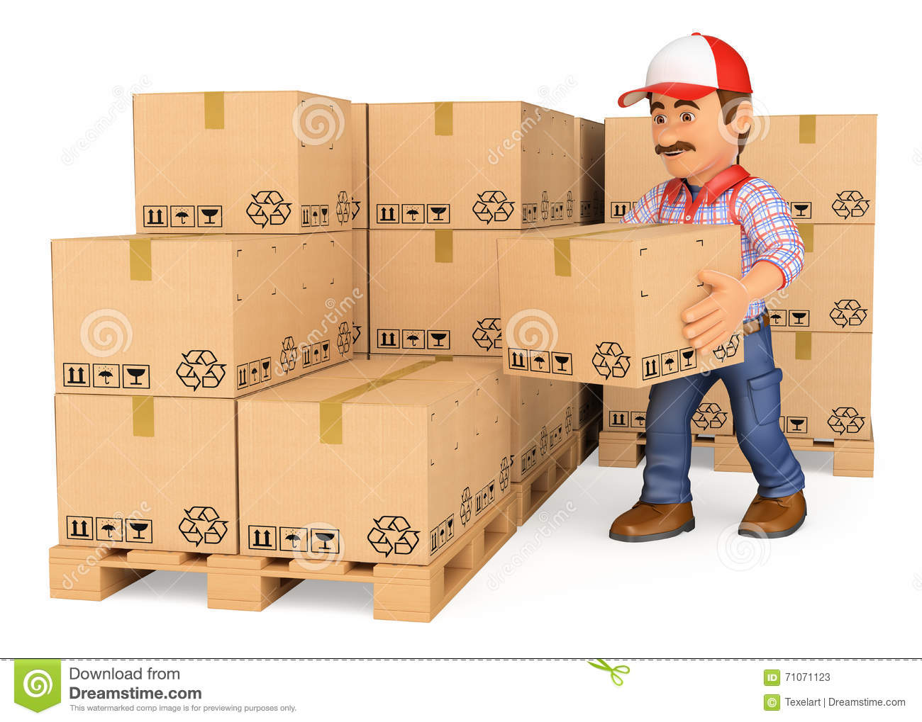
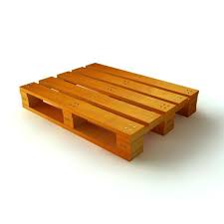

Scenerio 2: Register package
register package
with RFID
Register boxes
into package
Stock-keeper receives
goods receipt
Package is
Registered with RFID
Stock-keeper moves boxes into package
Boxes are registered with RFID

Slide 19
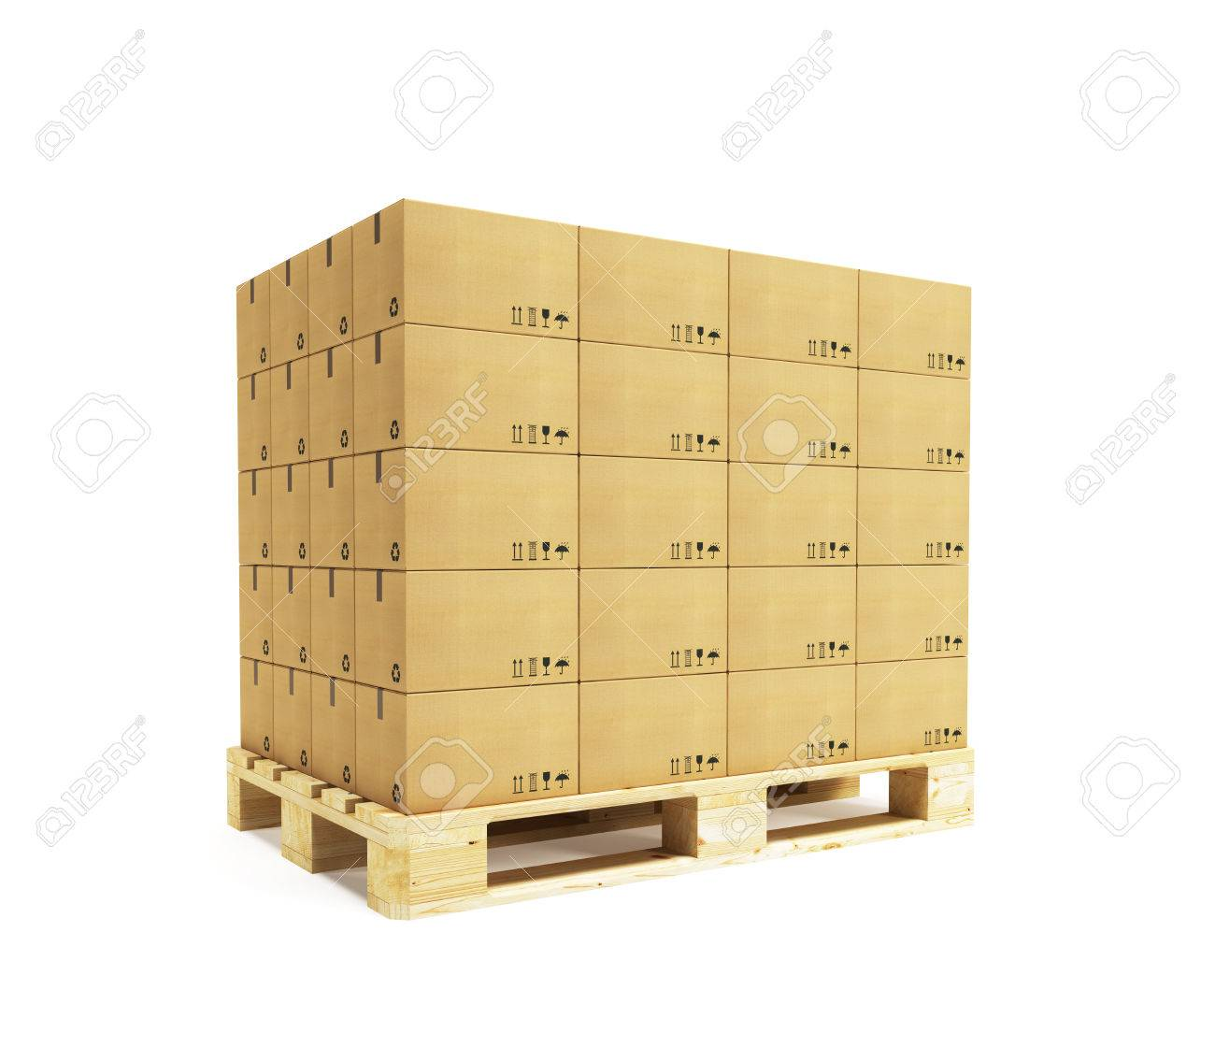
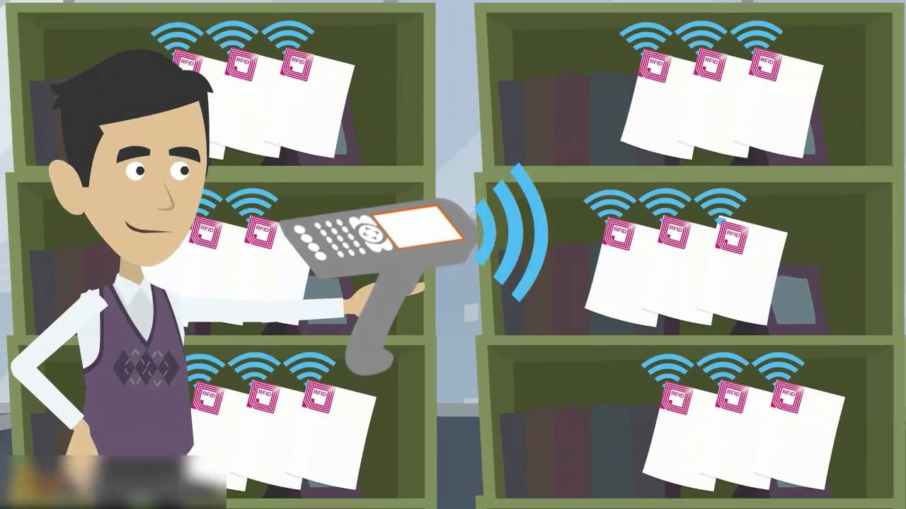
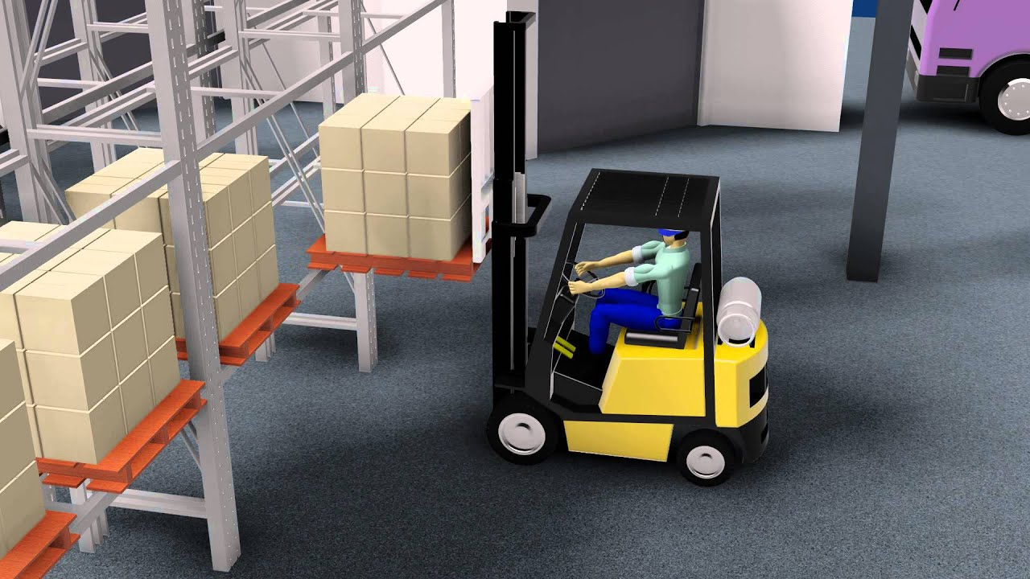
Scenario 3: stock-in products
select packages that
are registered with
RFID
select cell
that is registered with
RFID
Stock-keeper
Package has RFID tag
Move package into cell
Cells have RFID tags

Slide 20
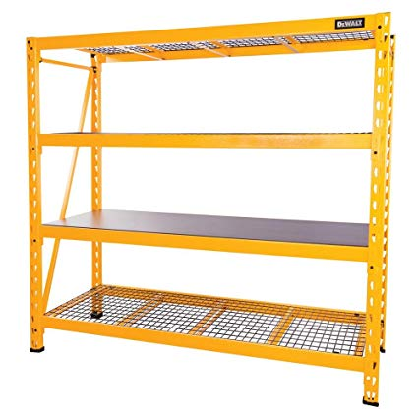
Scenario 4: transfer product
confirm
Transfer boxes
from shelf to other
shelf
Scan new package’s RFID
Scan boxes’ RFID
of old package
Boxes are transferred
to new cell
Transfer
package from
shelf to other
shelf
confirm
Stock-keeper
Scan new cell’s RFID
Scan package’s RFID
Package is transferred
to new cell

Slide 21
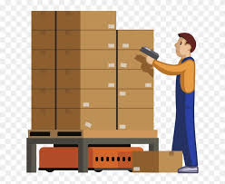
Scenario 5: stocktake inventory
Choose product
to stocktake
Report in-stock
quantity
Stock-keeper

Slide 22
Scenario 6: create goods issue
Create goods
issue
sent to
prepare to
stock out
Create goods
issue
sent to
Create goods
issue
sent to
Stock-keeper
Warehouse Accountant

Slide 23
Scenario 7: stock-out products
confirm
Choose boxes of
products in issue
confirm
Stock-keeper receives
goods issue
confirm
Stockout products

Slide 24
4. Conclusion & future plan

Slide 25
CONCLUSION & future plan
Future plan:
The existing systems can only scan one RFID tag at one time. We design our system to scan multiple RFID tags with a wide range.
We build this system for medium motorbike companies or stores so it doesn’t support automated system and stock-keepers have to scan the tags manually. We will integrate automated system for managing warehouse.

Slide 26
5. Q&A

Slide 28
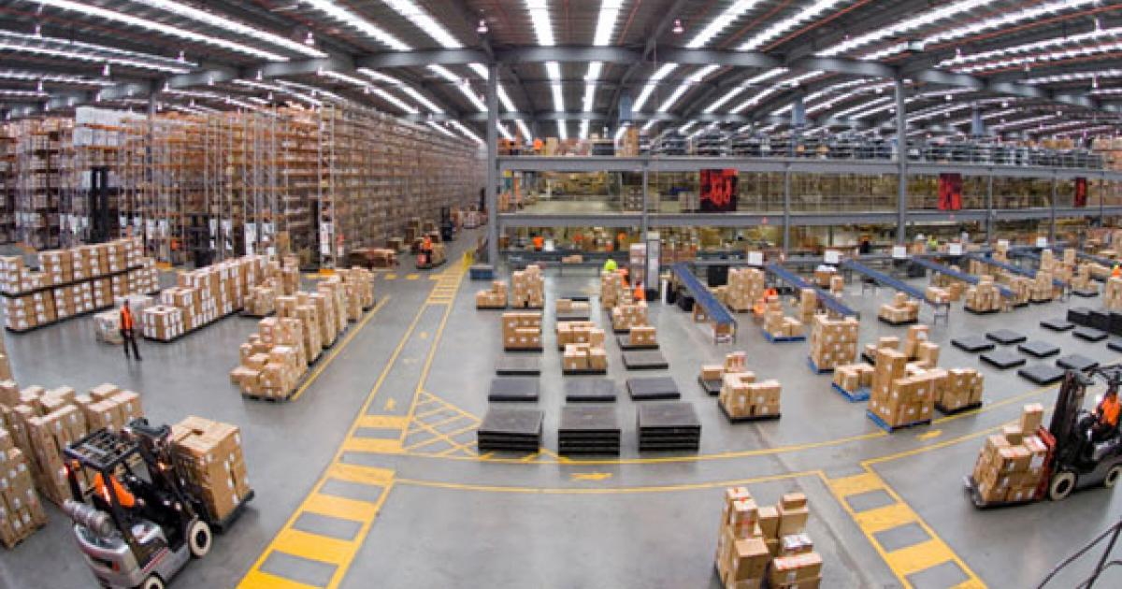
Suggest Boxes Algorithm

Slide 29
Suggest Boxes Algorithm
Suggest stockkeeper how to take boxes which have long stock-in date and short distance.
This solution uses Dijkstra algorithm to caculatate short distance from source shelf to destination shelf and base to criteria for choose right boxes.

Slide 30
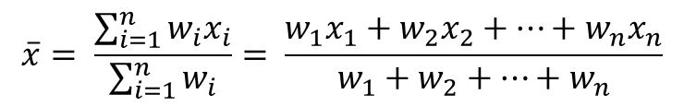

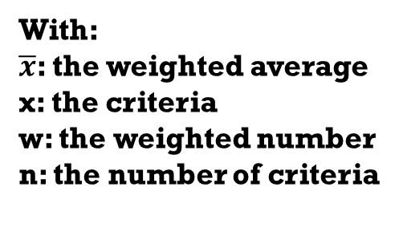
Formula
$$\overline{x}= \frac{\sum_{i=1}^{n}{w_{i}x_{i}}}{\sum_{i=1}^{n}{w_{i}}}= \frac{w_{1}x_{1}+w_{2}x_{2}+…+w_{n}x_{n}}{w_{1}+w_{2}+…+w_{n}}$$
With:
$\overline{x}$: the weighted average
x: the criteria
w: the weighted number
n: the number of criteria

Slide 31
Example
Criteria Shelf | Days (70%) | Distance (30%)
A | 20 | 10
B | 25 | 8
C | 20 | 8

Slide 32
$$\overline{x_{A}}=20×0.7+10∗0.3∗\left(−1\right)=11$$
$$\overline{x_{B}}=25×0.7+8∗0.3∗\left(−1\right)=15.1$$
$$\overline{x_{C}}=20×0.7+8∗0.3∗\left(−1\right)=11.6$$

Slide 33
Shelf | Weighted Average Number
B | 15.1
C | 11.6
A | 11

Slide 34
Complexity
Because we have to apply the formula for all shelves in warehouse so that the complexity of the algorithms is O(n)

Slide 35
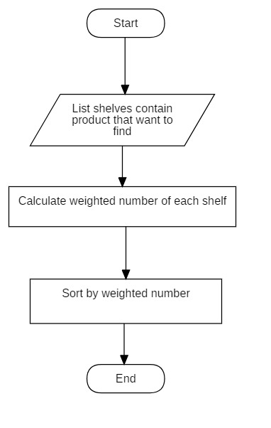
Flowchart

Slide 36
Convert Shelve’s coordinate to matrix algorithm

Slide 37
Formula
Assume that we have 2 shelves, distance between 2 column of shelves is x and distance between 2 row of shelves is y.
Compare the coordinates of two shelf
If X_{A} = X_{B} and |Y_{A} – Y_{B}| = 1: two shelves are adjacent with distance between 2 shelves is x
If X_{A} = X_{B} and |Y_{A} – Y_{B}| > 1: two shelves are not adjacent
If X_{A} = X_{B} and |Y_{A} – Y_{B}| = 0: two shelves are one
If Y_{A} = Y_{B} and |X_{A} – X_{B}| = 1: two shelves are adjacent with distance between 2 shelves is y
If Y_{A} = Y_{B} and |X_{A} – X_{B}| > 1: two shelves are not adjacent
If Y_{A} = Y_{B} and |X_{A} – X_{B}| = 0: two shelves are one

Slide 38
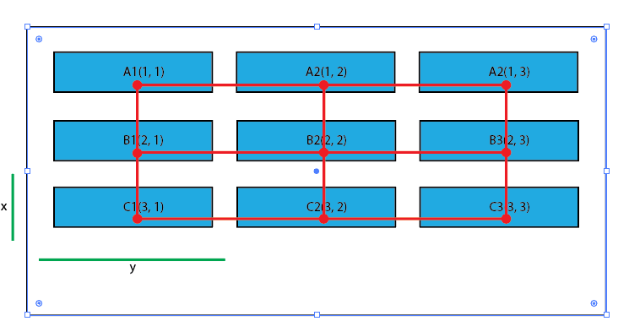

Slide 39
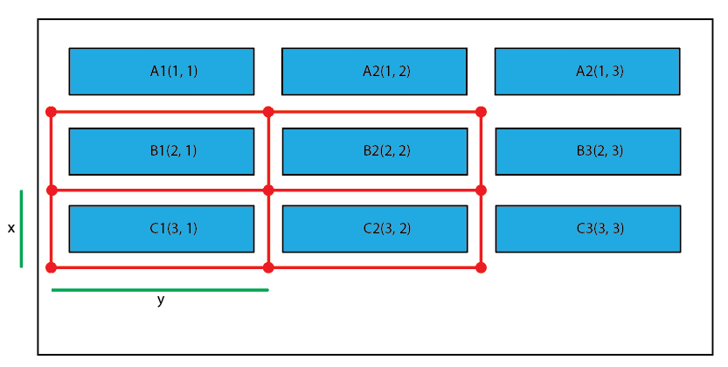
Example
 | A1 | A2 | A3 | B1 | B2 | B3 | C1 | C2 | C3
A1 | 0 | 2 | 0 | 1 | 0 | 0 | 0 | 0 | 0
A2 | 2 | 0 | 2 | 0 | 1 | 0 | 0 | 0 | 0
A3 | 0 | 2 | 0 | 0 | 0 | 1 | 0 | 0 | 0
B1 | 1 | 0 | 0 | 0 | 2 | 0 | 1 | 0 | 0
B2 | 0 | 1 | 0 | 2 | 0 | 2 | 0 | 1 | 0
B3 | 0 | 0 | 1 | 0 | 2 | 0 | 0 | 0 | 1
C1 | 0 | 0 | 0 | 1 | 0 | 0 | 0 | 2 | 0
C2 | 0 | 0 | 0 | 0 | 1 | 0 | 2 | 0 | 2
C3 | 0 | 0 | 0 | 0 | 0 | 1 | 0 | 2 | 0

Slide 40
Complexity
In total, the complexity of this algorithm is O(n²).

Slide 41
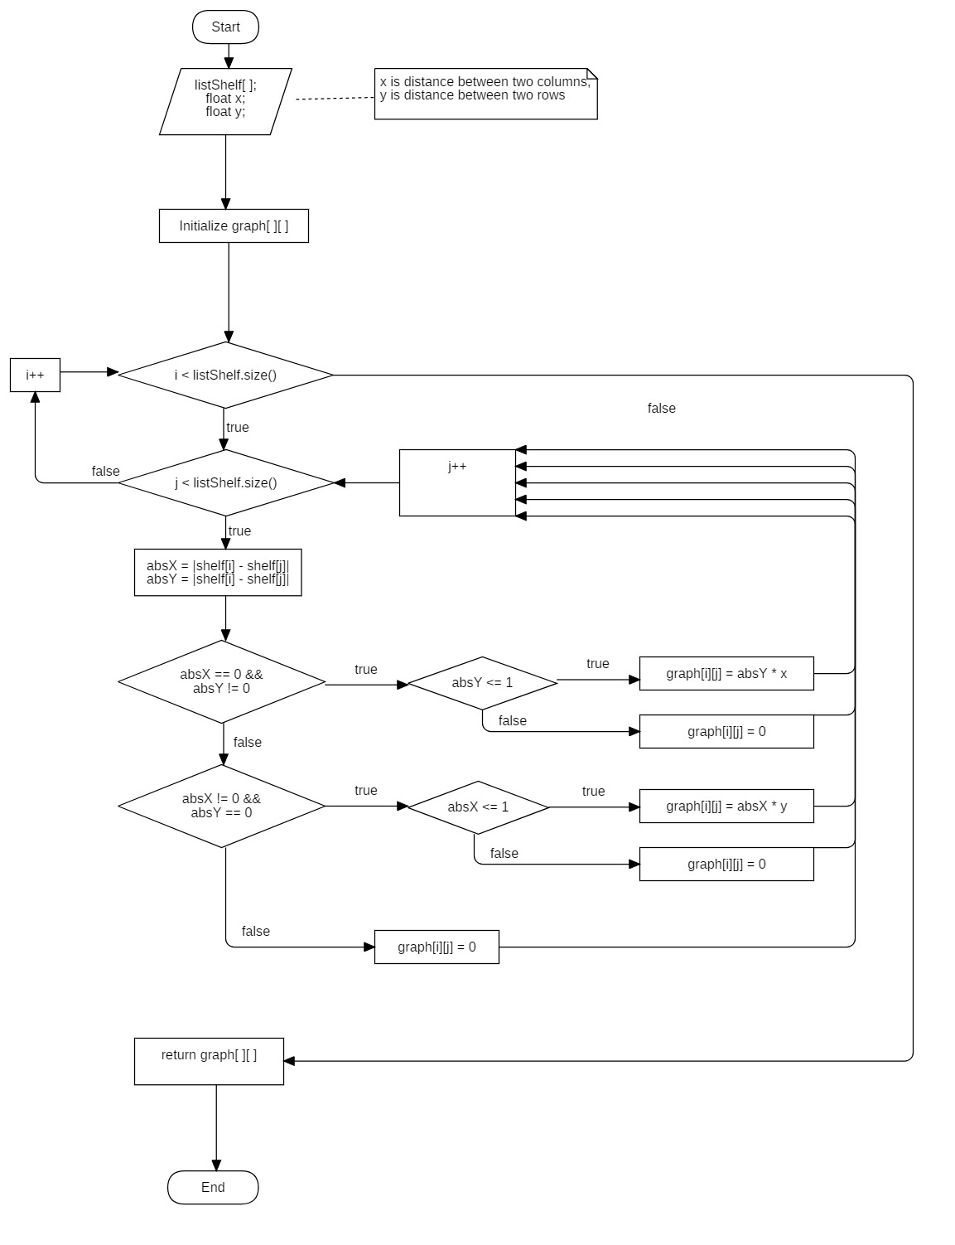
Flowchart

Slide 42
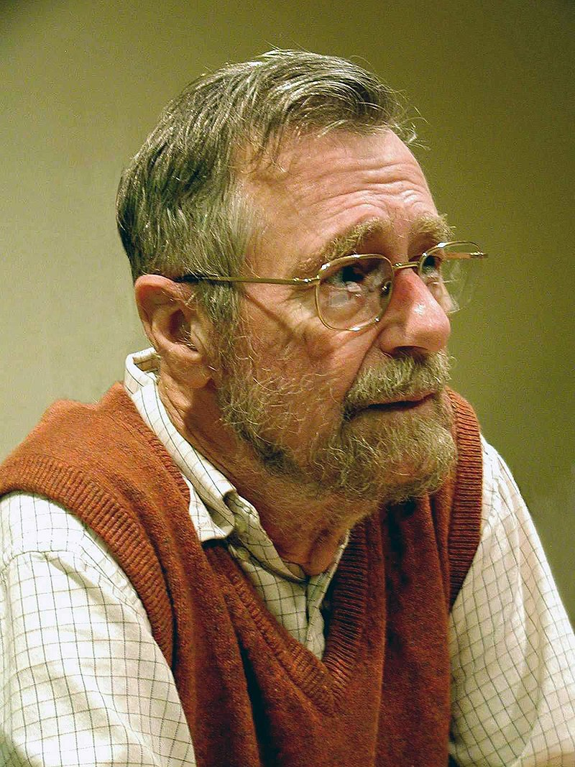
Dijkstra algorithm

Slide 43
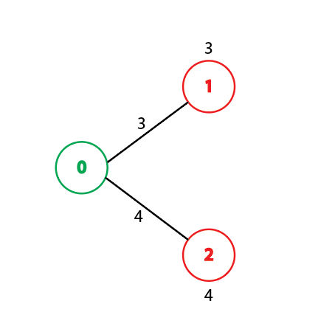
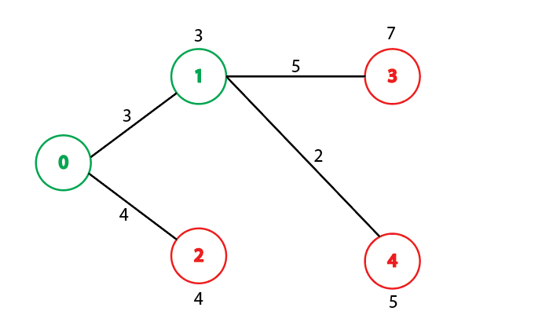
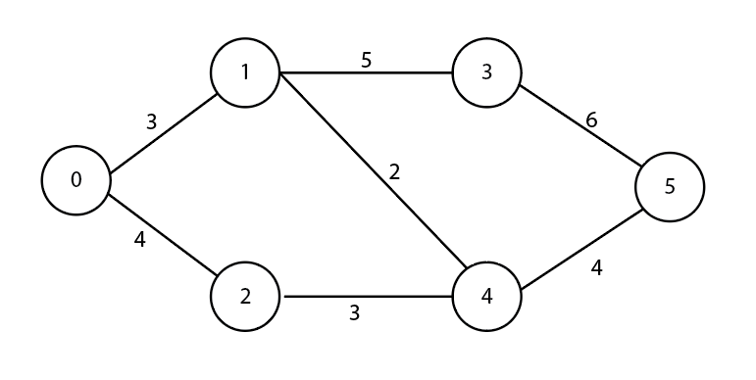
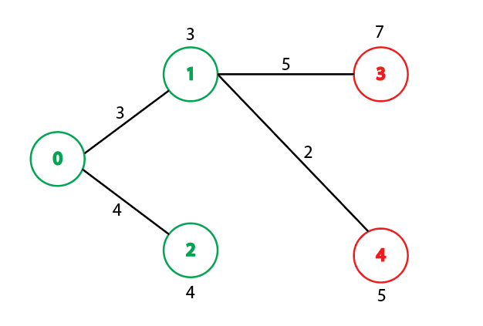
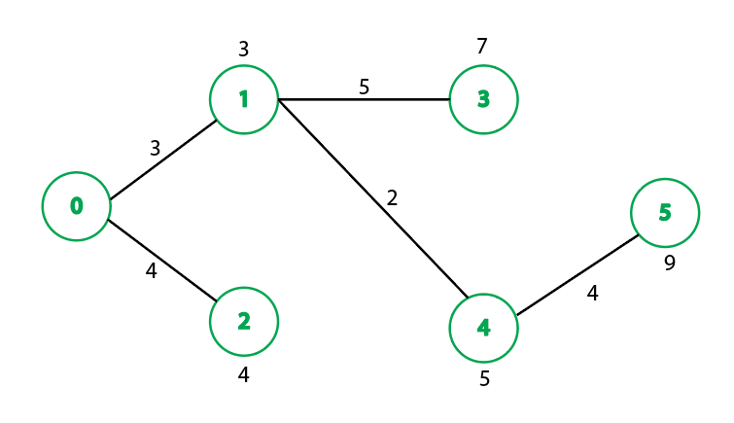
Example

Slide 44
Complexity
In total, the complexity of this algorithm is O(n²).

Slide 45
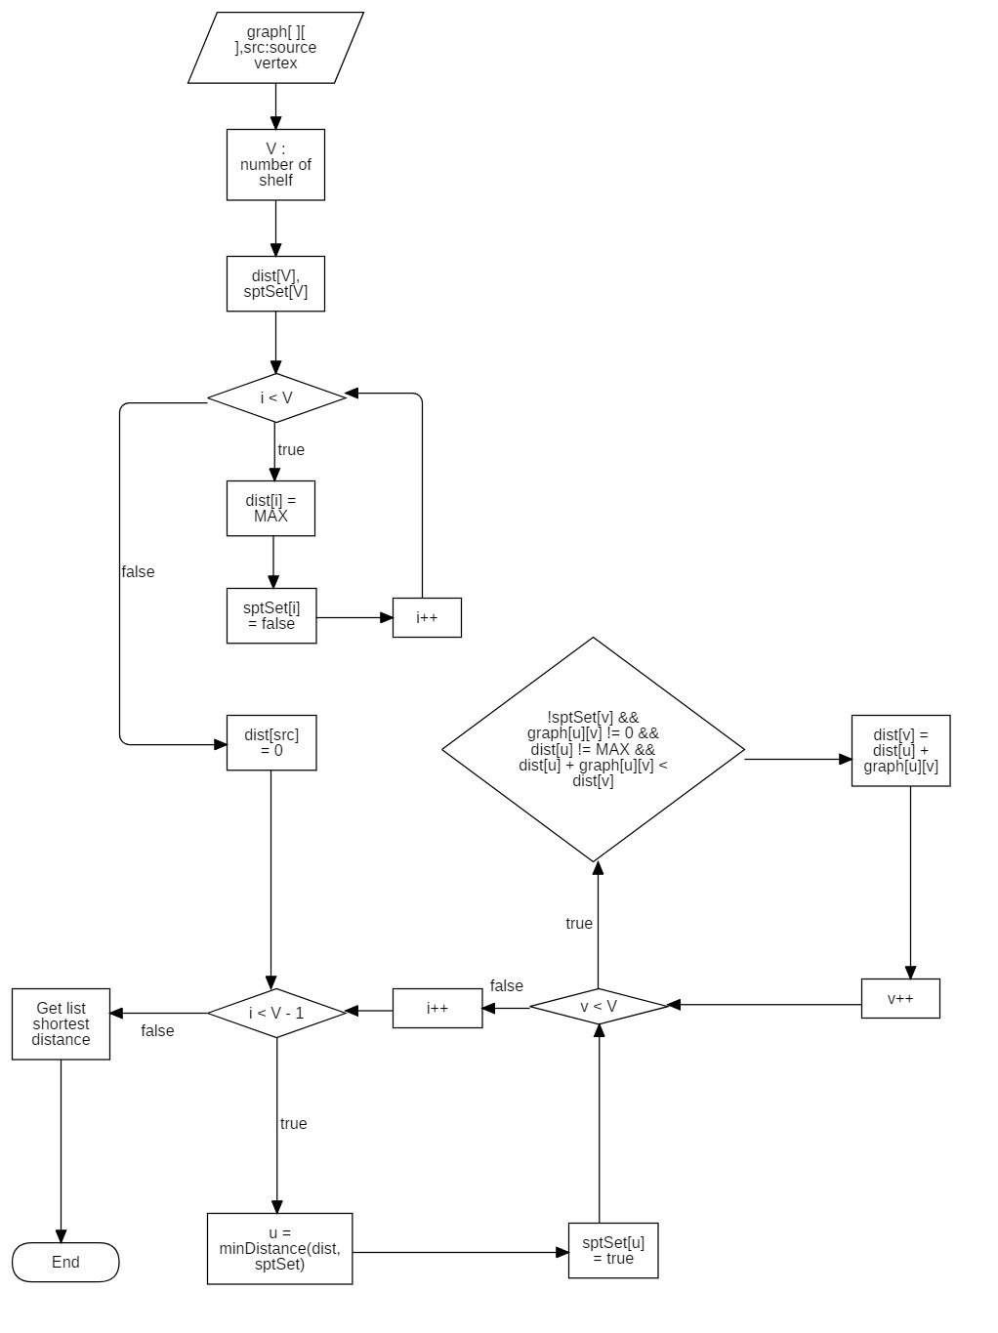
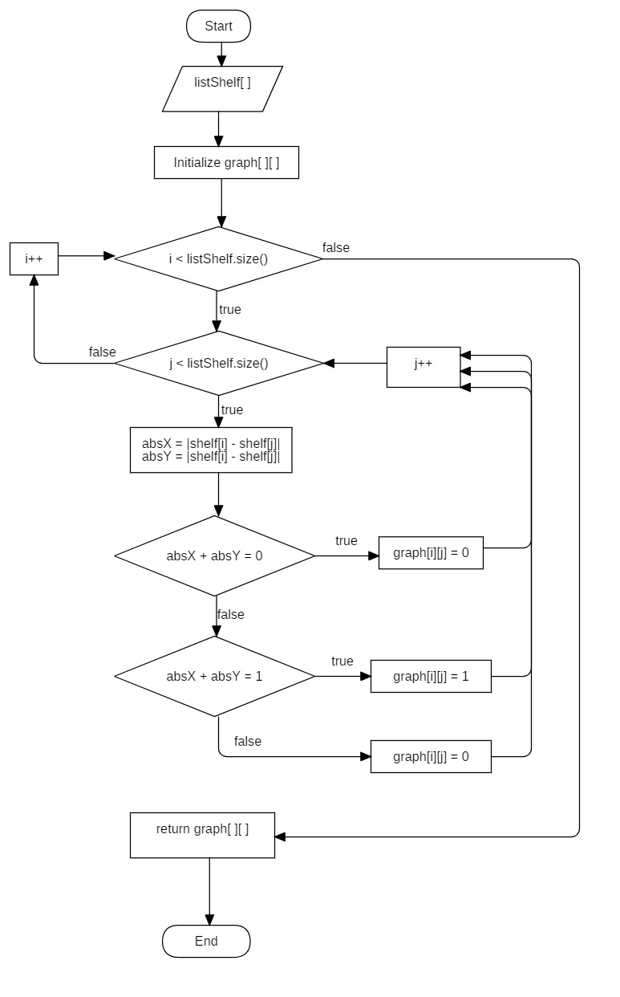
Flowchart

Slide 46
THANK YOU FOR LISTENING

