Slide 1

Long Short-Term Memory (LSTM)
Group: 3

Slide 2
Group member
Student ID | Full name
521H0493 | Trần Nguyễn Duy Bảo
521H0508 | Bùi Anh Phú
521H0511 | Nguyễn Hoàng Phúc
521H0413 | Lê Trần Nhật Quang
521H0517 | Hoàng Đình Quý Vũ

Slide 3
Introduction
LSTM is a type of RNN designed by Hochreiter & Schmidhuber.
It addresses the problem of long-term dependencies in traditional RNNs.
So, what is RNN?

Slide 4

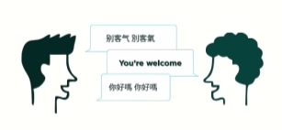
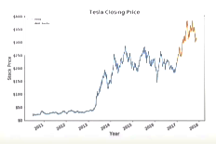
RNN
Recurrent Neural Network is a type of Neural Network where the output from the previous step is fed as input to the current step.
Type of data: Sequence data
RNNs are good at processing sequence data for predictions.
Speech recognition
Language translation
Stock prediction
Notes:
In traditional neural networks, all the inputs and outputs are independent of each other
When it is required to predict the next word of a sentence, the previous words are required and hence there is a need to remember the previous words.

Slide 5
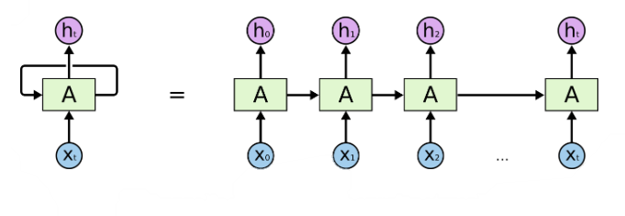
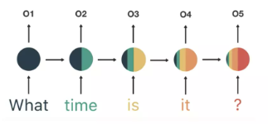
RNN
an unrolled Recurrent Neural Network

Slide 6
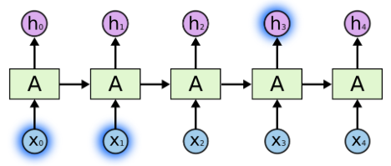
Sometimes, we only need to look at recent information to perform the present task.
RNN
The tree color is “green”
RNN performs well since the gap between the Prediction “green” and the necessary context information “tree” is small

Slide 7
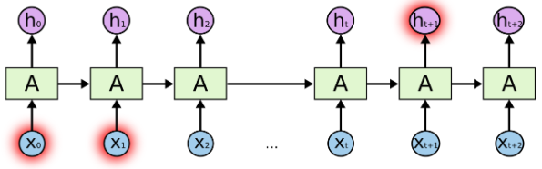
But there are also cases where we need more context
RNN
I live in Quebec in Northen Canada … where I live, the weather is generally “cold” most of the year
RNN performs poorly when the gap between the Prediction “cold” and the necessary context information “Canada” is large

Slide 8
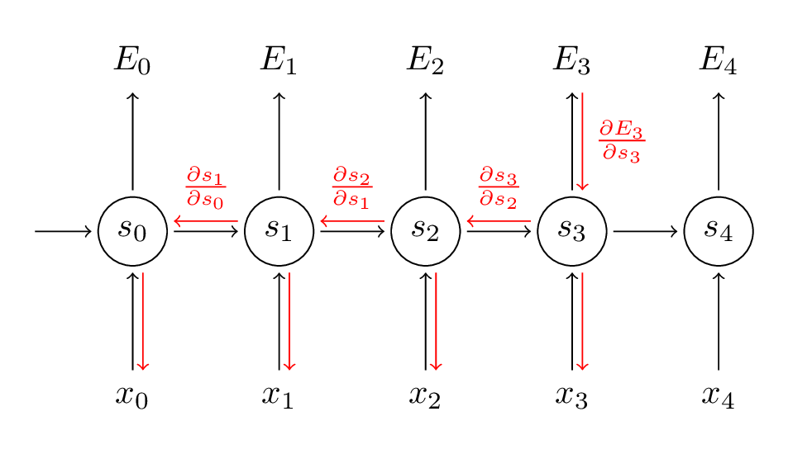
Backpropagation Through Time (BPTT): for training
RNN
Addresses the vanishing gradient problem
allowing gradients to flow back through time without vanishing or exploding.
This enables the network to learn long-term dependencies by effectively propagating and adjusting gradients over multiple time steps.

Slide 9
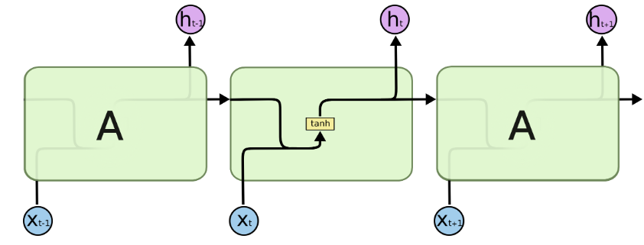
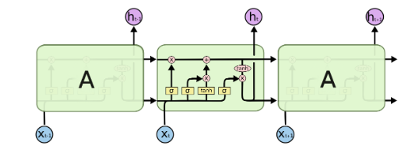
Recurrent Neural Network
Long Short Term Network

Slide 10
The Core Idea Behind LSTMs
Recurrent Neural Network
This line: memory or cell state enables LSTM to remember very old information
Long Short Term Network

Slide 11
The Core Idea Behind LSTMs
The cell state is kind of like a conveyor belt. It runs straight down the entire chain, with only some minor linear interactions.
It’s very easy for information to just flow along it unchanged.
LSTM have the ability to remove or add information to the cell state, carefully regulated by structures called gates.
This line: memory or cell state enables LSTM to remember very old information

Slide 12
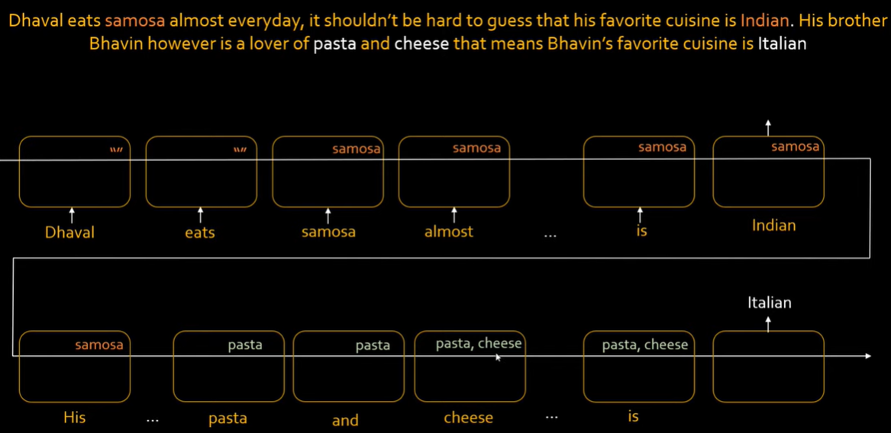
LSTM
Link: https://www.youtube.com/watch?v=LfnrRPFhkuY - Codebasic

Slide 13
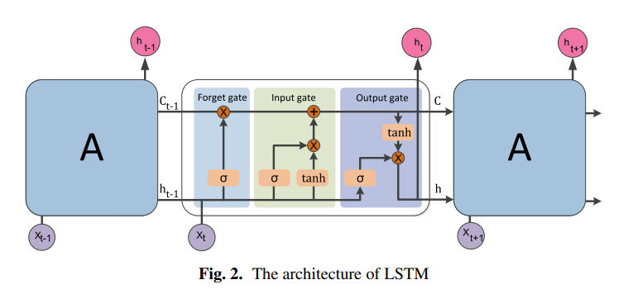
LSTM

Slide 14
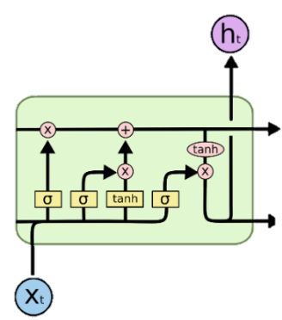
LSTM
LSTM contains gates that can allow or block information from passing by.
Gates consist of a sigmoid neural net layer along with a pointwise multiplication operation.
Sigmoid output ranges from 0 to 1:
fd
BG
0: Don’t allow any data to flow
1: Allow everything to flow

Slide 15
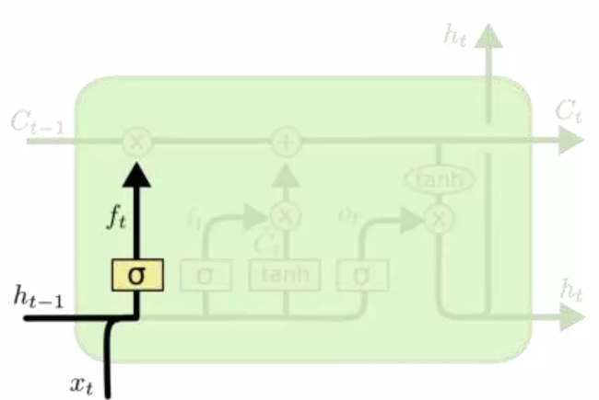

LSTM
Step1
Forget gate layer:
Decide what information throw away the cell state.
It takes the current input and the output from the previous time step to determine which information is no longer relevant and should be forgotten.
Output a number ranges from 0 to 1.

Slide 16
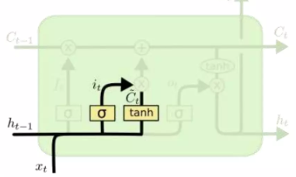

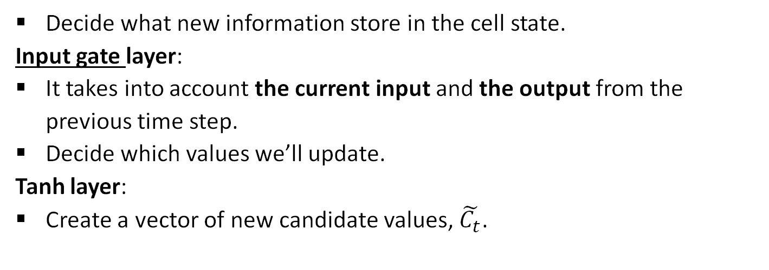
LSTM
Step2
Decide what new information store in the cell state.
Input gate layer:
It takes into account the current input and the output from the previous time step.
Decide which values we’ll update.
Tanh layer:
Create a vector of new candidate values, $\tilde{C_{t}}$.

Slide 17


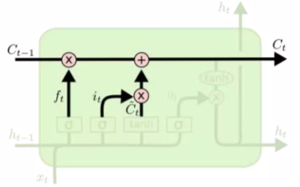

LSTM
Step3
Update cell state: Combine step 1&2
Forgetting the things we decide to forget earlier:
Adding information we decide to add:

Slide 18
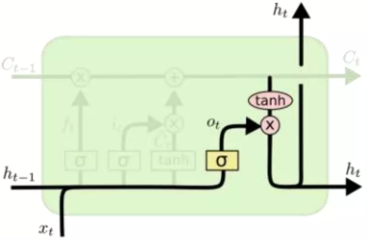
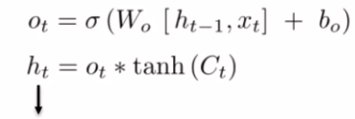
LSTM
Step4
Create output: Decide what we’re going to output.
Output gate layer:
Decide what parts of the cell state we’re going to output.
Tanh layer:
Push the values ranges from -1 to 1.
Hidden state/ Short memory

Slide 19
Conclusion
The cell state and hidden state work in tandem to process and retain information throughout the LSTM model.
The cell state acts as a long-term memory, allowing the LSTM to capture and remember relevant information over longer sequences.
The hidden state represents the short-term memory or the output of the LSTM at each time step, capturing the relevant information from the cell state.
The hidden state is then passed on as input to the next time step, enabling the LSTM to learn and predict based on the accumulated information in the cell state.

Slide 20
Conclusion
LSTM architecture consists of 3 gates regulating the flow of information:
Input gate: determines how much new information should be stored in the memory cell at the current time step.
Forget gate: controls the amount of old information to discard from the memory cell.
Output gate: regulates the amount of information to output from the memory cell at the current time step.
Tanh: acts as a squashing function.
Sigmoid: acts as a decision function (gate).

Slide 21
Advantages
Capturing long-term dependencies: LSTM models excel at capturing and remembering long-term dependencies in sequential data.
Handling vanishing/exploding gradients: LSTMs can mitigate the issue of gradients either diminishing or growing exponentially during training, enabling them to learn effectively from sequences of varying lengths.

Slide 22
Disadvantages
Computational complexity: LSTM models are computationally expensive compared to simpler RNNs. The additional components, such as gating mechanisms, increase the number of parameters and operations, resulting in longer training and inference times.
Need for large amounts of data: LSTM require a significant amount of labeled training data to generalize well. Insufficient data can lead to overfitting, where the model fails to generalize to unseen examples.

Slide 23
Thank you
for listening

