Slide 1
IMCRO algorithm in SCS Problem
GV: Nguyễn Chí Thiện
Trần Nhựt Anh – 521H0491
Nguyễn Hoàng Phúc – 521H0509
Hoàng Đình Quý Vũ - 521H0517

Slide 2
Agenda
I. Introduction SCS
II. IMCRO
III. ABC
IV. ACO
V. Compare

Slide 3
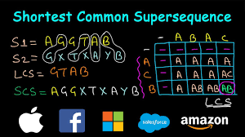
I. Introduction SCS
Shortest Common Supersequence (SCS)
The SCS problem was first defined by David Maier in 1976
Find the common supersequence with the minimum length.
Applications: DNA sequencing, data compression, artificial intelligence planning
Various algorithms to solve the SCS problem, such as ACB, ACO…

Slide 4
II.MCRO Algorithm
Parameter | Description | Type
popsize | Set of all feasible solutions | int
pe | Potential energy | float/double
ke | Kinetic energy | float/double
numHit | Number of collisions by a molecule | int
kElossrate | Percentage of the upper limit of KE reduction | Double
molecoll | Threshold to determine the type of chemical reaction: uni-molecule or inter-molecule | Double
initialke | Initial value of the kinetic energy assigned to each molecule in the initialization stage | float/double
apha/beta | Threshold values for the intensification and diversification | int
optimal | Optimal solution | double
Initialization
Iteration
Finalization

Slide 5
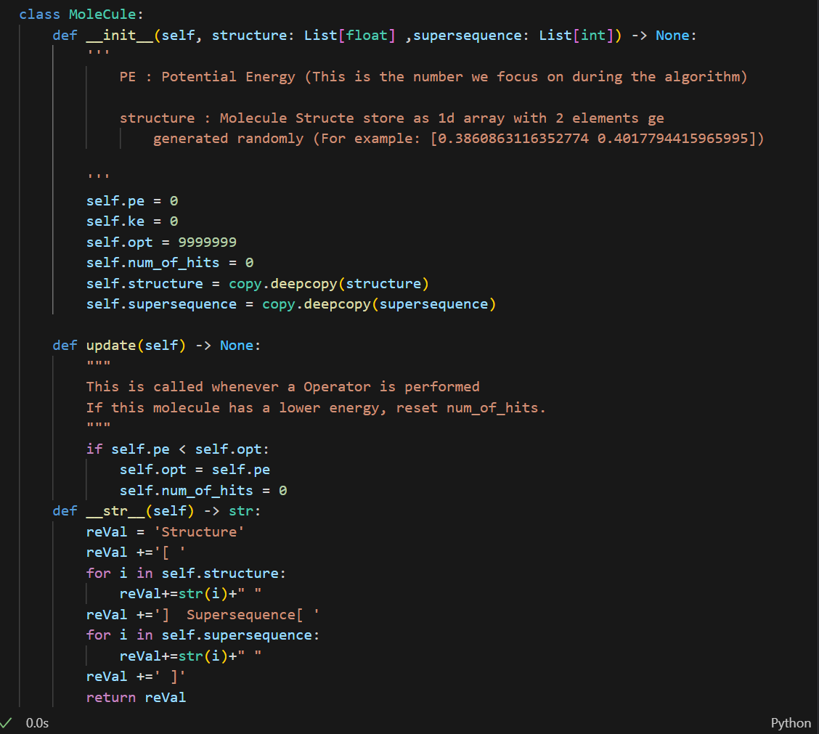
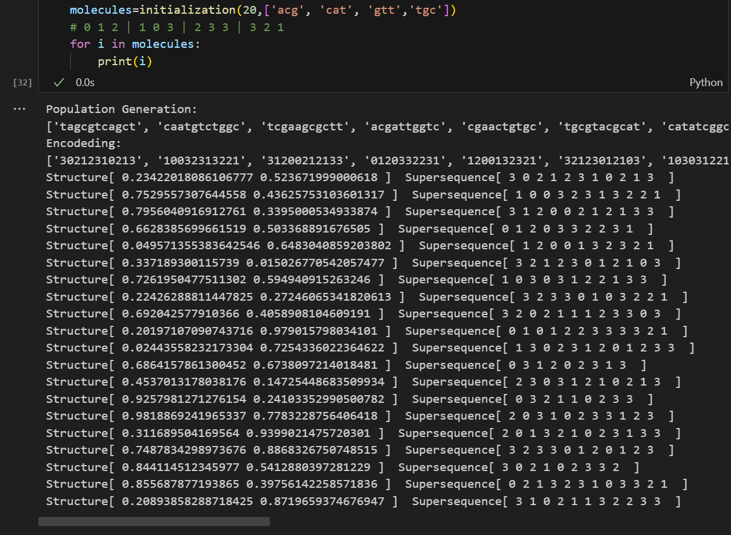
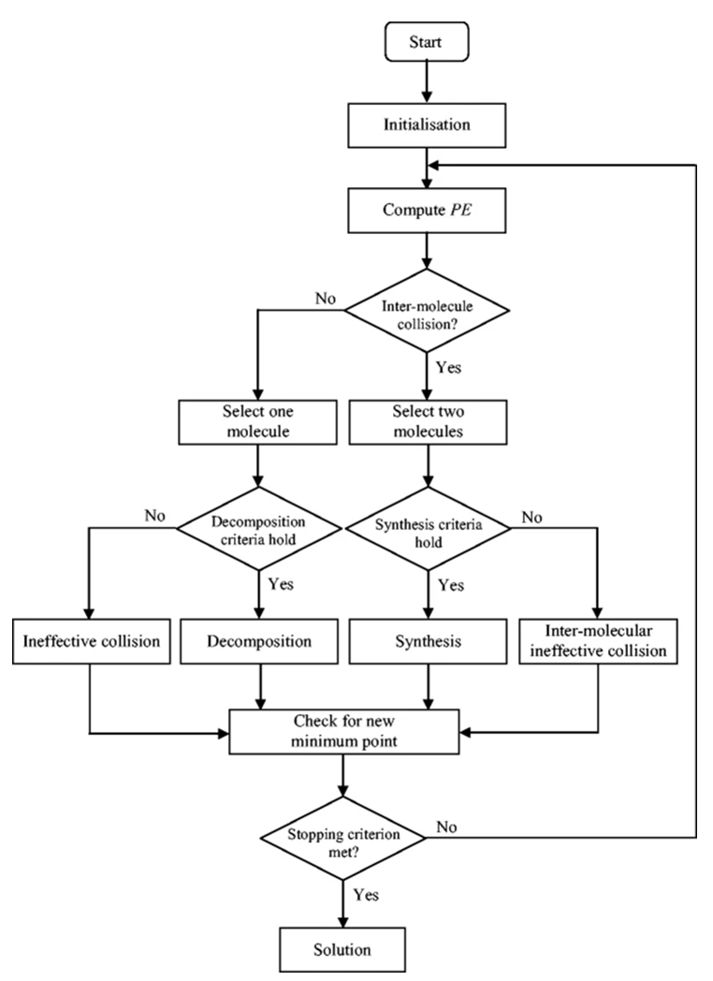
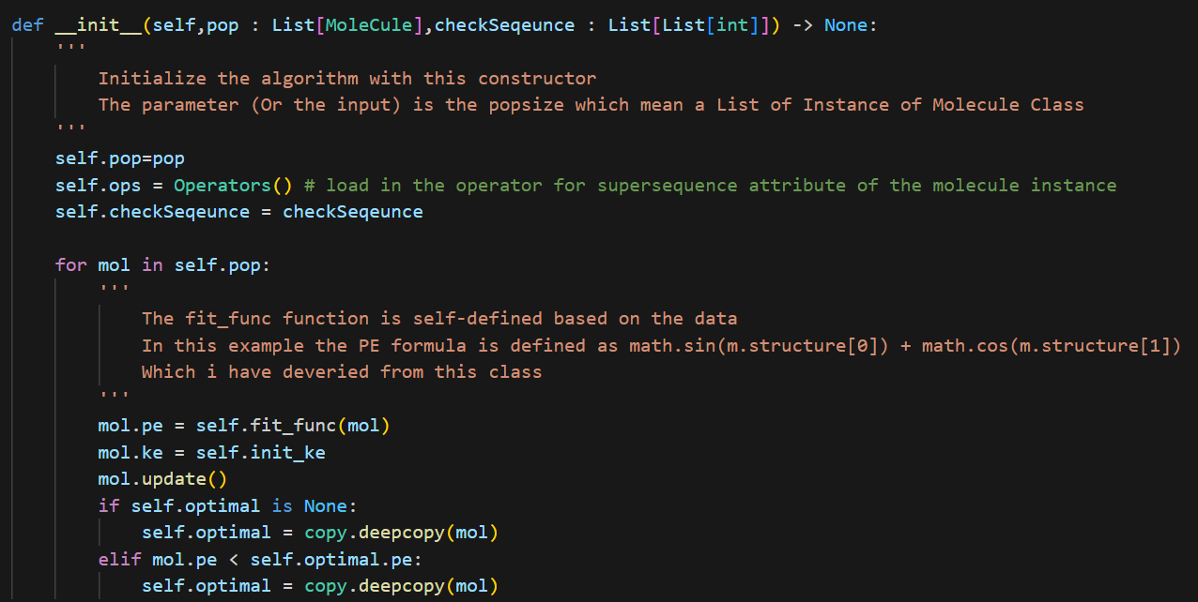
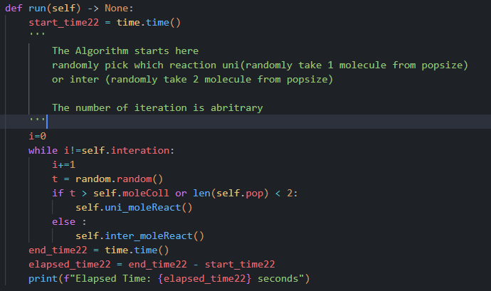
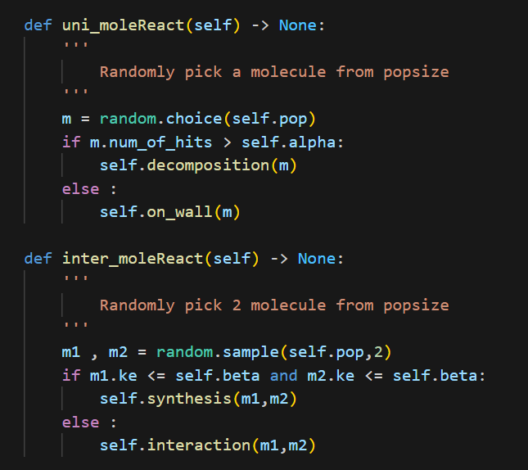
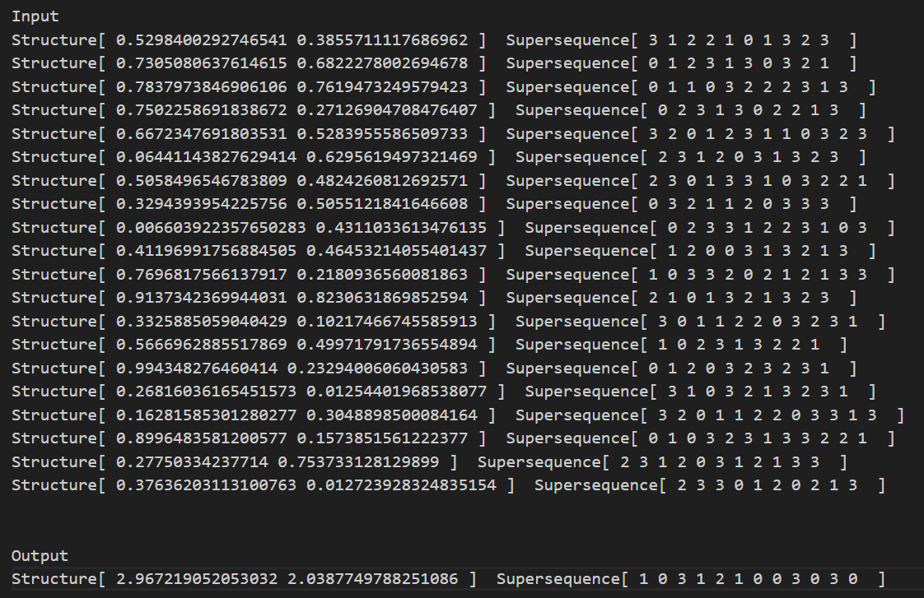
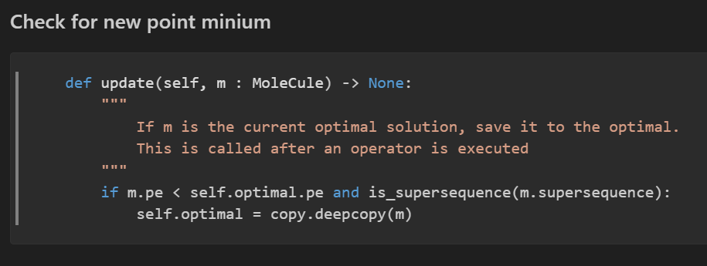
IMCRO BIG PICTURE

Slide 6
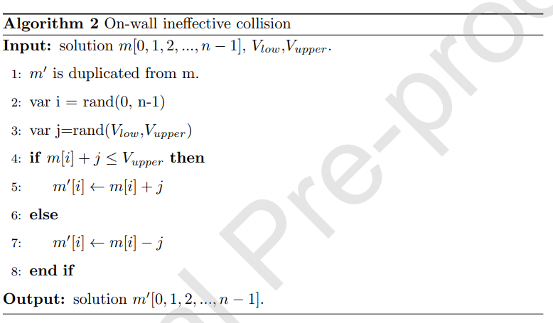
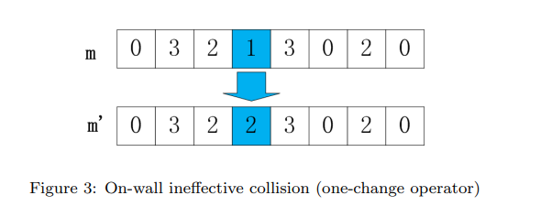
2.1 On-wall ineffective collision
Introduction
The one-difference operator alters a supersequence character, aiding in nearby solution exploration without shortening the length. It broadens possibilities for the Shortest Common Supersequence (SCS)

Slide 7
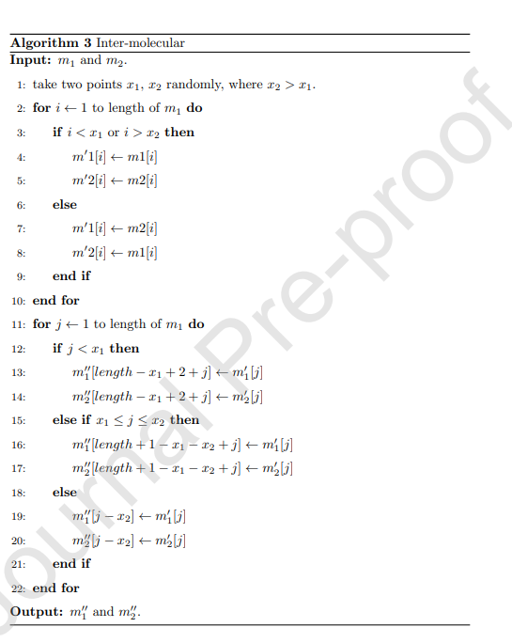
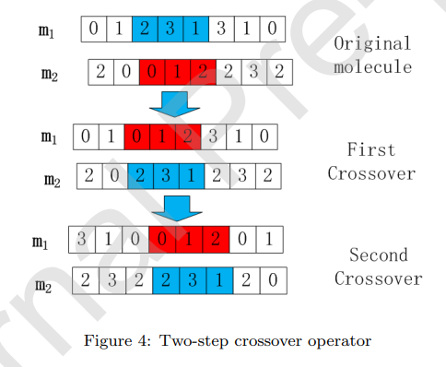
2.2 Inter-molecular ineffective collision
Introduction
Take two molecules m1 and m2 randomly, after 2 crossover operator to produce two new solutions m’1 and m’2 .
Crossover 1: between 2 molecules different
Crossover 2: Inside each molecule.

Slide 8
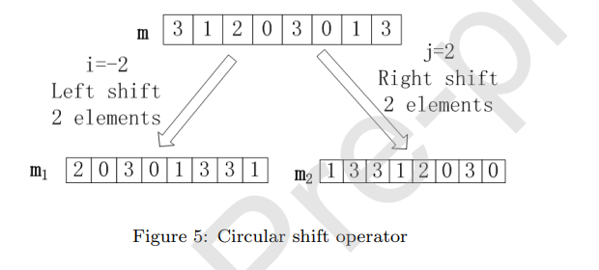
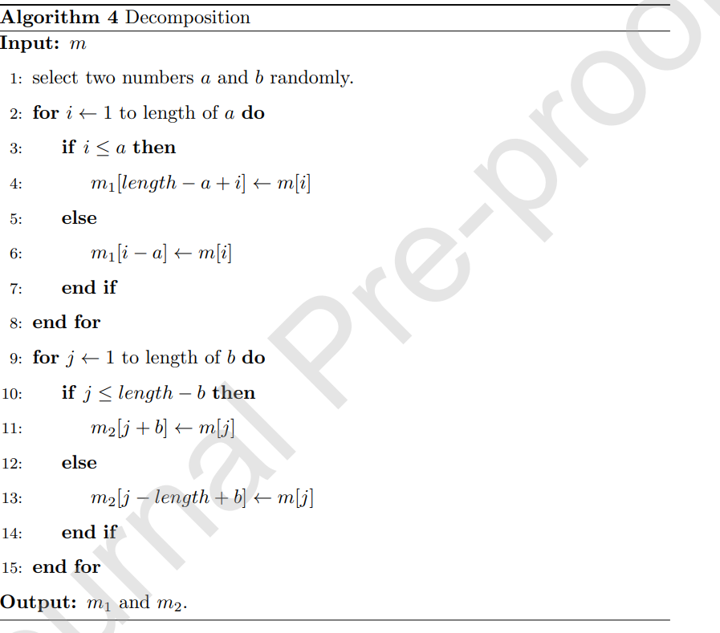
2.3 Decomposition
Introduction
The decomposition reaction enables exploration of a different search space, causing significant changes in molecular structures.
In a circular shift operator, generated within the range [-n, n].
Two randomly chosen integers,
-i : shift left i times
j : shift right j times

Slide 9
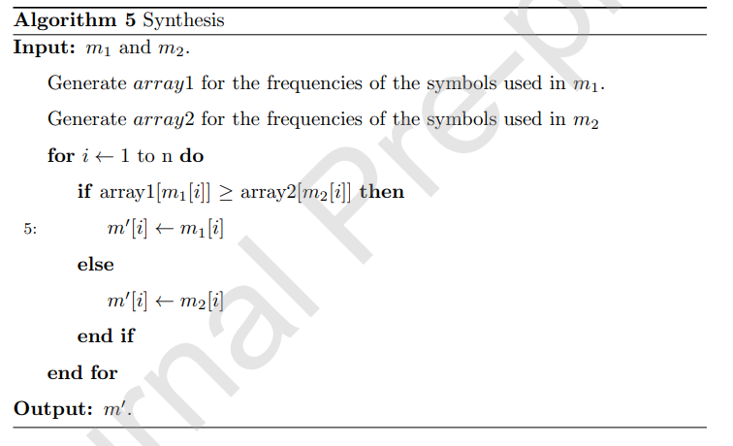
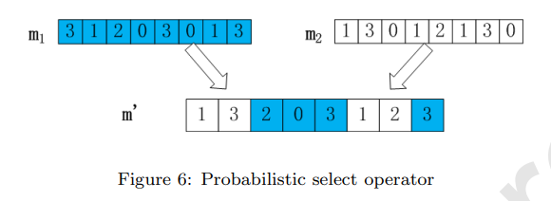

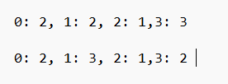
2.4 Synthesis
Introduction
Two molecules (m1 and m2) to combine new molecule (m’),the opposite of the decomposition reaction.
A variant of the probabilistic select operator accelerates convergence by exploring diverse molecular structures (frequencies)

Slide 10
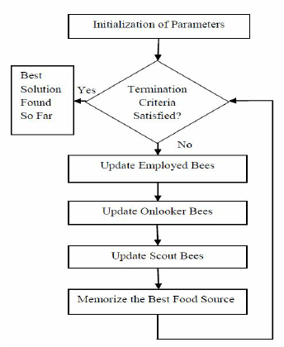
III. ABC ALGORITHM
Introduction
The introduction emphasizes the significance of the Shortest Common Supersequence (SCS) problem, highlighting its complexity as an NP-Hard problem and its relevance in various fields such as bioinformatics, computer science, and data compression.
The background section introduces the concept and methodology of the Artificial Bee Colony (ABC) algorithm. This algorithm is inspired by the natural foraging behavior of honeybees. It's an optimization algorithm that simulates the food foraging strategy of bees to find optimal solutions.

Slide 11
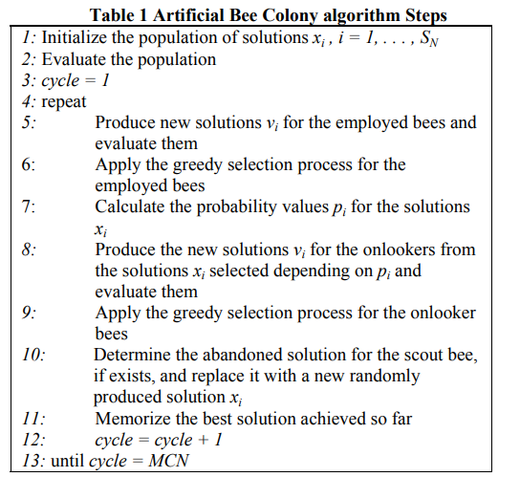
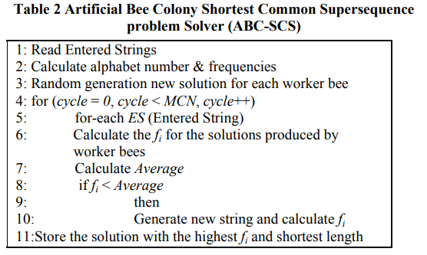
III. ABC ALGORITHM
Paper: Solving Shortest Common Supersequence Problem Using Artificial Bee Colony Algorithm
Author: Mustafa M. Noaman and Ameera S. Jaradat

Slide 12
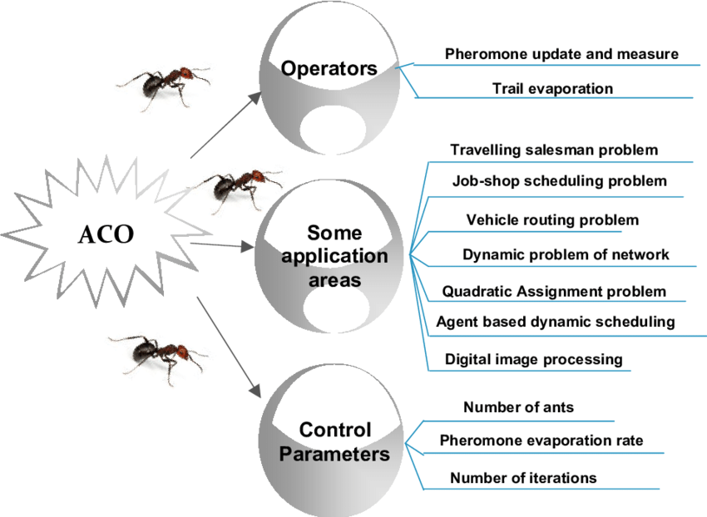
IV. ACO Introduction
ACO algorithm mimics ant foraging to find an optimal path. Ants explore paths, leaving pheromones. Paths with more pheromones are favored. For the SCS problem, ants represent paths in a sequence, and pheromones indicate promising subsequences. The algorithm leverages cumulative pheromone information to guide optimal path selection.

Slide 13
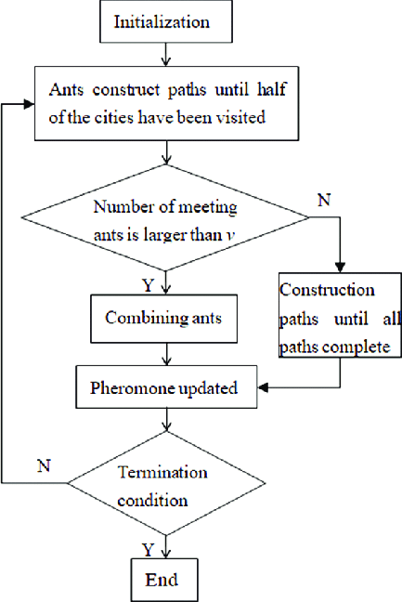
IV. ACO Flow chart
Initialize ants:
Create ants with random paths.
Calculate ant path distances.
Main loop:
Select best ant.
Perform local pheromone updates:
For each ant except the best 10%:
Swap random cities.
Update ant path if improved.
Perform global pheromone updates:
Swap three random cities for the best ant.
Update ant path if improved.
Update pheromone levels.
Sort ants by distance.
Output shortest path:
Return path of the ant with the shortest distance.

Slide 14
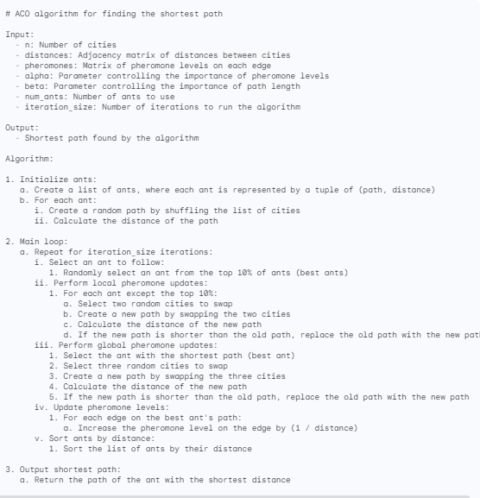
IV. ACO pseudocode

Slide 15
V. Compare Algorithm
Popsize | Iteration | IMCRO | ACB | ACO
20 | 10 | 0.044204 | 0.002598 | 0.016356
50 | 100 | 0.036787 | 0.05918 | 0.806577
100 | 200 | 0.038337 | 0.267454 | 2.082188
500 | 500 | 0.048489 | 3.166652 | 1.292229

Slide 16
Thank you
Contact
Trần Nhựt Anh
Nguyễn Hoàng Phúc
Hoàng Đình Quý Vũ

