Slide 1

CHAT APPLICATION USING SOCKET IO AND NODEJS
Advisor: Dr. Tran Giang Son
Mobile Application
Group Members:
Dao Hoang Anh
Pham Ha An
Nguyen Hong Dang

Slide 2
Outline
Introduction
Architecture and Activity
Networking
Demo (with emulator)

Slide 3
Introduction
Application and Source
Android Studio
Genymotion
NodeJs
Socket IO
Git-scm

Slide 4
Introduction
Socket.IO is a JavaScript library for real-time web applications.
Node.js is an open-source, cross-platform runtime environment for developing server-side Web applications.
Notes:
It enables realtime, bi-directional communication between web clients and servers. It has two parts: a client-side library that runs in the browser, and a server-side library for node.js. Both components have a nearly identical API. Like node.js, it is event-driven. USE because: Socket.IO provides the ability to implement real-time analytics, binary streaming, instant messaging, and document collaboration

Slide 5
Architecture and Activity
Our chat application will have a very simple architecture with a single just a single Activity that will take care of:
Registration
Send & receive box message

Slide 6
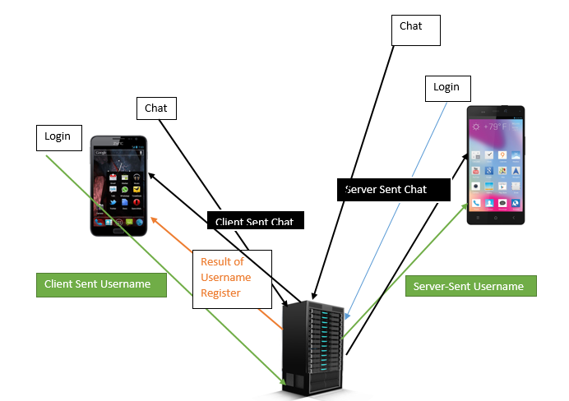
Networking

Slide 7
Demo

Slide 8
Thank you for listening

