Slide 1

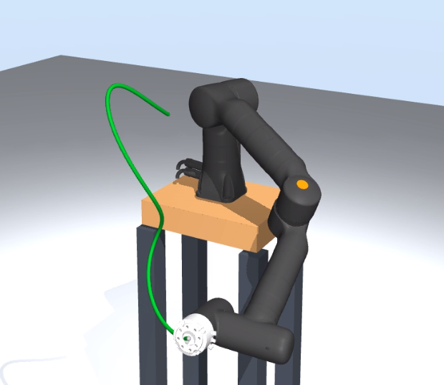
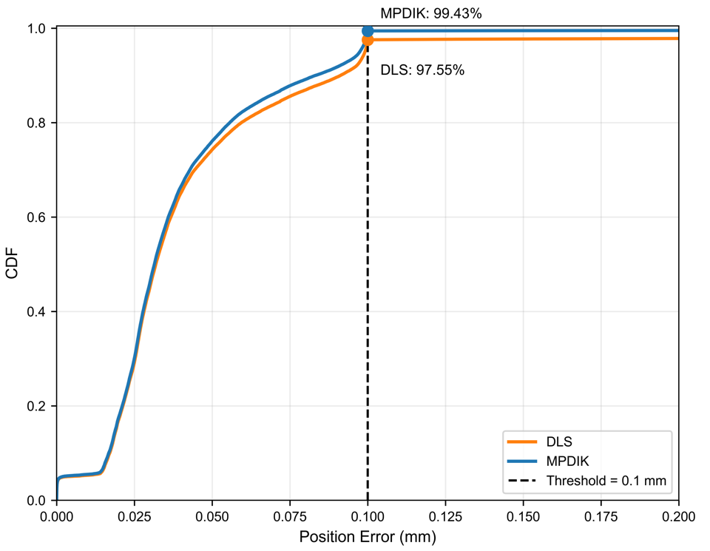
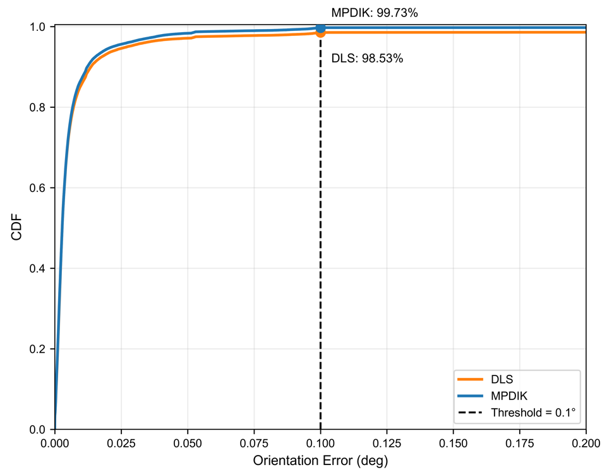

DEEP REINFORCEMENT LEARNING AND DAMPED LEAST SQUARES
INVERSE KINEMATICS METHOD FOR 7-DEGREE-OF-FREEDOM
TRAJECTORY TRACKING
Phuong Thanh Pham · Trong Hoang Anh Nguyen · Van Luan Tran
School of Engineering, Eastern International University · Ho Chi Minh City, Vietnam
EIUSC International Conference 2026
ABSTRACT
PROPOSED METHOD: MPDIK
We investigate sequential inverse kinematics for the 7-DOF Kassow KR810. Adaptive damped least squares (DLS) serves as the baseline; Multistep PPO–DLS Inverse Kinematics (MPDIK) introduces policy-guided joint seeds when DLS fails. On 630 MuJoCo trajectories, MPDIK raises complete-trajectory success from 78.3% to 91.9% and reduces position RMSE from 28.26 to 2.01 mm.
01 SOLVING ONE TRAJECTORY
200 ordered end-effector poses
Tₖ
T₂₀₀
INTRODUCTION
T₁
Seed waypoint k
Initial seed at k = 1
Previous result otherwise
Adaptive DLS
Solve for q ∈ ℝ⁷
Pose check
≤ 0.1 mm and ≤ 0.1°
The challenge
A redundant arm can reach the same pose with multiple joint configurations.
Sequential effects
Pass
Record q and advance to k + 1
Fail
Use PPO at the same k (02)
A poor solution at waypoint k becomes the initial seed for k + 1.
Repeat through waypoint 200. Trajectory success requires all 200 poses to pass.
KR810 in MuJoCo
(7 revolute joints)
Goal: accurate pose tracking with continuous joint transitions.
02 HOW PPO HELPS DLS
PPO proposes a new joint seed for the same target pose.
RELATED WORK
Observe
sₜ ∈ ℝ²⁷
Joints, last action,
target & pose errors
PPO policy
πθ(aₜ | sₜ)
7 normalized
joint adjustments
New seed
qₜ + Δqₜ
Scale action aₜ
to joint update Δqₜ
Retry DLS
Refine q
and recheck
pose error
Yu and Tan (2025) combined PPO and DLS for individual target poses. This study evaluates the approach on sequences of Cartesian waypoints, where the solution at one waypoint seeds the next.
Still outside tolerance? Update sₜ₊₁ and retry
EXPERIMENTAL BENCHMARK
Pass: advance to k + 1.
At 1,000 attempts: mark k as failed, carry the best finite joint configuration forward, and continue.
210 base
trajectories
3 initial
seeds each
630 total
trajectories
200 ordered waypoints / trajectory · 126,000 total
EXPERIMENTAL RESULTS
CIRCLE
FIGURE-EIGHT
HELIX
Benchmark results for DLS and MPDIK
72 trajectories
72 trajectories
72 trajectories
Metric | DLS | MPDIK
Successful waypoints | 122,909 (97.5%) | 125,274 (99.4%)
Completed trajectories | 493 (78.3%) | 579 (91.9%)
Overall position RMSE | 28.26 mm | 2.01 mm
Overall orientation RMSE | 5.22° | 0.33°
LINE
FREE-FORM
CHALLENGE
72 trajectories
72 trajectories
270 trajectories
How success is counted
Waypoint: ≤ 0.1 mm position error and ≤ 0.1° orientation error.
Trajectory: all 200 waypoints meet both tolerances.
The same 630 trajectories were used for PPO training and benchmark evaluation.

