Slide 1

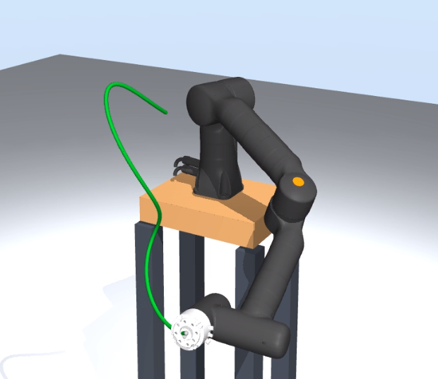
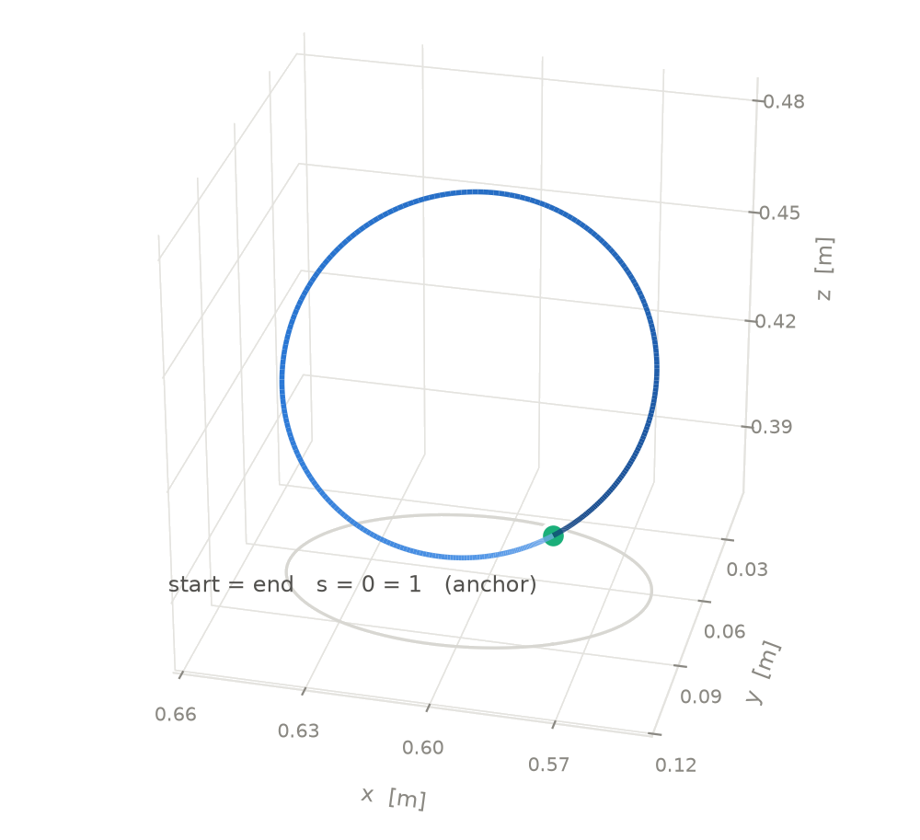
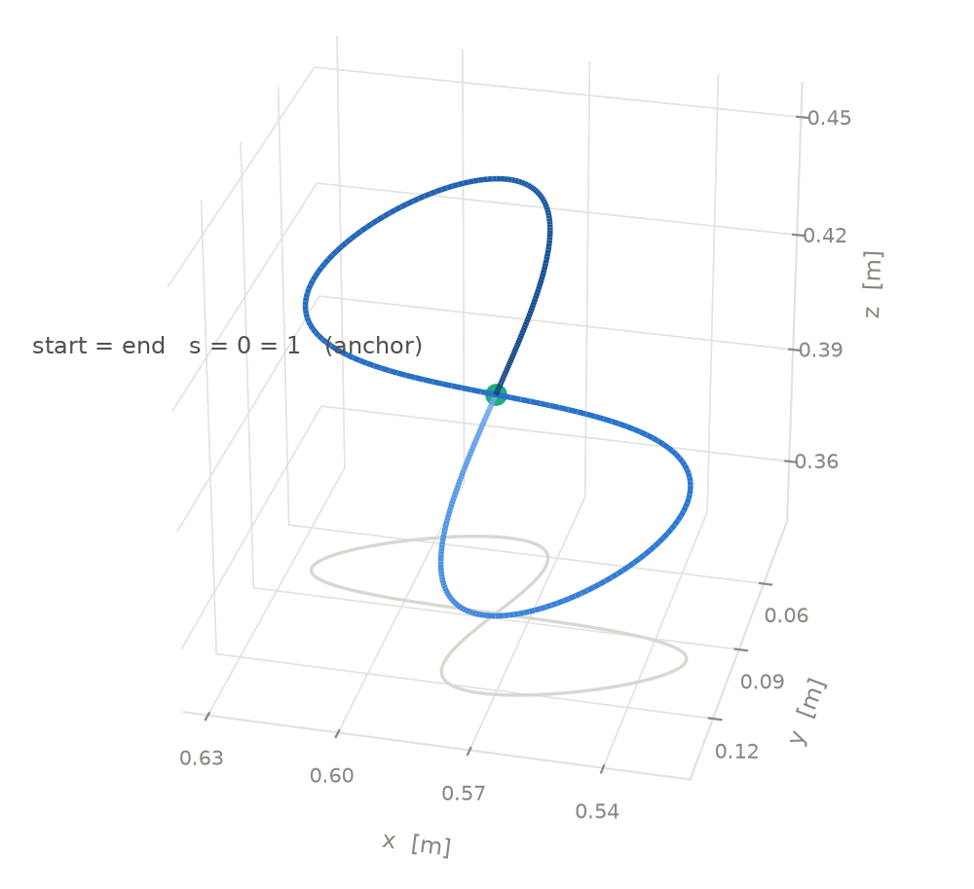
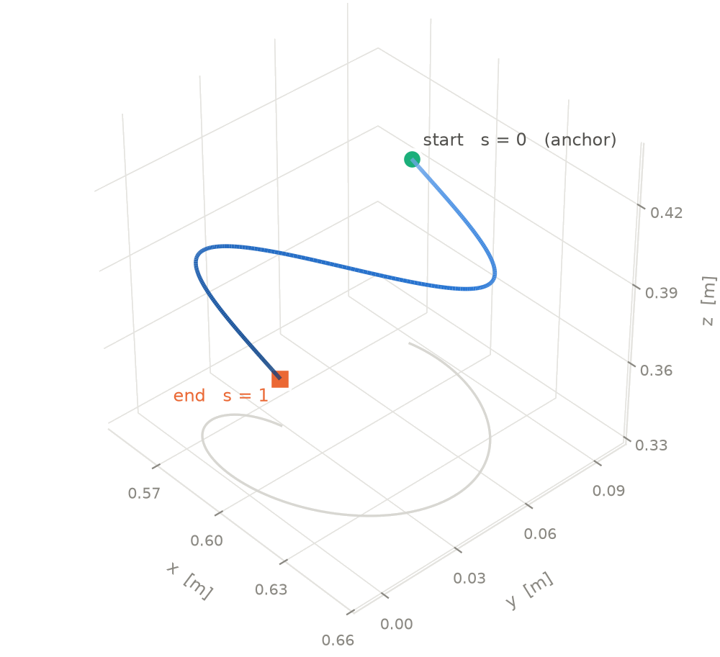
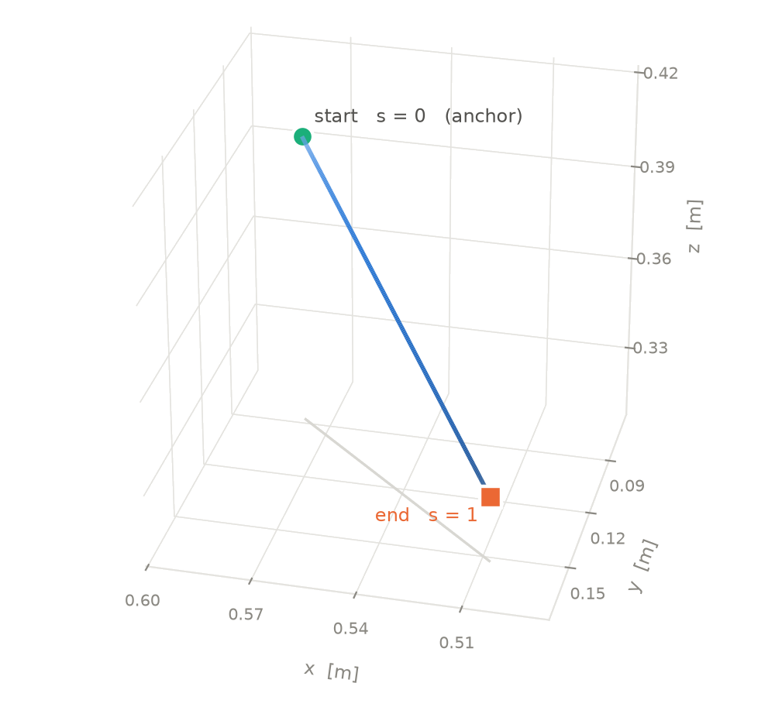
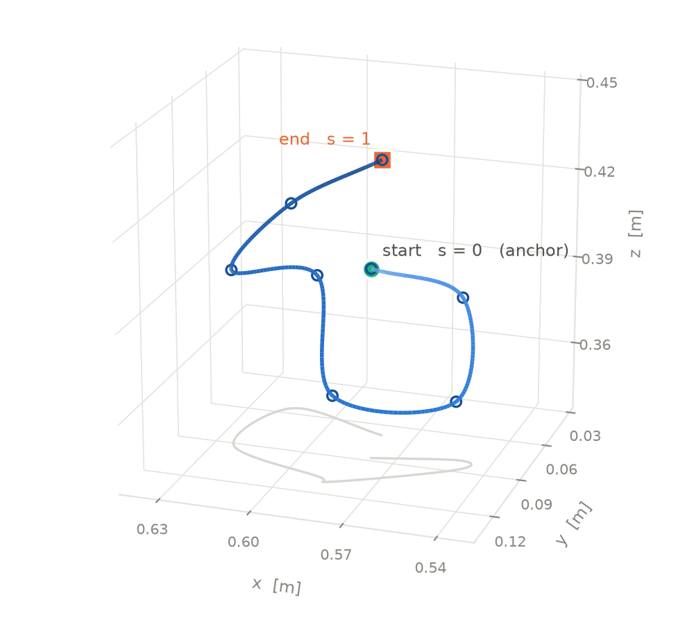
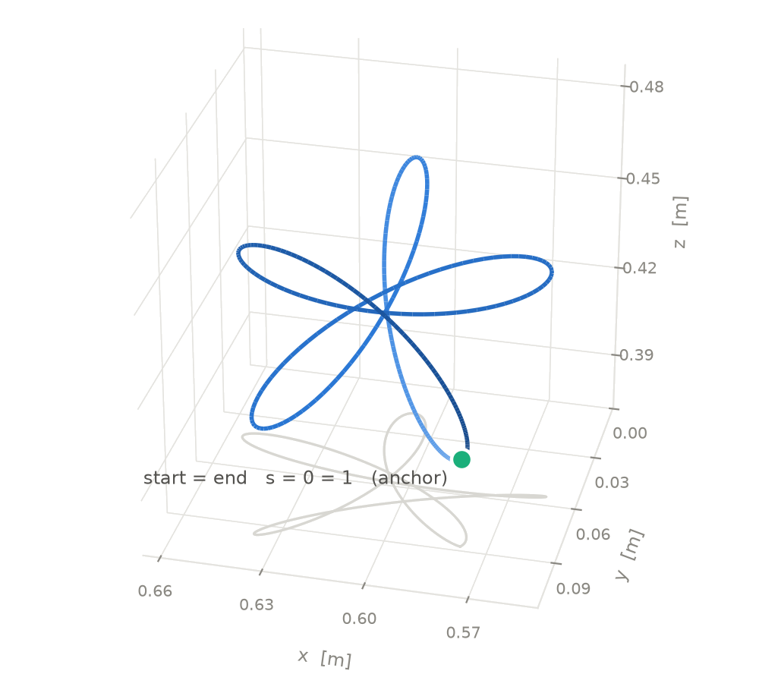
DEEP REINFORCEMENT LEARNING AND DAMPED LEAST SQUARES
INVERSE KINEMATICS METHOD FOR 7-DEGREE-OF-FREEDOM
TRAJECTORY TRACKING
Phuong Thanh Pham · Trong Hoang Anh Nguyen · Van Luan Tran
School of Engineering, Eastern International University · Ho Chi Minh City, Vietnam
Paper ID: 115 - EIUSC International Conference 2026
ABSTRACT
PROPOSED METHOD
We investigate sequential inverse kinematics for the 7-DOF Kassow KR810. Adaptive damped least squares (DLS) serves as the baseline; Multistep PPO–DLS Inverse Kinematics (MPDIK) introduces policy-guided joint seeds when DLS fails. On 630 MuJoCo trajectories, MPDIK raises complete-trajectory success from 78.3% to 91.9% and reduces position RMSE from 28.26 to 2.01 mm.
MPIDK ALGORITHM
T₁
T_{k}
T₂₀₀
INTRODUCTION
200 ordered end-effector poses
Seed for waypoint k
q₀ at k = 1 · q_{k−1} otherwise
The challenge
Adaptive DLS
solve q ∈ ℝ⁷ for T_{k}
A redundant arm can reach the same pose with multiple joint configurations.
Sequential effects
Pass
Pose check
≤ 0.1 mm, ≤ 0.1°
Fail
A poor solution at waypoint k becomes the initial seed for k + 1.
Record solution
q_{k}, advance to k + 1
PPO rescue
same k → figure 02
KR810 in MuJoCo
(7 revolute joints)
Goal: accurate pose tracking with continuous joint transitions.
Target waypoint T_{k}
s = o_{t}
RELATED WORK
Actor new π_{θ}
Observation o_{t} ∈ [−1, 1]²⁷
joints 7 · prev. action 7
target pose 7 · pose error 6
a_{t}
Loop
Environment
C_loss L_{V}(φ)
Yu and Tan (2025) combined PPO and DLS for individual target poses. This study evaluates the approach on sequences of Cartesian waypoints, where the solution at one waypoint seeds the next.
r_{t}, o_{t+1}
PPO policy a_{t} ↦ Δq_{t}
Memory
Critic V_{φ} → Â_{t}
New seed q_{seed} = q_{t} + Δq_{t}
Actor new
Actor old
Update
EXPERIMENTAL BENCHMARK
Adaptive DLS (q_{seed}, T_{k}) → q_{DLS}
π_{θ}
Ratio ρ_{t}
π_{θ old}
Pose check ≤ 0.1 mm, ≤ 0.1°
Pass
Loss ^{CLIP}(ρ_{t}, Â_{t})
Update θ
Fail: retry with o_{t+1}
Pass best solution after 1000 times
(a) DLS environment: waypoint rescue
(b) PPO actor–critic training
CIRCLE
FIGURE-EIGHT
HELIX
EXPERIMENTAL RESULTS
72 trajectories
72 trajectories
72 trajectories
Benchmark results for DLS and MPDIK
Metric | DLS | MPDIK
Successful waypoints | 122,909 (97.5%) | 125,274 (99.4%)
Completed trajectories | 493 (78.3%) | 579 (91.9%)
Overall position RMSE | 28.26 mm | 2.01 mm
Overall orientation RMSE | 5.22° | 0.33°
LINE
FREE-FORM
CHALLENGE
72 trajectories
72 trajectories
270 trajectories
Success thresholds: Position error ≤ 0.1 mm and orientation error ≤ 0.1°.

