Slide 1
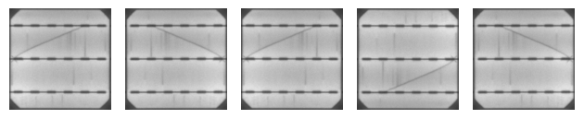
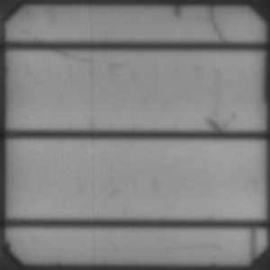
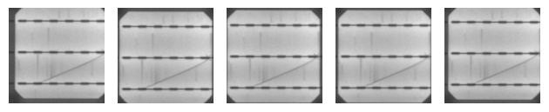
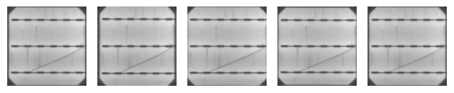
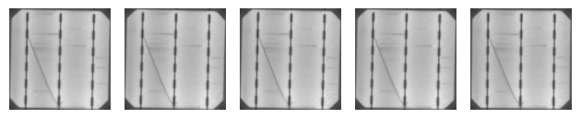

(b) Random horizontal and vertical flip
Metallic connection (a.k.a. busbar)
Translation axes
(c) Random horizontal and vertical shift
(d) Random zoom
(a) Anatomy of a solar cell
(e) Random rotation by 90$°$

Slide 7
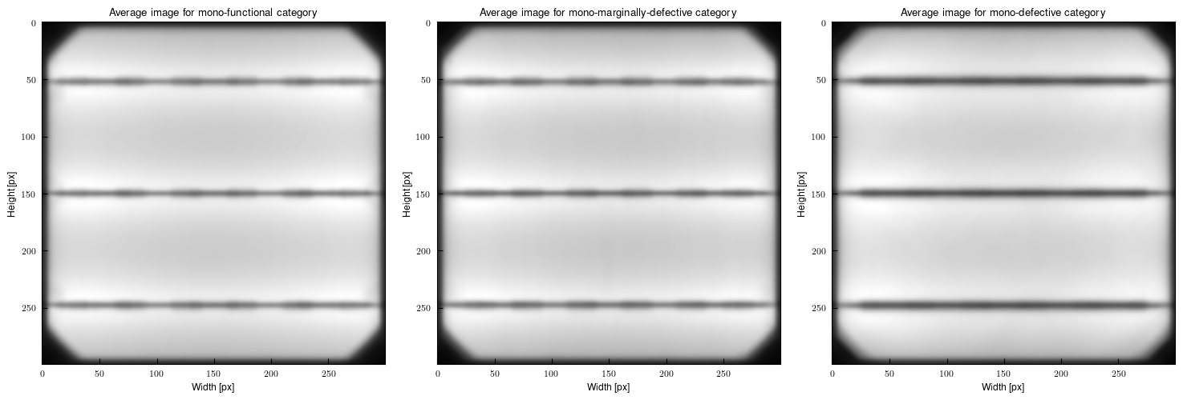
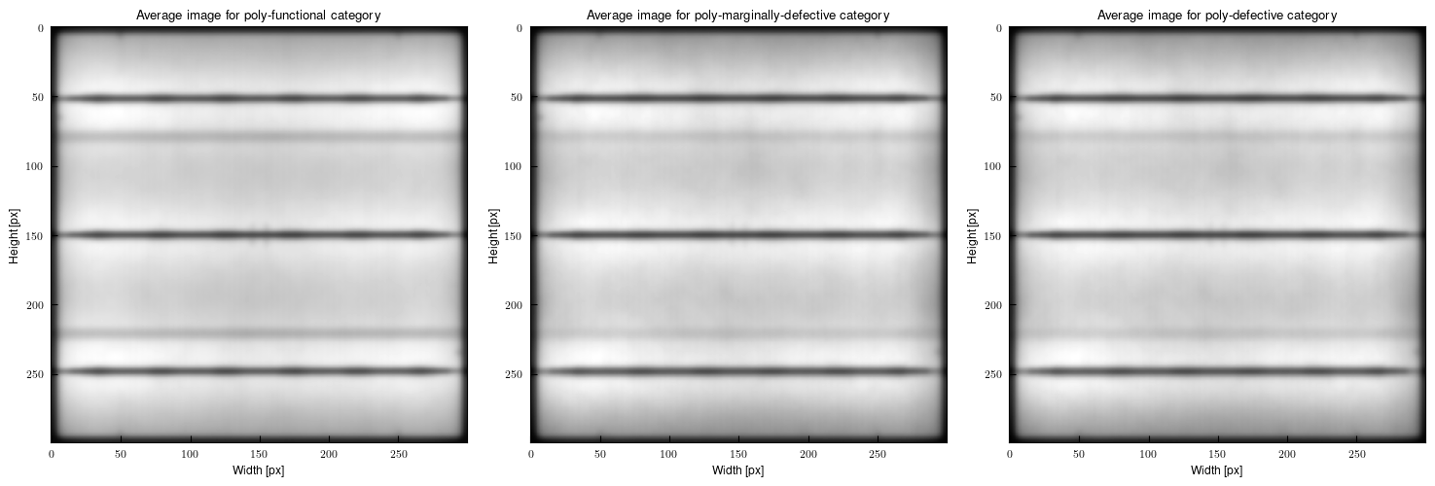
(a) Monocrystalline samples
(b) Polycrystalline samples

Slide 8
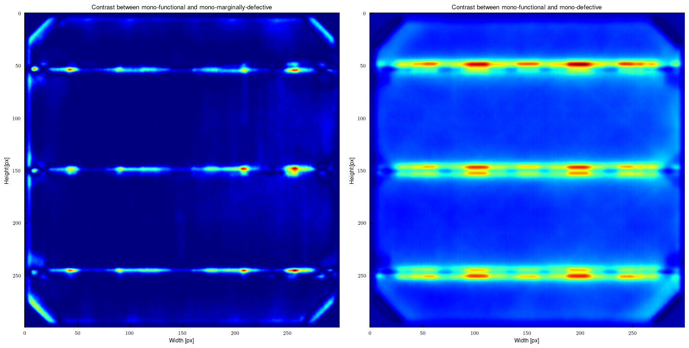
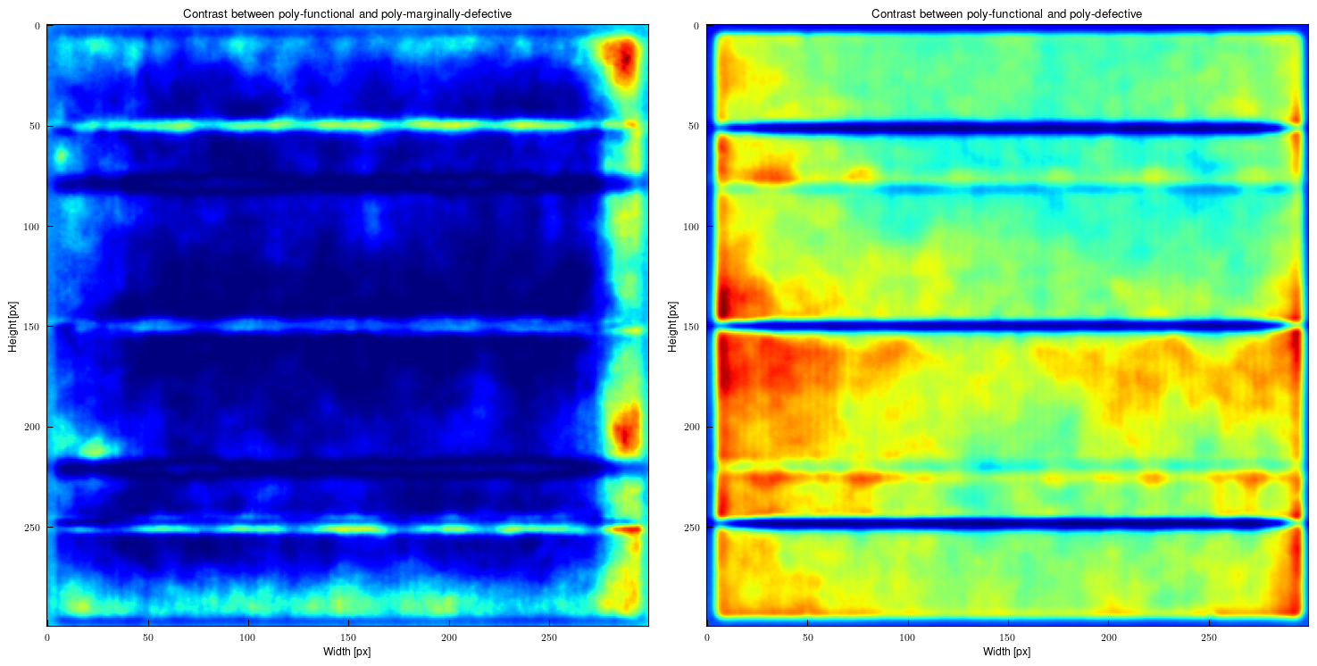
(a) Monocrystalline samples
(b) Polycrystalline samples

Slide 9
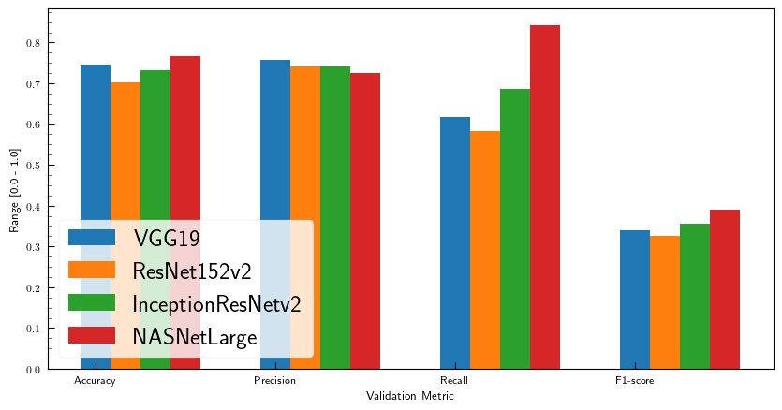
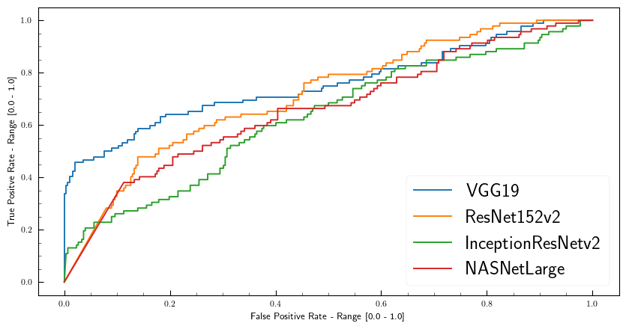
(a) Validation Result
(b) ROC and AUC
 | A | B | C | D
Accuracy | 0.7463 | 0.7015 | 0.7313 | 0.7672
Precision | 0.7563 | 0.7402 | 0.7417 | 0.7263
Recall | 0.6164 | 0.5839 | 0.6871 | 0.8415
F1-score | 0.3396 | 0.3264 | 0.3567 | 0.3898
 | A | B | C | D
AUC | 0.7557 | 0.7015 | 0.6307 | 0.6612

Slide 10
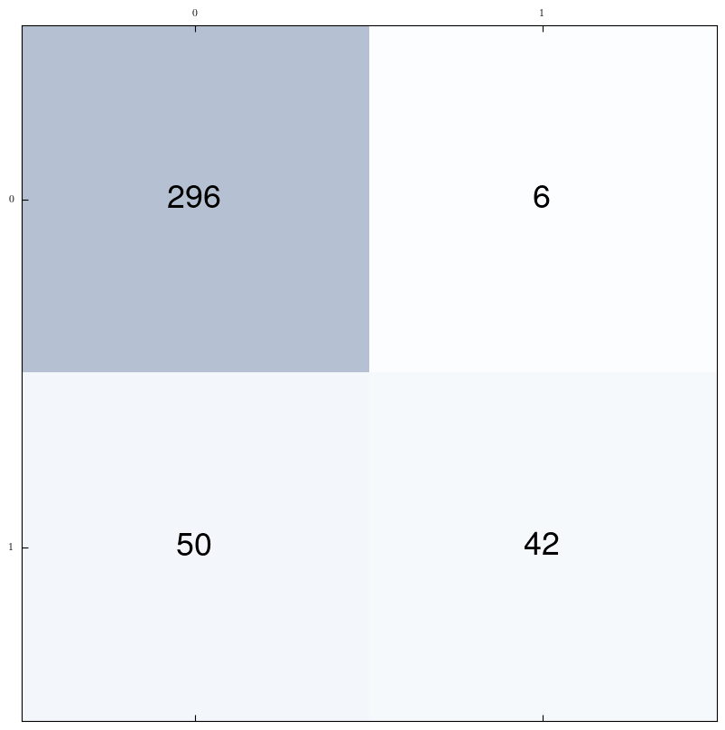
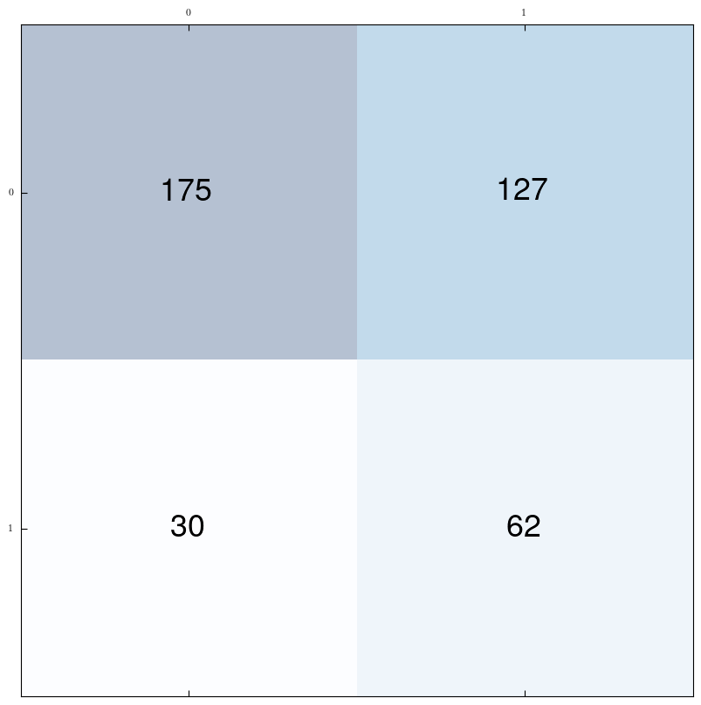
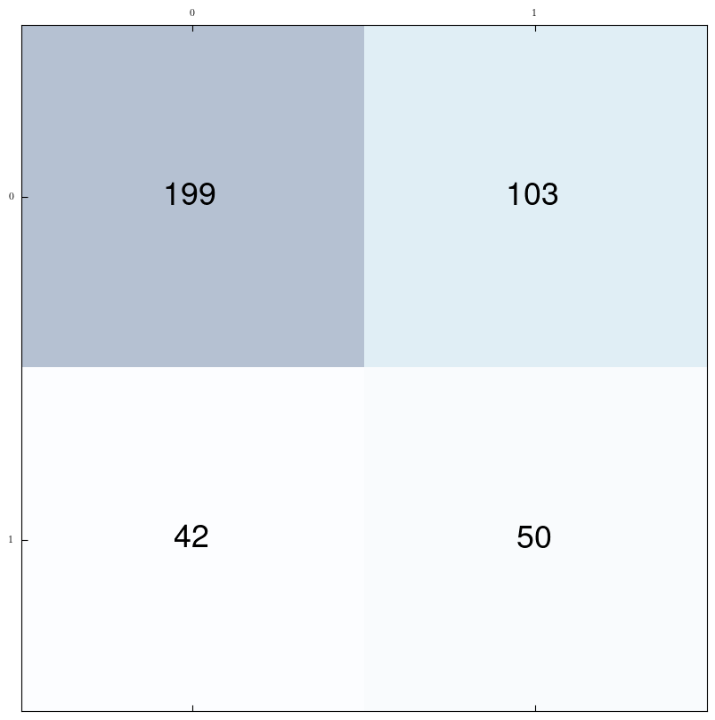
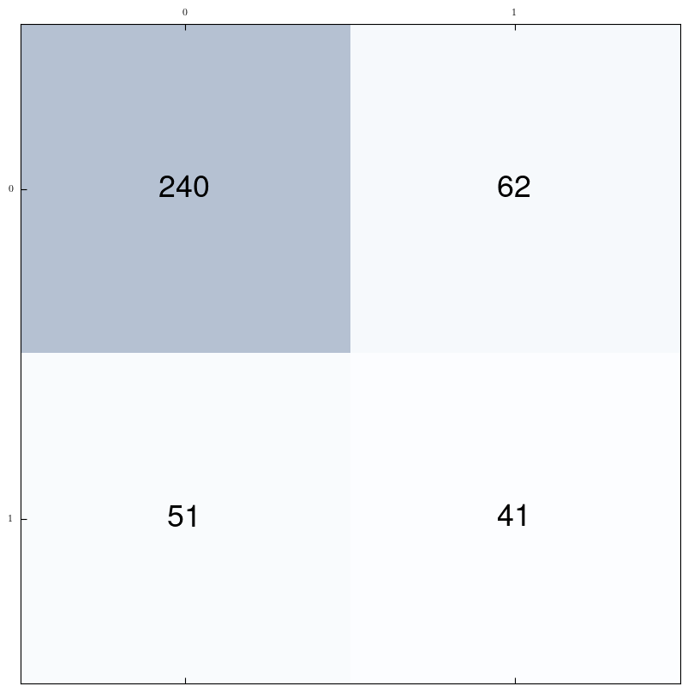
VGG19
ResNet152v2
InceptionResNetv2
NasNetLarge

Slide 11
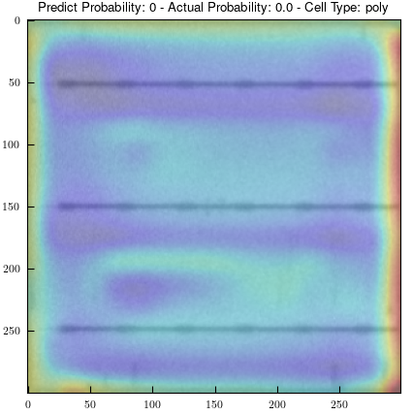
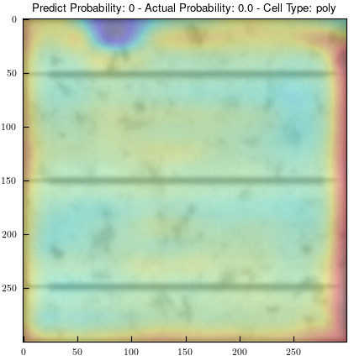
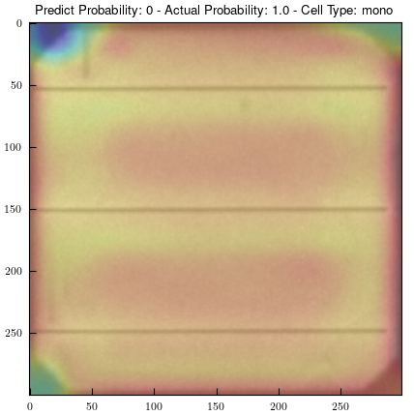
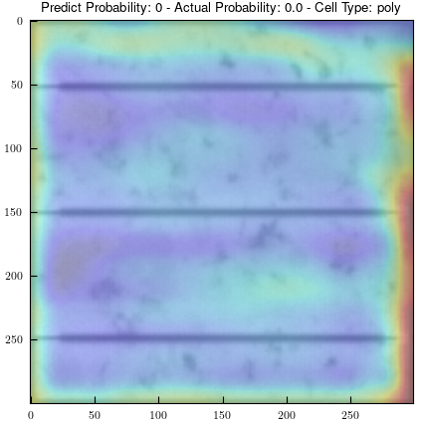
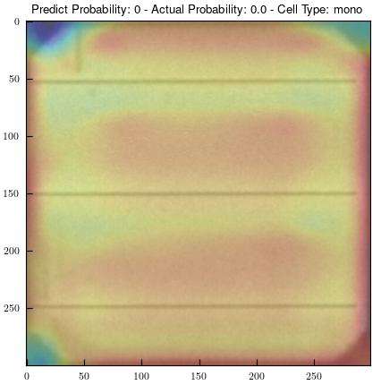
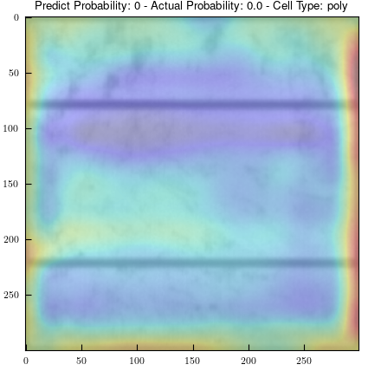
(a) VGG19

