Slide 1
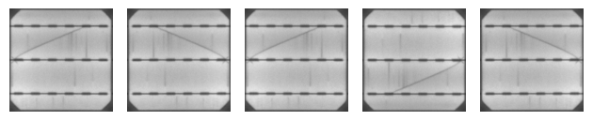
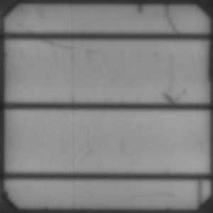
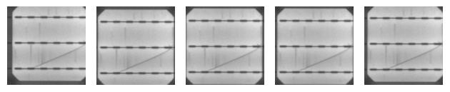
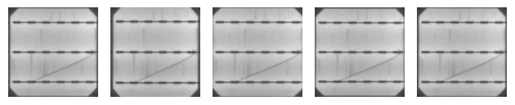
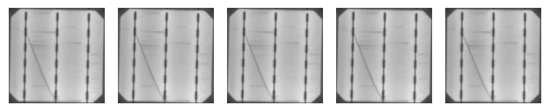

(b) Random horizontal and vertical flip
Metallic connection (a.k.a. busbar)
Translation axes
(c) Random horizontal and vertical shift
(d) Random zoom
(a) Anatomy of a solar cell
(e) Random rotation by 90$°$

Slide 7
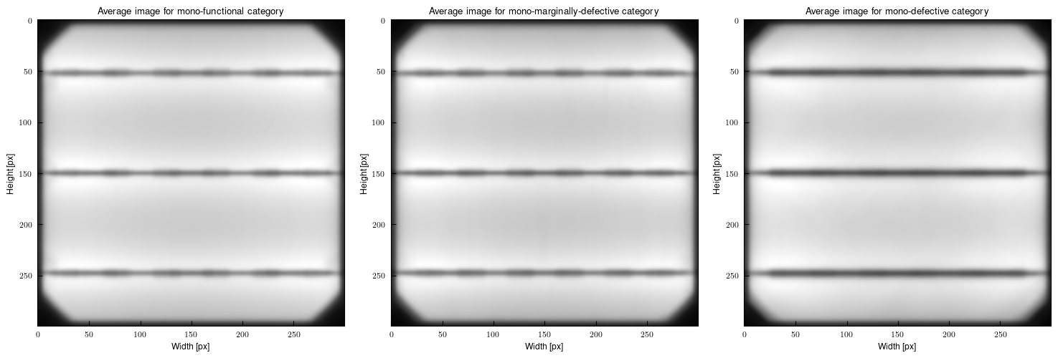
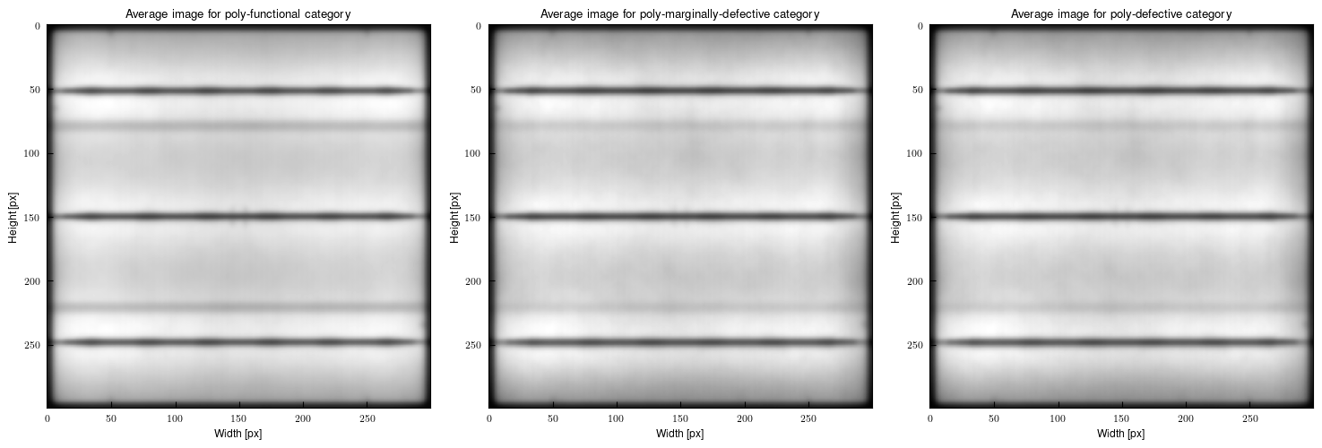
(a) Monocrystalline samples
(b) Polycrystalline samples

Slide 8
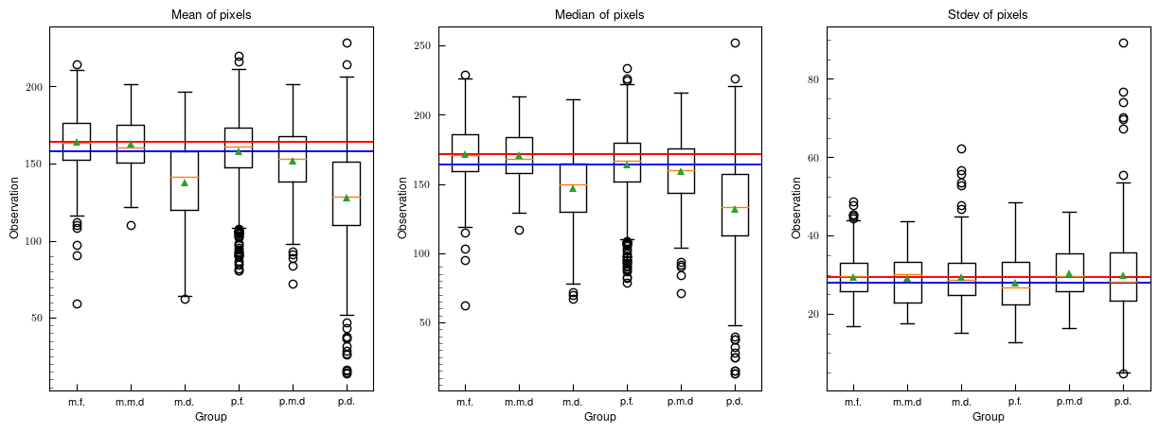
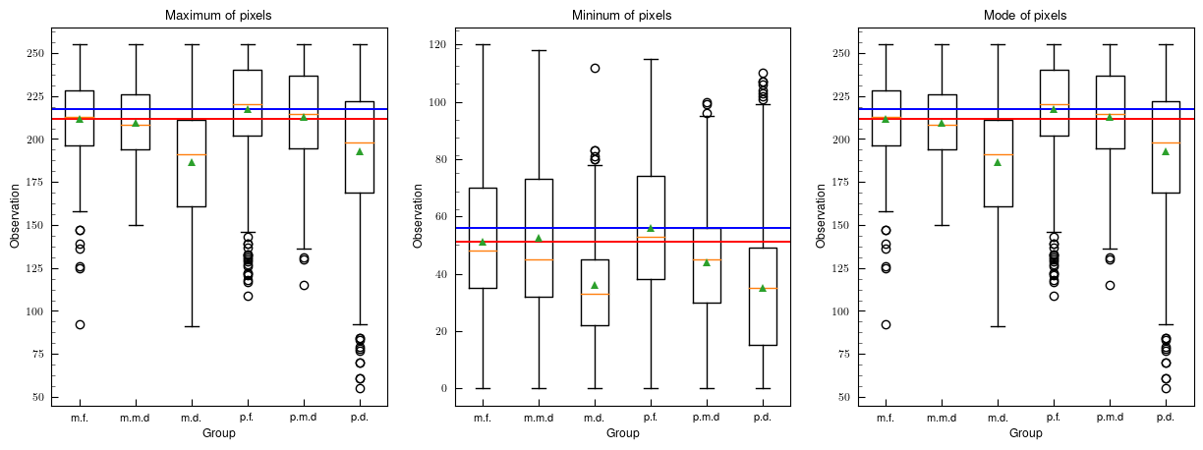

Slide 9
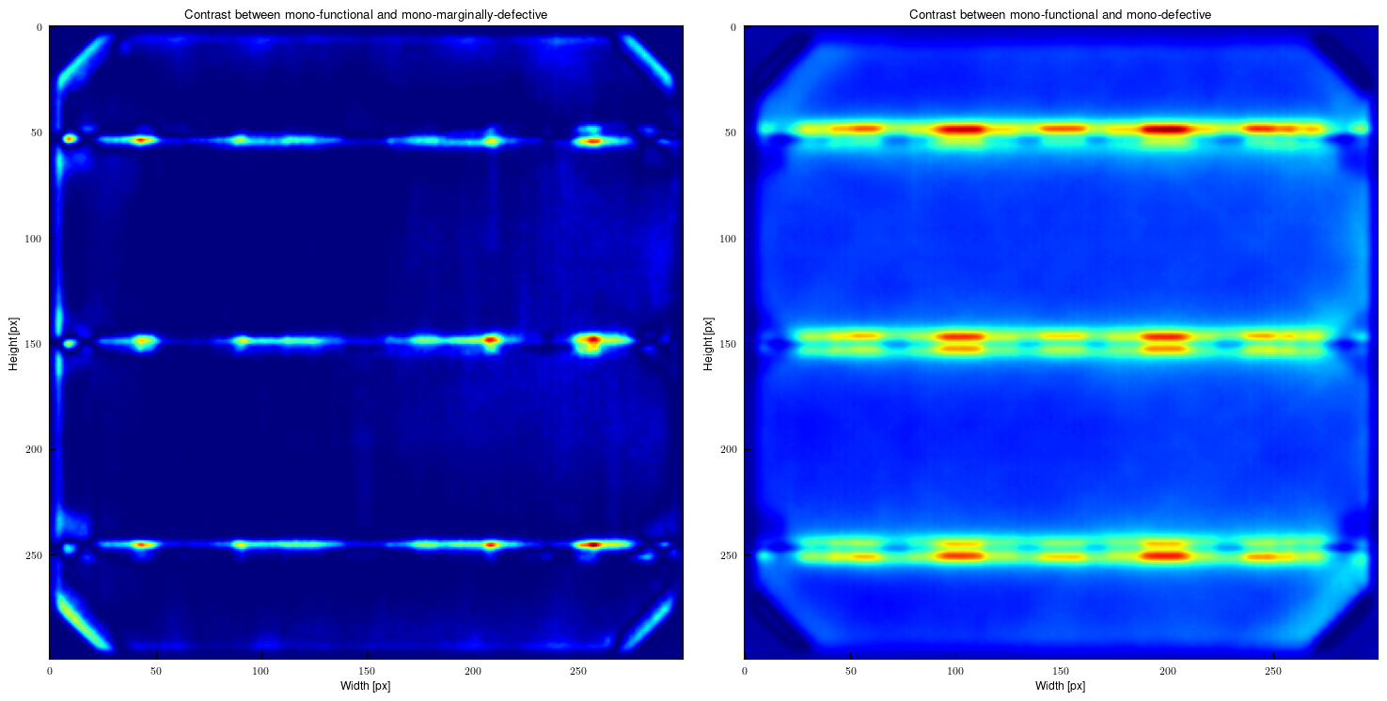
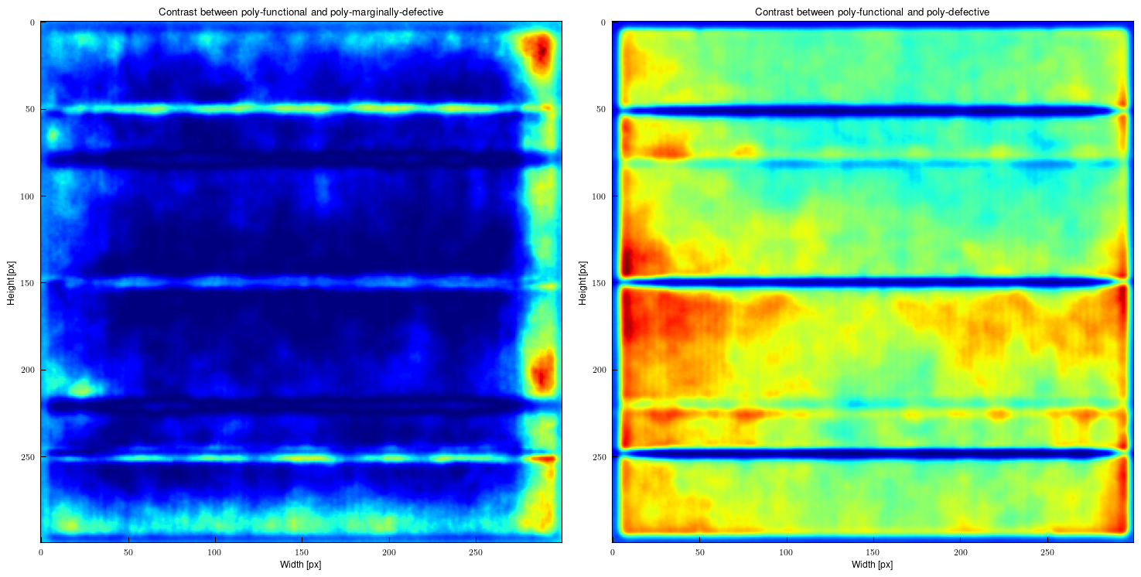
(a) Monocrystalline samples
(b) Polycrystalline samples

Slide 10
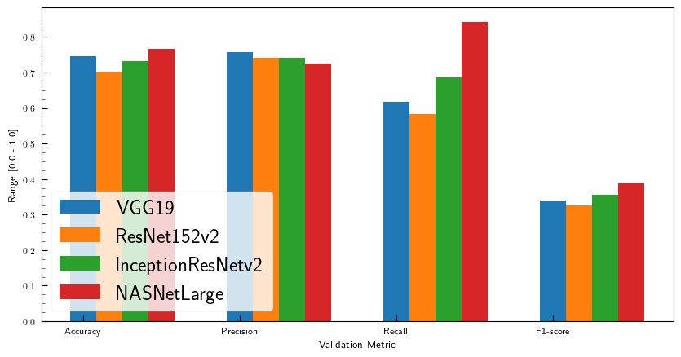
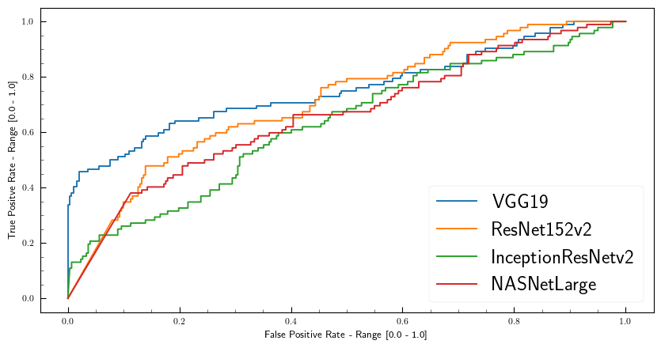
(a) Validation Result
(b) ROC and AUC
 | A | B | C | D
Accuracy | 0.7463 | 0.7015 | 0.7313 | 0.7672
Precision | 0.7563 | 0.7402 | 0.7417 | 0.7263
Recall | 0.6164 | 0.5839 | 0.6871 | 0.8415
F1-score | 0.3396 | 0.3264 | 0.3567 | 0.3898
 | A | B | C | D
AUC | 0.7557 | 0.7015 | 0.6307 | 0.6612

Slide 11
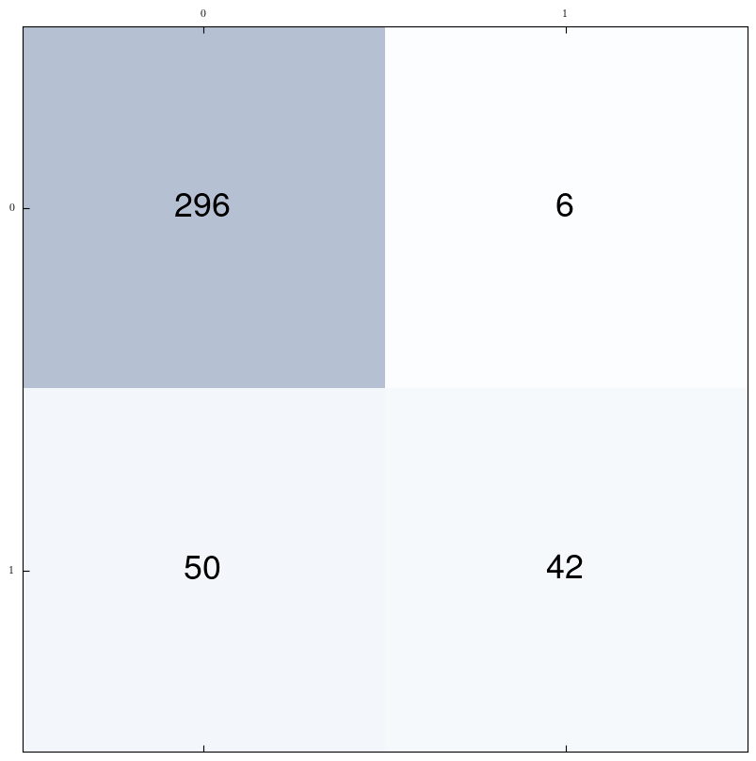
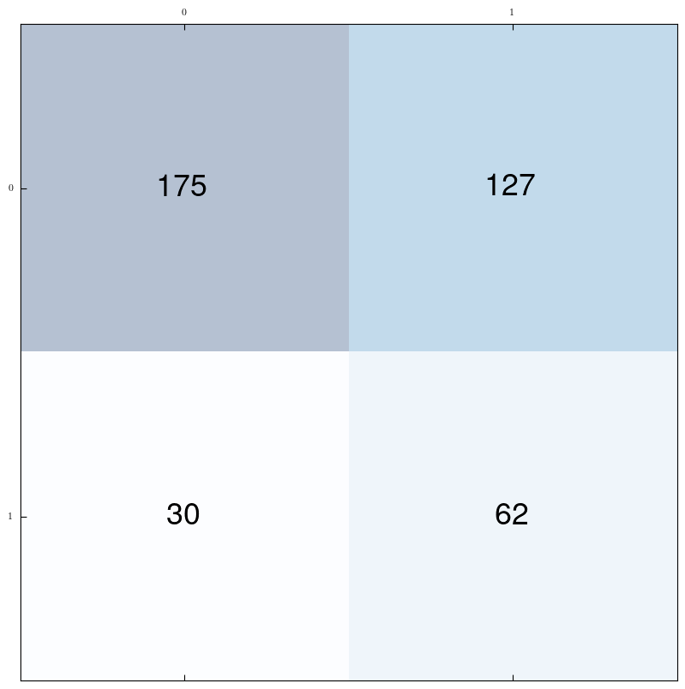
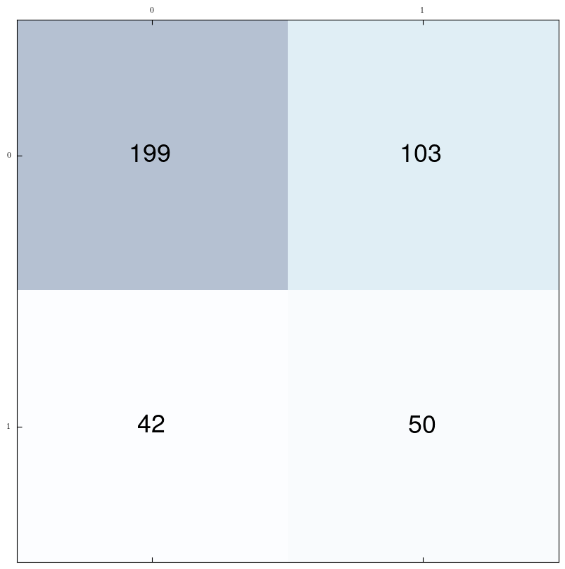
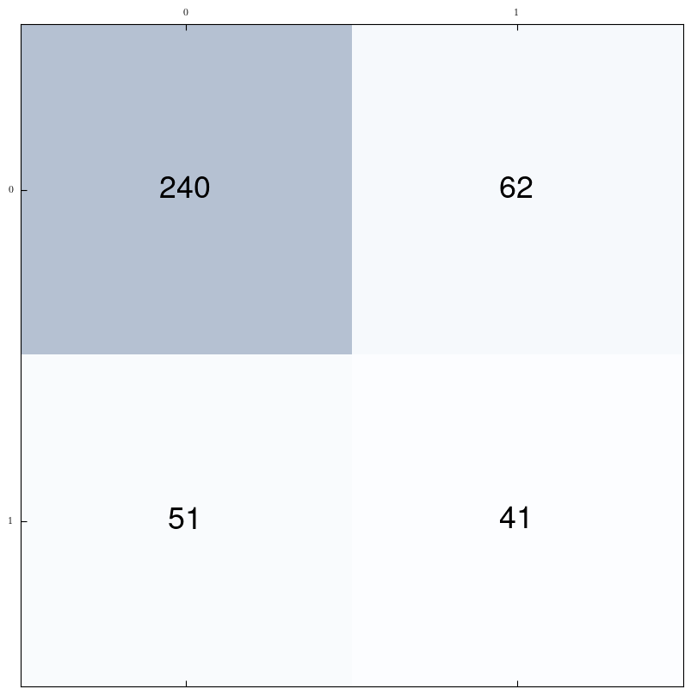
VGG19
ResNet152v2
InceptionResNetv2
NasNetLarge

Slide 12
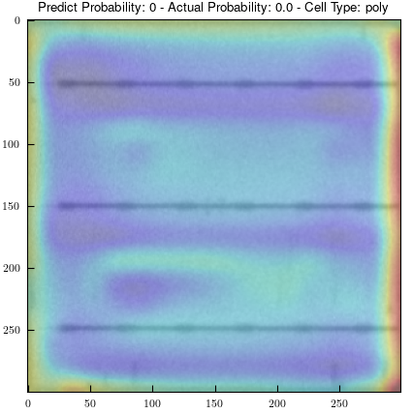
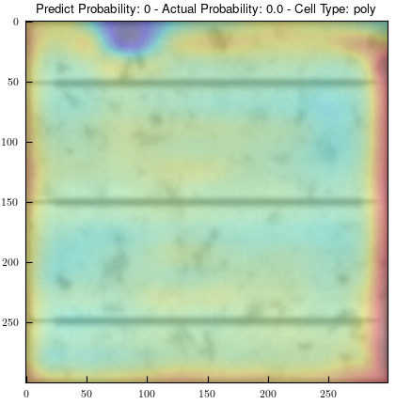
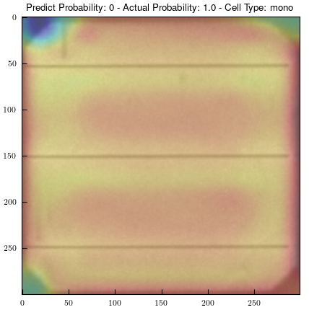
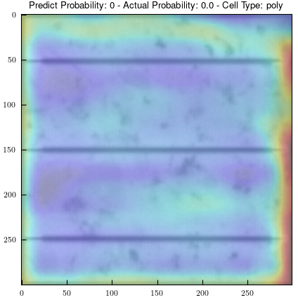
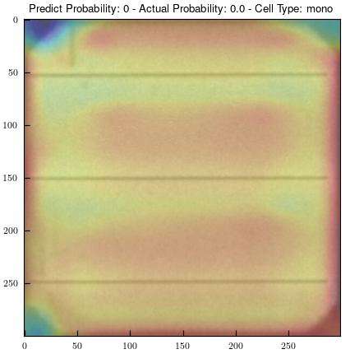
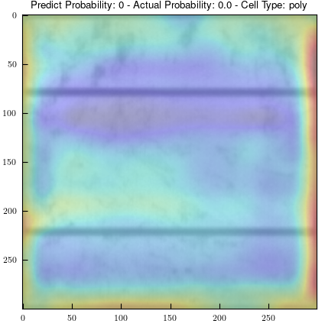


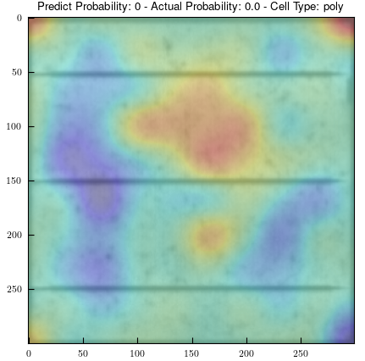
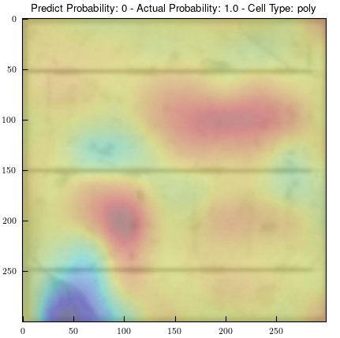
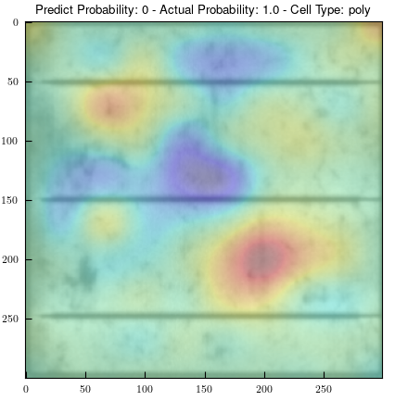
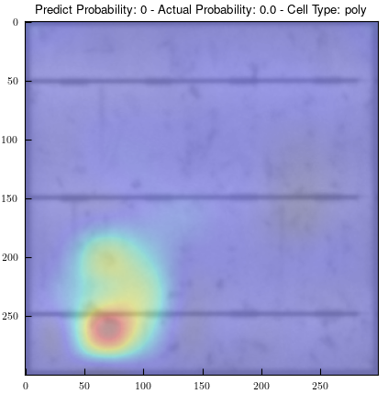
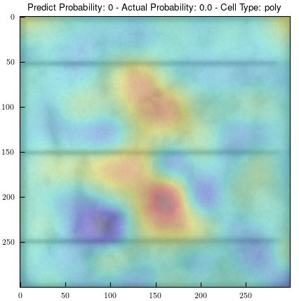
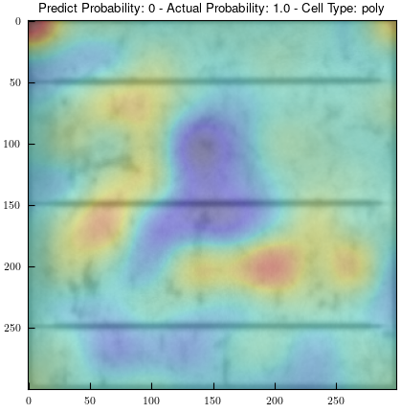
(a) VGG19
Correct
Correct
Wrong
Correct
Correct
Correct
(b) ResNet152v2
Correct
Wrong
Correct
Correct
Correct
Wrong

Slide 13
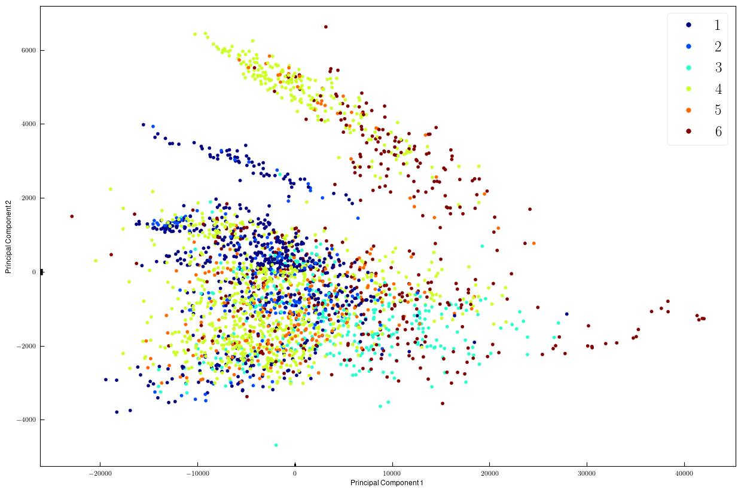
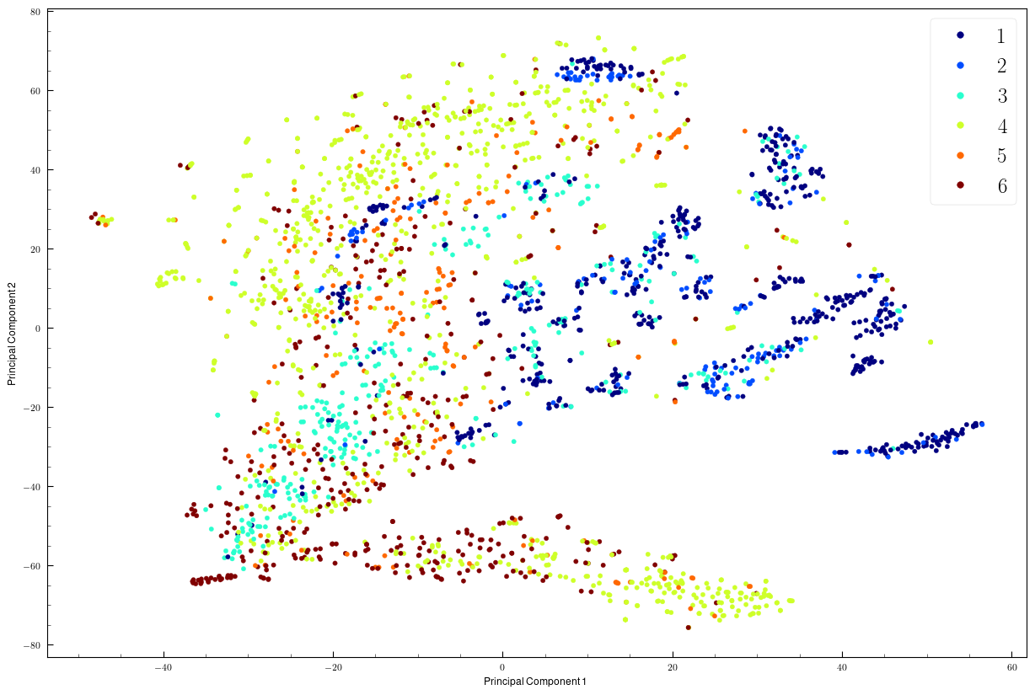
(a) PCA embedding
(b) t-SNE embedding

